Slide 1
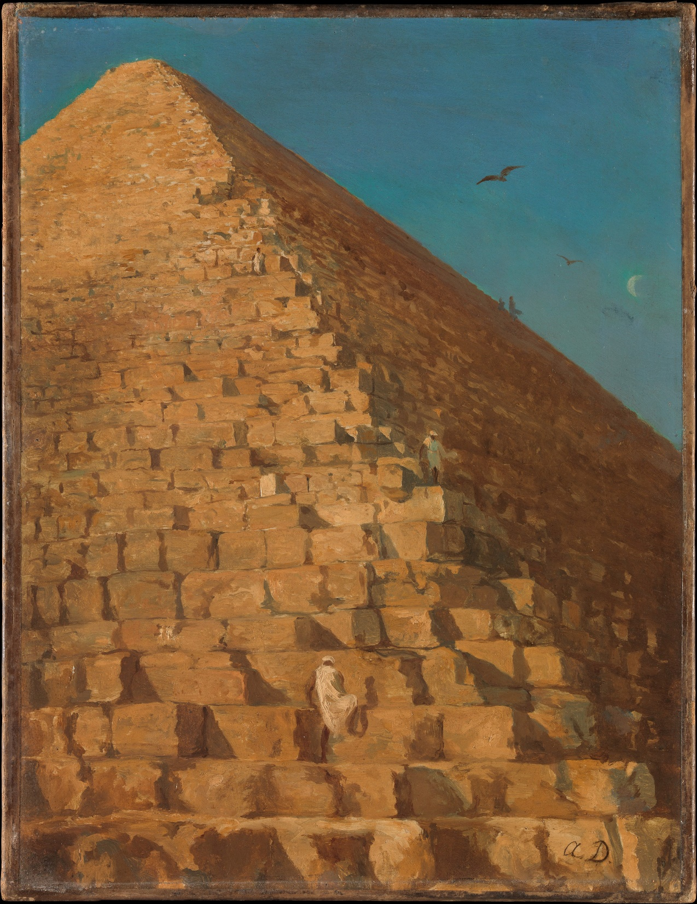
Ancient Egyptian
Transition Year
Classical Studies
Course
Introduction to Course

Slide 2
Course Aims:
The aim of this course is to examine the civilization of Ancient Egypt; how it was a hugely influential factor in the development of human civilization.
The aim is that you will gain an appreciation for Ancient Egypt; you will gain knowledge of all three cultures, histories, art, literature, and languages.

Slide 3
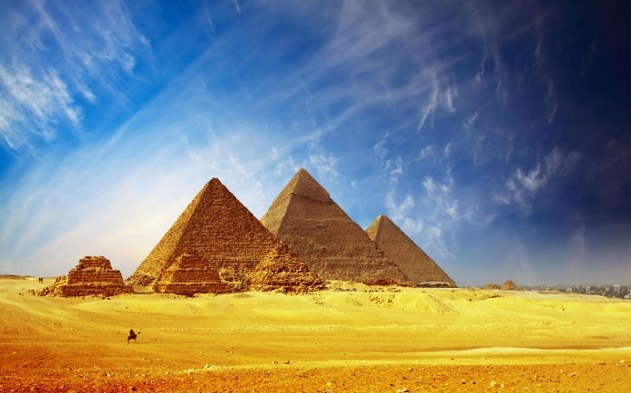
What will this Course Cover?
Ancient Egypt
Daily Life and History of Ancient Egypt. Mythology and Religion of Ancient Egypt. Language and Writing of Ancient Egypt. A case study of Queen Cleopatra.

Slide 4
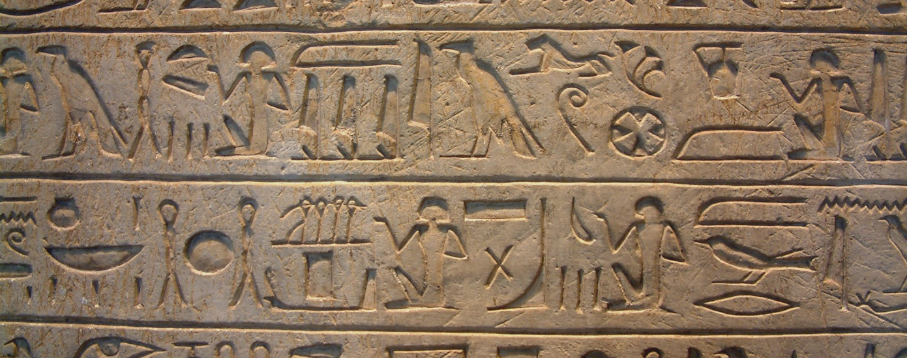
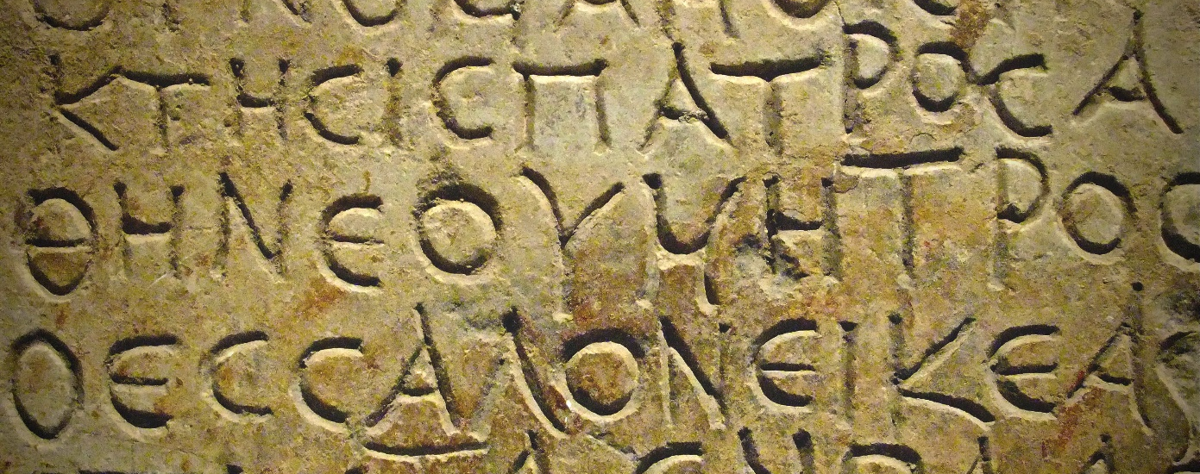
Language Component
Key to understanding the Ancient world is to understand their languages. It helps us understand their society, culture, and psychology.
Each strand has a language component – a new component for all of you (none of you will have studied any ancient language in great detail.
You will learn basic Middle Egyptian; enough to recognise key words, transliterate the alphabet and words, and the translate short sentences and passages

Slide 5
Assessments:
Exams | Research Project | (Optional) Translation Portfolio
There will be one exam. It will cover knowledge of the Egyptian Civilization; skills of analysing sources, written and visual. | All students will research, gather, and present on an historical figure (Cleopatra) from Egypt. | Throughout the year we will be translating passages of Egyptian. You will collect these in an online portfolio which will contribute to your final grade.

Slide 6
Digital Learning: Microsoft Teams
The course will be organized through an online platform.
Assignments, resources, PowerPoints, videos, ancient sources, photocopies of the books will be stored there.
All assignments are to be completed and submitted online (and/or in person)
Your language Portfolio will also be collated online.

Slide 7
Questions?

Slide 8
What do you already know about Ancient Egypt? Brainstorm

Slide 9
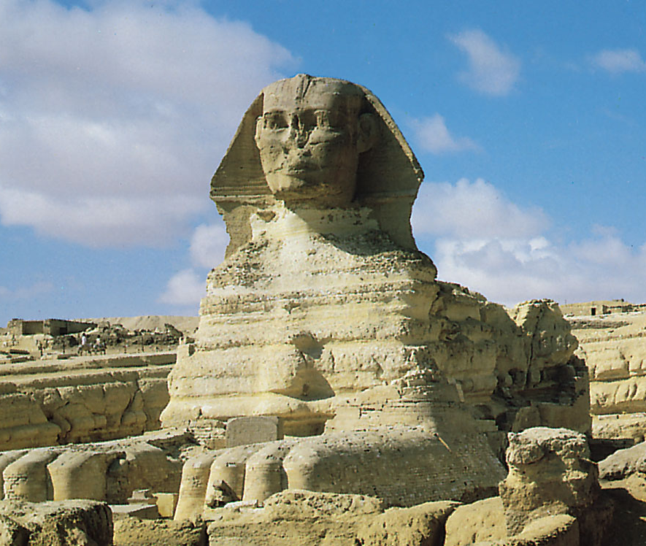
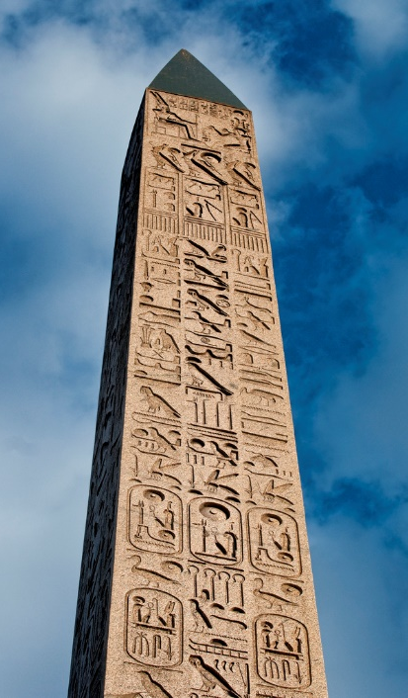
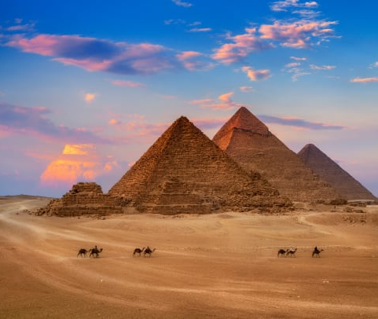
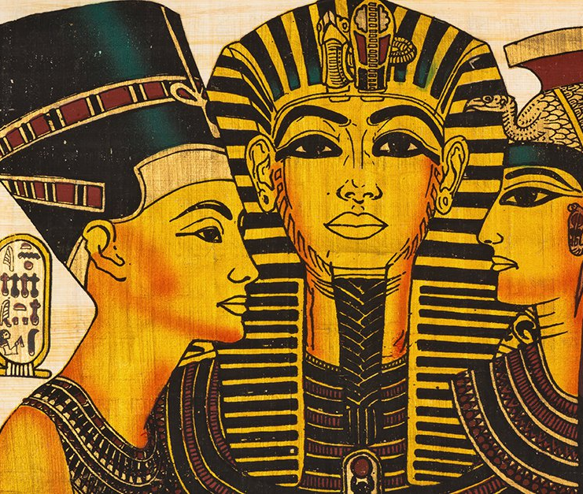
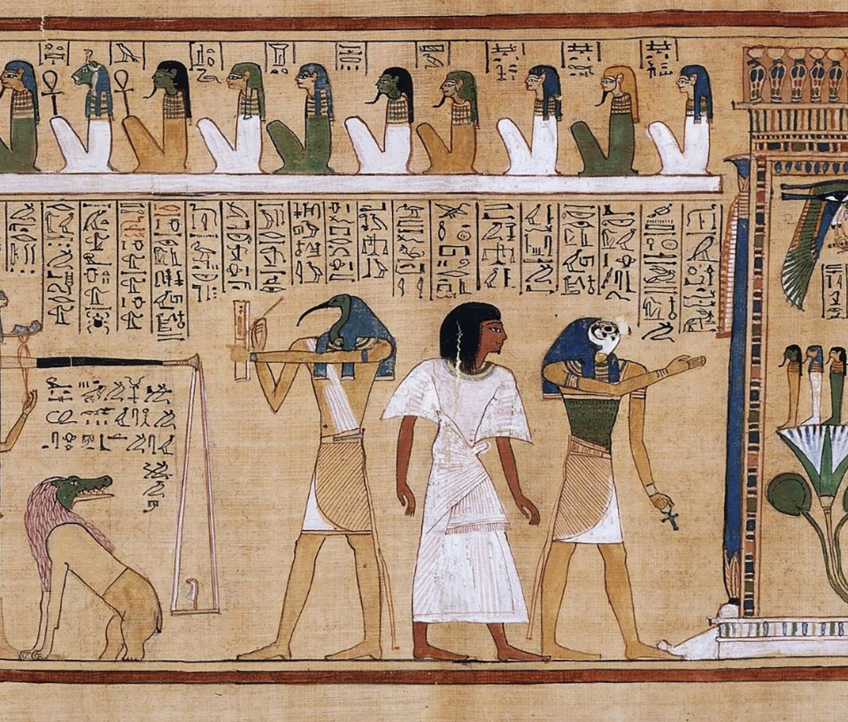
Notes:
What do these images tell us about Ancient Egypt?

Slide 10
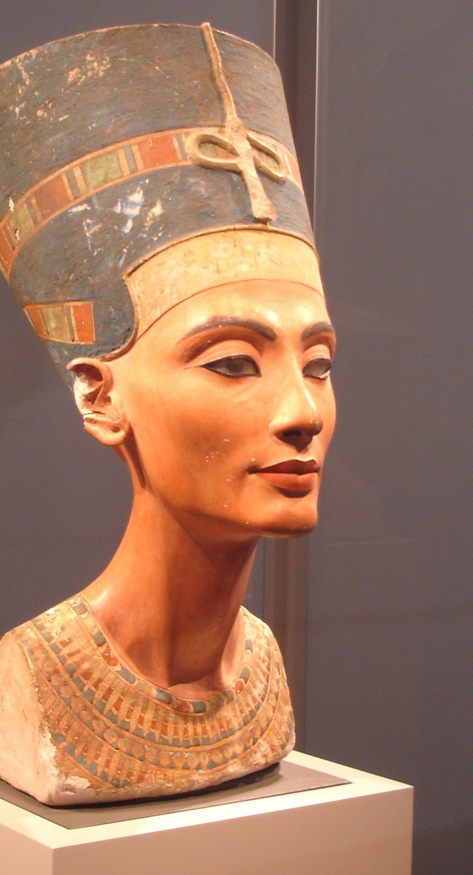
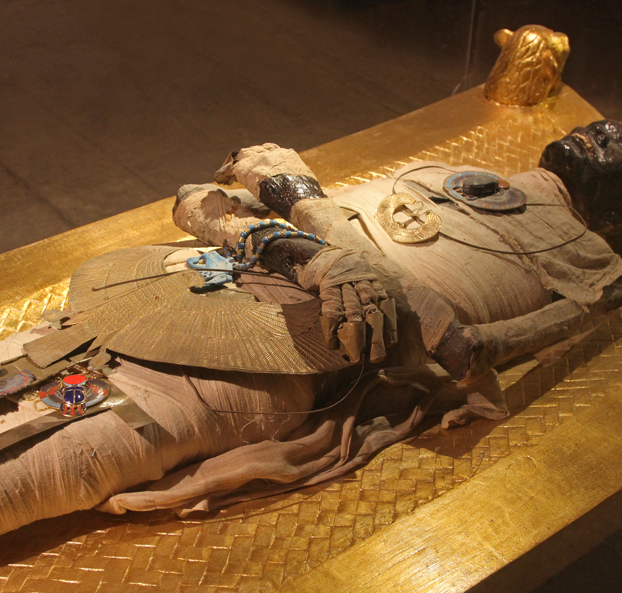
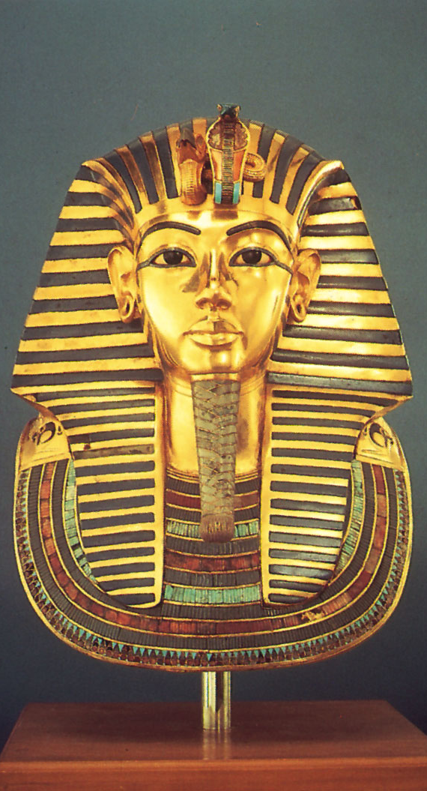
Notes:
What do these images tell us about Ancient Egypt?
Who were the people in these images?

Slide 11
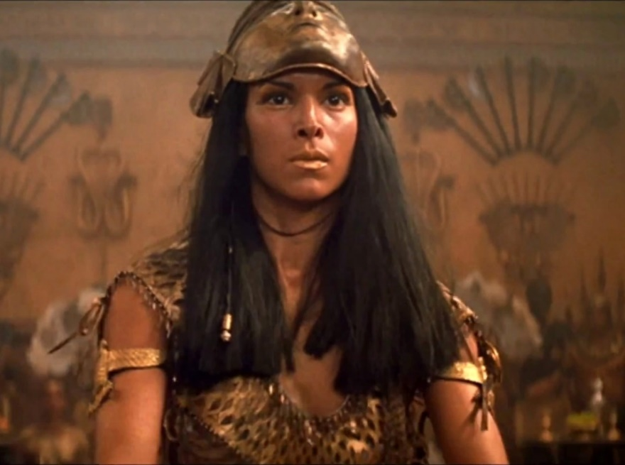
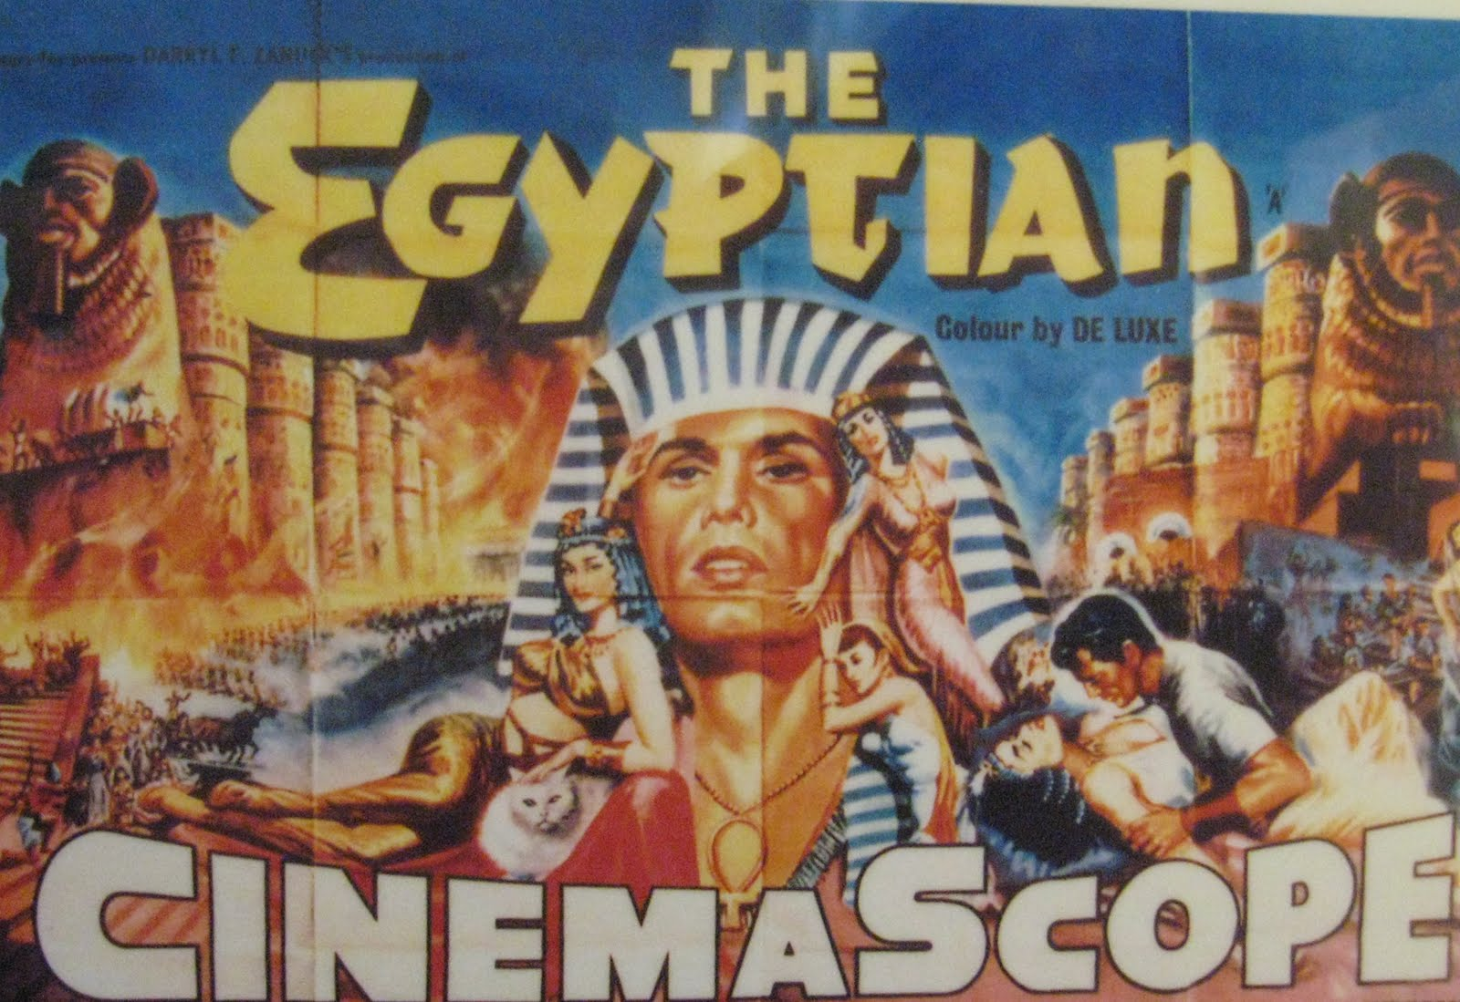
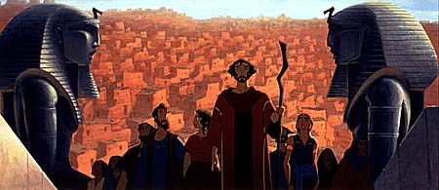
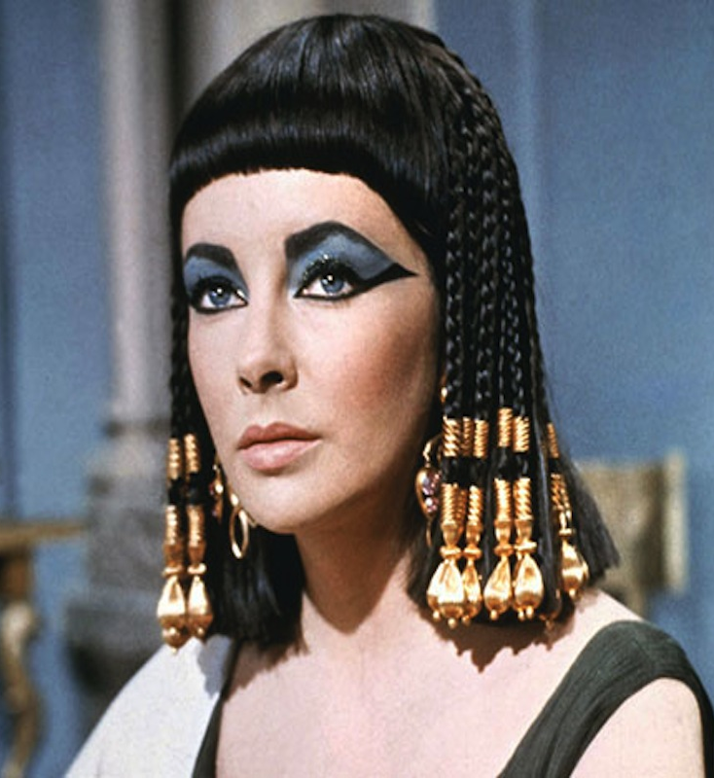
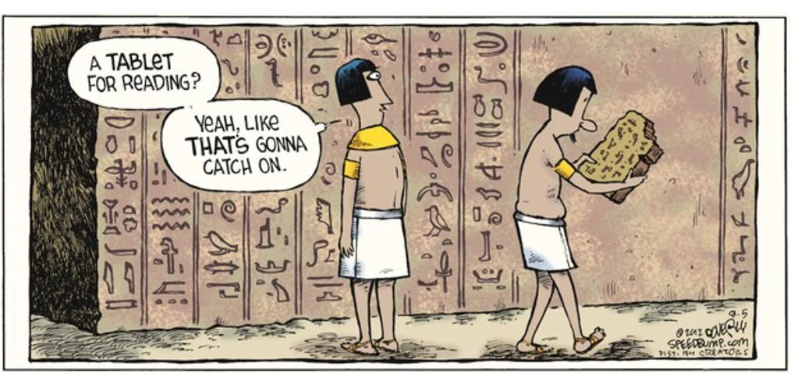
Notes:
Why do you think Egypt is still re-imagined in our world today?

Slide 12
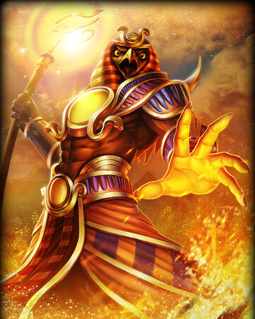
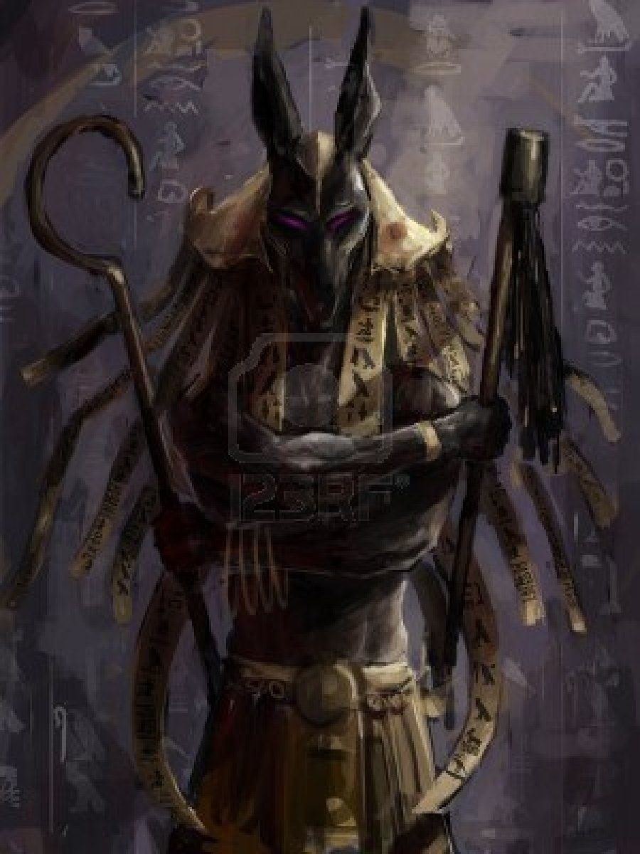
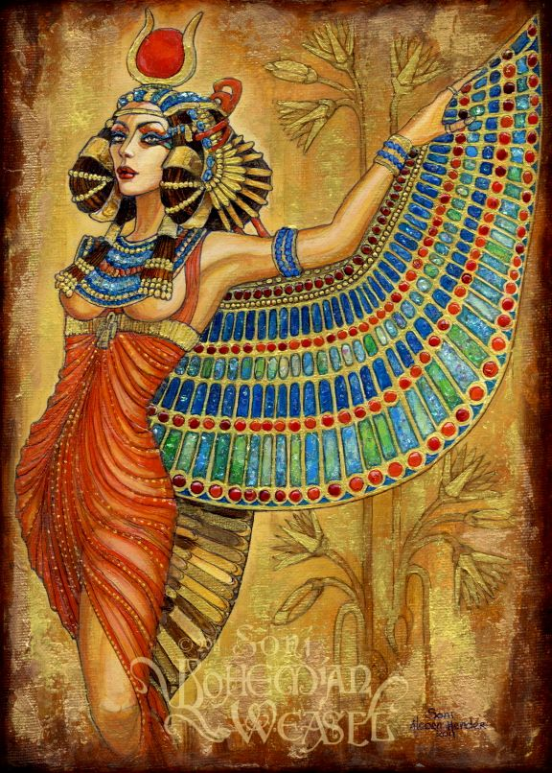
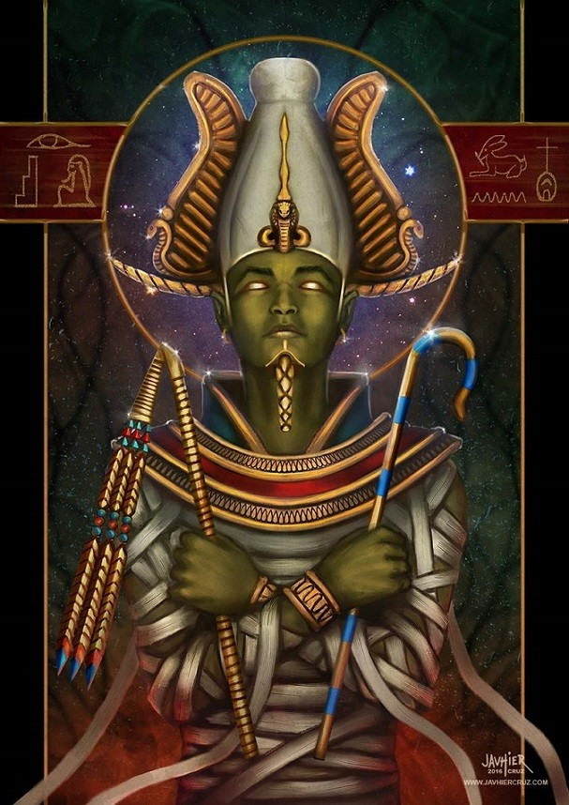
Notes:
What do these images of Egyptian gods suggest about the psychology of the Ancient Egyptians?

Slide 13
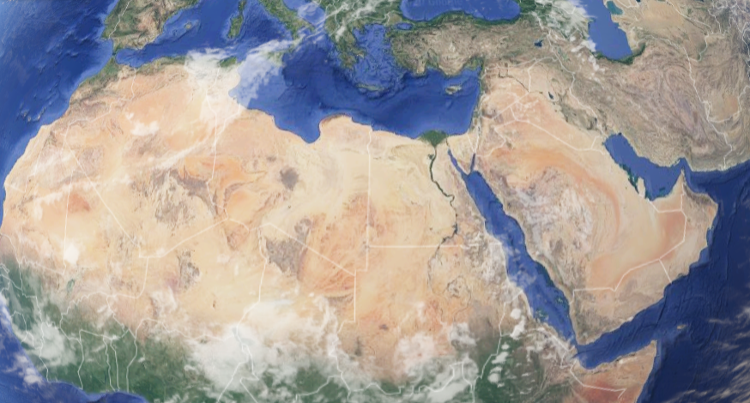

Slide 14
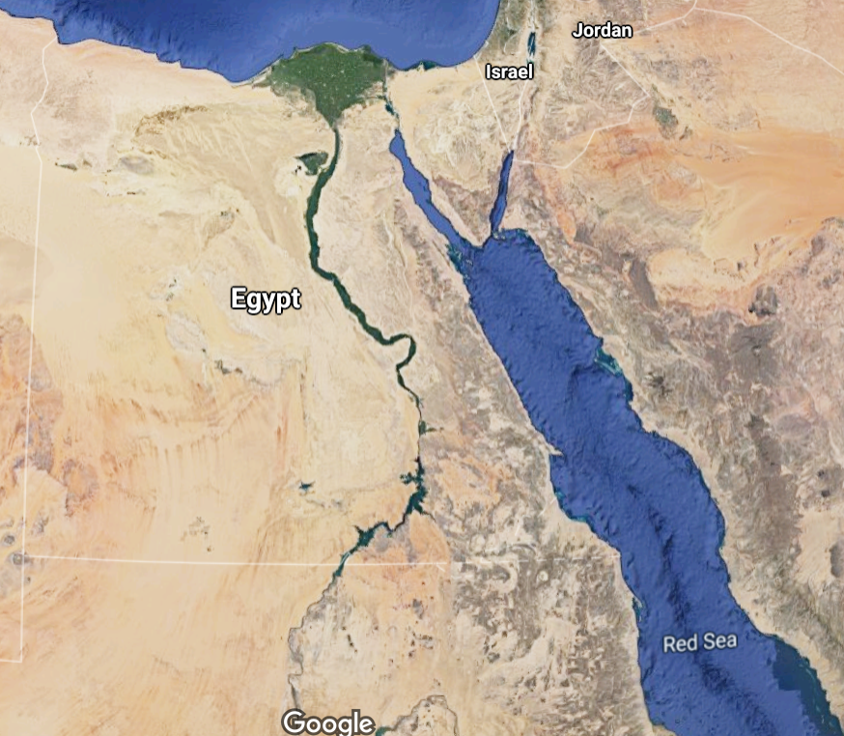
Notes:
What does this map suggest about the landscape of Egypt?

Slide 15
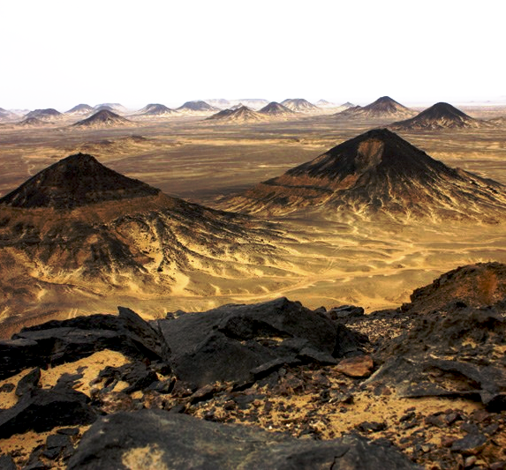
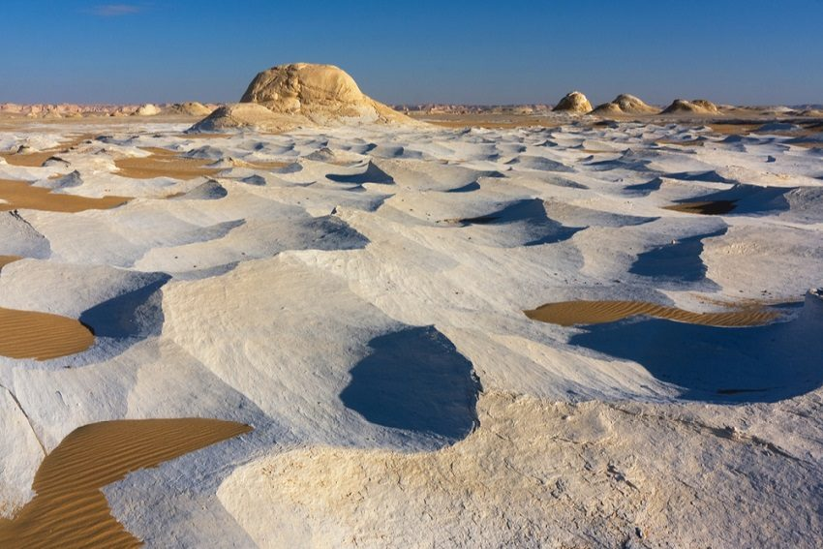
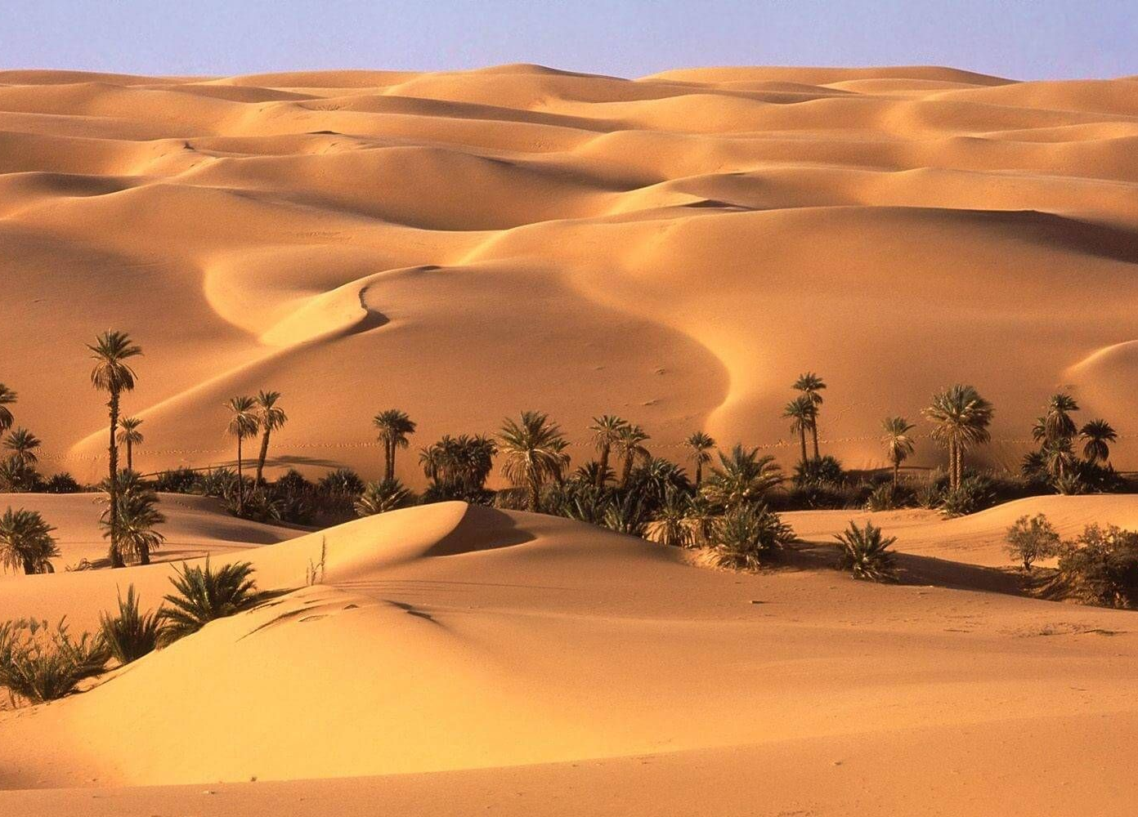

Slide 16
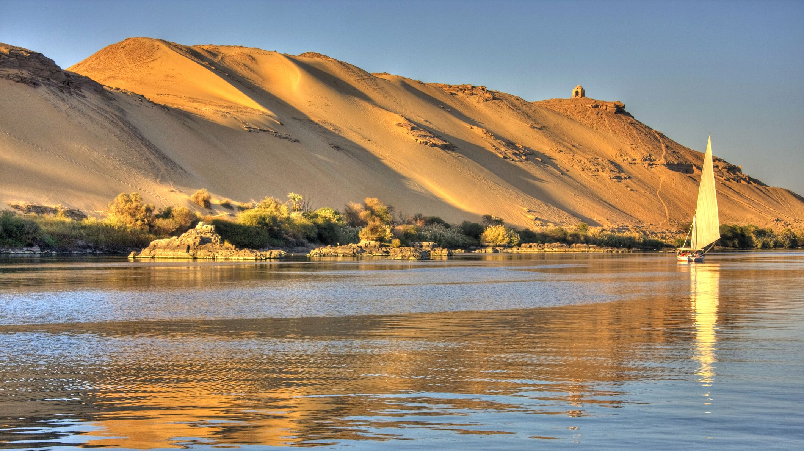

Slide 18
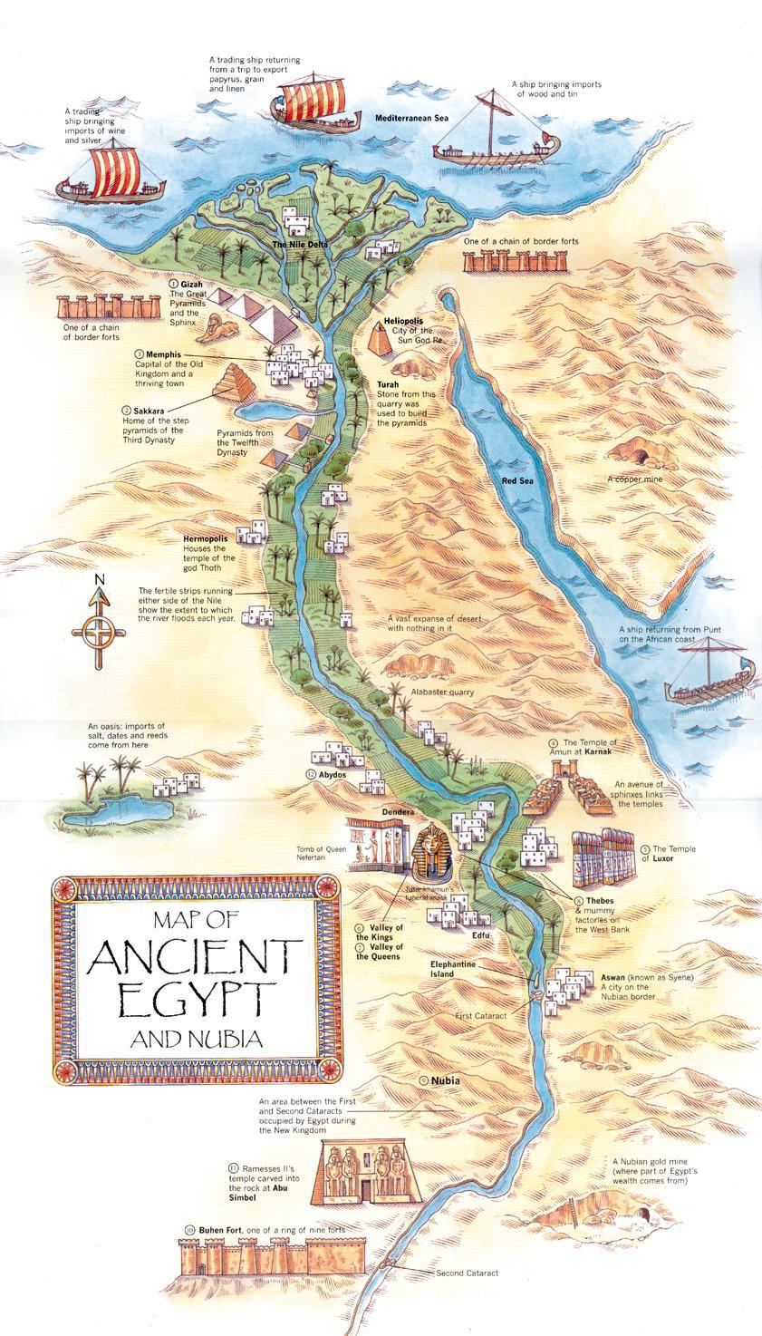

Slide 19
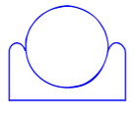
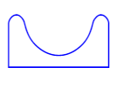
Notes:
What do you think each of these Hieroglyphs represent? What do you think they mean? Left: Sun discs between two horizons, means horizon; Centre: mountains on each side of the Nile valley, means land; Right: rugged mountainous terrain, representing the land outside the valley, something considered hostile, so it means foreign land.

