Slide 1
Ancient Egypt: Could women by Leaders?
The Ancient Egyptian female Pharaoh and her erasure from history.

Slide 2
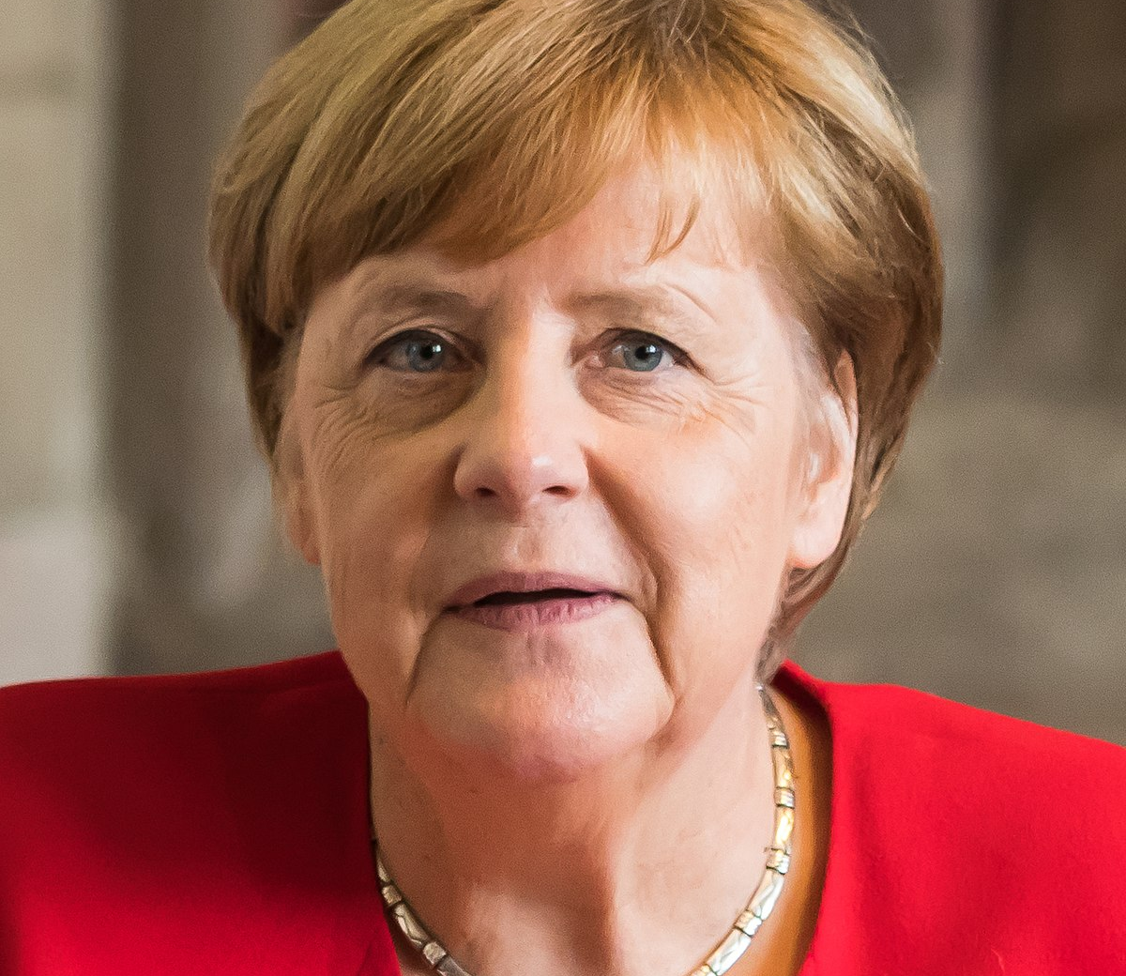
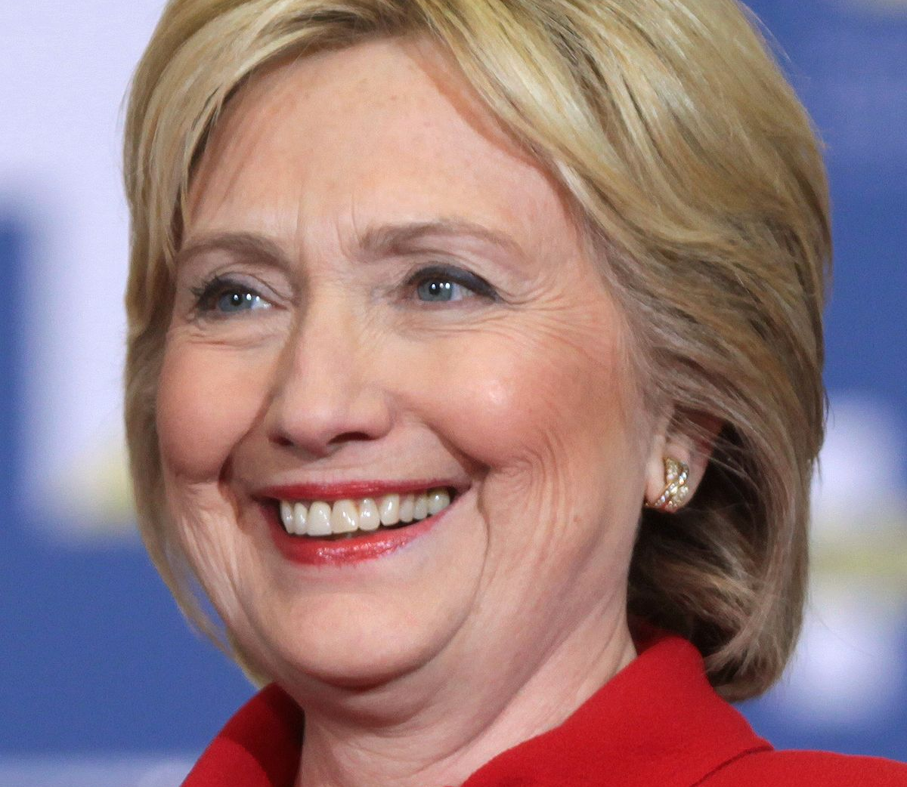
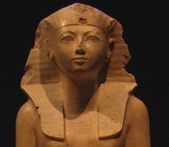
Watch: Hatshepsut Inquiry question. How are women in Power treated by the public/media? Debate: Societies tolerance for women in Power has not changed since Hatshepsut

