Slide 1
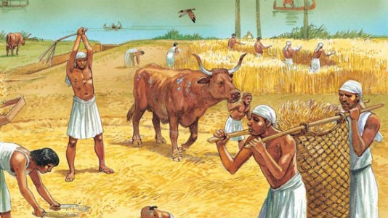
Ancient Egypt
Daily Life –
Jobs in Ancient Egypt

Slide 2
Answer the following questions about Ancient Egypt – based on what we learnt last week
Who farmed Ancient Egypt’s crops – slaves or freemen?
Who built the Pyramids and most Egyptian buildings – slaves or free laborers?
What jobs would the slaves do?
Who was at the top of Ancient Egypt’s social structure?
Name two of the next highest professions.
Who might Egypt go to war with?
What role did religion play in Egyptian Society?
Were Egyptian women treated equally to men?

Slide 3
What is the typical day of an Ancient Egyptian Priest: Daily Life of Egyptian Priest
Outline the daily routine of an Egyptian Priest.
What privilege is given to the Pharaoh and Priests?
In our opinion, why was religion so important to Ancient Egyptians?
How does the Priest show reverence to their god?
In y

Slide 4
Contrast: Role of Religion
Today
Ancient Egypt

Slide 5
What is the typical day of an Ancient Egyptian Doctor: Daily Life of Egyptian Doctor
Outline the daily routine of an Egyptian Doctor.
What are some of the Ingredients a Doctor might have?
Why is medicine so important to the Ancient Egyptians?
What does this video tell you about the role of women in Ancient Egyptian Society?
In y

Slide 6
Compare: Role of Women Today with Ancient Egypt
Similarities
Differences

Slide 7
Ancient Cats: Cats Throughout History
Outline the history of Cats and Humans.
How did the Cat help Ancient Egyptian Farmers?
How did the Cat help Ancient Egyptian sailors?
How did the Egyptians show reverence for their Cats?
In y

Slide 8
Compare: Role of Animals
Today
Ancient Egypt

