Slide 1
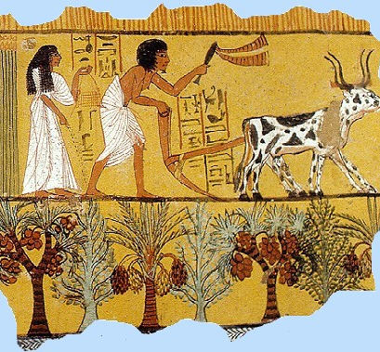
Ancient Egypt
Daily Life –
Social Structure

Slide 2
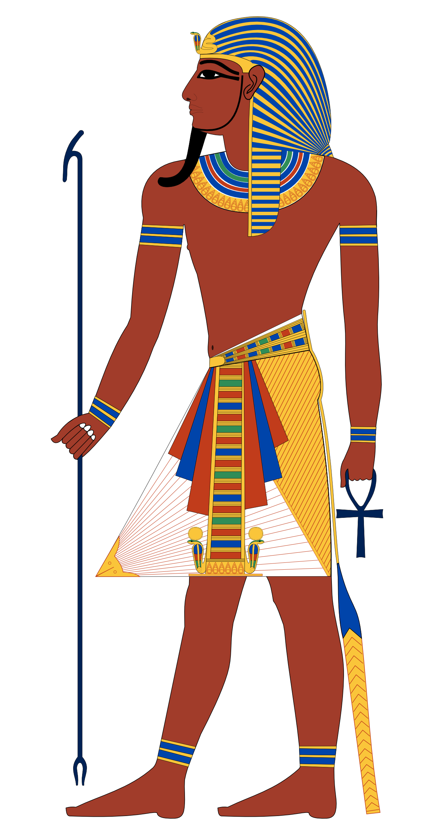
Pharaohs
Chose a number Out of 12…
Notes:
Divide class in the pairs or small groups. Each student picks a number. Roll dice. Closest student in each group to the rolled number is Pharaoh (Re-Role if two are equally close).

Slide 3
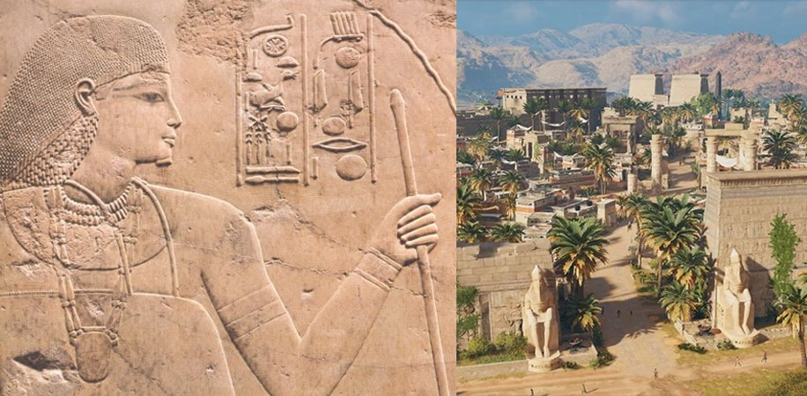
Delegate
Pharaoh: Leads group
- A Vizier
- A High Priest (if applicable)
- A General (if applicable).
Notes:
Pharaoh chooses the role of their groups – if group bigger than 2. If two, than the second student is Vizier.

Slide 4
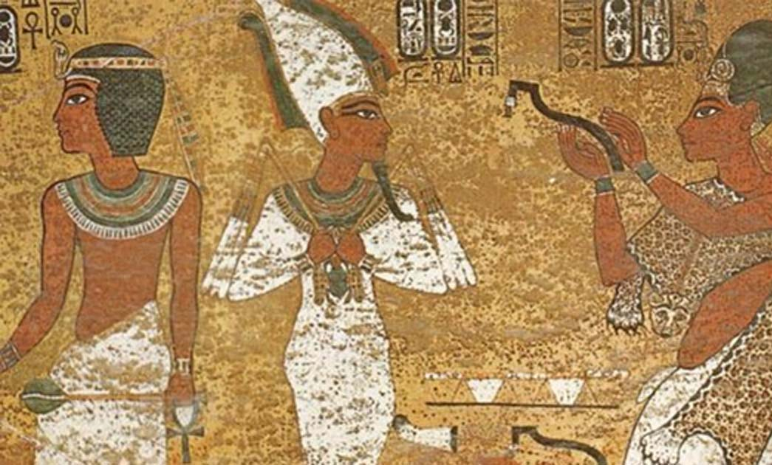
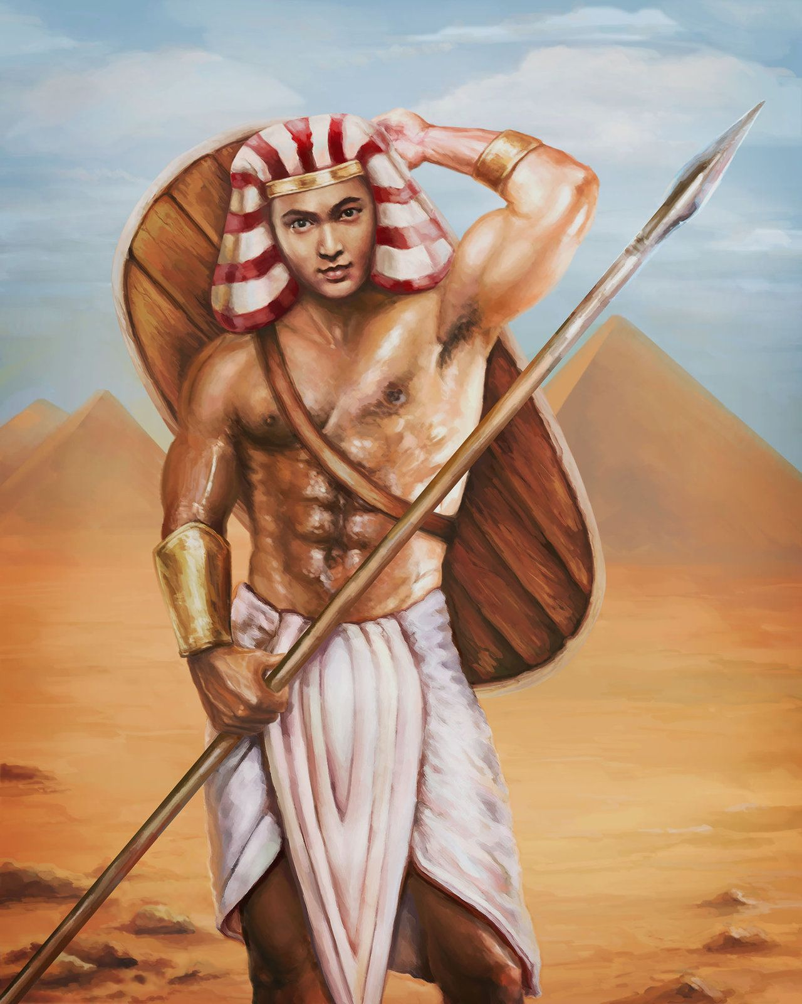
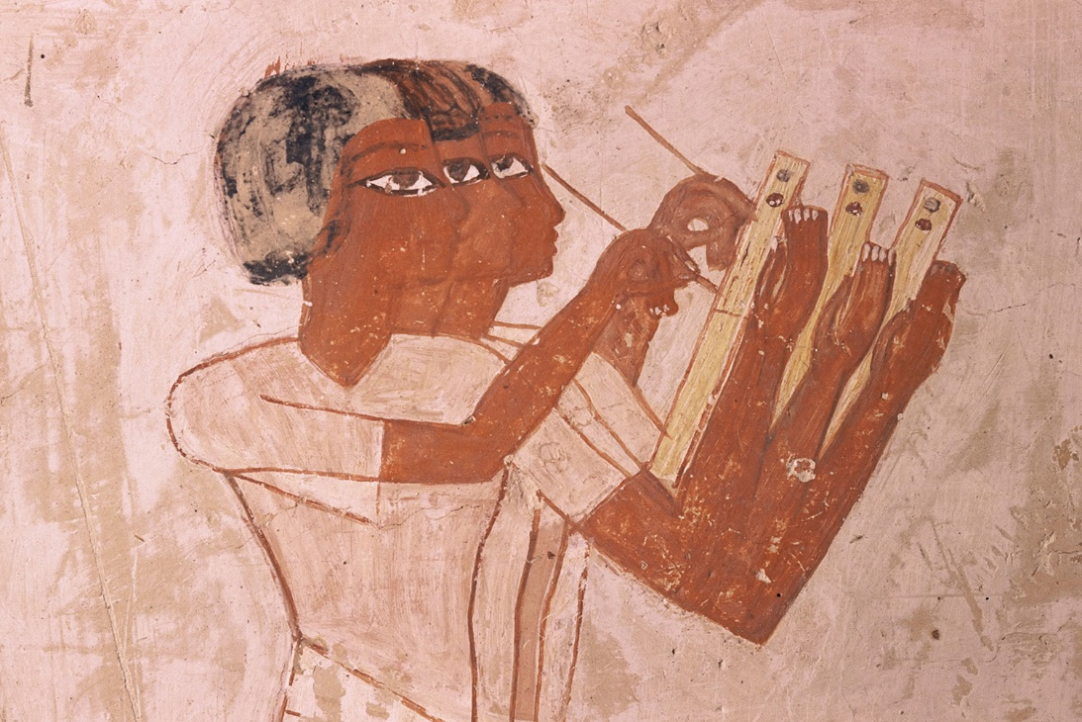
How are you going to manage your kingdom?
Will you prioritize…
The Army
Administration
Religion
Notes:
100 Points: General is second in command.
120 Points: Vizier is second in command.
150 Points: High-Priest is second in command.

Slide 5
Rules
Make simple decisions as a group.
The Pharaoh has the final say on the decision but must listen to her advisors.
Whoever is 2nd in command gets to speak directly after the pharaoh – then the others.
Vizier takes records of all points gained and lost.
As you make decisions, you will be assigned points either by the role of the dice or on how wise this decisions is (based on Ancient Egyptian custom of course).

Slide 6
Who will gather your food?
Slaves
Freemen
Notes:
50 Points
100 Points

Slide 7
How will you make money from your resources?
Will you prioritise…
Mining
External Trading
Internal Trading
Notes:
50 Points
80 Points
70 Points

Slide 8
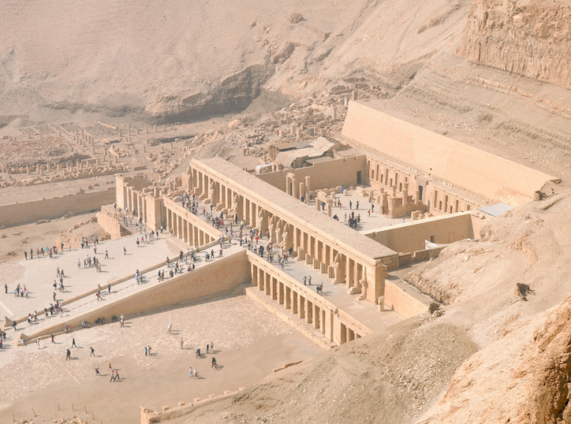
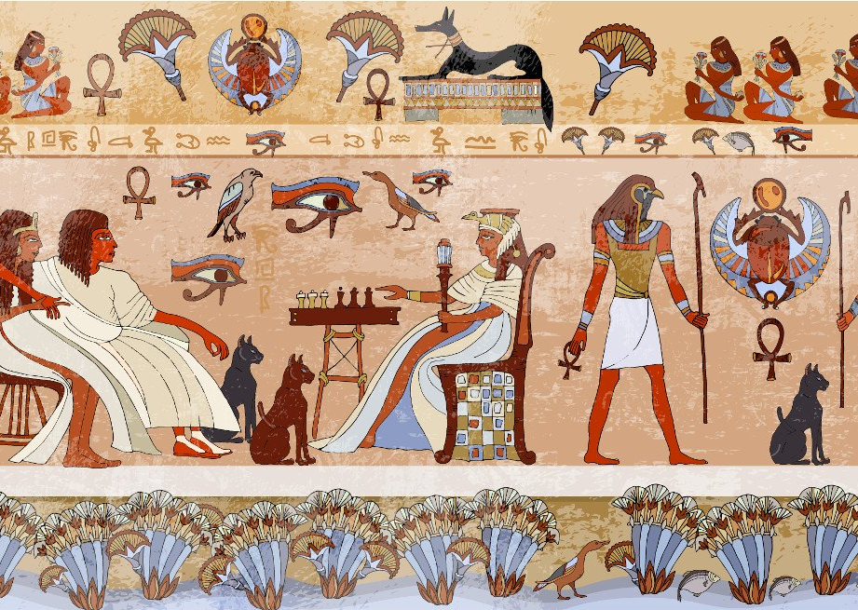
How will you use your newfound wealth?
You have money…
Build Temples
Craft treasures
Patronize art & philosophy
You can save
Invest in your army
Notes:
200 Points
20 Points
150 Points
50 Points
150 Points

Slide 9
Invasion from the South
If you invested in your army you have a free pass and get 50 points…
Otherwise you must:
Ignore
Risk Battle
Sue for Peace
Notes:
1-4: drought overtakes invading army you are saved; any other role: Devastation to the South, crop failure, and death – lose 200 Points, role for 1 or 2.
1-6: Stunning Victory, you’re enemies fear you, gain 100 points; 7-8: draw and peace, gain 10 points; 9-12: you lose, -100 points.
12-8: favourable peace, gain 50 points; 7-3: some concessions, 25 points; 2-1: role again for Battle scenario.

Slide 10
The Nile hasn’t flooded the last two years – the gods are angry! What do you do?
If you invested in the Temples you have a free pass and 50 points…
Otherwise you must either:
Pay tribute to the Gods
Ignore
Invade your neighbours for resources
Notes:
1-7: Gods are appeased, drought ends, gain 150 points; 8-12: Gods are not appeased, lose 150 points.
1-4: Rains come anyway, gain nothing; Any other role: lose 200 points
1-3: War brings more devastation, lose 250 points; 4-7: War brings no profit, lose 200 points; 8-12: War brings profit, gain 50 points

Slide 11
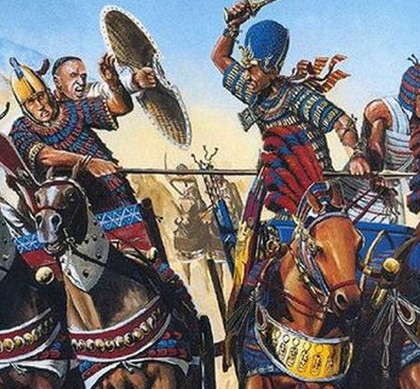
A new danger, war with the Hittites – what do you do?
Sue for peace
Risk open Battle
Bribe a rival to the Hittite throne
Ignore
Notes:
1. 12-8: favourable peace, gain 50 points; 7-4: some concessions, 25 points; 3-1: role again for Battle scenario.
2. 1-6: Stunning Victory, you’re enemies fear you, gain 100 points; 7-10: draw and peace, gain 10 points; 11-12: you lose, -100 points.
3. 1-3: Rival gains throne, you gain peace, 50 points; 4-8: Rival begins civil war, quick peace is made with you, 60 points; 9-12: Rival dies, role again for sue peace or Battle.
4. 1-4 Hittite King dies, peace is made, no gain; any other role: invasion, crop failure, and death – lose 200 Points and you must role for 1 or 2.

Slide 12
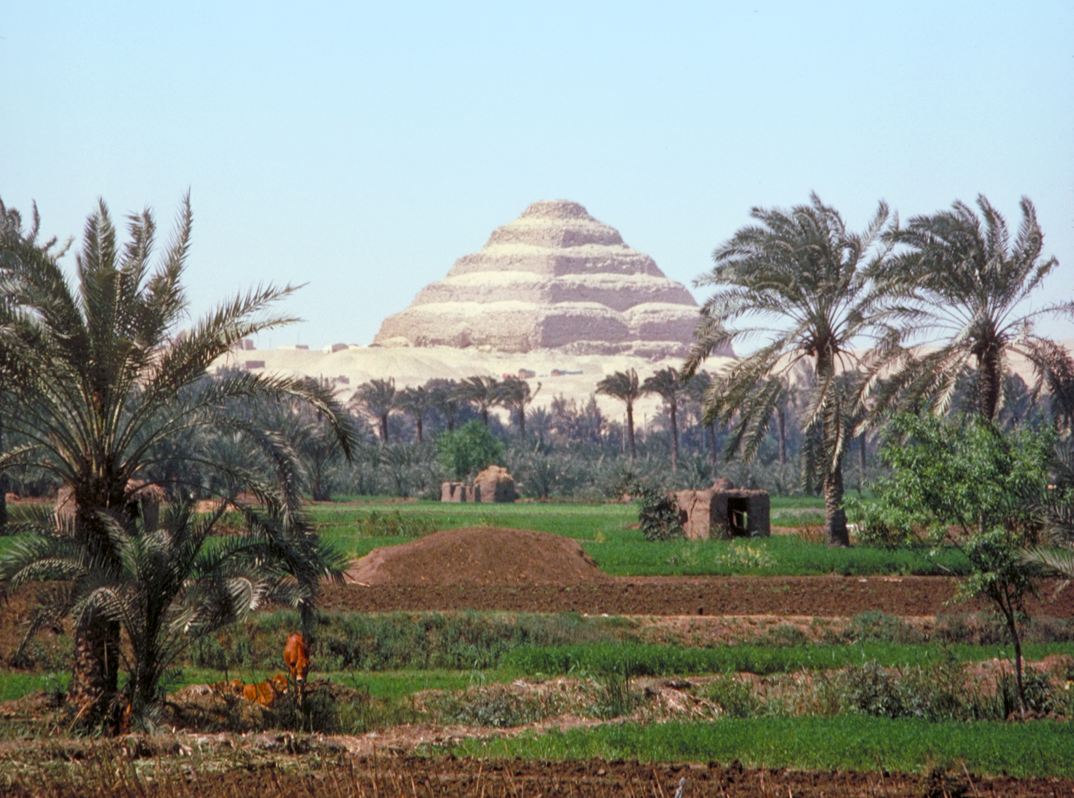
New Land from the Hittite War: you have new land, new subjects, and new wealth – what do you do?
Enslave the peoples of the new land
Slaughter them
Make them a vassal kingdom
Notes:
1-7: slaves rebel, lose 100; 8-12: new, cheap labour, gain 150 points
1-5: gain nothing; 6-12: survivors attempt assassination, lose 300 points.
1-6: Vassal rebels, lose 50; 7-12: vassal brings more wealth, gain 200 points.

Slide 13
Priests demand tribute: do you pay?
Notes:
Yes – gain nothing
No – priests disfavour – lose 50 points

Slide 14
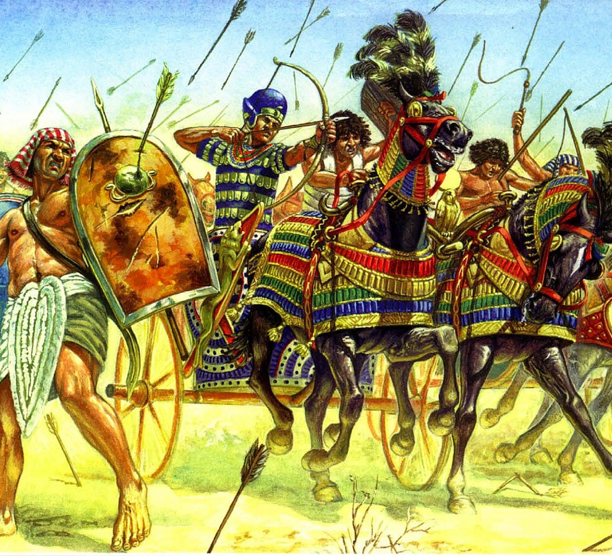
Rebellion
If you patronized the arts and philosophy, you have a free pass…
Otherwise you must:
Attempt to openly suppress the rebellion
Sue for a truce
Ignore
Notes:
1-8: Stunning Victory, you’re enemies fear you, gain 100 points; 9-10: draw and peace, gain 10 points; 11-12: you lose, -100 points.
12-10: favourable peace, gain 50 points; 9-3: some concessions, 15 points; 2-1: role again for Battle scenario.
1-3 Rebels flee country, gain nothing; any other role, lose 300, and role again for 1 or 2.

Slide 15
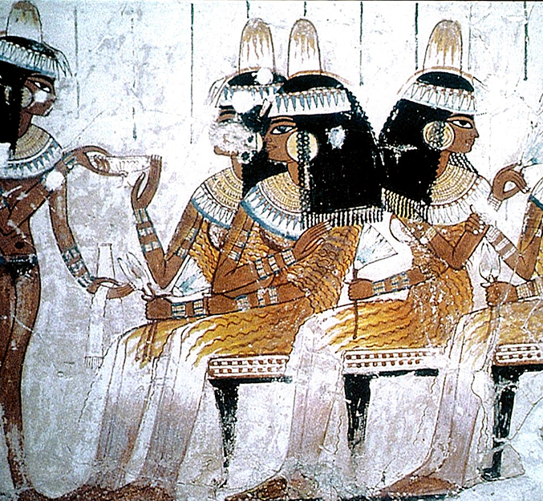
Time to Marry?
Do you marry:
The Hittite Consort
The Assyrian Consort
The Egyptian Consort
Notes:
Peace with the Hittite Empire – gain 50 points, two warrior sons, and 1 daughter - unfortunately, she is not a beautiful daughter, and will be difficult to marry to a man: 1-8 no marriage, lose 25; 9-12: marriage, gain 25).
Peace with Assyria – gain 60 points, 1 warrior son, 1 beautiful daughter – but disfavour with the gods, your son will die before you: role 1-5, daughter marries a worthy heir, gain 50; 6-7, daughter doesn’t marry, lose 100; 8-12, daughter marries an unworthy, violent, arrogant heir, lose 200).
Peace in Egypt – gain 55 points, 1 warrior son, no daughters – risk of war with Assyria and Hittites: role 1-6 short war (lose 50), 7-12 peace (lose nothing)

Slide 16
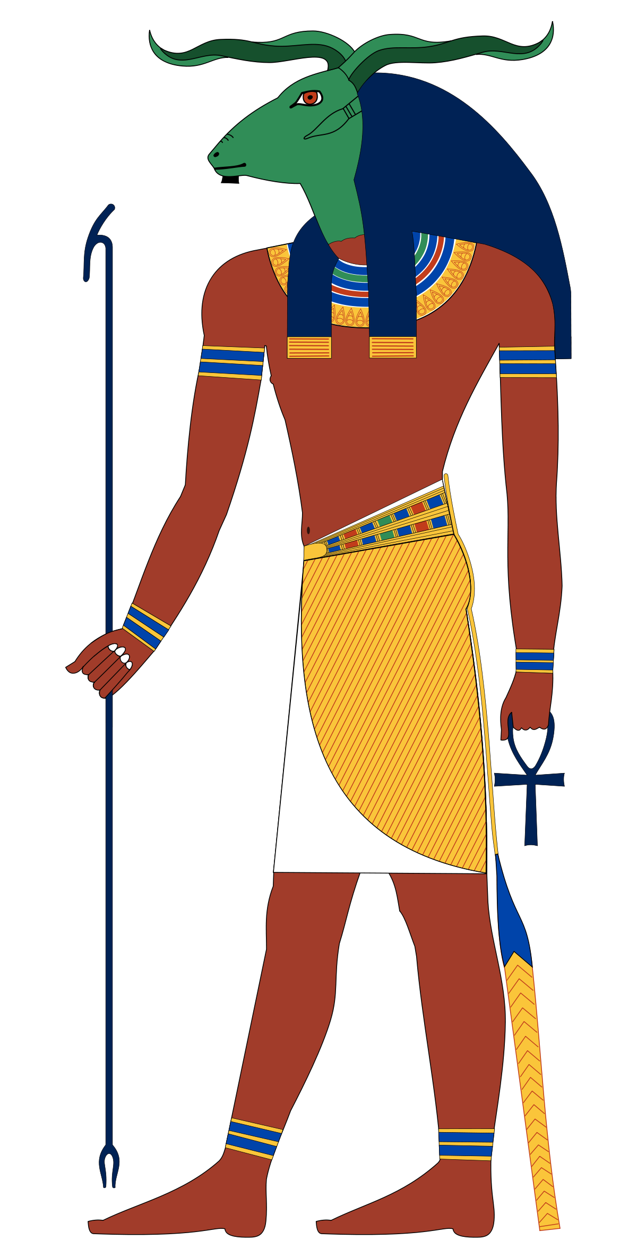
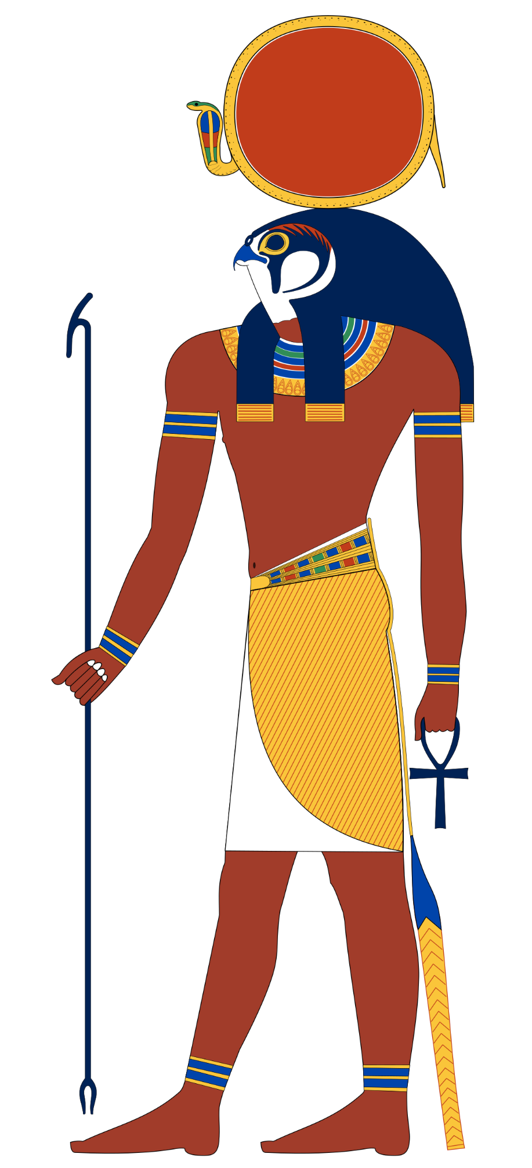
Rival Religion: a priest of Khnum and a priest of Ra are asking for tribute – who do you pay?
You pay tribute to Ra
You pay tribute to Khnum
You don’t pay to either
Notes:
Good harvest – but you may have offended Khnum: 1-6 Nile doesn’t flood, lose 90; 7-12 Nile floods lose nothing.
Good harvest – but you may have offended Ra: 1-6 drought lose, 100; 7-12 no drought lose nothing.
1-4 avoid gods wrath; any other role, lose 200 and role again for A or B.

Slide 17
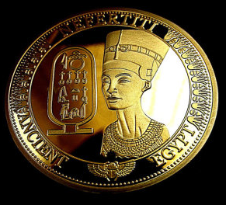
You’re low on funds:
If you saved your wealth you have a free pass…
Otherwise you must:
Invade another country
Send out trade envoys
Allow foreign traders to settle on your lands
Rob the wealth of your people
Notes:
1-3: invasion brings profit, gain 200 points; 4-7: no profit, lose 50; 8-12: bring loss, lose 200
1-8: increase in trade, gain 100; 9-12, no trade increase, lose 50.
1-5: peace and increased trade, gain 150; 6-10: dissent and loss, lose 50; 11-12: insurrection, lose 100.
1-3: People oppressed but you gain little and cause economic devastation, lose 100; 4-12 open rebellion, lose 300. Role for 1, 2, or 3.

Slide 18
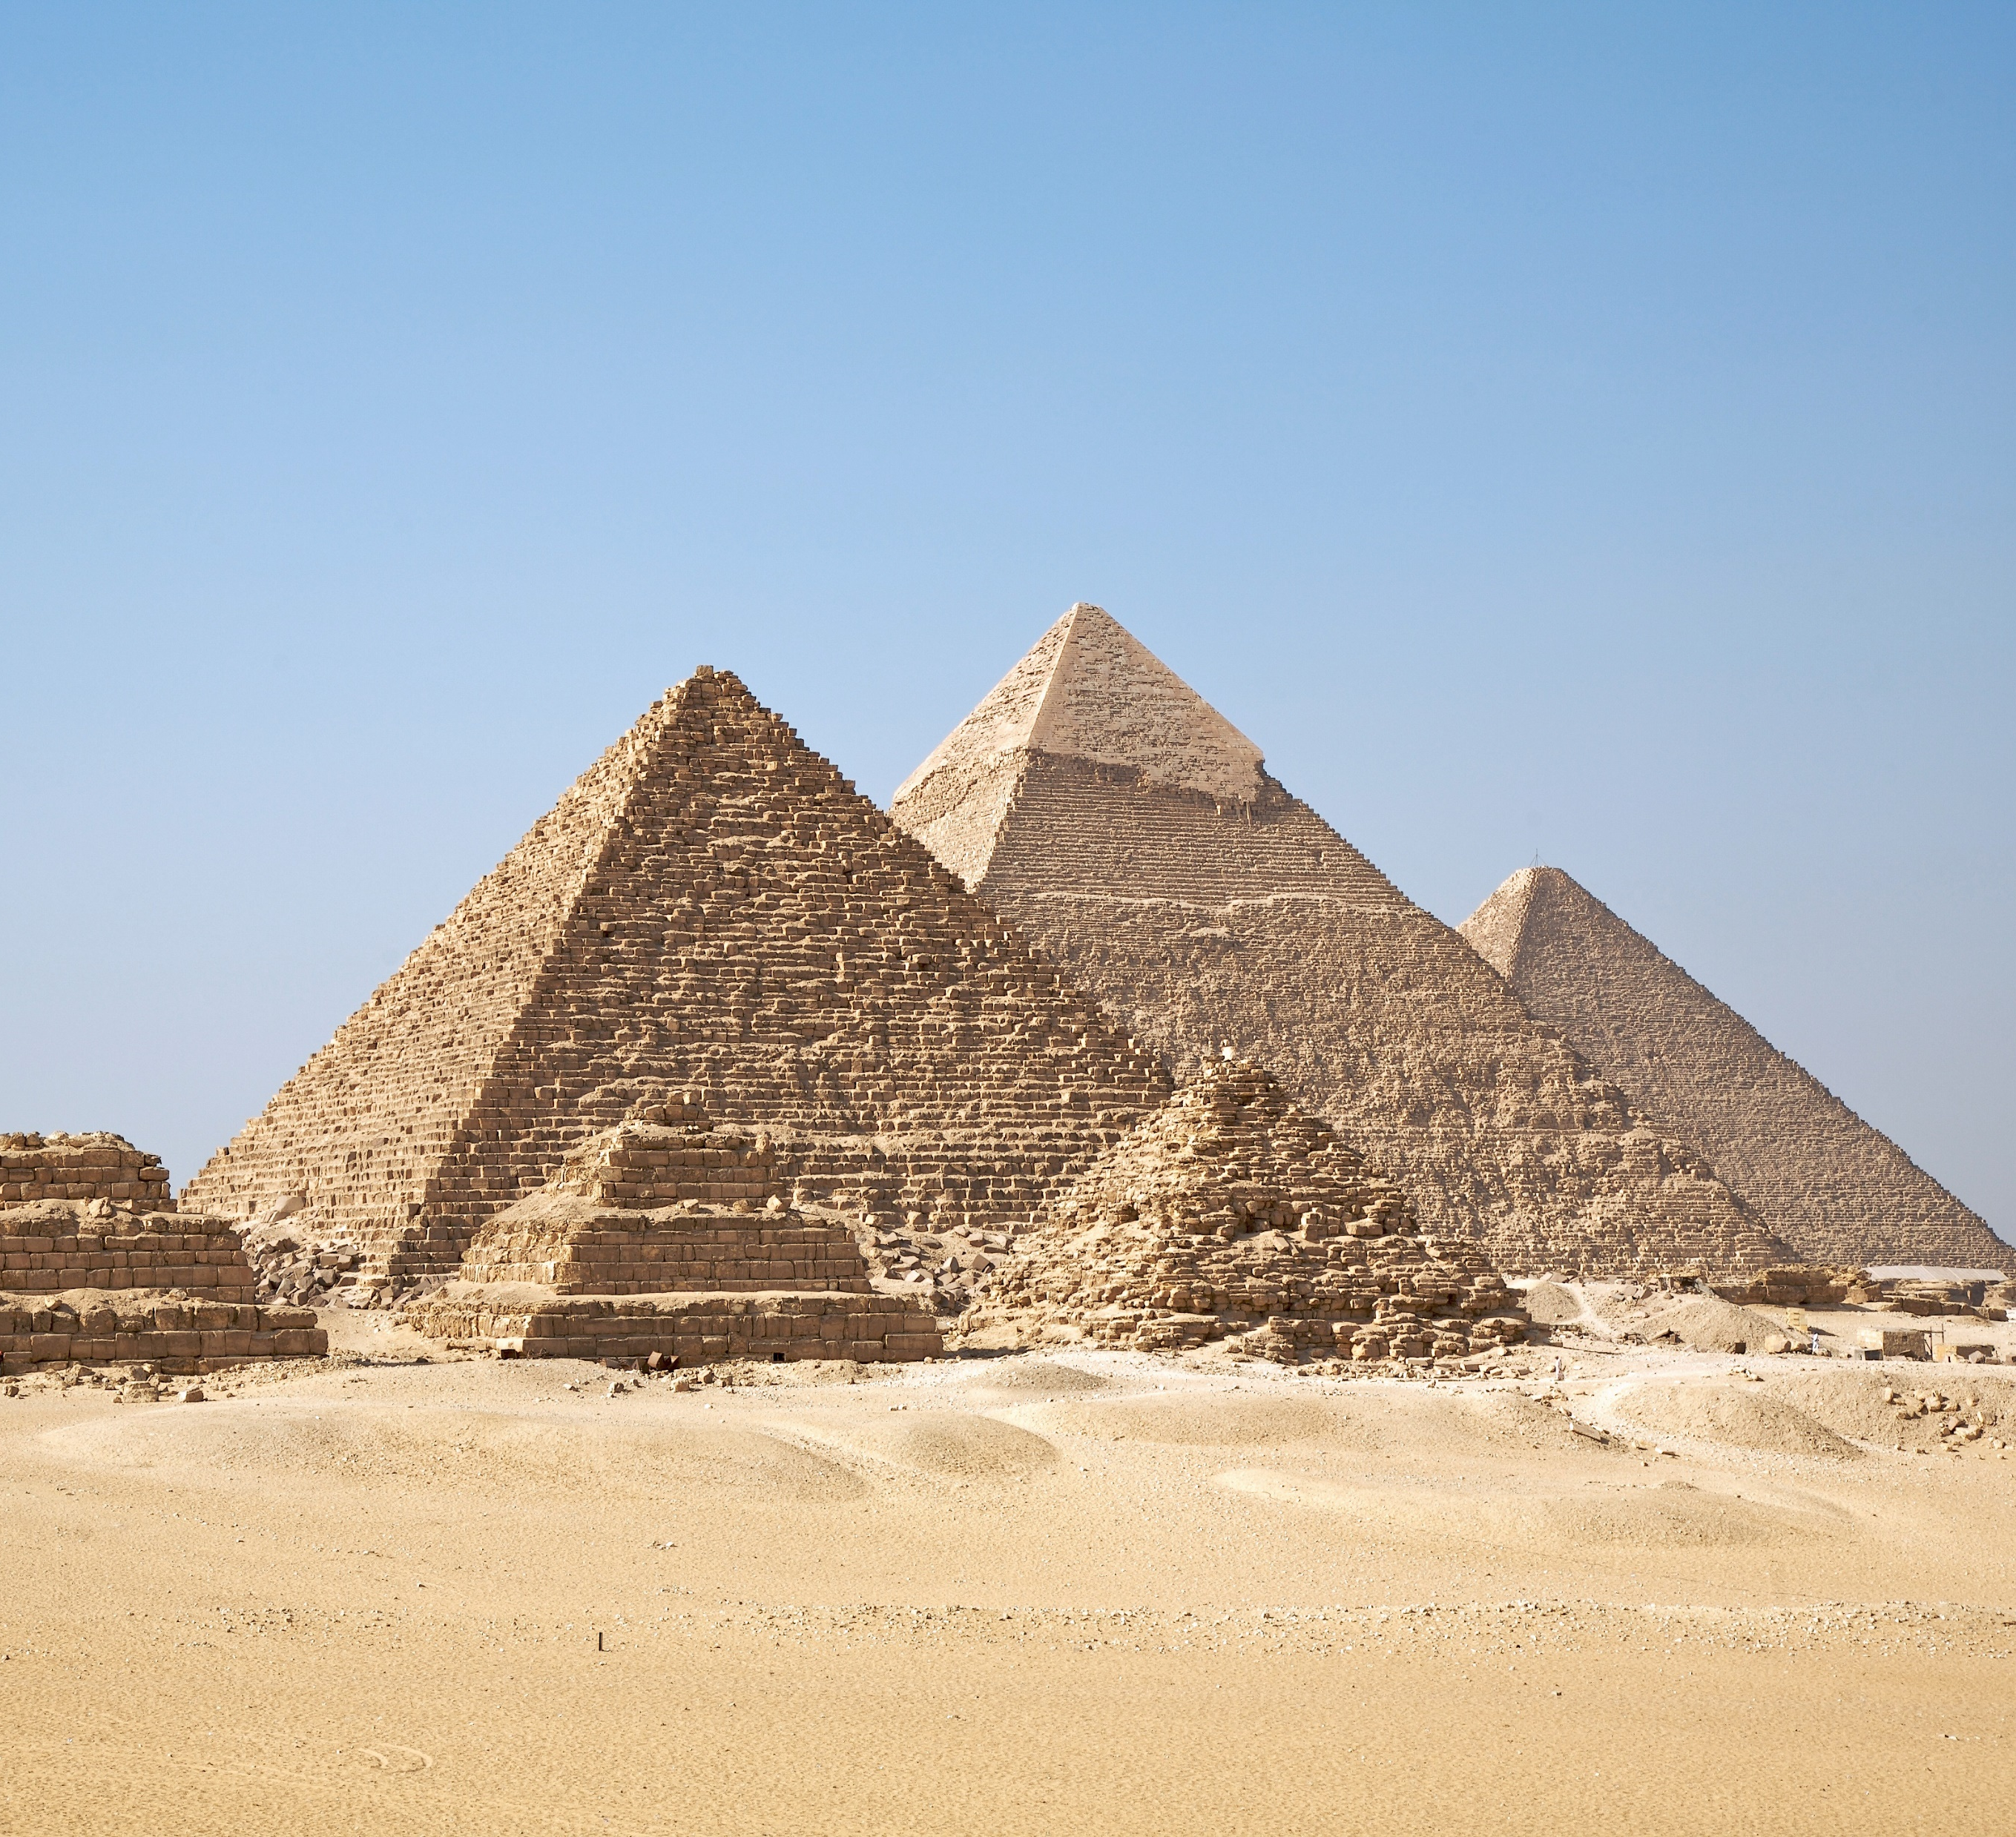
You’re legacy:
You’ve survived to old age but death is still approaching; you must ensure Maat and that you survive Duat…
How will you ensure your legacy remains?
Build a Pyramid
Build a Temple
Build a new City
Notes:
Wealth and legacy: 200 points
Gods’ favour and legacy: 250 points
People’s favour and legacy: 300 points

Slide 19
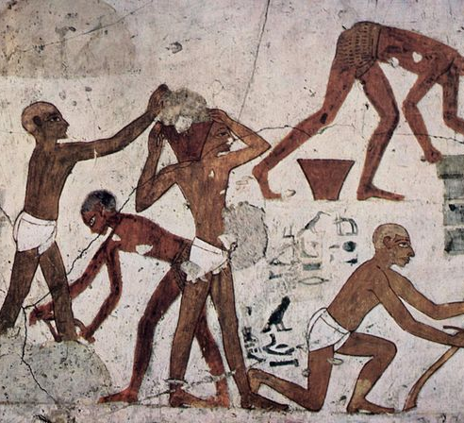
Will you use slaves or free labourers?
To build will you use…
Slaves
Free Labourers
Notes:
A. Work is not complete: lose 190 points
B. Work is complete: lose nothing

Slide 20
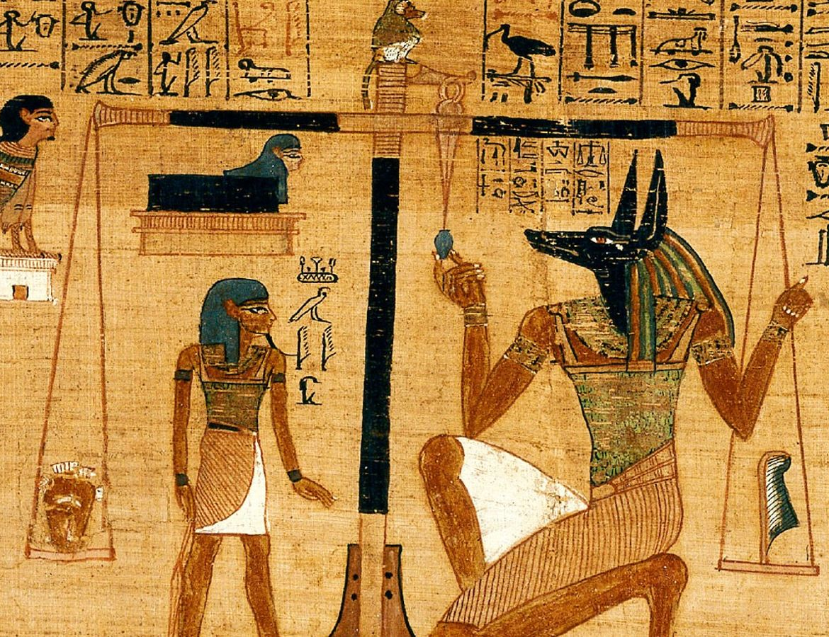
How do you fair in Duat?
Count you scores: How have the gods judged your reign?
Is your soul lighter than a features?
Have you ensured Maat?
616 Points – you survive the trial… just.
716 Points – you impress the Gods
895 Points – you are a god. Osiris reborn!

