Slide 1
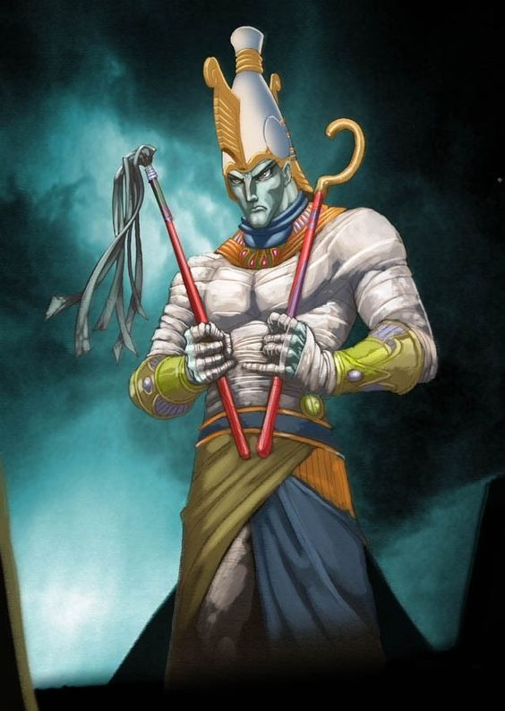
The Story of Osiris
- The God of Life and Death

Slide 2
How far would you go to out-do a sibling?

Slide 3
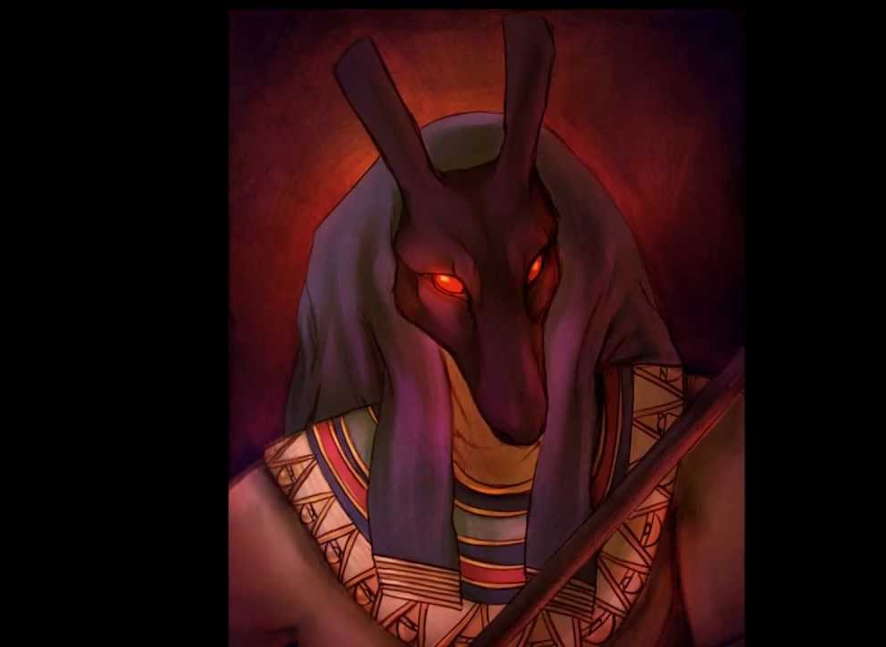
Osiris vs Seth
Osiris was the god of life and death – the god of the Nile, fertility and agriculture.
He was the legitimate heir to the throne of Egypt.
He was happily married to his wife Isis.
Seth was the god of Chaos – of the desert, violence, and foreigners.
He was not given the throne while his brother was.
He was married to Nephthys – but it was not entirely happy.

Slide 4
Myth Analysis
What are the themes of this Myth?
What does this Myth tell us about Egyptian values?
What motivates Seth to do what he does – is this ever justified?
Is there a message to this Myth?
Death of Osiris

Slide 5
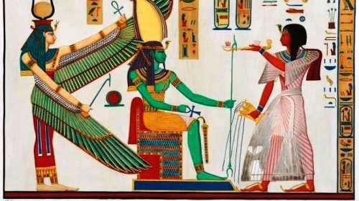
Isis
This Photo by Unknown Author is licensed under CC BY

Slide 6
Watch the following video and complete the tasks:
Summarise the myth.
Describe the motivations for Isis’ character.
What do we learn about Egyptian values from this Myth?
Isis and the 7 Scorpions

