Slide 1
Roman Army Battles

Slide 2
Battles
Preparation
Line-up
Battle

Slide 3
Prep: Stage 1
Patrols move ahead of the main army to see where enemy troops are and in what numbers
This can take a few days
Various factors might decide when the battle will actually happen
What do you think these factors were?

Slide 4
Prep: Stage 2
Did you see a red flag waving outside the principia this morning? That means the battle will happen today
The legate and senior officers go and confer in the praetoria
You wait with your contubernium until you get an order from your centurion – either to line up or to join your cohort/legion

Slide 5
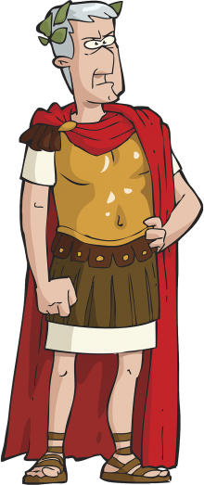
Prep: Stage 2
The emperor or the legate makes a sacrifice to Jupiter
The emperor or the legate makes a motivational speech to the army
Write a few lines of the kind of speech you think they would give

Slide 6
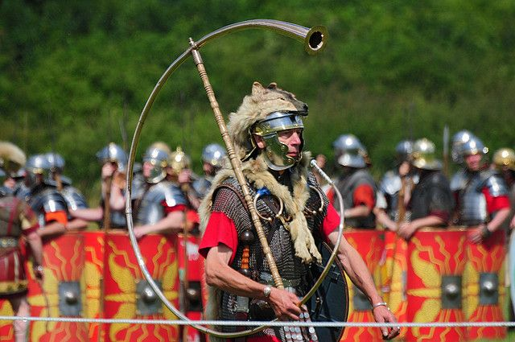
Line-up begins
3 blasts from the trumpet (played by the cornicens) and it’s time to line up
How do you think the army would line up?

Slide 7
The enemy
Numerii
Cavalry
Units
/ Alae
Cavalry
Units
/ Alae
Auxiliaries
Legionaries
Legionaries

Slide 8
Which line up indicates fighting a more difficult enemy and why?
(a) Legionaries in deep rank
(b) Legionaries in shallow rank
Aux.
Aux.
Legionaries
Leg.
Leg.

Slide 9
In Battle
Who do you think would fire the first shots?
Gladiator Battle Scene
How accurate do you think this battle scene is?

Slide 10
In Battle
Legionaries then march forward shoulder to shoulder
Throw their pilums then charge with their swords out
Cavalry come in from the sides
Follow the standard!
Collide with the enemy with your shield, then stab him in the guts

Slide 11
Rules of Battle

Slide 12
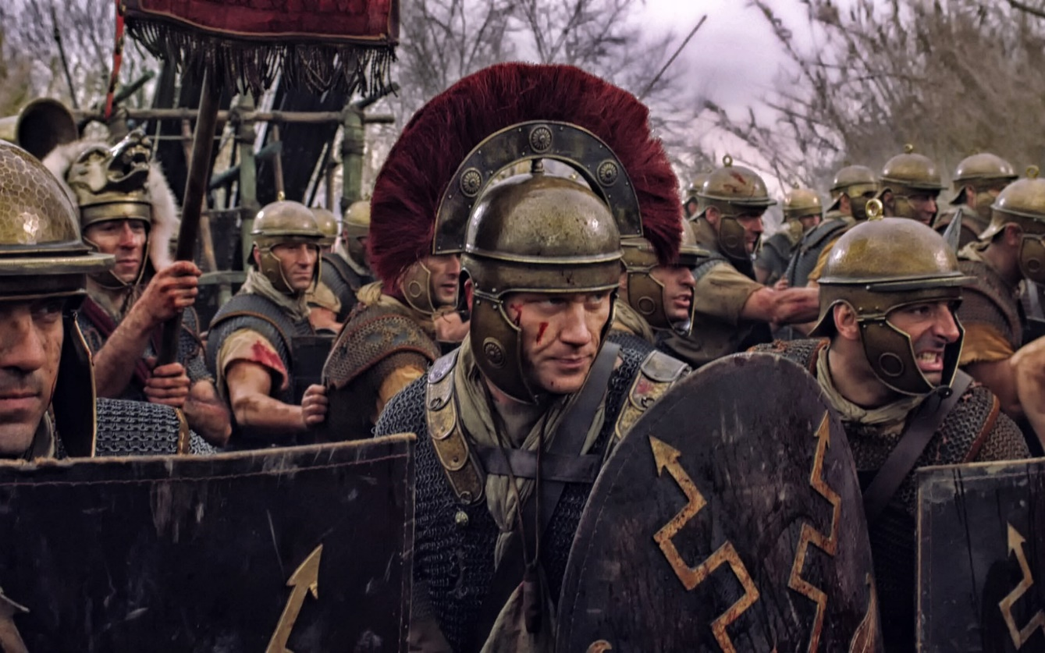
Rules of Battle
Do NOT retreat
“Hold the line”
If you are an injured legionary in the front line what do you do?
If you lose your sword or shield – punishment

Slide 13
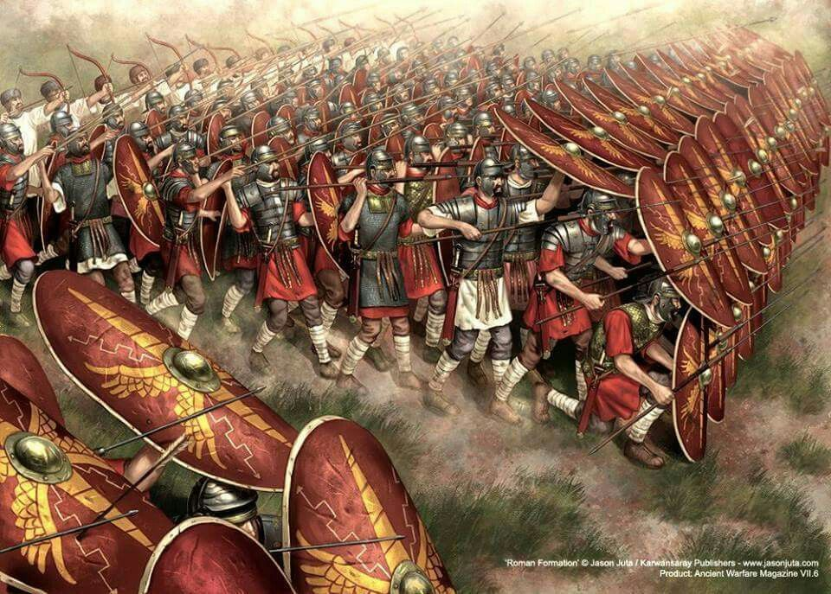
What’s wrong with these stats?
“At the battle of Artaxata, the Armenians lost 100,000 infantry and ALL their cavalry. The romans had 100 wounded and 5 dead.”
- Plutarch
“In an expedition to Arabia, the romans lost 2 men and the enemy lost 10,000.”
-Strabo

