Slide 1
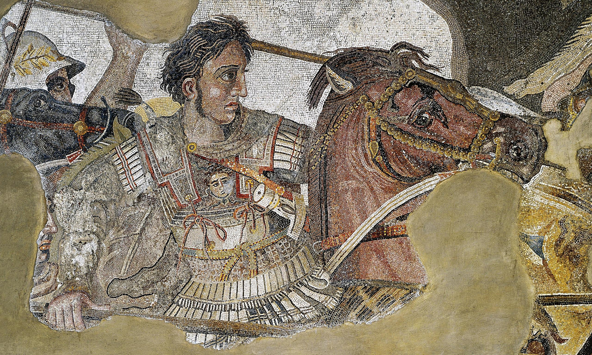
Alexander the Great
Introduction

Slide 2
Learning Outcomes:
Part I
Identify
some elementary facts about Alexander
List
some of Alexander’s qualities/achievements
Predict
some of the qualities of Alexander’s Character
Part II
Locate
Alexander’s Home Country
Observe
the qualities of Alexander’s Home Country’s landscape
Infer
the some of the qualities of Alexander’s People
Compare
Alexander’s Country Men to the rest of Greece.

Slide 3
What do you already know about Alexander the Great?

Slide 4
What did Alexander achieve – why do we learn about him?

Slide 5
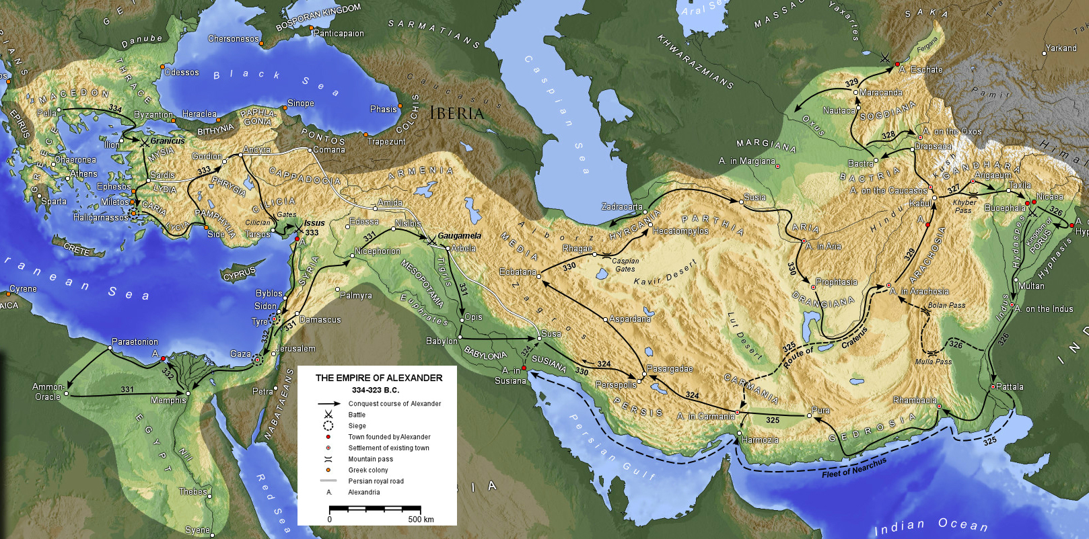

Slide 6
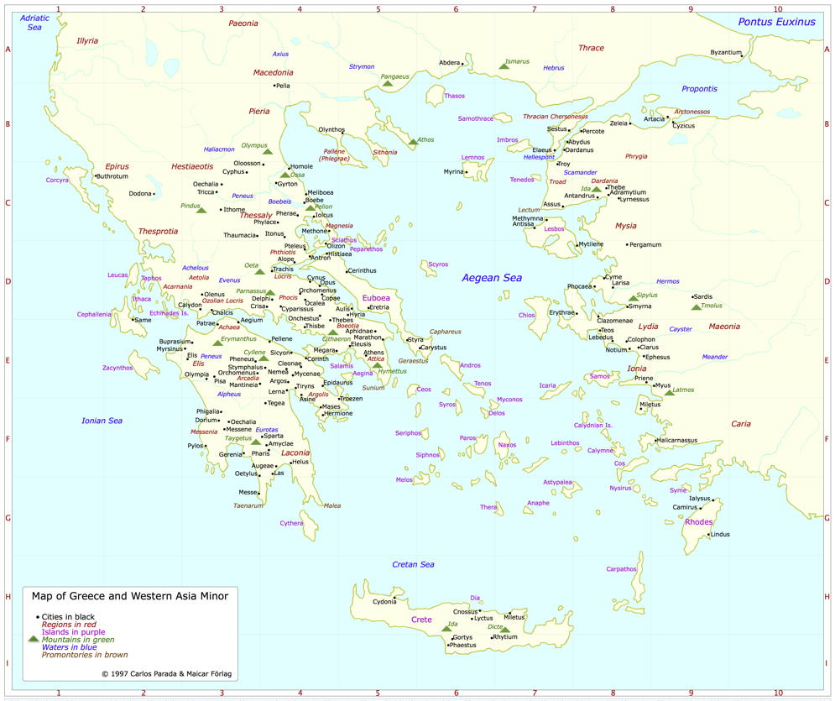
Where was he from?

Slide 7
What do we know about Macedonia?

Slide 9
Who were the Macedonians?
Government: Monarchy.
Military (Originally) Hoplite, peltast, and cavalry
Architecture: Same as other Greek States.
Clothing: same but with a kausia, a flat cap.
Language: a barbaric dialect of Greek.
Ancestry: The Kings claimed ancestry from Perdiccas of Argos.
Faith: Zeus, Hera, Hades, Poseidon, etc.
Loyalties: they kingdoms sides with the Persians in the Persian Wars.

Slide 11
Were the Macedonians Greek?

Slide 12
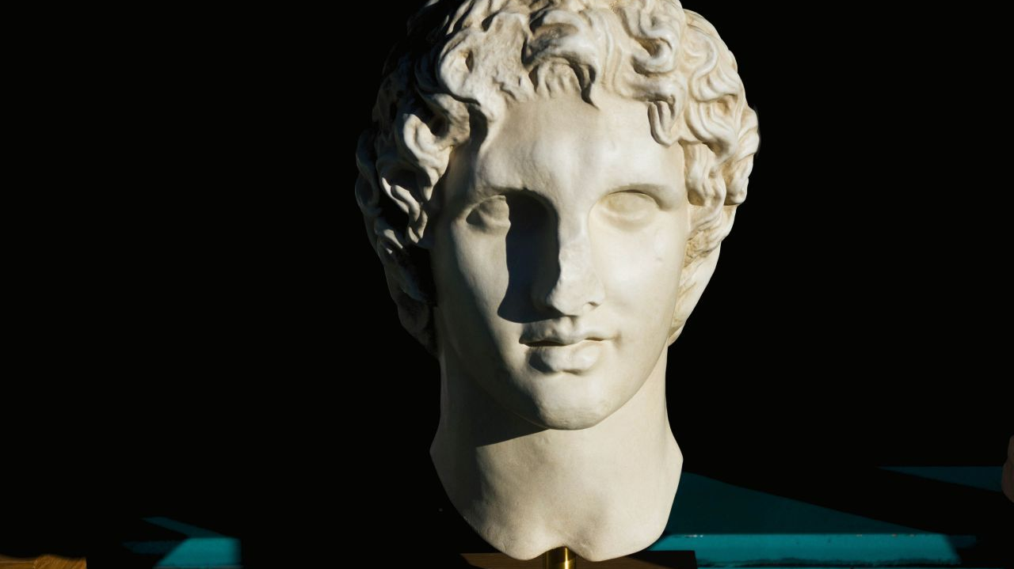
The Exam
Types of Questions

Slide 13
Types of Questions
The Alexander component of the Exam (Topic 2) can be a though as Alexander’s campaigns… but it can also be easy.
The trick is to prepare enough and pick the right question on the day.
They can ask you about anything from the whole of Arrian and Plutarch. This is a huge amount of content.
However, there are standard questions that come up every year.

Slide 14
Battle/Siege Questions
Almost every year there is at least one question on one of Alexander’s Battles of Sieges – there are about 7 which have come up. These are
Siege of Thebes
Battle of Granicus
Battle of Issus
Siege of Tyre
Battle of Gaugamela
Siege of Aornos Rock
Battle of Hydaspes River.
Other possible sieges/battles are: The Siege of Halicarnassus, Indian Mallian Fort, Campaigns against the Northern Tribes, Miletus and the Coastal Policy.

Slide 15
Battle Questions can be divided as so…
The Lead-up: What happened in the run-up to the battle/siege? How did Alexander prepare? How did his enemy prepare? Did he have to overcome any obstacle before the battle started?
The Battle: What was the course of the battle?
Outcome/aftermath: what happened after the battle? How did Alexander treat his enemy? What did he gain? What did he achieve?
Leadership/character: What do we learn about Alexander’s character from any incident in the battle? (Pick an adjective to describe him based on the evidence).

Slide 16
Battle Questions: What do you need to learn?
Learn the facts. Every detail counts in this question: Names of the generals/people involved, the numbers of soldiers, the names of the types of soldiers, the place names, the dates. This is history – you must have details!
Learn the steps. The Battle/siege is an event in time where a lot of things happened in a short period. You must have a good knowledge of what happened in each key step/stage of this event. With battles it’s about manoeuvres, with sieges its about obstacles and their solutions.
Quotes: are only necessary sparingly. Maybe if there is a phrase that nicely summarises Alexander’s character. But no need for quotes when describing the main course of the battles. Instead make references to what the authors say “According to Arrian…”

Slide 17
Other Questions: Character, Key Events
The other types of questions you get on Alexander are usually about some key events that highlight his character. These include:
Alexander’s childhood
His relationship with his parents and teacher (Aristotle)
Alexander Traveling to Egypt.
Alexander’s sacking of Persia.
Alexander’s policy of Orientalism.
Alexander’s execution of Philotas and Parmenion.
Alexander’s murder of Cleitus to Black.
Alexander’s execution of Callisthenes.
Alexander’s forced to turn home.
Alexander’s foolishness/heroics at Mallian Fort.
Alexander’s crossing of the Gedrosian Desert.
Mutiny at Opis
Alexander’s Death
Alexander relationship with Women
Alexander’s relationship with alcohol

Slide 18
Alexander the Great
Development of Macedonian War Machine

Slide 19
Learning Outcomes:
Identify
main components of the Macedonian Army
Describe
the different features/equipment of the soldiers
Identify
strengths and weaknesses of different soldier types
Organise
Evaluate
strengths and weaknesses to traditional Macedonian battle tactics.
the best battle plan for an Macedonian army

Slide 20
Hoplite Warfare

Slide 21
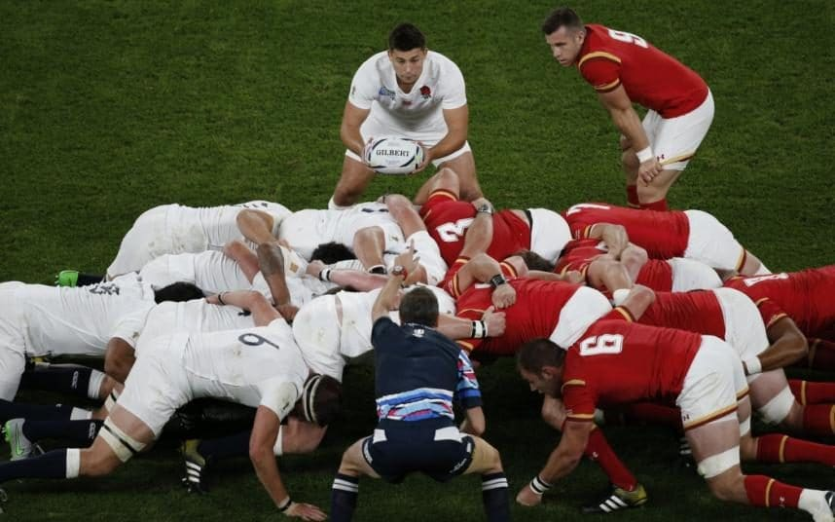
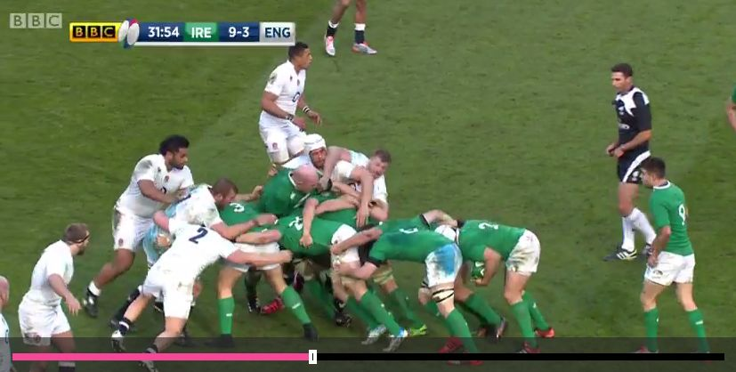

Slide 22
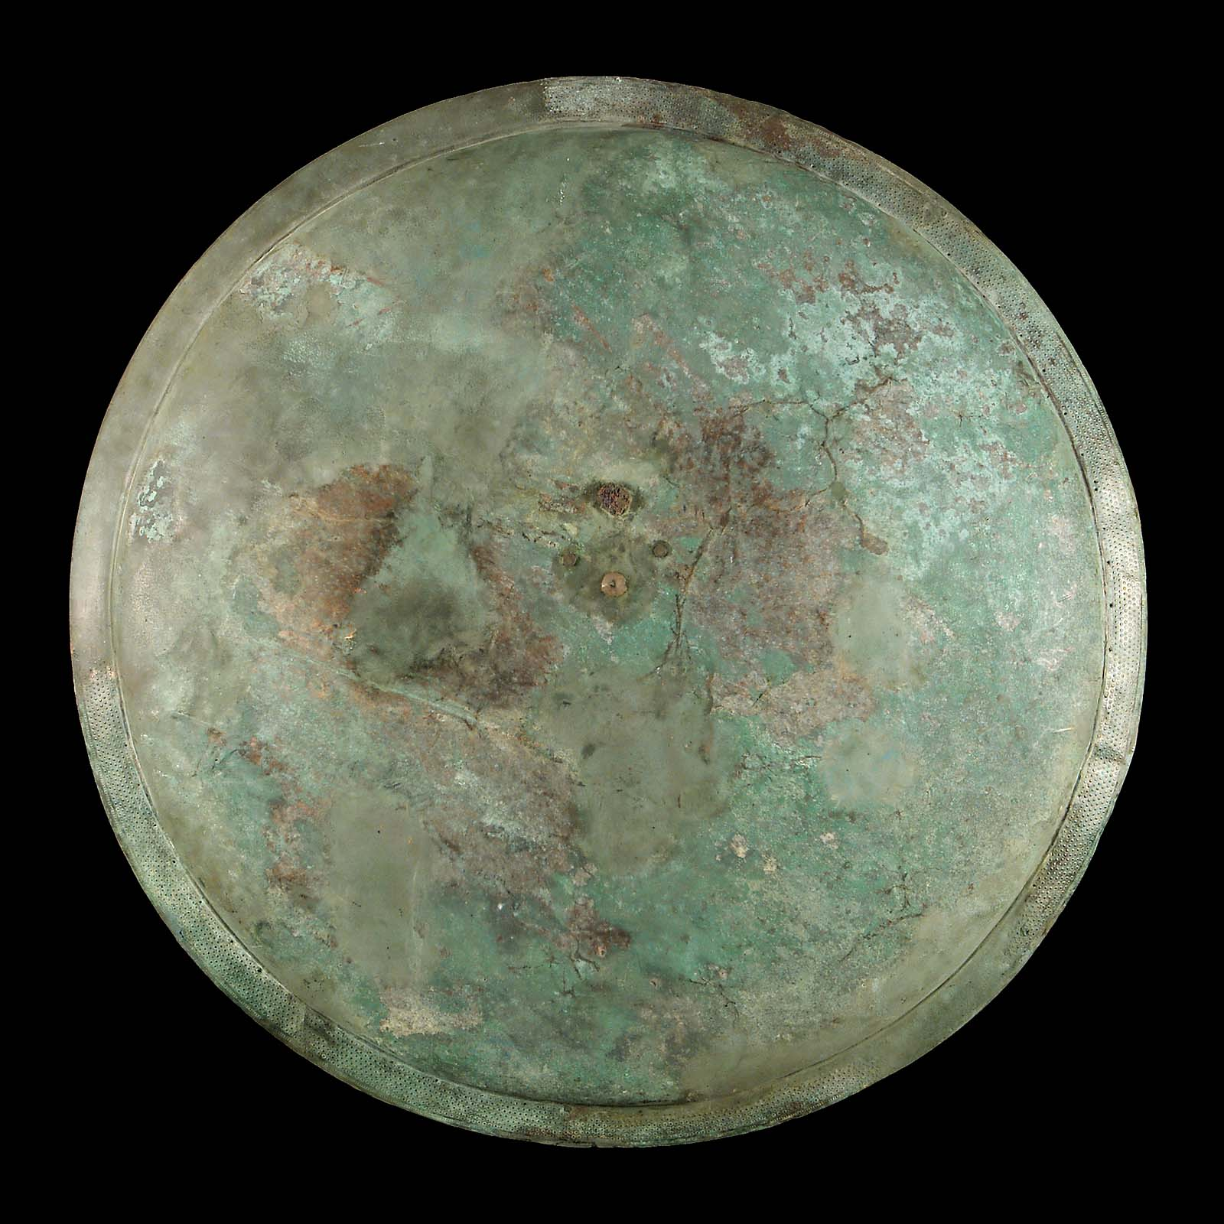
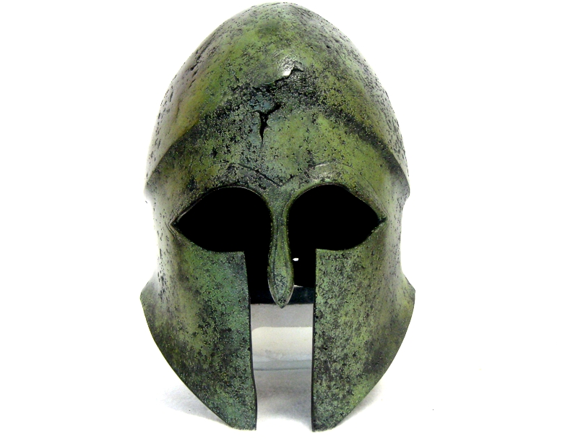
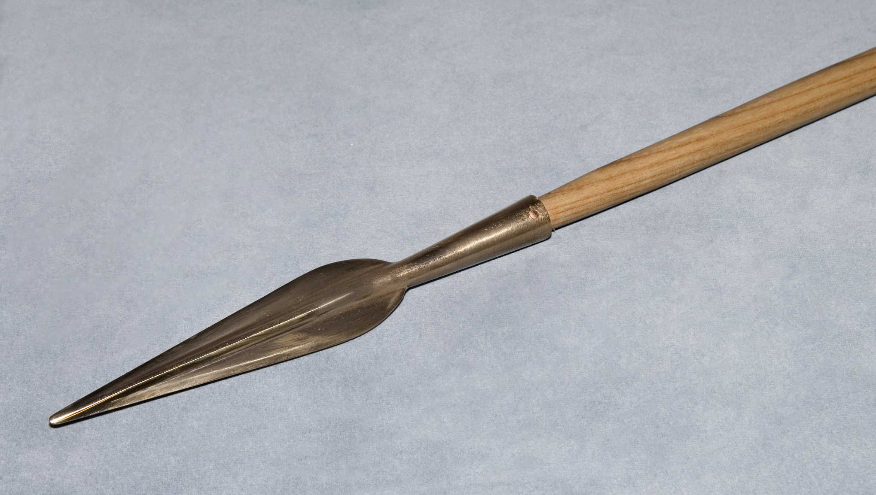
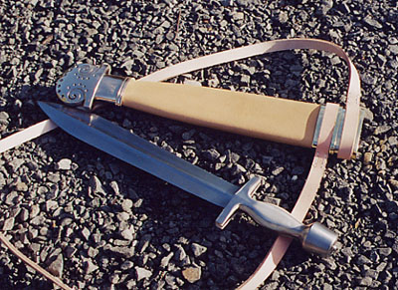
Left: Hoplon Shield.
Right: Helmet – The Corinthian Helmet.
Bottom Right: Spear replica.
Bottom Left: Ancient Greek Sword Replica, Xiphos.

Slide 23
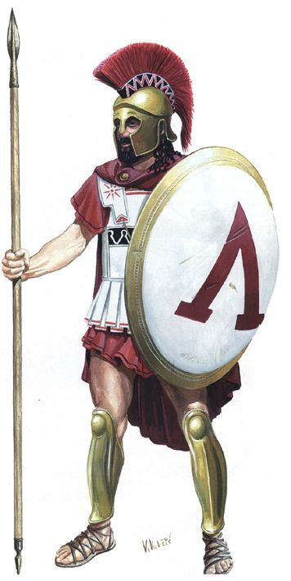
Main Body of Armour and weapons
Large 1m diameter shield, called a hoplon.
A bronze helmet with cheek and neck guards and crest coming out of the helmet top – usually. Called a Corinthian Helmet.
Bronze body armour (never topless) - Linothorax.
Bronze grieves.
One 2.4m long thrusting spear (never thrown)
One short sword for close combat fighting – called a Xiphos.

Slide 24
Ancient Sources:
So speaking, he strengthened the courage and spirit of each man. When they heard their king, each rank fell in more closely. As when a man joins together the close stones of a high house wall that shields against the force of the wind, so they fitted together helmets and studded shields. They pressed shield upon shield, helmet upon helmet, and man upon man. Horsehair crests on their helmets brushed each other as the soldiers nodded standing in dense array next to each other. In front of the line two men stood in full armour, having one purpose: to open the fight in the van.
The Illiad, 16.210-220

Slide 25
Main Tactic: Phalanx

Slide 28
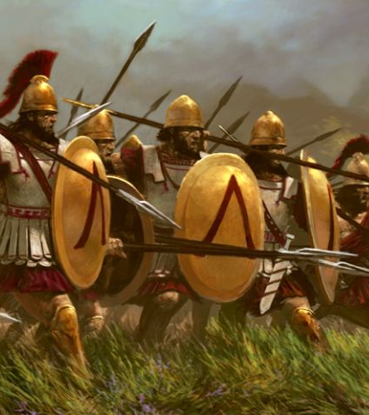
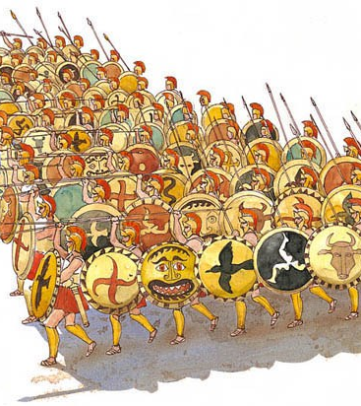

Slide 29
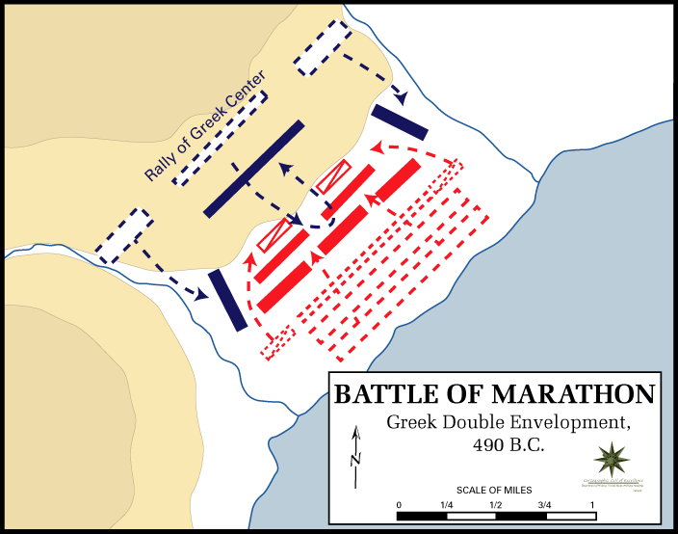

Slide 30
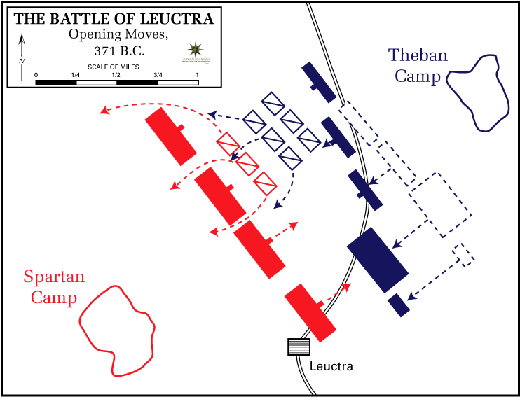

Slide 31
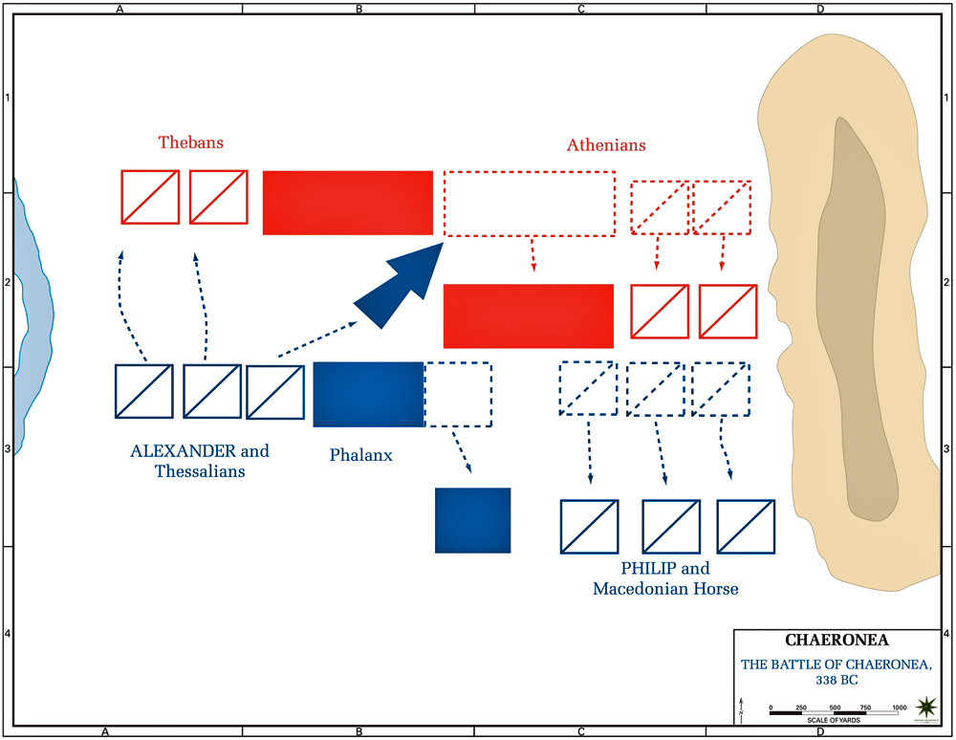

Slide 32
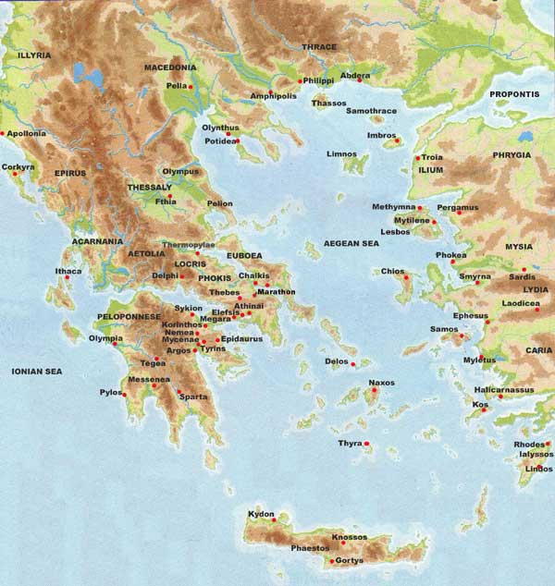

Slide 33
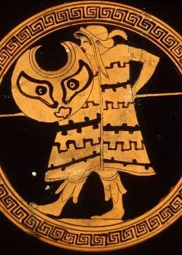
Other fighters:
Little cavalry.
Some light infantry: e.g. peltasts.
Peltasts originated in black-sea region: they wore little armour – Phrygian cap and crescent wicker shield (pelte) – and used throwing javelins and short swords.

Slide 34
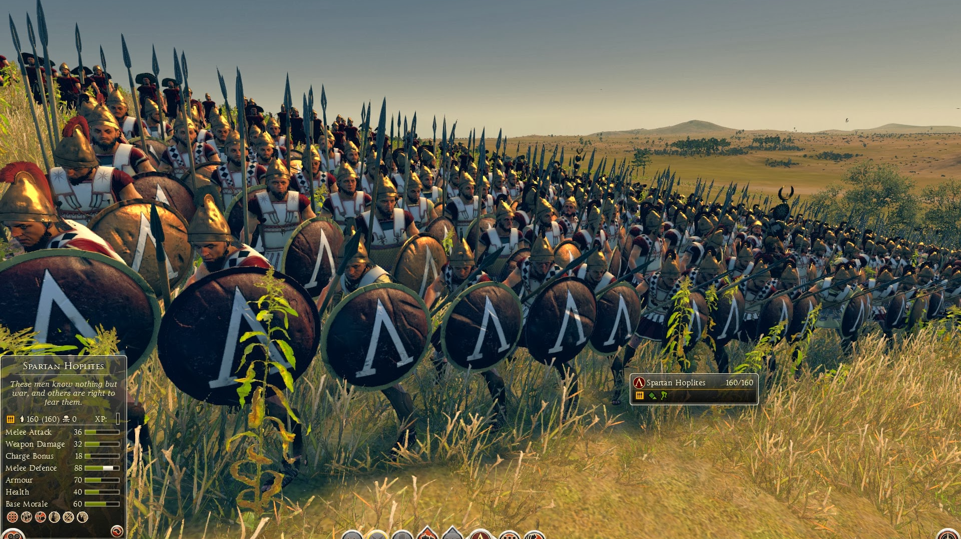

Slide 35
What were the main bodies of the Macedonian Army?
Heavy Infantry: Sarissa
Companion Cavalry: Shock Cavalry
Thessalian Cavalry: Heavy Cavalry
Hypaspist Infantry, the Guards
Mercenaries, Greeks, Thracian , Cretans, Agriarians.

Slide 36
Heavy Infantry: Pike-men: Sarissa
Sarissa: a long pike between 4 and 6m long.
Smaller round shield like a Apsis.
Armour and helmets.
A short sword called a kopis.

Slide 37
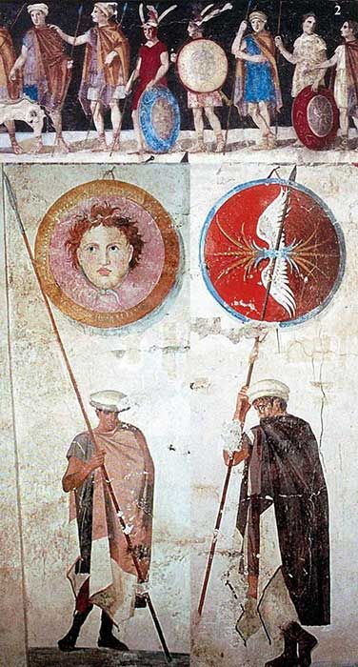
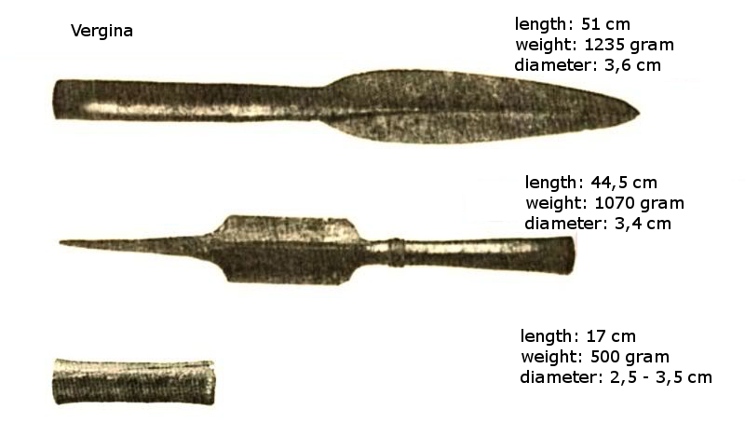
Notes:
Kausia = Macedonian Cap; helmets like Phrygian cap but metal or like Greek Helmet.

Slide 38
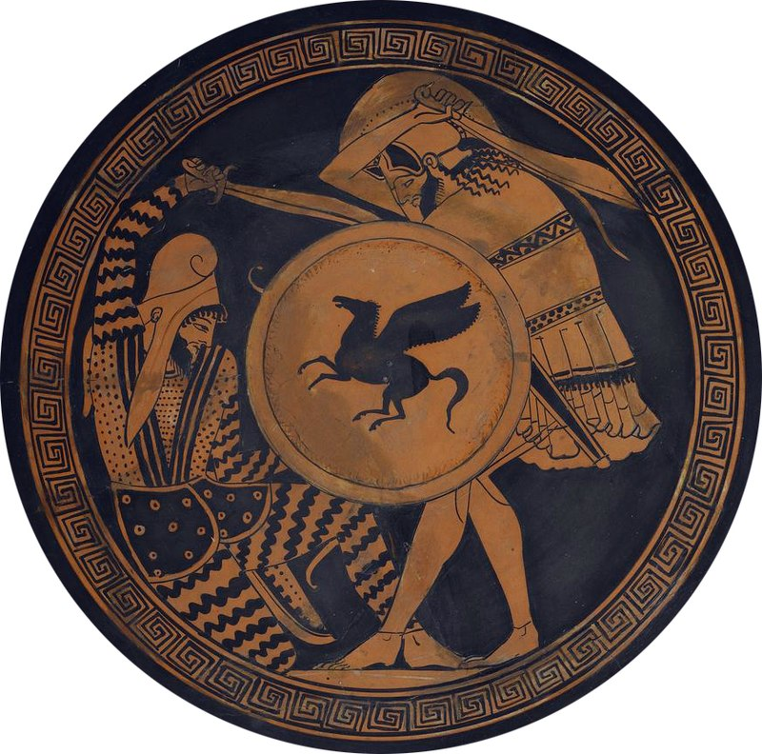
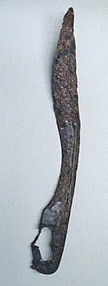

Slide 39
Ancient Greek Infantry Tactics:

Slide 40
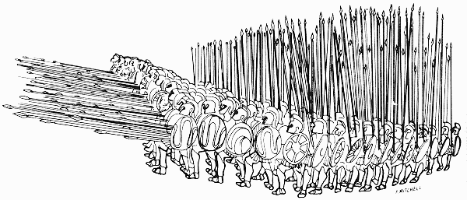

Slide 41
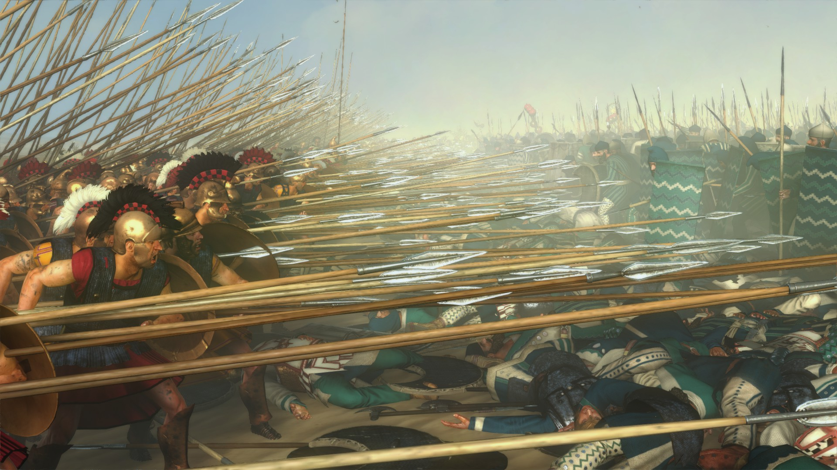

Slide 42
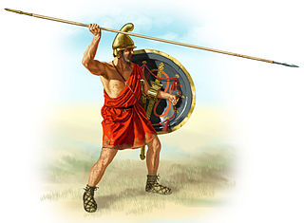
Light Infantry: Peltasts, Archers, Agrianians. Medium Infantry: Hypaspist/The Guards/Foot Companions

Slide 43
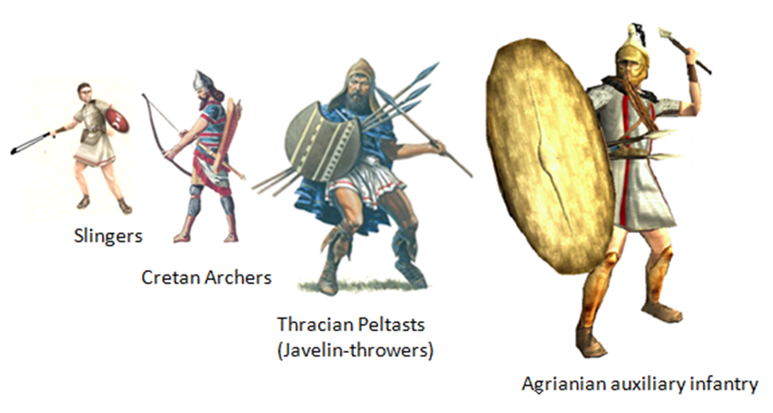

Slide 44
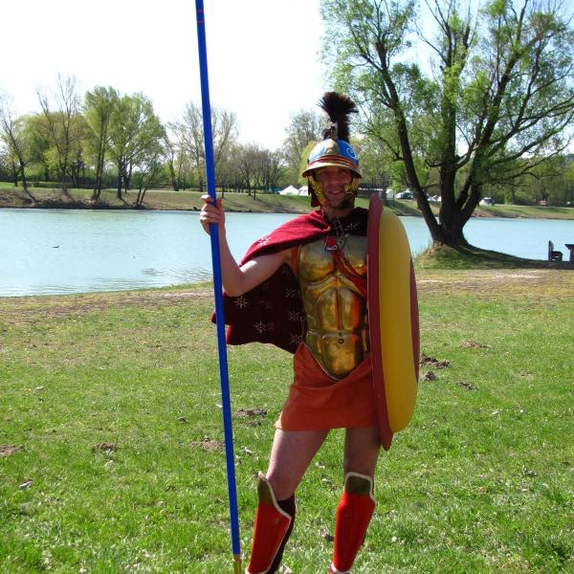

Slide 45
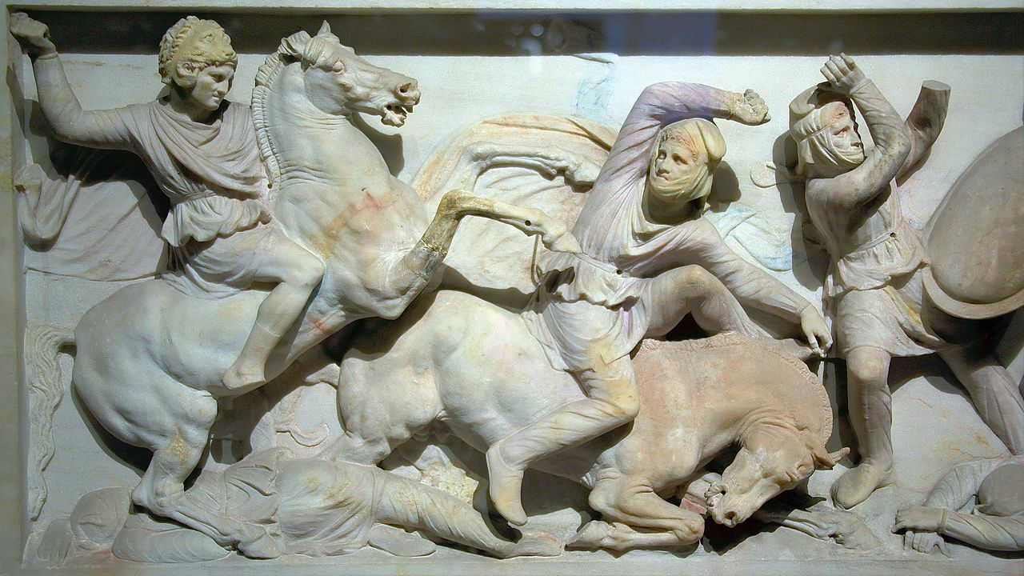
Cavalry: The Thessalians and Companions

Slide 46
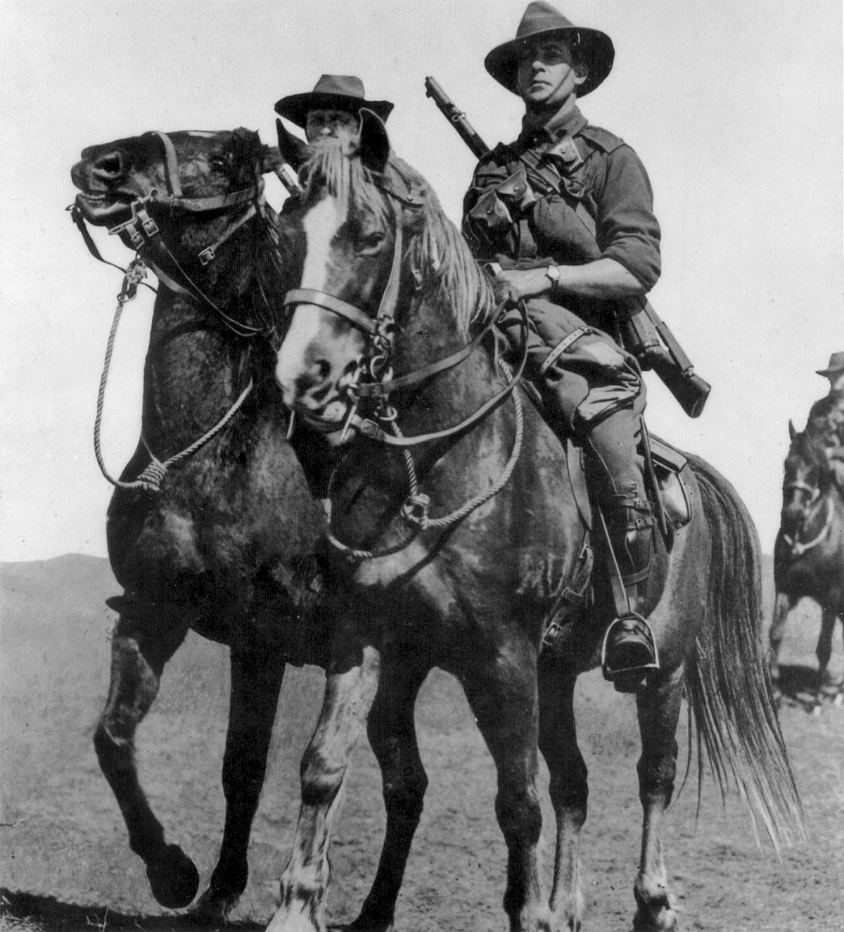
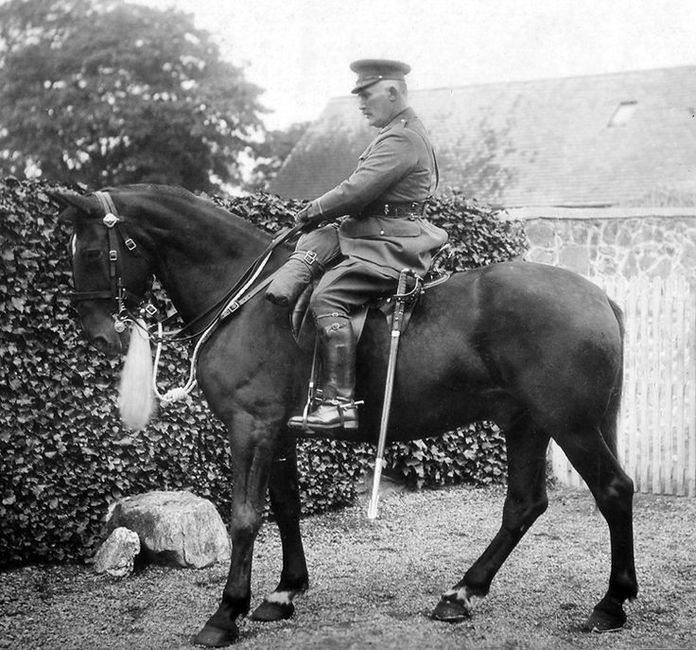

Slide 47
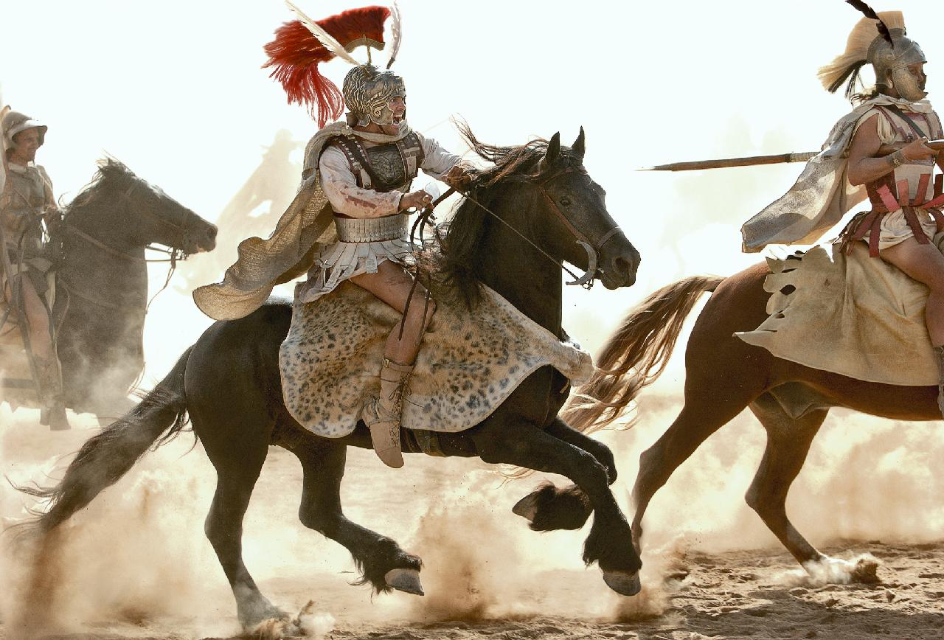

Slide 48
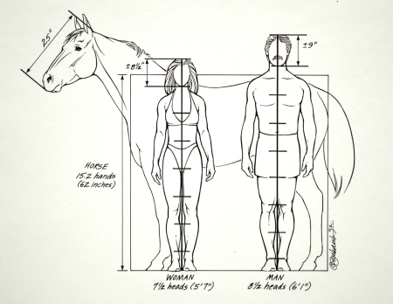
Weight/Height of Horse Compared to Man
Man:
Height: 1.77m
Weight: 80kg
Speed: average about 8 mph (top 44.72 km – aka.Usain Bolt)
Horse:
Height: 1.8m
Weight: 1000kg
Speed: average 27kmph (top speed 44km)

Slide 49
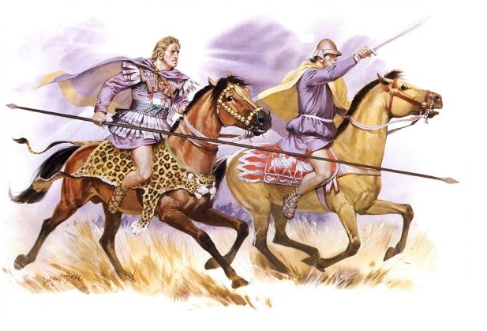
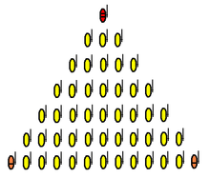
Companions
Elite Macedonian Cavalry.
Used long lance 3.4m long to pierce enemies in front line.
Highly manoeuvrable and fast.
Used wedge formation to keep a solid shape when charging. This was because all men could see their leader.
Shock Cavalry – hit the enemy hard and in their vulnerable spot.
Alexander led them into battle himself.

Slide 50
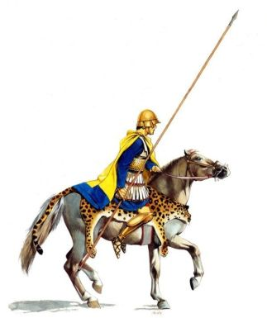
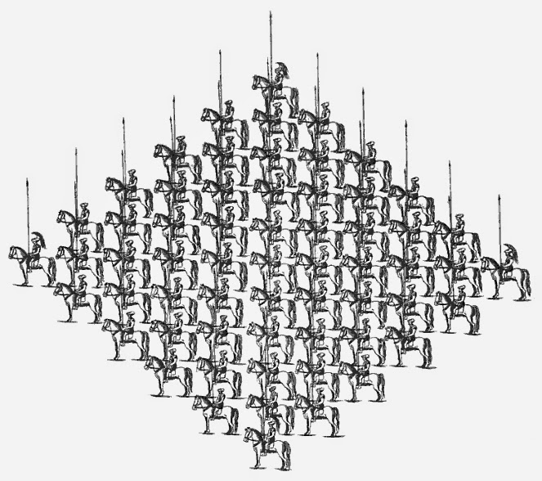
Thessalian Cavalry
From the Northern Greek Kingdom of Thessaly (South of Macedon).
Elite fighting force of cavalry with similar armament to the Companions.
They fought in a diamond shape.
They were used as defensive cavalry – hold the flank!

Slide 51
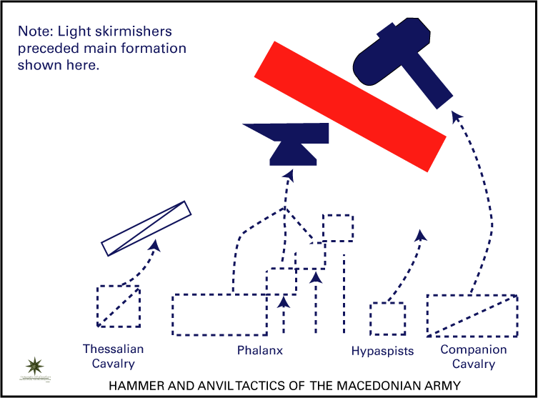

Slide 52
Past Paper Question: 2006

Slide 53
Who were his family?

Slide 54
Learning Outcomes:
Identify
main characteristics of those closest to Alexander in his childhood
Summarise
the lives of each person
Compare
the different traits of these persons
Speculate
the influence these persons might have on Alexander

Slide 56
Epirus

Slide 57
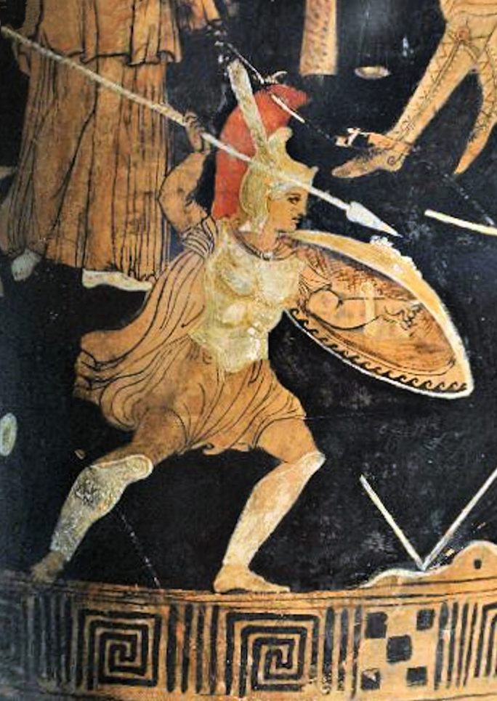
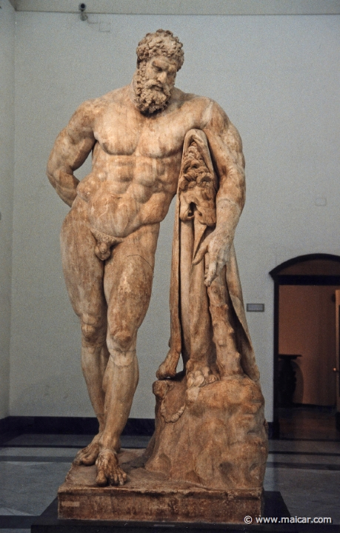
Family Ancestors
Through his mother: Achilles.
Through his father: Heracles.

Slide 58
Why were there difficulties between Alexander’s Parents?

Slide 59
Research Task:
Using the provided worksheet and Plutarch’s Life of Alexander compose a Character Analysis of Alexander’s closest family (parents and tutors/teachers).

Slide 60
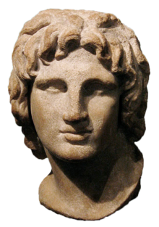
Basic Facts
Summary of Life:
Main Traits/Characteristics:
?
Birth?
Death?
Country of Origin?
Spouse?
Children?
Before Marriage
Marriage
After Marriage
Who were her Ancestors?
The Mother: Olympias
What was her relationship with/influence on Alexander?

Slide 61
Basic Facts
Summary of Life:
Main Traits/Characteristics:
?
Birth?
Death?
Country of Origin?
Spouse?
Children?
Political/Military Career
Who were her Ancestors?
Marriage/Family Life
The Father: Philip
What was his relationship with/influence on Alexander?

Slide 62
Basic Facts
Summary of Life:
Main Traits/Characteristics:
?
Birth?
Death?
Country of Origin?
Life Before Alexander
Life as Alexander’s Teacher
Life after Alexander
His primary Philosophy?
The Teacher: Aristotle
What was his relationship with/influence on Alexander?

Slide 63
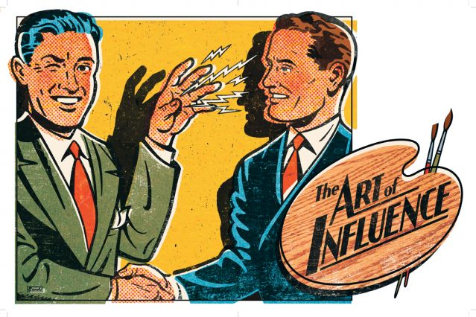
What Influence did they have on his character? What evidence is there?
Focus on the past – Alexander’s childhood.
Consider what influence these childhood events/relationships had. What examples from Alexander’s career/life were influenced by Philip, Olympias, and Aristotle?

Slide 64
Past Paper Questions:
Questions on Alexander’s childhood are not common – however none have come up in a few years.
They can also often be quite tricky.

Slide 65
Alexander the Great
The Campaigns of Alexander -
Part I: Philip's Conquests

Slide 66
Learning Outcomes:
Identify
key/relevant information about Philip’s conquests
Discuss the cause and effect
relationship between Philip’s conquests and Alexander’s

Slide 67
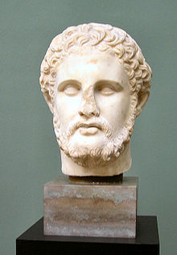
Philip II: Introduction
Born: 382 B.C.
Died: 336 B.C.
Came into Power: 359 B.C.

Slide 68
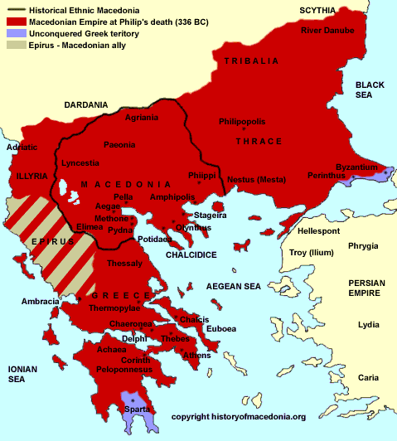
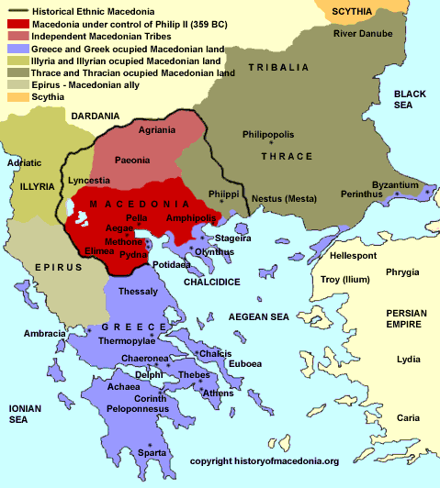
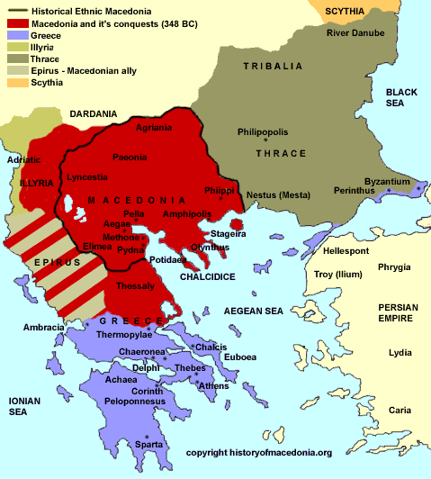

Slide 70
Alexander the Great
The Campaigns of Alexander -
Part II: Thebes

Slide 71
Learning Outcomes:
Read
Arrian and Plutarch’s account of Alexander’s sacking of Thebes
Outline
the main stages of the siege
Discuss
the Alexander’s actions – sacking the city and enslaving its people
Justify
Alexander’s slaughter and enslavement of the Theban people.

Slide 72
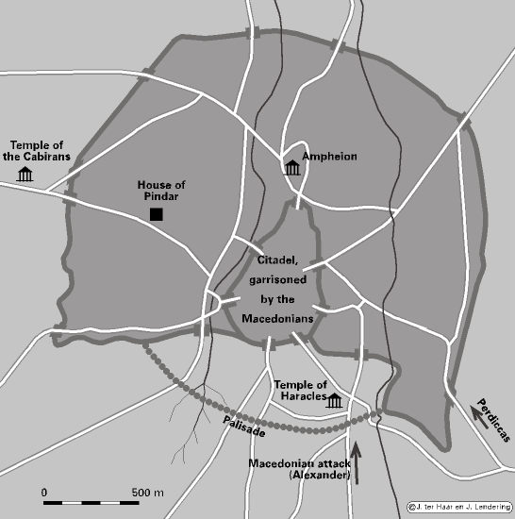

Slide 73
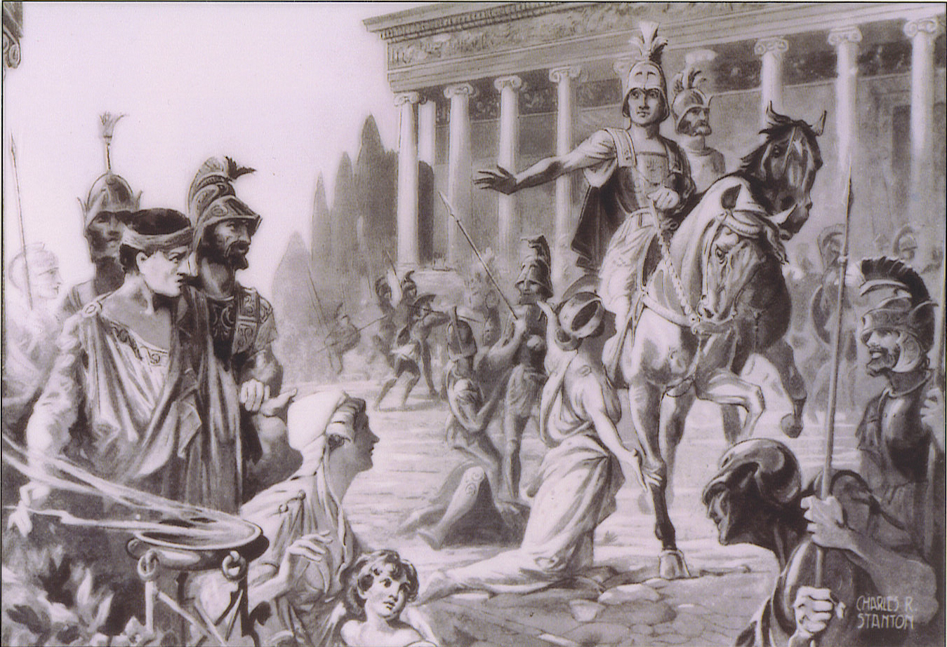
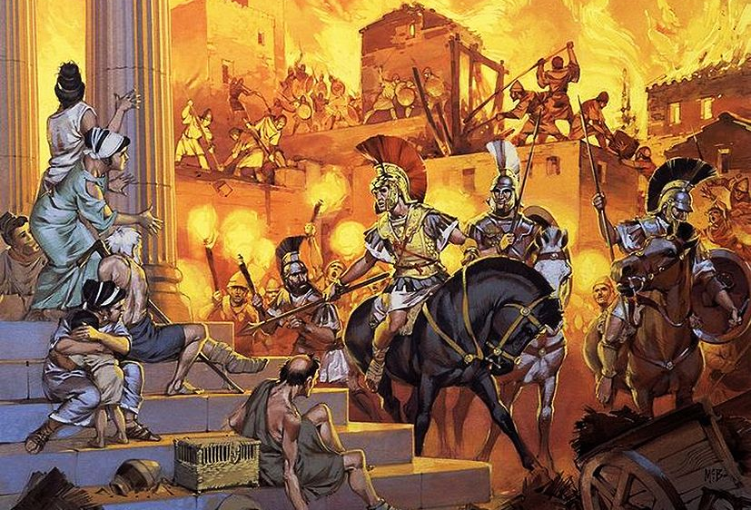
How do Arrian and Plutarch describe the sacking? How do their accounts differ?
How do they excuse Alexander’s sacking of the city?

Slide 74
Alexander the Great
The Campaigns of Alexander -
Part III: The Battle of Granicus

Slide 75
Learning Outcomes:
Read
Arrian and Plutarch’s account of the Battle of Granicus
Sequence
the main stages of the Battle
Discuss
The importance of the Battle
Evaluate
Alexander’s leadership skills/character

Slide 76
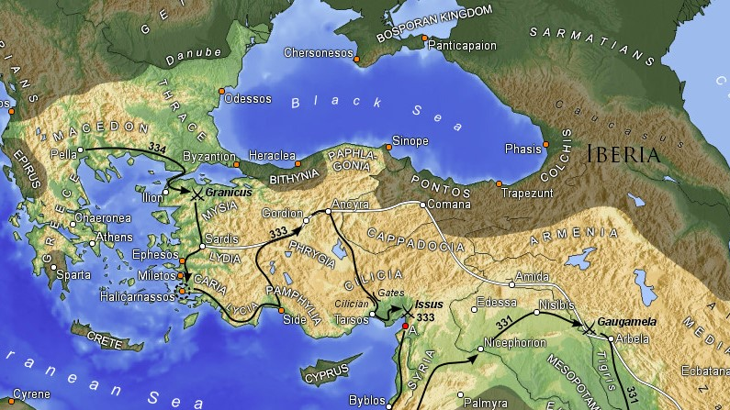

Slide 77
The Background
336 B.C. – Alexander ascension.
335 B.C., Spring – Meets league of Corinth; Campaigns against Thracians and the Getae Tribes.
335 B.C. – Thebes sacked.
334 B.C. – Alexander jounreys across the Hellespont meeting advance force under Parmenion
334 B.C – Alexander leaves 12,000 infantry and 1,500 cavalry with the general Antipater in Macedon.
334 B.C. – Alexander moves to engage the Persian force led by Memnon at Granicus.

Slide 78
The Battle: Numbers
32,000 infantry (including light troops and archers)
5,000 cavalry
20,000 Cavalry
20,000 Mercenary Infantry (mainly Greek Hoplite Infantry

Slide 79
The Battle: the Leaders (characters)
Macedonia/League of Corinth
Alexander
Parmenion
Cleitus the Black
Philotas; Hephaestion; Ptolemy
Persia (see page 75 of Arrian for these names)
Memnon
Mithredates
Spithridates

Slide 80
Can you remember the Soldier types used by Macedonia and Persia?

Slide 81
Macedonia

Slide 82
Sarissa Pikemen. Hoplites.

Slide 83
Cretan Archers Gaurds/Hypaspists

Slide 84
Thessalian Cavalry Companion Cavalry

Slide 85
Persia

Slide 86
Hoplite Mercenaries Persian Immortals (spear and bow)

Slide 89
Parmenion is sent as an advance
guard into Asia Minor.

Slide 90
Antipater is left in Macedonia with 12,000 infantry and 1,500 cavalry.

Slide 91
Alexander crosses the Hellespont into Asia Minor with 30,000 infantry and 5,000 cavalry.

Slide 92
Alexander visits Troy:
exchanges his armour for that supposedly
left there from the Trojan war;
sacrifices to Priam (father of Hector
and Paris);
Hephaestion and Alexander
lay wreaths on Patroclus’
and Achilles’ tombs.

Slide 93
Memnon arrives at the River Granicus
with 20,000 infantry and 20,000 cavalry.

Slide 94
In spring 334 B.C.,
Alexander arrives at the River Granicus.

Slide 95
Parmenion suggests crossing the river upstream and attacking the following day.

Slide 96
Alexander decides to attack immediately.

Slide 97
Parmenion is given the command of the Macedonian left wing. While Alexander takes command of the Right.

Slide 98
An advance force of light and heavy infantry is ordered by Alexander to advance from the Macedonian left flank, under the command of Amynates; supported by a cavalry squadron under Ptolemy.

Slide 99
Alexander leads the Companion cavalry across the river in order to attack the Persian cavalry head on as they move to fight the forces led by Amynates and Ptolemy.

Slide 100
The Persian cavalry move
to counter Alexander’s Companions.

Slide 101
Alexander and his Companions do fierce battle with the Persian cavalry “with infantry tactics” (little movement), killing many of their leaders in the process.

Slide 102
Alexander is almost killed
but saved by Cleitus the Black.

Slide 103
The Macedonians pursue the retreating Persian Cavalry.

Slide 104
The central Macedonian Phalanx crosses the river
in order to attack.

Slide 105
The rest of the Macedonian army now advances in the wake of the defeated Persian cavalry, and confronts the Mercenary Greek infantry.

Slide 106
The Persian cavalry is overcome
and eventually retreat from the battlefield
– losing 1,000 to the Macedonians.

Slide 107
The Greek Mercenaries are
slaughtered and defeated.

Slide 108
Alexander orders the enslavement of all Greek Mercenaries captured – 2,000 prisoners in all.

Slide 110
The Aftermath
Casulties (see Arrian, pg 74/75):
Macedonia/Greece: 300-400 killed.
Persians Killed: Cavalry: 1,000; Infantry: 3,000 infantry.
Persian Captured: infantry: 2,000.
Initial Persian resistance is overcome.
Memnon – the Mercenary leader – flees South.
Alexander executes and enslaves Greek Mercenaries fighting for Persia (see Arrian pg 75)
Alexander sends 300 full suits of Persian armour back to Athens as an offering to Athena.

Slide 111
Alexander the Great
The Campaigns of Alexander -
Part IV: The Coastal Campaign

Slide 112
Learning Outcomes:
Summarise
Alexander’s campaign down the coast of Asia Minor – including the siege of Miletus and Halicarnassus
Identify
the danger’s of the Persian navy
Speculate
ways of tackling a navy without fighting a naval battle
Evaluate
The success of Alexander’s Coastal Campaign

Slide 113
Alexander Moves South

Slide 114
Alexander was faced with strongly fortified ports at Halicarnassus and Miletus…

Slide 115
Without using a Navy how could you nullify the enemy fleet?

Slide 116
Key names - facts
Parmenion sent west to secure coast.
Alexander marching south – takes Miletus after heavy fighting.
Alexander sends Greek/Macedonian fleet home: he plans to defeat the Persians by taking the coastal towns.
Memnon gathers a force at Halicarnassus.
Alexander goes to meet him – Alexander needs to take this port in order to achieve his goal.

Slide 117
Alexander the Great
The Campaigns of Alexander -
Part V: The Battle of Issus

Slide 118
Learning Outcomes:
Read
Arrian and Plutarch’s account of the Battle of Issus
Outline
the events leading up to the Battle
Analysis
the layout of Darius and Alexander’s armies
Evaluate/Speculate
who will win the battle

Slide 120
Lead-Up
Alexander is in Tarsus, Cicilia and sick. Darius is in Assyria on an open plain waiting Alexander’s approach.
The delay of Alexander leads some in Darius court to worry about the moral of soldiers and wisdom of remaining static for too long. An exiled Macedonian, Amyntas advises waiting for Alexander who he says “will come wherever Darius is. Darius listens to the former.
Alexander eventually moves south hugging the Mediterranean coast, while Darius moves north further inland, along the mountains. They likely pass each other in the mountains without noticing one another.
Darius comes to Issus, where the Macedonian sick/injured lie. Alexander sends some Guards by ship back North to investigate where Darius’ army is.
Alexander and Darius learn of the other’s location (Darius from the sick; Alexander from his Guard/scouts). Now Alexander turn around, back North along the coast. Darius moves south along the coast. They meet at the Pinarus River. Between the narrow pass of the Mountains and the Sea.

Slide 121
The Battle Stages
Darius sets up his Greek Infantry in the Centre (surrounding himself) and his weaker Persian Infantry on the flanks, with archers placed in front of the infantry.
Darius puts ALL of the cavalry onto his right flank by the flat coast.
A small contingent of Cavalry and Infantry is placed in the hills behind Alexander’s line.
Alexander advances: his Macedonian phalanx in the centre; his Companion cavalry – under his command on his left; and his Thessalian/Allied cavalry facing the Persian cavalry by the coast.

Slide 126
The Aftermath of Issus
Read Arrian and Plutarch’s accounts of Alexander’s conduct after the Battle of Issus…
How does he act?
Is there any evidence of his acting nobly?
What motives do you think he had for his actions?

Slide 127
Essay Question
In 333 BC at the river Issus, the armies of Alexander and Darius met for the first time.
(a) Describe the course of the battle. (35)
(b) What do you learn about Alexander from his conduct during and after the battle? (15)

Slide 128
Alexander the Great
The Campaigns of Alexander -
Part VI: The Siege of Tyre

Slide 129
Learning Outcomes:
Read
Arrian and Plutarch’s account of the Siege of Tyre
Outline
the events of the Siege
Analysis
the problems/obstacles Alexander and Tyrians faced in the Siege
Evaluate
Alexander’s conduct as a leader and strategiest/Sieger
Connect/compare
the defensive and offensive strategies and technologies of ancient warfare to a modern context

Slide 130
After Issus…

Slide 131
Siege Warfare: Bank Analogy
What can be used to protect/defend a bank? List at least 5 examples
How would you overcome these obstacles to rob a bank? What could you use? List at least 5 examples

Slide 132
Siege Warfare: Ancient Defence Sytems
How did the Ancients defend their cities? List at least 5 examples.
How could they overcome these obstacles to besiege a city? List at least 5 examples

Slide 134
Can you think of any solutions to the problem faced by Alexander? How to besiege a city on an island without a navy available?

Slide 137
Tyre Stage 1: Read Arrian for an account of the following events during the siege of Tyre
Builds a Mole
Protects the Mole with Two Towers; Hides and Skins Protect the Two Towers from Flames.
Cattleboat/Horse-Transport ship rigged by Tyrians to enflame Towers and Mole
Tyrian Success: Boat crashes into Mole, Towers Burn, Tyrian ships come close to stop soldiers dowsing the flames

Slide 139
Step 2: Read Arrian for an account of Alexander’s solution to his initial setback
Wider mole with more Towers
Alexander is “Relentless, Implacable”
Acquisition of a fleet. Cyprus + Phoenecia. Consider that the kings of the cities are with the fleets and their cities have been occupied by Alexander. It is a no brainer to come over to Alex’s side.
Reinforcements from Greece (4000)

Slide 140
Alexander’s Navy

Slide 142
Step 3: The effect of the new fleet on the progress of the siege
Surprisingly Large Fleet, Tyrians decide not to Battle in open water
Blockade of Harbours by Tyrians: Ships with bows out, line across the harbour entrance
Blockade of Town (Alexander): Cypriots and Sidonians are slip between North and South Harbours respectively.
Artillery Ships: brought close to the walls to bombard
Tyrians build wooden towers on walls and hurl Large sunken stones blocks beneath the sea to hinder Macedonian advance
Macedonians – protected by new fleet – pull stones from the sea, attaching chains to their anchors instead stopping Tyrian divers cutting them

Slide 143
Seige Weapons

Slide 144
Step 4: Read Arrian’s account of the Tyrian’s last resistence
Last efforts of the Tyrians; a surprise attack on the Cypriot contingent (North) as Alex is away resting.
Tyrian Fleet initially successful.
Alexander quickly returns to his quinquereme and taking 5 triremes ventured North to help the Cypriots.
Alex locates a weak spot in the walls to the south facing Egypt.
Shouts from soldiers on the Tyrian walls let their fleet know of Alex advance; but some didn’t turn back quick enough. A quinquereme and quadrireme were captured. Other ships were disabled.

Slide 146
Step 5: Read Arrian's account of the end of the siege
Alex bring gangways after his siege engine bombard the weak spot.
The Guards manned one ship Admetus. Alex himself commanding the Guards makes first breach cross the gangway and assails the breach.
In the meantime, other ships are sent to attack the two harbours simultaneously. Other ships with missiles and siege engines are ready to bombard other parts of the wall.
Admetus and Alex cross. The former is first to set foot on the wall. They captured the walls and Alex made his way along them to the royal quarters.
Both fleets successfully broke into the harbours.
Tyrians gathered at the shrine of Agenor. Alex with the Guards advanced on them and killed them were they stood.
A great slaughter ensues – the Macedonians are frustrated by the length of the siege and (apparently) the Tyrians had earlier captured some of their men, killed them, and thrown their bodies into the sea.

Slide 147
Aftermath
Losses of 8,000; 30,000 sold into slavery; Admetus also dies in the assault.
King Azemilcus and some Carthaginians who had come to the city to visit the “mother-city” fled to the Temple of Heracles. They were pardoned.
Alexander sacrificed to Herakles and held a military parade; the fleet also held a review in honour of Herakles and held athlethic events and a torch-race to the temple precinct.
Alexander offered the first siege engine to break the walls and the sacred Tyrian ship of Heracles at the temple.

Slide 148
Alexander as a Besieger
Based on the events of the Siege of Tyre and Alexander’s actions discuss the following:
What problems did Alexander face?
What were Alexander’s solutions?
How effective were these solutions?
What does this say about Alexander’s abilities as a general?

Slide 149
Homework:
“If Alexander deserves fame as a general, then it is above all in his capacity as a besieger, and of all his sieges, Tyre was his masterpiece.”
(Paul Cartledge) From your reading of Arrian, do you agree with this statement? Give reasons for your answer.
(50)

Slide 150
Alexander the Great
His Personality: Political and Personal

Slide 151
What adjectives could be used to describe Alexander the Great?
Intelligent
Inspirational
Brave
Courageous
Ruthless
Ambitious
Reckless
Generous
Tactical
Impulsive
Foolish
Narcissistic
Egotistical
Alcoholic
Kind
Gentle
Noble
Tyrannical
Political
Pious
Violent
Aggressive
Passionate
Lustful
Abstinent
Stoic
Prudish
Clever
Megalomaniac
Self-Righteous
Confident
Determined
Brutal
Fanatical
Haughty
Humble
Thoughtful
Etc….

Slide 152
Alexander Cannot be all these things…
… so why is he described in these conflicting ways?
Public Image: Alexander built a public image for himself while alive. This image could vary depending on to which public he was presenting himself.
Legacy: Alexander’s legacy was used by his Generals after his death to justify his greatness – and by extension their own.
History: There are also conflicting historical accounts – the sources used by Plutarch and Arrian for their accounts of Alexander disagreed upon what kind of man he was.

Slide 153
Use a Venn Diagram to consider and categorise Alexander’s traits under personal and public

Slide 154
Alexander the Great
The Campaigns of Alexander -
Part VII: Alexander in Egypt

Slide 156
After Tyre…

Slide 157
The founding of Alexandria

Slide 158
Founding of Alexander
Do you believe in destiny?
What mysticism surrounds the founding of Alexander?
Do you find their versions of events believable?
Whose account – Arrian or Plutarch’s – is the more believable? Give reasons for your answer.

Slide 160
The Oracle at Siwah… Alexander the God!
Read Plutarch and Arrians account of Alexander’s visit to the oracle at Siwah…
Is it believable?
Do you think the Oracle really addressed him as the son of Zeus?

Slide 161
Politics…
What does Alexander’s visit to Egypt, his founding of Alexandria, and his visit to Siwah tell us about Alexander’s political aims?

Slide 162
Can you be justified in claiming yourself a God or the son of a God?

Slide 164
Alexander the Great
The Campaigns of Alexander -
Part VII: The Battle of Gaugamela

Slide 165
Gaugamela: the Evidence
Read Arrian’s account of the Battle.
While reading keep these points in mind…
What are the main stages of the Battle?
How does Darius Form his army?
What are Darius’ advantages?
How does Parmenio suggest overcoming them?
How does Alexander actually achieve his famous victory?
Is his strategy typical of Macedonian custom? How does it differ?

Slide 168
Alexander the Great
The Campaigns of Alexander -
Part VIII: After Gaugamela

Slide 170
Babylon

Slide 171
Can you think of other sackings from history or the present day?
https://youtu.be/rkb3y6K3waU

Slide 172
What do the sources say?
What was Alexander’s Motives for the sacking of Persepolis according to Plutarch and Arrian?
What is different about their accounts?
Do you believe their reasoning?
Which account do you find more believable?
What does their accounts say about Alexander’s character?

Slide 173
Death of Darius
Darius fled after the battle of Gaugamela hoping to raise support in the eastern provinces of the empire – such as Bactria and Hyrcania
The Satrap (Governor of Bactria) of Bactria, Bessus, betrayed Darius and killed him
Read Arrian and Plutarch to see Alexander’s reaction
Why do you think Alexander react in this way?

Slide 174
Alexander the Great
Plot, Murders, and Mutiny - Orientalism

Slide 175
Orientalism
After Alexander defeated Darius and the Persians at Gaugamela in 331 B.C. the first phase of his campaign had come to an end – he had conquered the Persian army. Now he faced the task of incorporating the Persians into his new empire. To do this he adopted a policy of integration: blending Greek and Eastern customs. This is called Orientalism.
Reading the texts from Arrian and Plutarch – note their reaction and opinion on this policy.

Slide 177
Plots and dissent against Alexander
The result of Alexander’s policies of Orientalism led to several key plots, murders, and mutinies against Alexander.
We will read some extracts from Arrian and Plutarch exploring these.
Philotas
Cleitus the Black
Callisthenes
Mutiny at Opis

Slide 178
Conspiracy: Philotas
While we read Arrian and Plutarchs account of the conspiracy of Philotas ask yourself these questions.
Who was Philotas?
How was he involved in the conspiracy on Alexander’s Life?
What are the main reasons for Alexander’s actions against him? What were Alexander’s motives?
Do you believe Alexander was justified in his actions – should Parmenion have been killed?

Slide 179
Bessus
While we reading the account of the execution of Bessus ask yourself these questions.
Why was the execution of Bessus so important to Alexander?
What does Alexander’s reaction to Darius death show about his character?
Are Alexander’s brutal punishments of Alexander justified? To they show a change in character or policy.

Slide 180
Cleitus the Black
While we read Arrian and Plutarchs account of the murder of Cleitus the Black ask yourself these questions.
Who was Cleitus the Black?
Why did he argue with Alexander
What was Alexander’s actions in response?
Do you believe Alexander was justified in his actions?
How do Arrian and Plutarch excuse Alexander?

Slide 181
Callisthenes
Callisthenes was the official historian of Alexander’s conquests.
He was the grandnephew of Aristotle. Aristotle viewed foreigners suspiciously and would have opposed Alexander’s Oriental policies.
Callisthenes openly rejected Alexander’s Orientalism policies too.
He was then associated – as a sort of mentor - with some Macedonian youths who plotted against Alexander.
Therefore, Callisthenes was implicated in the plot and executed.

Slide 182
Mutiny at Opis
While we read Arrian and Plutarchs account of the Mutiny of Opis ask yourself these questions.
When did the mutiny occur?
Why did the mutiny occur?
What was Alexander’s reaction?
How did he deal with the plot?
What does this tell us about the ordinary soldiers attitude to Alexander and his Oriental policies?

Slide 183
Sample Questions in the Exam – and how to answer them.

Slide 184
Sample Questions in the Exam – and how to answer them.

Slide 185
Alexander the Great
The Campaigns of Alexander -
Part X: The Siege of Aoronos Rock

Slide 189
What do the sources say?
Read Arrian’s account of the Siege of Aoronos Rock and identify the following:
The Key Stages of the Siege.
The Main Obstacles facing Alexander.
The means by which Alexander overcame these obstacles.

Slide 190
Is this Alexander’s Greatest Achievement in Siege Warfare?

Slide 191
Hydaspes
Alexander

Slide 197
Alexander the Great
Reckless and Brave:
Alexander Turns Home

Slide 198
Two (4) Words that can describe Alexander:
Brave/courageous
Reckless/ambitous

Slide 199
Why did Alexander want to conquer the world?

Slide 200
Alexander Goes Home
Two obstacles faced Alexander after the victory at Hydaspes.
Another River Crossing – the river Hyphasis.
More Indian Kingdoms with elephants and disciplined armies.
Would you have followed Alexander through all that?

Slide 201
Alexander at the Mallian Fort
After turning home – by the insistence of his men. Alexander fought against more Indian tribes as he marched south along the Indus River.
At a fort of Mallians, Alexander got himself into trouble, was in isolated, injured, and almost died.
A sign of his reckless nature… but this recklessness also cost more than his own health, soon it would cost many other’s their lives.

Slide 202
Crossing the Gedrosian Desert.
In order to get back to the centre of his empire at Babylon, rather than crossing around the Gedrosian Desert – in southern Afghanistan and Iran – Alexander decided he would cross the desert.
This caused his army more losses than any other battle prior.
And his reasons for doing it seem reckless, selfish, and foolish.
It is perhaps a sign that Alexander was not always Great.

Slide 203
Past Papers

Slide 204
Death of Alexander
How did he die?
What was significant about his Death?

Slide 205
Alexander’s Death
The importance surrounding Alexander’s death is the fact that he died abruptly and so young.
He son Alexander IV by Roxanne was only an infant at his death and many of his commanders – Ptolemy, Perdiccas, Antipater, Seleceus, and Antigonus would vie for the rule of his kingdom upon his death. They would eventually found what is called The Successor Kingdoms.
Alexander’s Empire would not last. His heirs would not inherit his throne for long…
Because of this many throughout the centuries speculated that perhaps Alexander had been poisoned.

Slide 206
Reading Arrian and Plutarch’s account
While reading Arrian and Plutarch’s account consider the following:
How do they account for his death?
What were the circumstance that led up to Alexander’s death?
How do their accounts differ?
Do you believe their accounts?

Slide 207
Legacy of Alexander
What do the sources say about Alexander’s legacy?
Having finished your own study of Alexander, do you agree with their opinion of Alexander?

