Slide 1
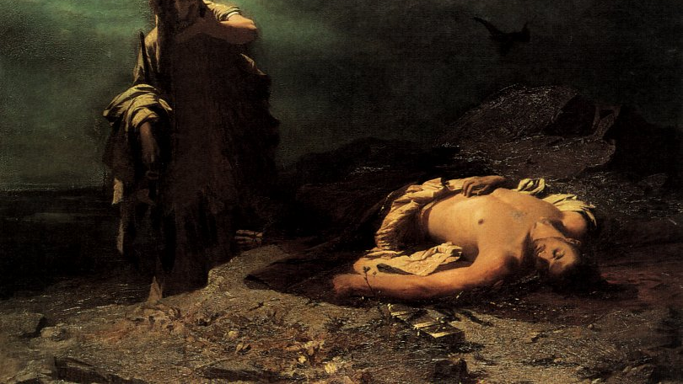
Antigone
Ancient Greek Drama

Slide 2
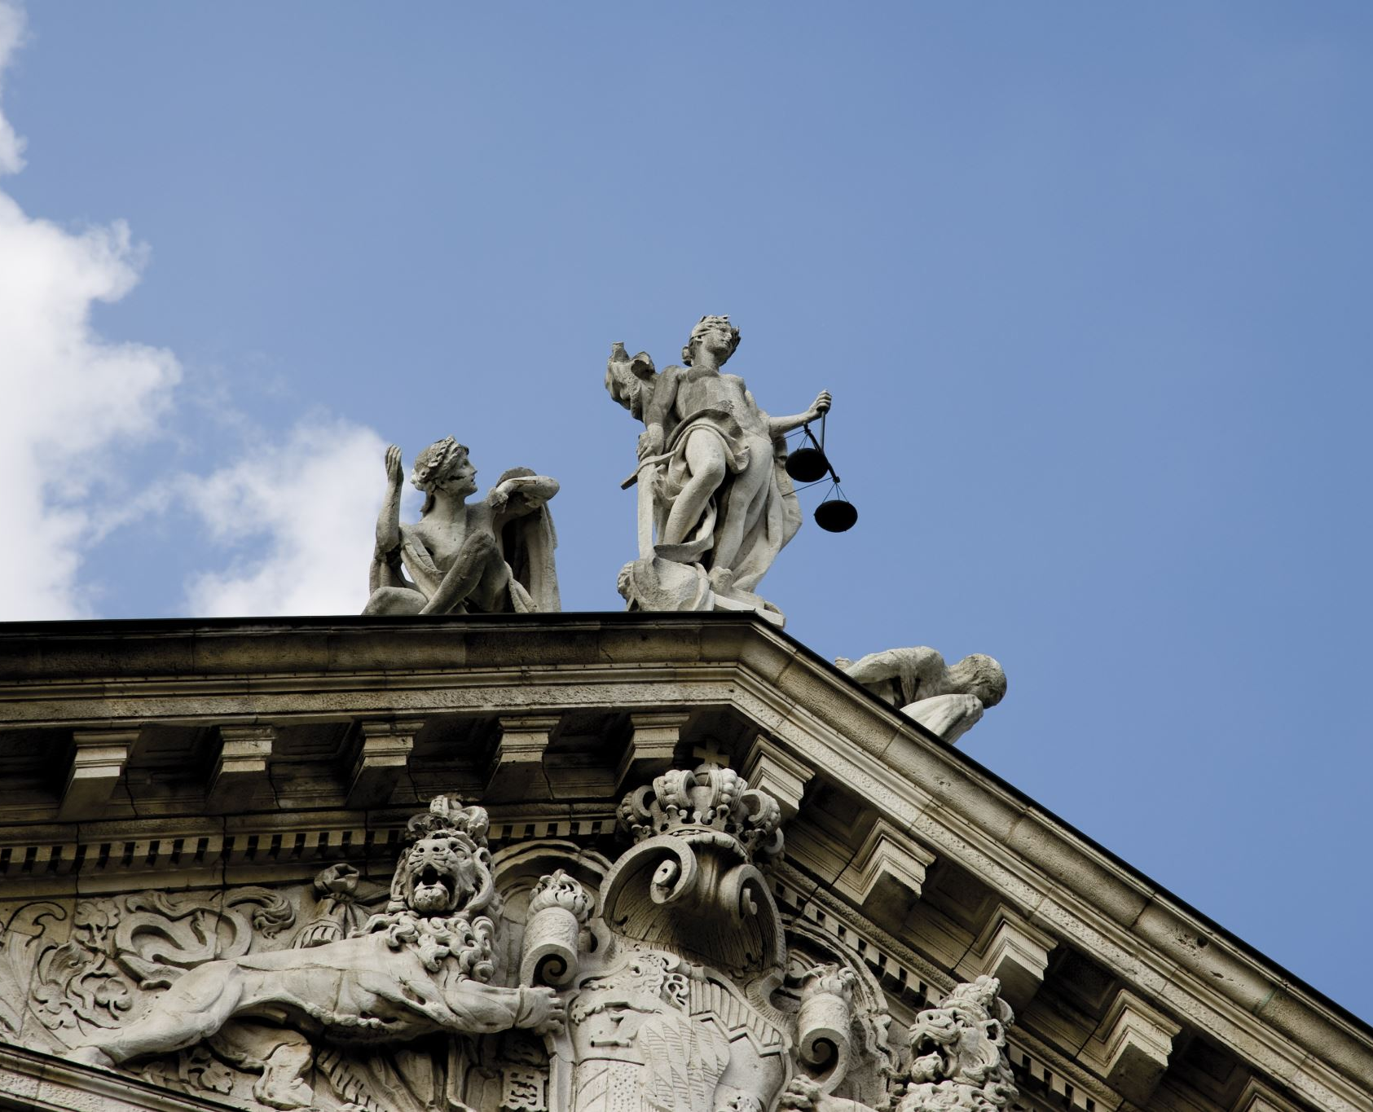
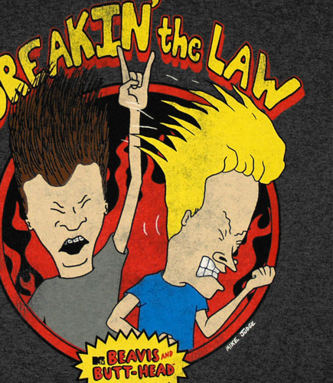
Question
Would you ever break the law? What would it take for you to break the law?
Is there any circumstance were you can be justified in breaking the law?

Slide 3
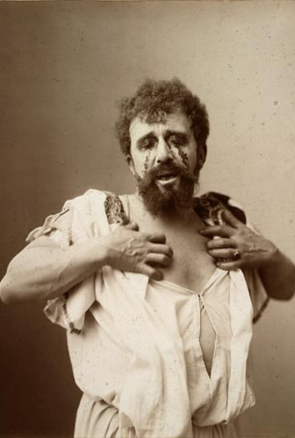
Antigone: Backstory
The story of Antigone is a sequel to two Myths: Oedipus and the 7 Against Thebes.
Oedipus is the story of a baby abandoned at birth, raised by foster parents, told by prophecy that he would kill his father and marry his mother. So, he flees his home, only to meet his father at a crossroad and kill him in an argument, save his “home” town of Thebes from the Sphinx and be rewarded with a marriage to the queen (unknown to all, his actual mother!).
You can guess what he, his wife, and their 4 children felt when they found out!

Slide 4
7 Against Thebes
Once Oedipus is found to be the (unknowing) murderer of his father and the husband of his mother, Jocasta (his wife/mother) kills herself, and Oedipus blinds himself. H
His throne is taken to him and given in trust to his uncle (brother-in-law) Creon.
Soon Oedipus is exiled accompanied only by his daughter Antigone.
When his two sons, Polynices and Eteocles, grow to manhood they decide to rotate the command of the city. But, soon this doesn’t work. Eteocles refuses to give the throne; Polynices flees to Argos, marries the princess and returns with 6 heroes to attack Thebes.
Oedipus in the meantime dies in exile (in Athens) and his daughter, Antigone, returns to the city.
In the attack of the 7 heroes on Thebes, both Polynices and Eteocles kill each other simultaneously.

Slide 5
Tragedy
As you can see Greek stories make Soap Operas seem tame.
This is because the Greeks were fascinated by big concepts and heroes with tragic flaws or (in the Greek) harmatia.
All Greek tragic heroes have some flaw which leads to their downfall.
Can you think of any heroes from your favourite stories who had a tragic flaw leading to their downfall? What was their flaw?
Why we enjoy these types of stories is unclear. But, the Greek philosopher Aristotle believed it was something he called catharsis. This means: the release of emotion. In a sense, we feel what the hero feels and release our own feelings.
Ted-Ed: Tragic Hero

Slide 6
Main Characters
Antigone – Daughter of Oedipus.
Ismene – her sister.
Creon – King of Thebes, Uncle to Antigone.
Polynices – Antigone’s brother, who is left unburied.
Eteocles – Antigone’s brother, who was buried.
Haemon – Creon’s son and Antigone’s fiancée.
Tiresias – a blind seer/oracle.
Eurydice – Creon’s wife
Soldier
Messenger

Slide 7
Major Themes
The best way to analyse this play is by looking at the central conflicts.
Greek loved conflicting views – the more opposite each other, the better.
Female vs Male
Individual vs the State
Old vs Young
Divine Law vs Man’s Law

Slide 8
Other themes
Death
Incest
Justice
Power

