Slide 1
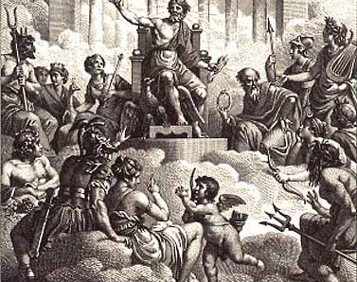
The Gods
Greek and Roman

Slide 2
Primordial Gods
Chaos to Uranos

Slide 3
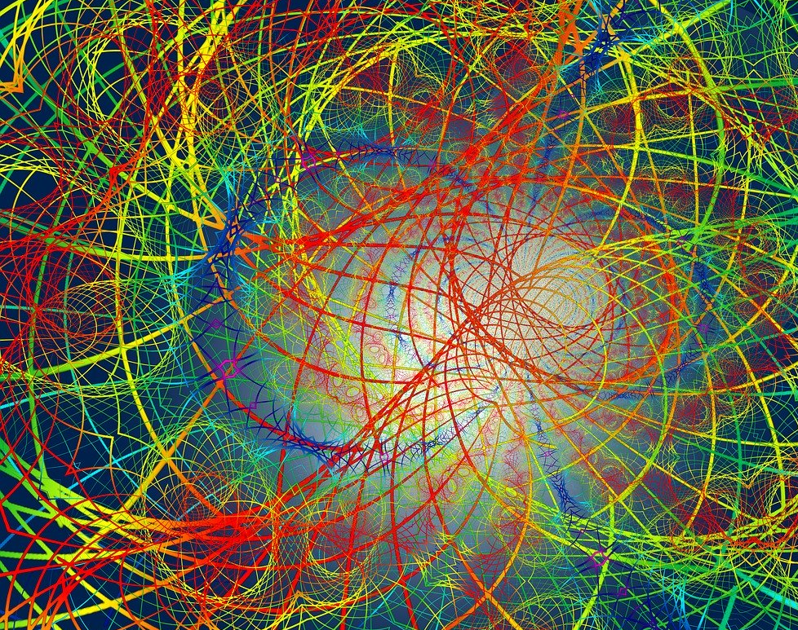
The Beginning…
Greek Mythology – from Hesiod to Ovid – tells us that the beginning of everything was Chaos.
From Chaos, the primordial gods come forth: Gaia or Earth, Tartarus or Hell, and Erebus or darkness, Nyx or Night – and in some accounts, even before all these came Eros or Love.

Slide 4
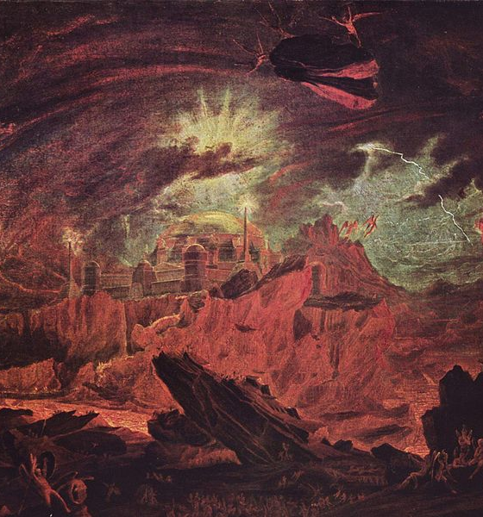
Primordial Beings
You will notice that the gods Gaia, Tartarus, Nyx, and Erebus are spoken about as “beings” or gods and as places or forces of nature.
This is because all gods represent forces of nature in the kosmos/universe.
But with early gods, this is especially more pronounced. This is why they are called the primordial (first order) gods. As they are the primary elements of the kosmos.

Slide 5
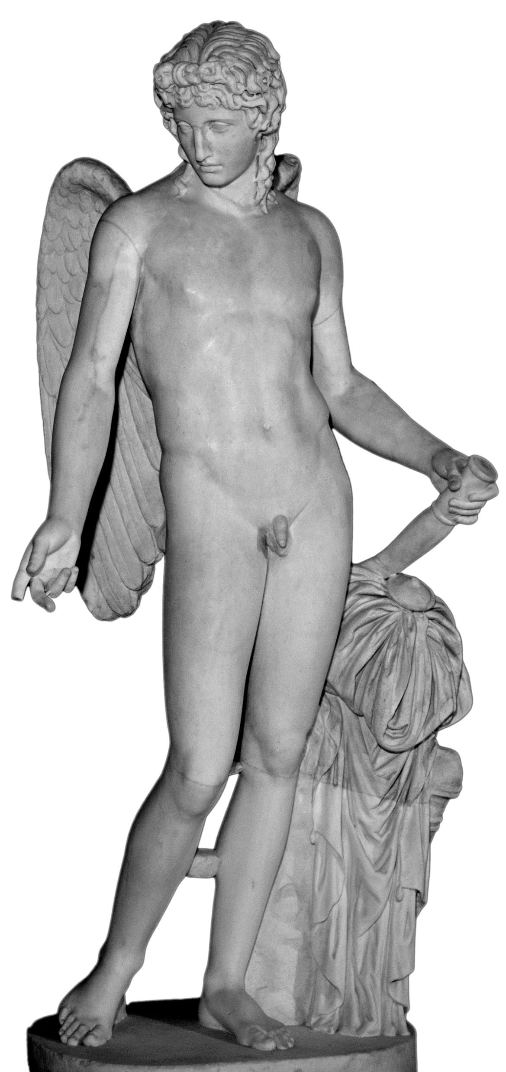
The Anomaly of Eros/Cupid
The God of Love, Eros or Cupid to the Romans, is one of those gods whose origins differ depending on who is telling the story.
To Hesiod, Eros was one of the primordial gods like Gaia and Chaos. This makes sense, since Love can be said to be a force over all mortal and immortal beings.
Eros is often depicted in Greek and Roman mythology as a god with powers over all the immortals – even the king of the gods, Zeus!
But, in other versions of Greek and Roman mythology, Eros/Cupid is the son the goddess of Love Aphrodite or Venus to the Romans – and a grandson of Zeus or Jupiter to the Romans.

Slide 6
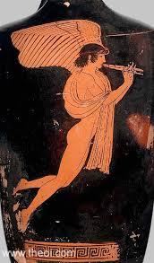
Stimulus Question
Study the image in this slide:
Describe the sculpture and vase painting.
By what common motifs might we identify Cupid/Eros?

Slide 7
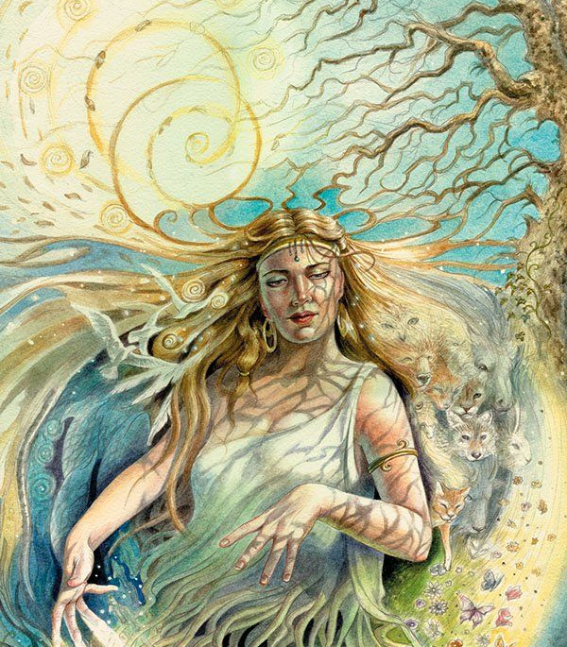
Gaia/Terra
Gaia is the first mother goddess. Her Roman equivalent is Terra.
She is the earth and also an anthropomorphic (human shaped) goddess who represents the earth/even walks the earth.
Confusing yes. But, she is a goddess so they follow different rules – why not have several different forms.
Gaia as a mother goddess – of course – has a lot of children; and has a lot of children with those children.
She would give birth to Uranos or the Heavens/Sky with whom she would marry and have lots of children.

Slide 8
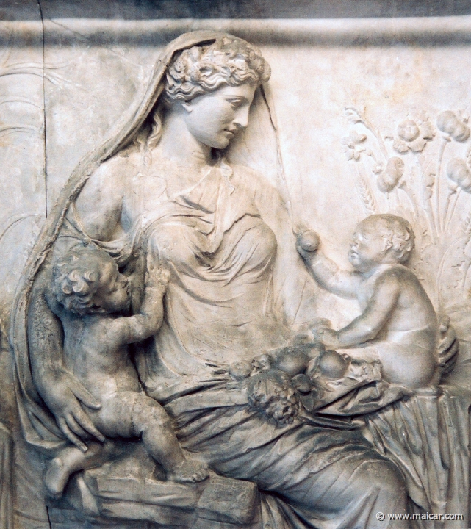
Stimulus Questions
Study the image in this slide:
Describe this sculpture.
What themes are expressed in this sculpture?
How might we know this is Gaia/Terra?

Slide 9
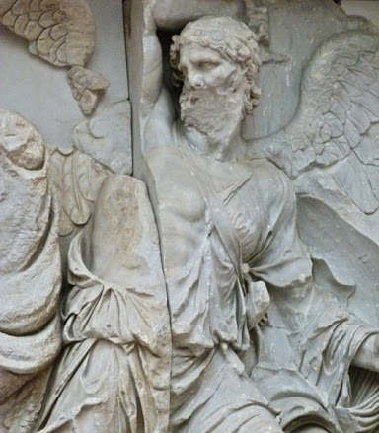
Uranos/Caelus
Uranos represents the Heavens or Sky. His Roman equivalent is Caelus.
He would be the first King of the Gods.
His children by Gaia include: The Cyclopes, the Hecatoncheires (or 100 armed), the Meliae (Nymphs), The Giants, and the Titans - and in some versions, Aphrodite the goddess of Love.
During his reign, he would lock up the cyclopes and the Hecatoncheires and other children of Gaia in Tartarus as he feared and hated them.

Slide 10
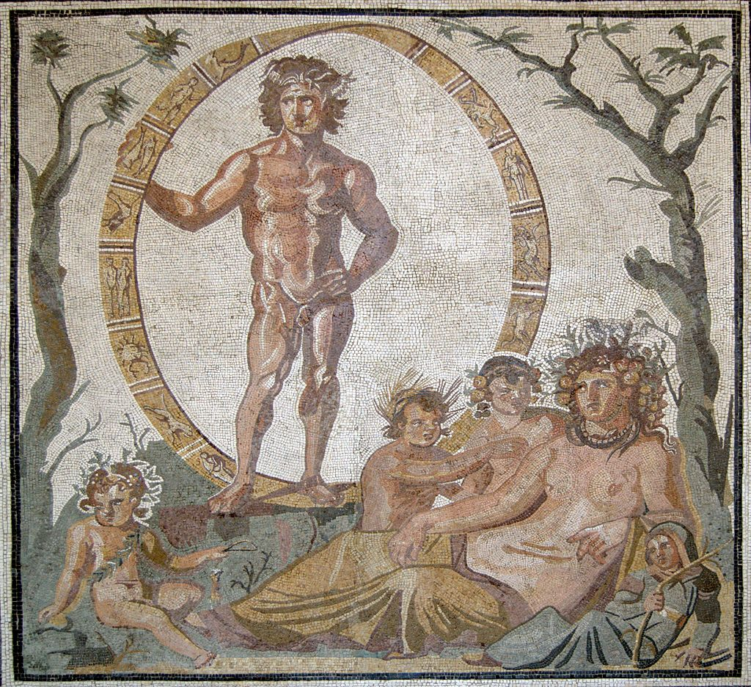
Stimulus Question
Study the image in this slide:
Describe this Mosaic
Who are the figures in the picture?
How might you tell which figure is Uranos/Caelus and which Gaia/Terra?

Slide 11
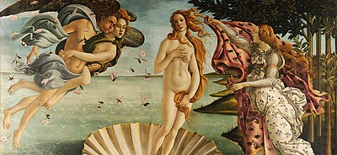
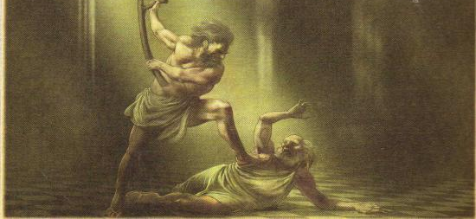
Downfall of Uranos
As you might imagine, Uranos’ locking Gaia’s children away didn’t sit well with Gaia.
She conspired with her Titan children – who were the only one’s free – to dethrone Uranos and free her other children.
Cronos – her youngest son – would be the primary conspirator.
He was given a adamantine sickle – usually associated with harvest to attack Uranos.
They waited till night fall, when Uranos would descend from the heavens and lay with his wife, Gaia. Cronos attached his father and castrated him with the sickles – cut off his genitals.
Uranos was dethroned. In some versions, the blood from his wound fell on the Earth/Gaia to give birth to the Giants and the Furies; and in others his genitals were tossed into the sea, where is semen would produce the lovely Aphrodite.

Slide 12
The Titans
Reign of Cronos and the Golden Age

Slide 13
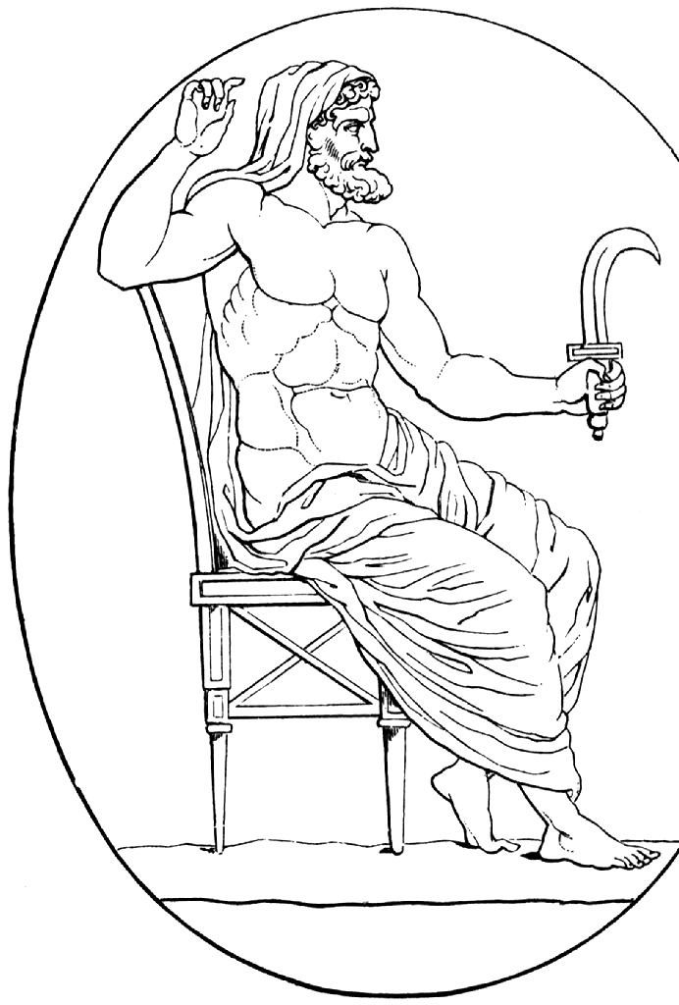
Cronos/Saturn
Cronos was the youngest son of Gaia and Uranos. His Roman equivalent was Saturn.
He is often associated with good harvest – particularly in Roman religion.
During his reign, humans lived in the Golden Age in tune with nature – no poverty, hunger, war, disease, and death.
However – like his father – he locked Gaia’s children up in Tartarus once more.
What identifying feature is there for Cronos?

Slide 14
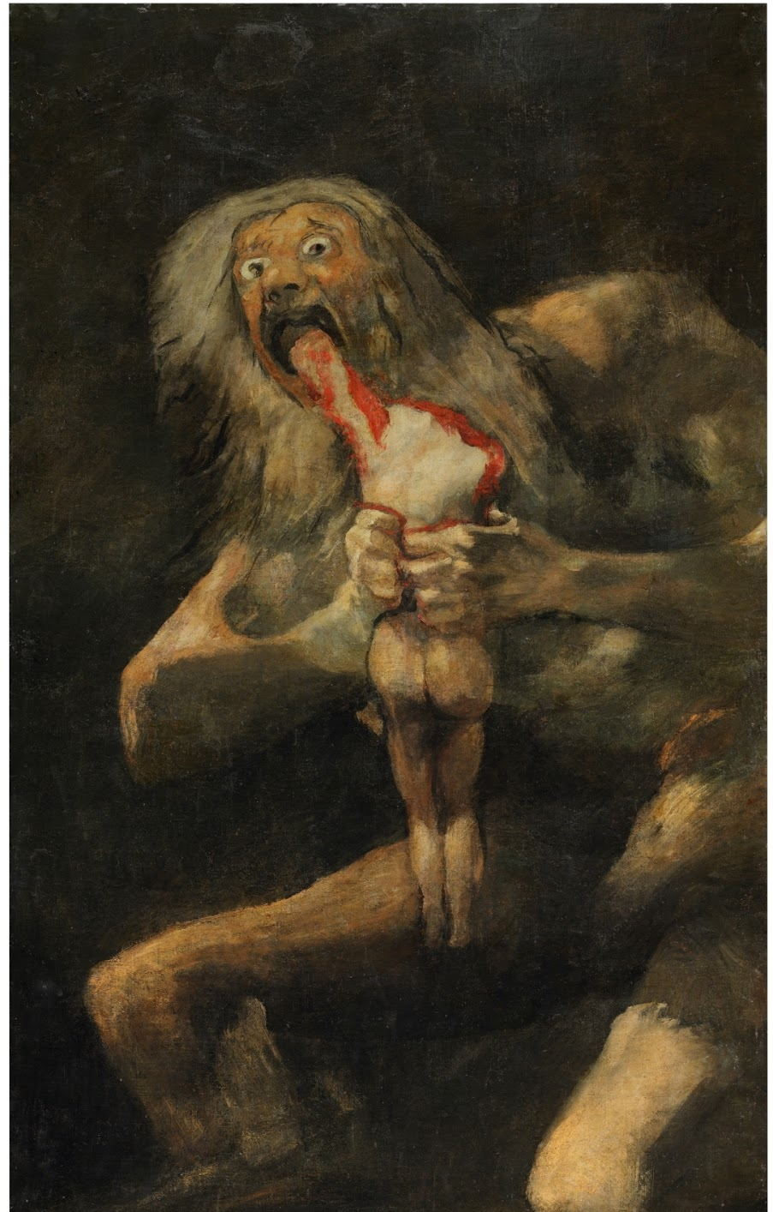
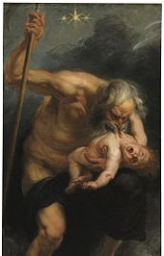
Cronos’ Children
He married his siter Rhea – or Opis in Roman mythology – and had 6 children – Hestia, Demeter, Hera, Hades, Poseidon, and Zeus.
Both Gaia and Uranos had warned Cronos that one of his children would be more powerful than him and overthrow him.
So, Cronos ate 5 of the six children to prevent them overthrowing him.

Slide 15
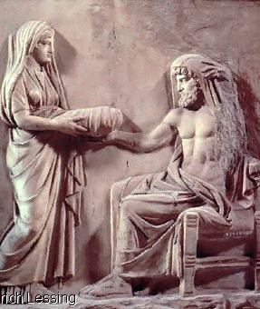
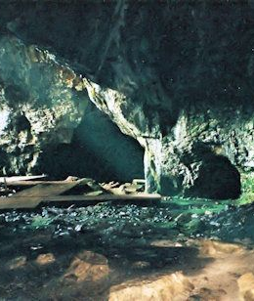
Zeus’ Upbringing
Rhea was horrified at Cronos’ actions. While pregnant with the last child, Zeus, she retreated to Crete and the cave of Dicte to give birth.
Zeus was raised by the nymphs Adrastia and Ida to raise. And the protection of the Curetes. Zeus was fed on the milk of the goat Amalthea.
In the meantime, Rhea gave Cronos a stone swaddled in cloth to eat.

Slide 16
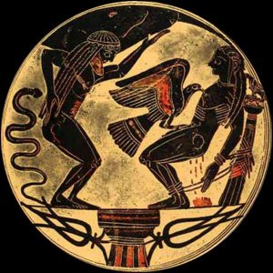
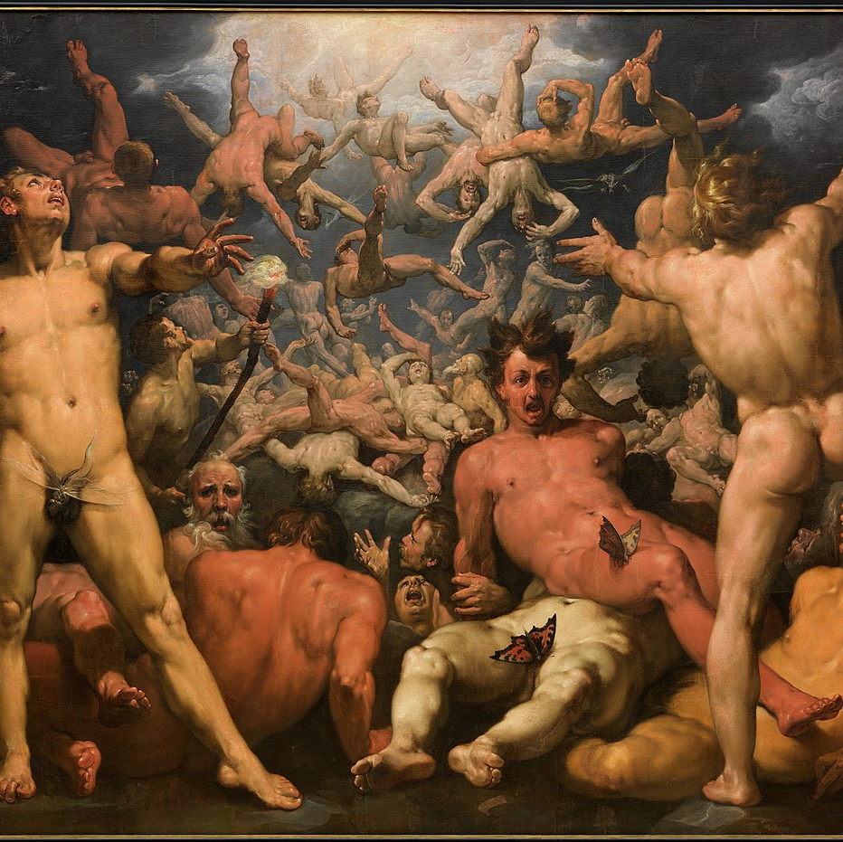
The Titanomachy
When Zeus was raised to adulthood he return to Cronos with a poison given him by Metis. He gave the drink to Cronos who drank it and then hurled up Zeus’ siblings – Poseidon first, then Hades, then Hera, Demeter, and Hestia.
They launched a war against their father and the ruling gods; 10 year war between Cronos’ children – now called the Olympians – and the Titans. (Some Titans like Prometheus, Epimetheus, Rhea, Gaia, and the other female goddesses, sided with Zeus and his siblings).
Zeus – on the advice of Gaia – freed Gaia’s children from the Tartarus. They would help Zeus overthrow the Titans.
The Cyclopes gave Zeus a lightning bolt, Poseidon a Trident, and Hades a Helmet.
Atlas, son Iapetus and Asia, would lead the Titans in the War. But, ultimately they would be defeated and those Titans who had fought against Zeus and the Olympians were locked up in Tartarus.
Atlas was forced to hold Gaia and Uranos apart forever – preventing them conceiving new children.

Slide 17
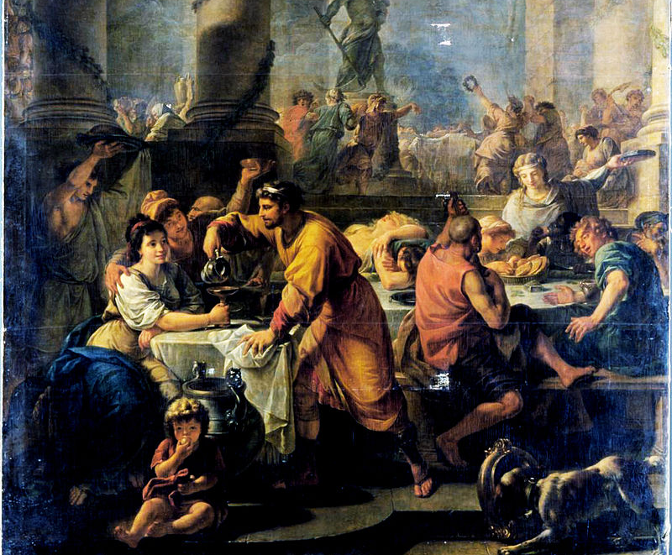
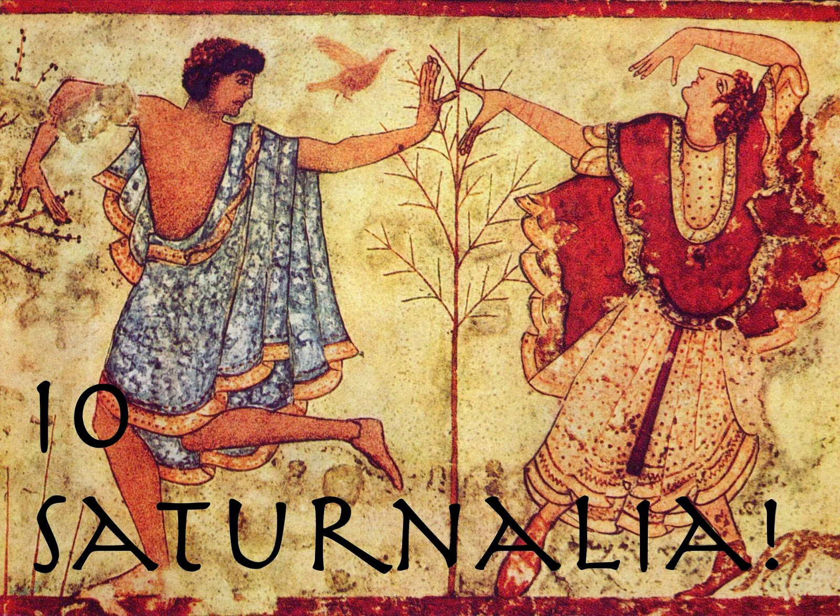
What happened to Cronos/Saturn?
In some version, Saturn is locked up in Tartarus with the Titans to continue his rule there.
But, according to Virgil, Saturn came to Italy or Hesperia (Greek name) as an ousted king.
He came to the land of Latium (central Italy around Rome) and founded the people of Latium teaching them agriculture.
The Romans had a festival in honour of Saturn, the Saturnalia, between 17th to the 23rd of December, around the Winter Solstice. The social norms of Rome would be reversed, slaves would be masters, masters slaves; people would wear masks and give small gifts to each other and celebrate. This meaning to reflect the Golden Age of Saturn’s rule.
People would greet each other with Io Saturnalia.
The Greek equivalent was called to Kronia.

Slide 18
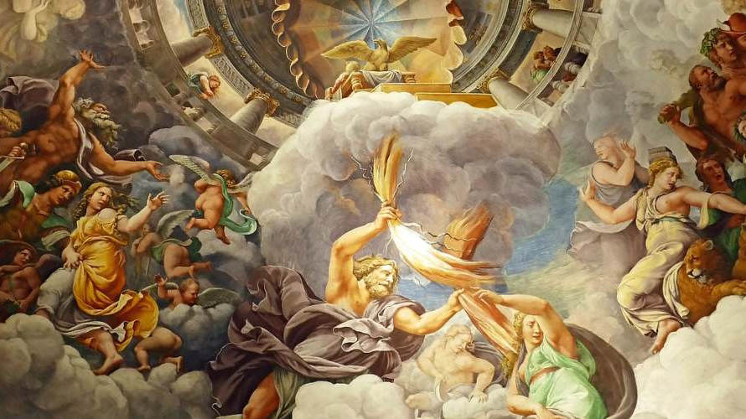
The Olympians
Profiles

Slide 19
Mt Olympus
When Zeus and his siblings took control of the kosmos they ruled from the peak of one of the tallest mountain in Greece, Mt. Olympus.
Many of Zeus siblings and children would become one of the Olympians. Traditionally there are 12. However, the number and group varies depending on the story.
The Romans on the other hand, believed that the gods lived in the skies above Rome itself – as the centre of the universe.

Slide 20
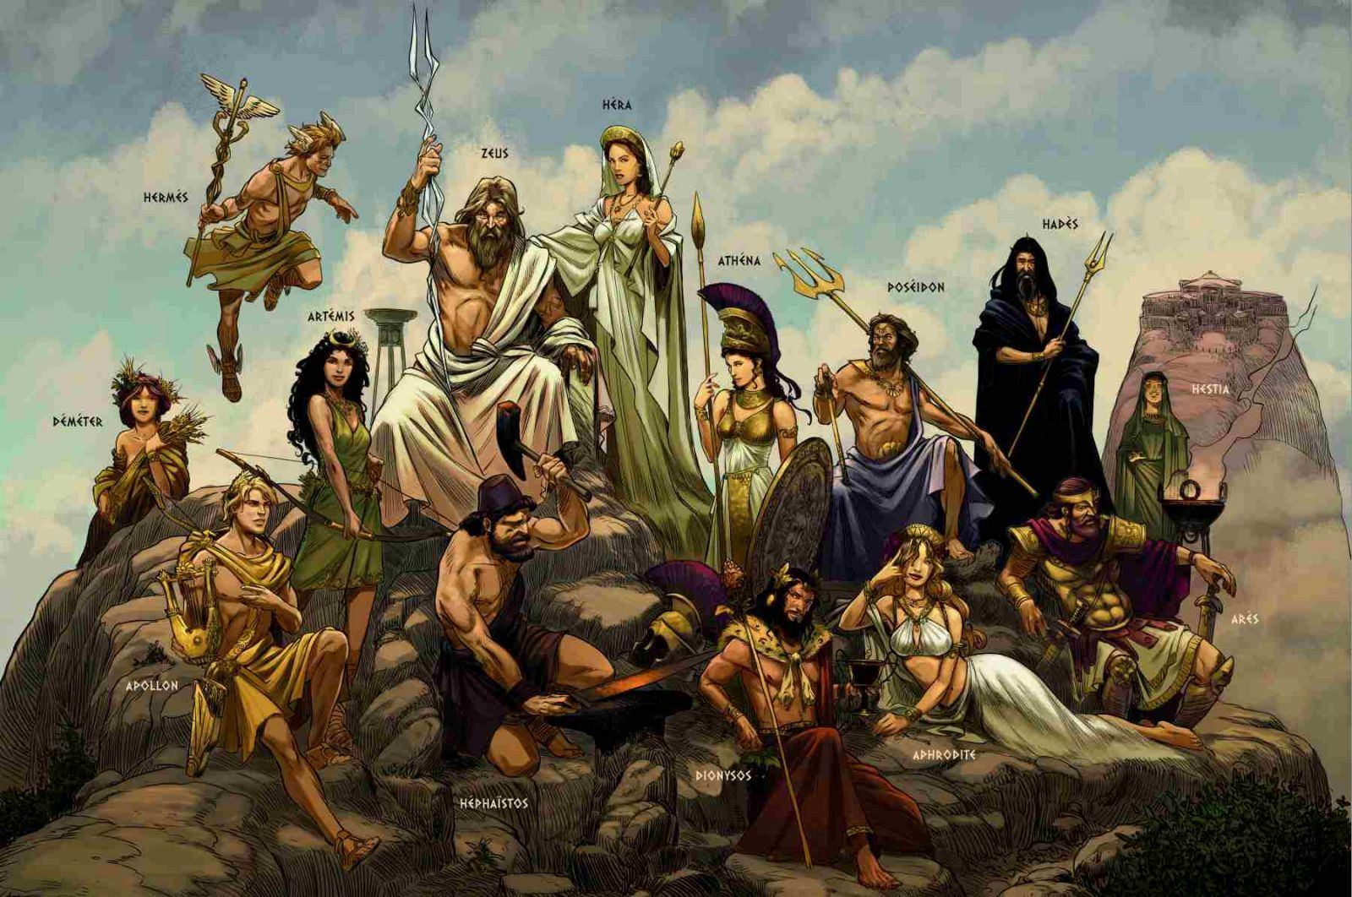

Slide 21
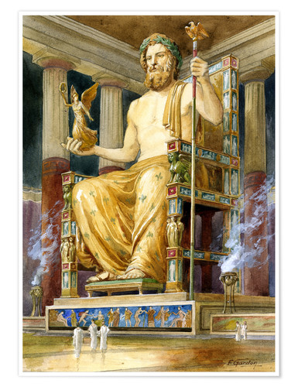
Zeus/Jupiter
Zeus is the king of the Gods, the god of the sky, the heavens, thunder, and the weather. His Roman equivalent is Jupiter.
He is the most powerful of all the gods.
Homer tells a story of how once all the gods banded together to chain Zeus down – he was later freed with the help of Thetis and Bireaus, one of the Hecatoncheires.
He defeated the dragon Typhon, the Titans, and was feared by the mortals and immortals alike.
He is also the guardian of the fates – he ensures what is fated occurs.
When he nods it means that something is fated to happen.
His wife is his sister Hera, however, Zeus has children by many consorts both mortal and immortal.

Slide 22
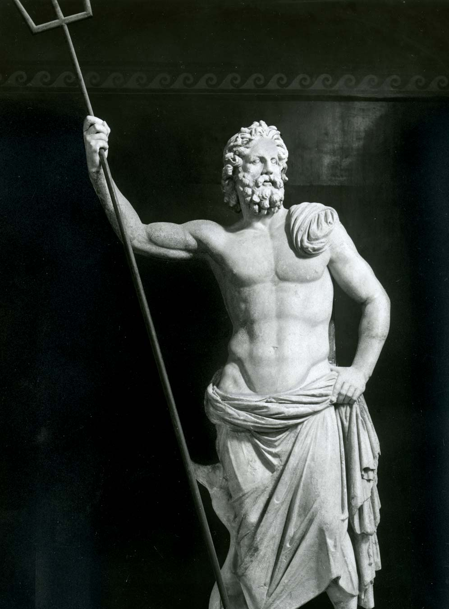
Poseidon/Neptune
Poseidon is the brother of Zeus and god of the sea, earthquakes, and horses. His Roman equivalent is Neptune.
While his brother ruled by lightning bolt, Poseidon ruled with the trident.
Poseidon is often included among the 12, but is also known for spending is time in his palace in the sea.
He – like his brother – is known for seducing many women and men.
His wife was Amphitrite and they had a son Triton and daughter Rhode.

Slide 23
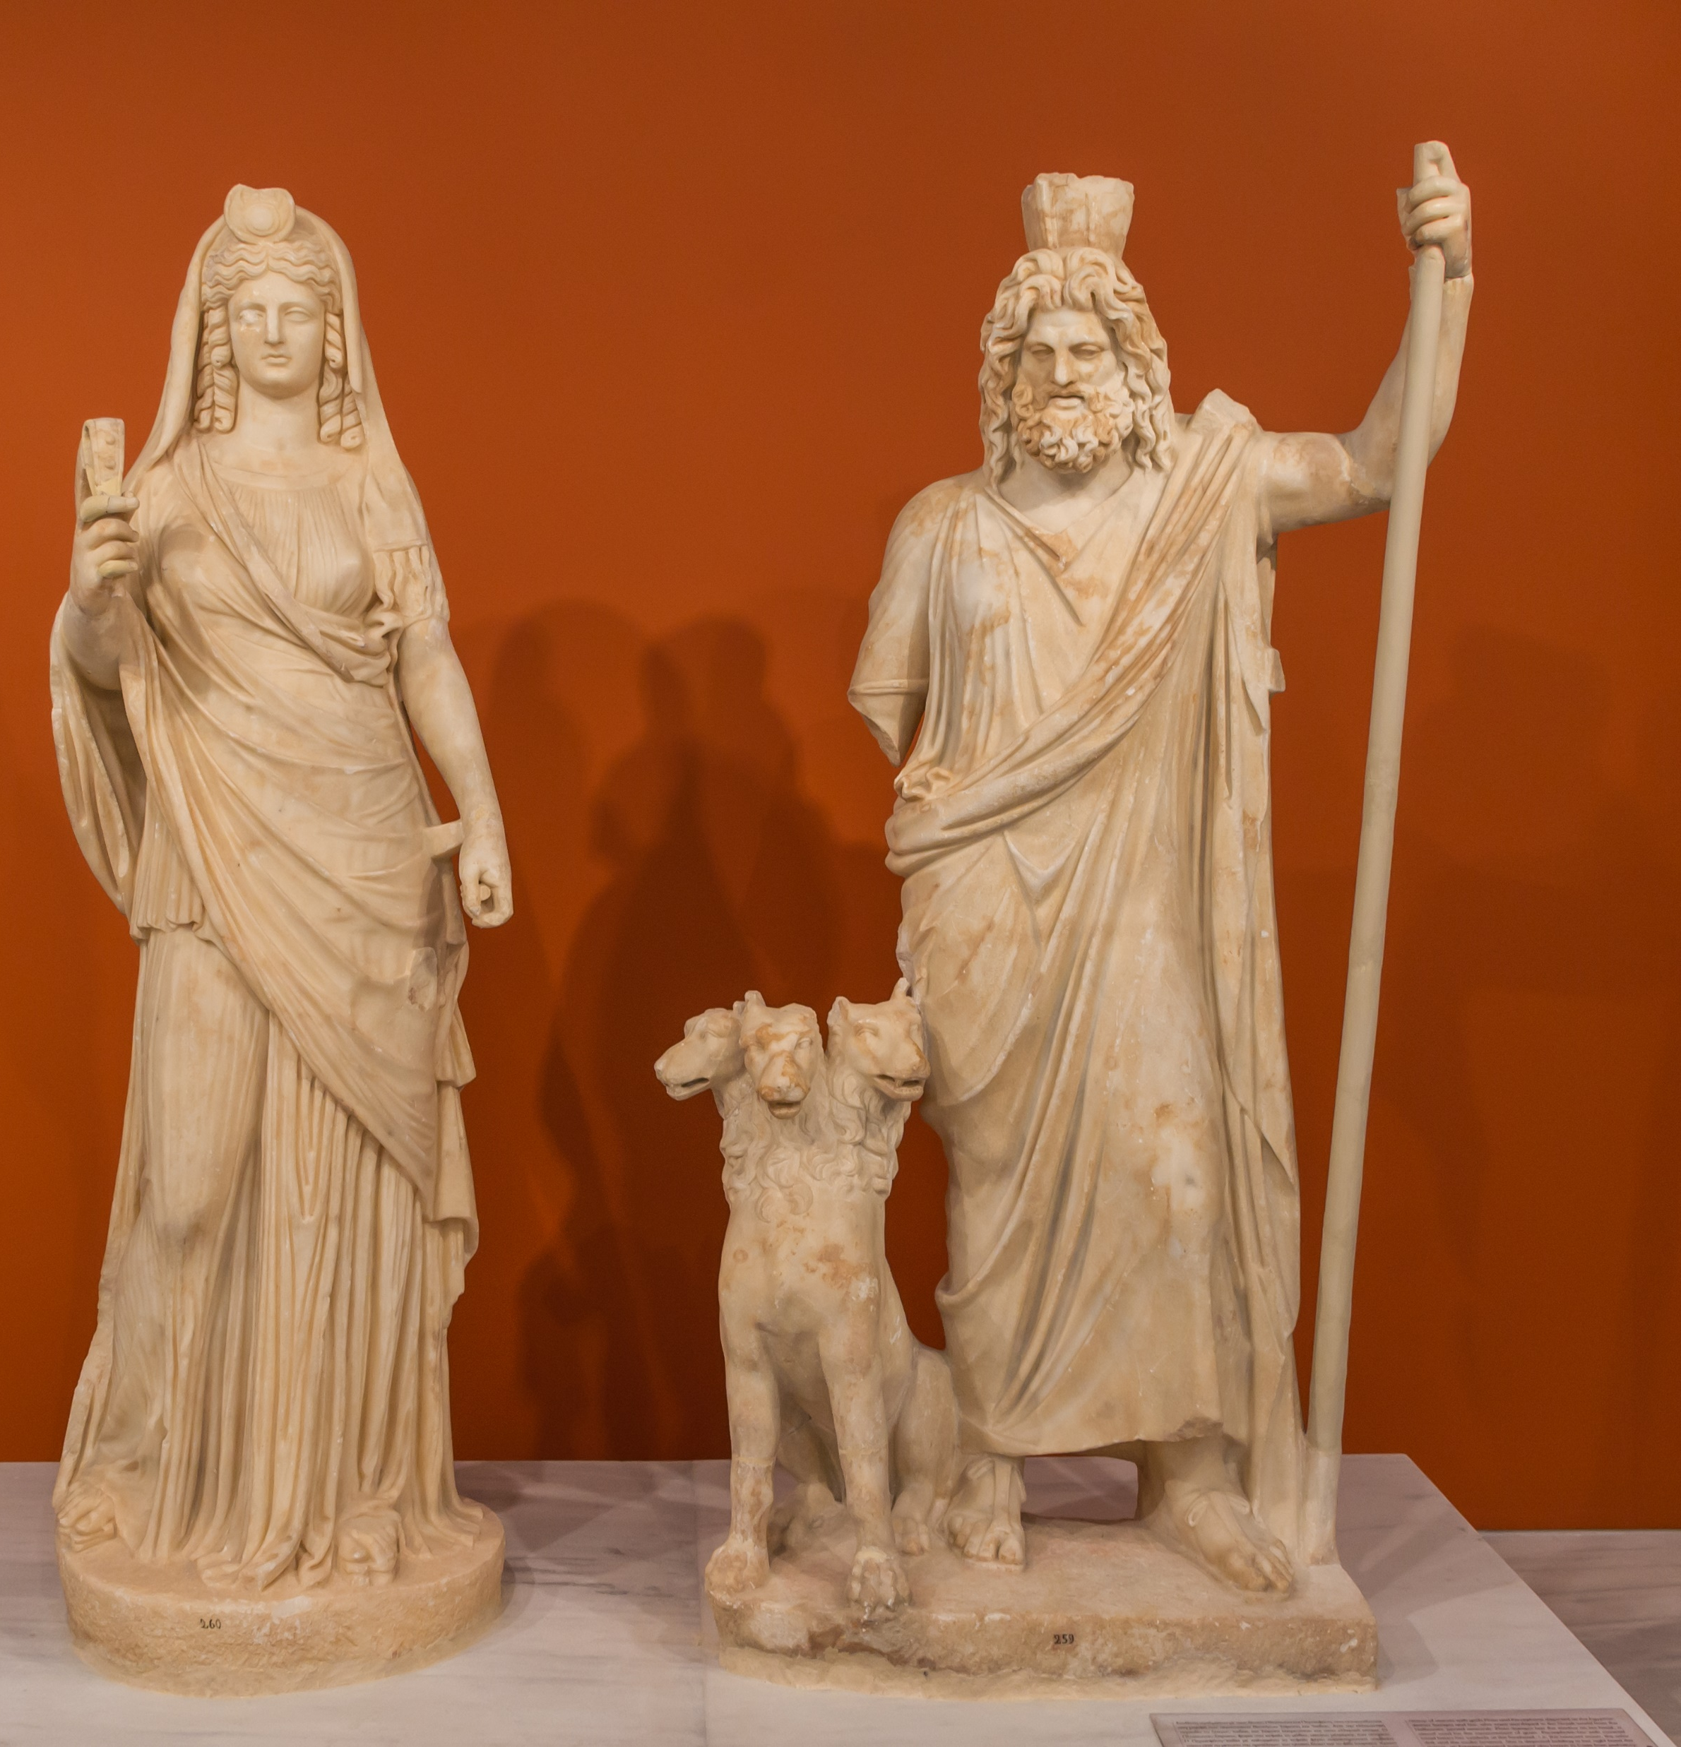
Hades/Pluto
Hades is the brother of Zeus and Poseidon. He is the ruler of the Underworld (often called Hades after himself). His other name is Pluto – the most common name in Latin.
He received a Helmet from the Cyclopes. And drew the short straw in the allotment of the realms.
His realm was guarded by the 3 headed dog Cerberus.
His wife was the daughter of Zeus and Demeter, Persephone – Roman equivalent Proserpina. He abducted her to be his bride. When she was commanded to return to her mother, Hades gave her 6 pomegranate seeds to eat. Having eaten the food of the dead, she was compelled to return every six months to be his bride and queen of the Underworld.
Hades is rarely seen on Olympus but rather lives in his palace in the Underworld.

Slide 24
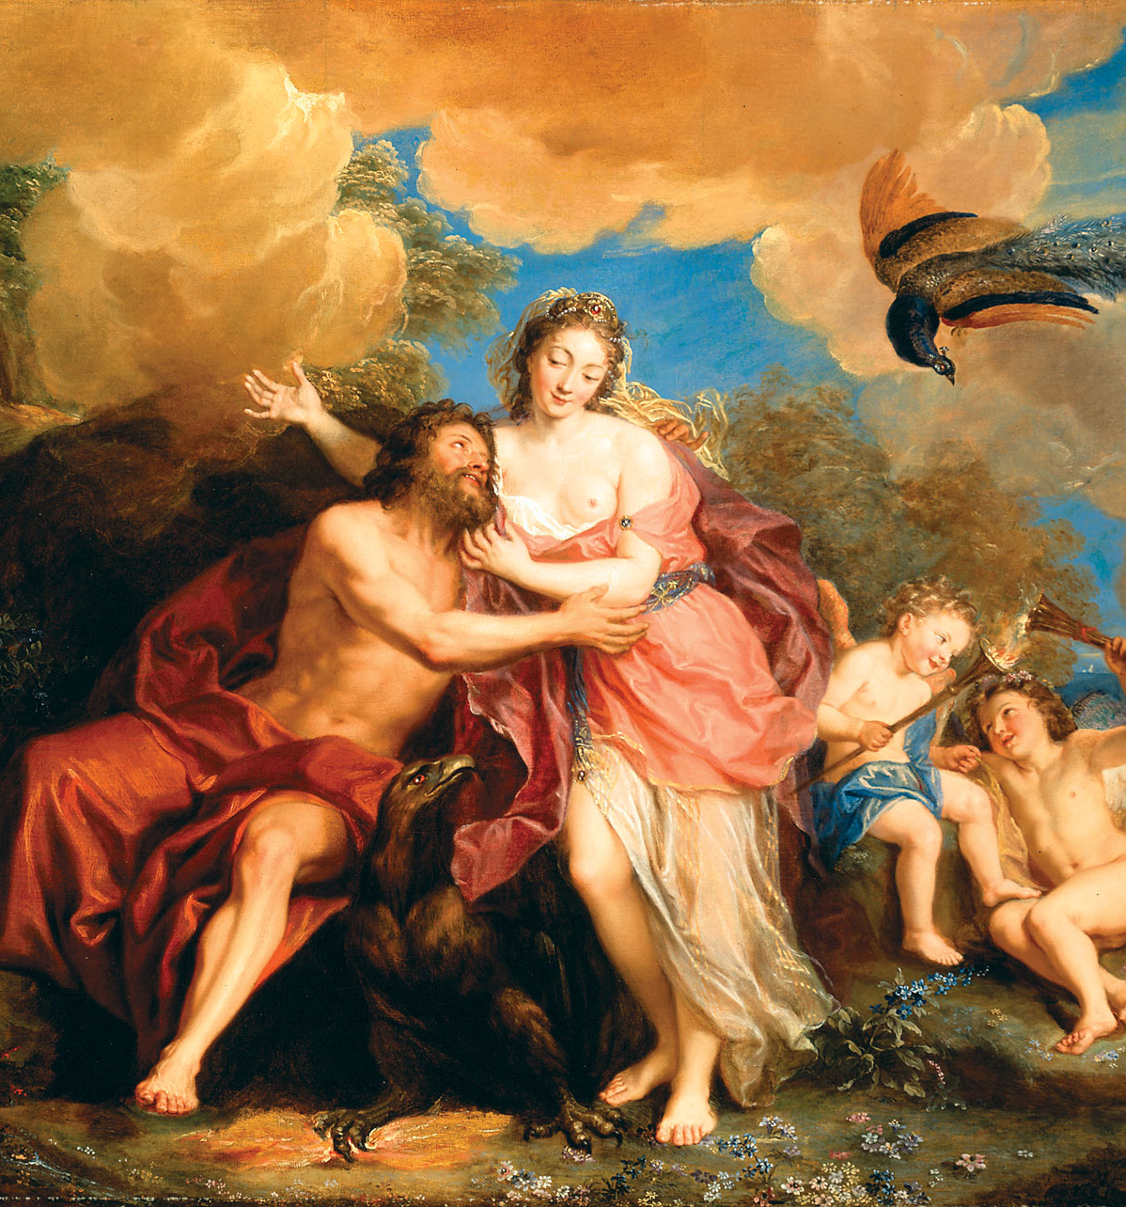
Hera/Juno
Hera was the Queen of the Gods, the loyal wife of Zeus, and the goddess of marriage (ironic that her husband was so unfaithful!). Her Roman equivalent was Juno.
She often punishes the Zeus’ romantic conquests in spite and pride. She is often in fear of her husbands power – but, at times, manages to manipulate him to her will.
She had several children by Zeus: Ares, Hebe, and Eilithyia – and in some cases Hephaestus. However, in other versions it is said that she conceived Hephaestus to spite her husband he gave birth to Athena by himself.
She is often associated with the peacock, who pull her chariot.

Slide 25
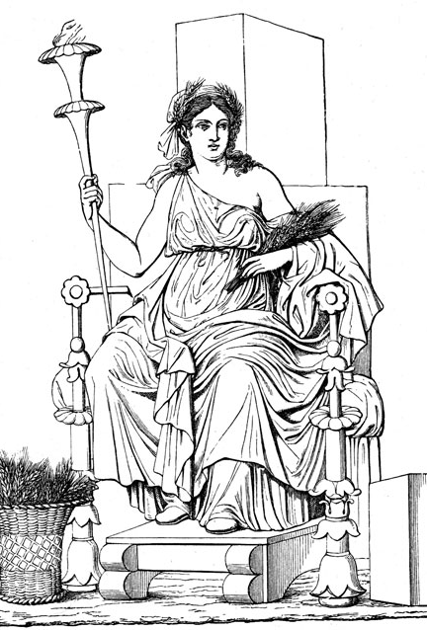
Demeter/Ceres
Demeter is the goddess of agriculture – farming. Her Roman equivalent is Ceres.
Demeter and Zeus are said to be the parents of Persephone; however, in many version Persephone’s mother is either Rhea or the Styx.
However, (accepting Persephone is Demeter’s daughter) when Hades snatched her away from her mother, stories are told of Demeter’s self-exile from Olympus, her visit the Eleusis where she was cheered by the old woman Lambe, her nursing of child of Metanira and Celeus who she tried to make immortal, and her rape by her younger brother Poseidon while in the form of a horse. She gave birth to the horse god Arion.
Eventually, she had neglected the growth and farms suffered so much that Zeus commanded that Persephone be returned to her, but, Persephone having eaten the pomegranate seeds, meant that her daughter would only spend 6 months with her a year. The other months, Demeter would be sad once more and neglect the harvest, thus formed the seasons.

Slide 26
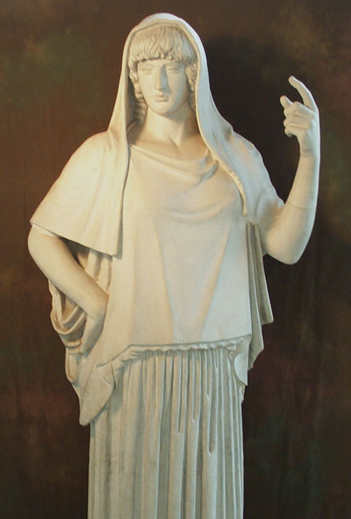
Hestia/Vesta
Hestia was the goddess of the hearth or fire. Her Roman equivalent was Vesta.
She is sometimes omitted from the 12 Olympian Gods, but is nonetheless of vital importance. She played a particularly important role in Rome. The fire of her Temple was to be kept lite perpetually by the Vestal Virgins.
She would remain chaste and a virgin for her existence – rejecting the advances of Poseidon and Apollo. In many ways she is the antithesis of Aphrodite.

Slide 27
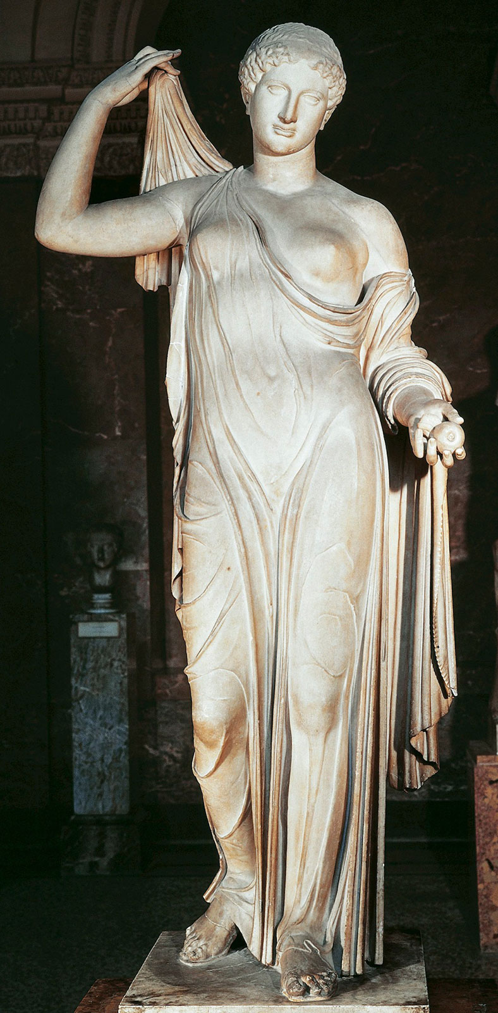
Aphrodite/Venus
Aphrodite was the goddess of Love. Her Roman equivalent was Venus.
In some versions, she was born from the ocean mixing with Uranos’ semen. In others, she is the daughter of Zeus and Dione.
She was married to Hephaestus, but her lover was Ares.
She was also the lover of many mortals including Anchises and Adonis.
In some versions, Eros or Cupid his her and Ares son – in others he is a primordial god.
She is known to punish those who reject love.

Slide 28
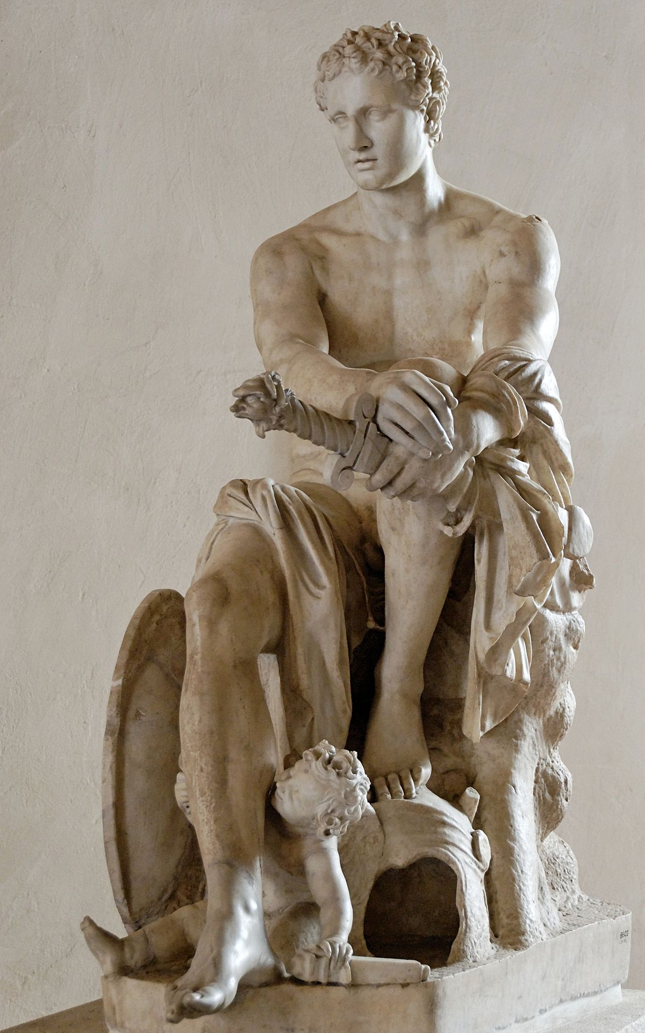
Ares/Mars
Ares was the god of violence and war. His Roman equivalent was Mars.
He is depicted as ruthless and bloodthirsty in Greek tradition, but more militaristic in Roman traditions.
His lover was Aphrodite, who we would meet in secret.

Slide 29
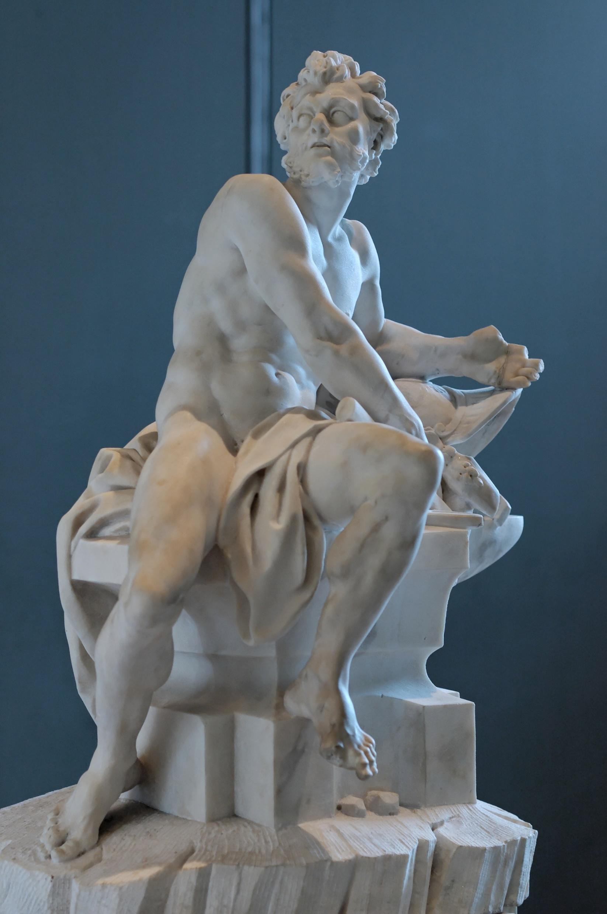
Hephaestus/Vulcan
Hephaestus is the god of fire and metal smithing. His Roman equivalent is Vulcan.
Whether born of Hera and Zeus or just Hephaestus most versions agree that he was thrown from Mt Olympus at birth – possibly because of his ugliness and his limp (sometimes this is said to be the cause of it).
He landed on the island of Lemnos and was taught the smithing crafts by the Sintians.
Upon his return to Olympus he is said to have built a throne for Hera from which she could never rise. In some versions, Dionysus then had to fetch him back to Olympus while drunk to free Hera.
His wife was Aphrodite, who was unfaithful to him – particularly with Ares. It is said that he caught the lovers once in an unbreakable net and dragged them in front of all the other gods to humiliate them.
In other myths he also attempts to seduce Athena. She rejects him, but his semen falls on her thigh and then to the earth, giving birth to the founder of Athens, Erectheus.

Slide 30
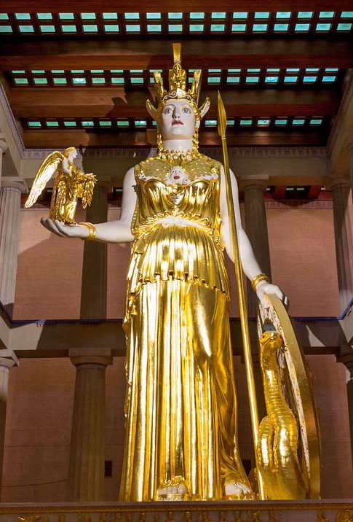
Athena/Minerva
Athena was the goddess of wisdom, strategic warfare, and craft. Her Roman equivalent was Minerva.
She is the daughter of Zeus and Metis. When Metis was pregnant with her, Zeus consumed Metis because he heard that a son by Metis would be more powerful than himself.
But, Athena still grew, and eventually Zeus suffered a massive headache. His head was split open by either Prometheus or Hephaestus. Out sprung Athena in full battle armour.
She is often shown in the full battle armour over her peplos and chiton (women’s clothing), with snakes, and holding a shield the Aegis.
She would retain her virginity rejecting the advances of the other gods.
She is also associated with owls, representing wisdom, and olives.
She gave her name to the city of Athens.

Slide 31
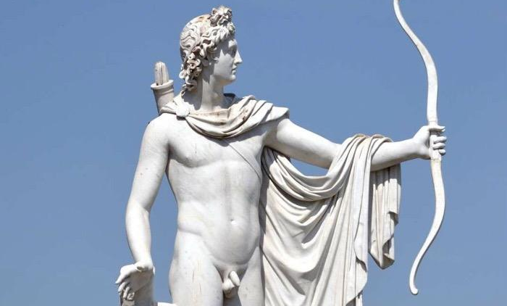
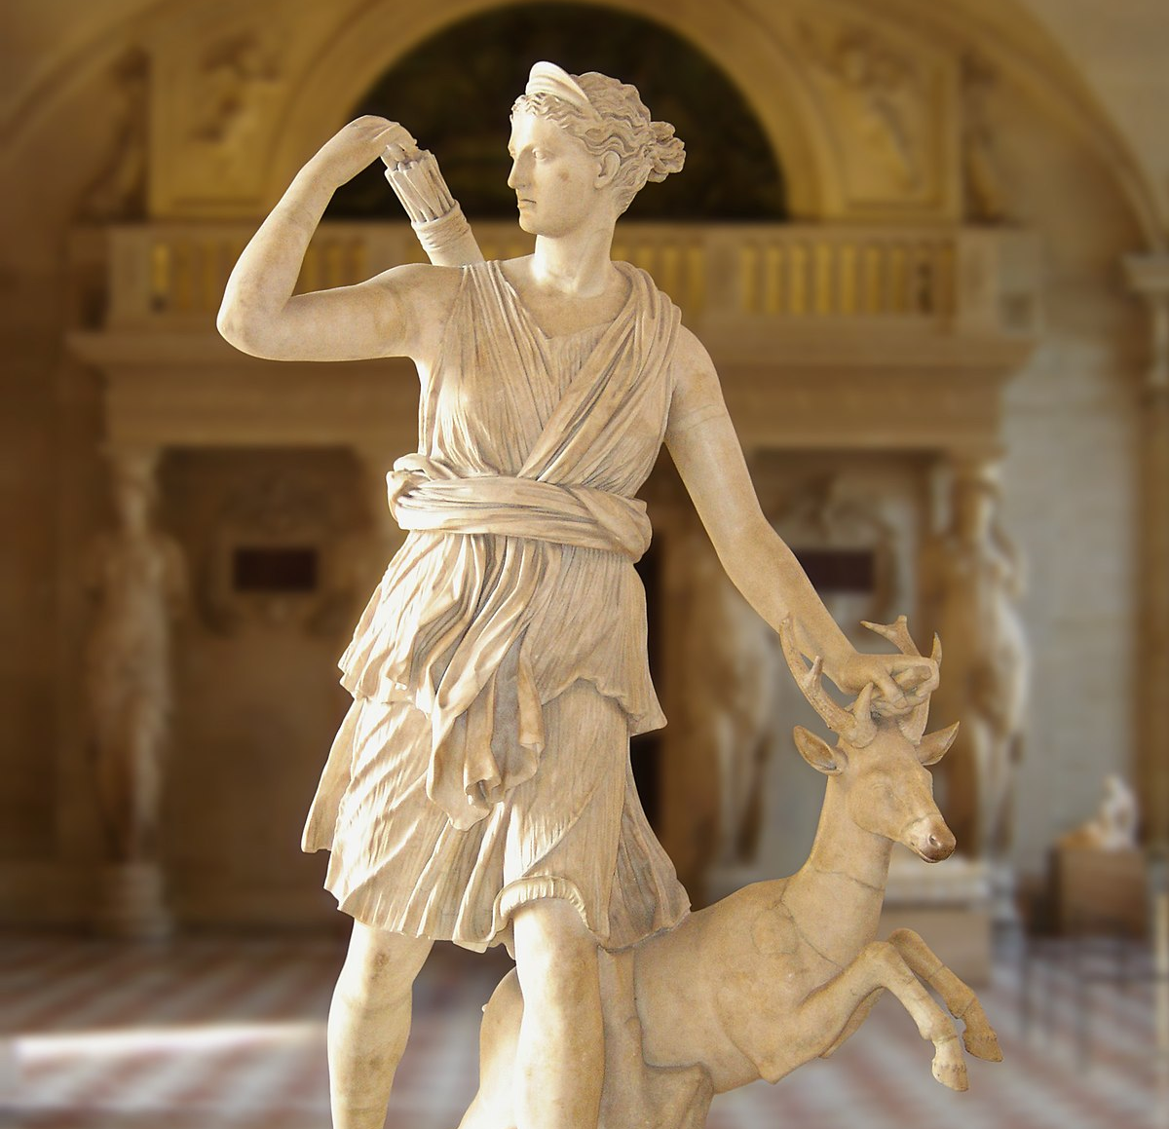
Apollo and Artemis/Diana
Apollo is the god of the sun, music, prophecy, and plagues. His Roman equivalent is Apollo (same). Artemis is the goddess of the hunt, chastity, childbirth, and the moon. Her Roman equivalent is Diana.
Both were born to their mother Leto or Latona on the island of Delos – a floating island. Their mother had been seduced by Zeus, and has punishment, Hera had commanded the Earth not to allow her to give birth on land. So, she had to find a piece of land detached from the earth – Delos.
Artemis was born first and then helped her mother give birth to Apollo.
Apollo was given a golden bow by Hephaestus, Artemis a silver bow. Apollo would kill the Python snake at Delphi and take up the role of prophesier there. Artemis would roam the lands of Greece hunting and rejecting men – and punishing those she deemed to impede her chastity.
Apollo would have many, many lovers both male and female – just like his father.

Slide 32
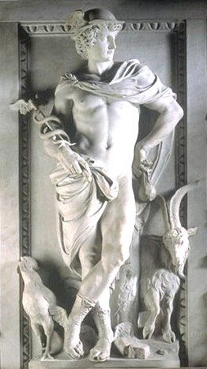
Hermes
Hermes was the god of robbers, travellers, orators, merchants, and heralds. He was the messenger of the gods. His Roman equivalent was Mercury.
He was the son of Zeus and Maia, the daughter of Atlas.
He wore a travellers hat, winged sandals, and held a wand that could put someone to sleep.
He was also the god who would escort the dead to the banks of the Styx to cross into the Underworld.

Slide 33
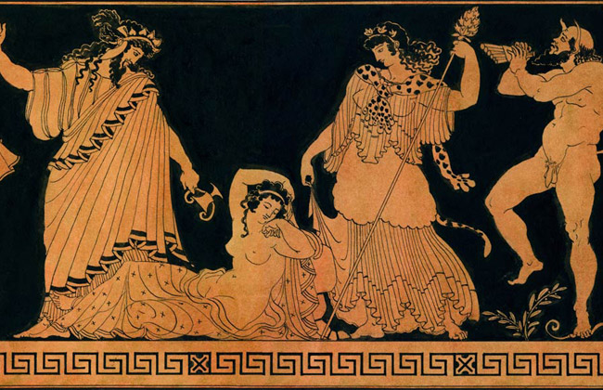
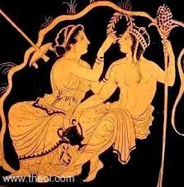
Dionysus/Liber/ Bacchus
Dionysus was the god of revelry, ecstasy, wine, fertility, and madness. His Roman equivalent was Bacchus or Liber (earlier equivalent).
He was the son of Zeus and the mortal princess of Thebes, Semele. She was tricked by Hera into asking to see Zeus in his true form. Zeus – having sworn by the Styx to do as she asked before knowing what she asked – did so. She was consumed by the fire of his true form. Zeus took the foetus, Dionysus, and sewed it into his thigh. Later, Dionysus would be cut out fully grown.
Dionysus was then driven made by Hera and travelled the world; eventually he was cleansed Rhea. But he continued to travel the world in his chariot pulled by Leopards and followed by his mad followers, Maenaids or Bacchantes, who were known to go made and tear people apart.
Dionysus would often bring curses of madness on to people who disrespected him.
His consort/wife was Ariadne who had been abandoned on the island of Naxos by the Athenian hero Theseus.

Slide 34
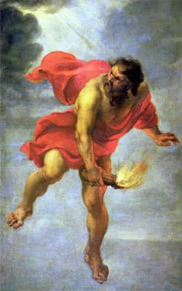
Visual Evidence
Examine the following Visual Sources of the Gods:
Identify the god(s) – both in the Greek and Roman – and explain how you know they are that god/goddess.
Can you describe the myths being told?

Slide 36
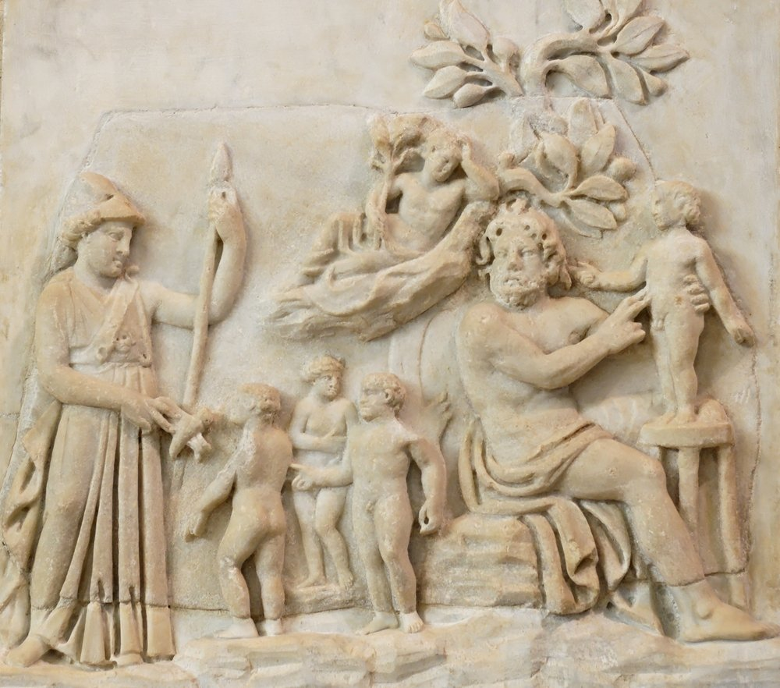

Slide 37
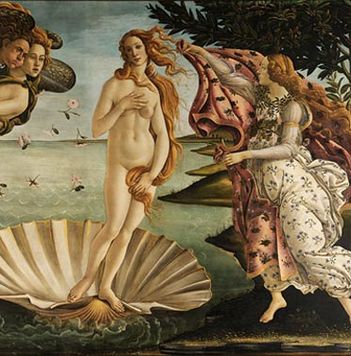
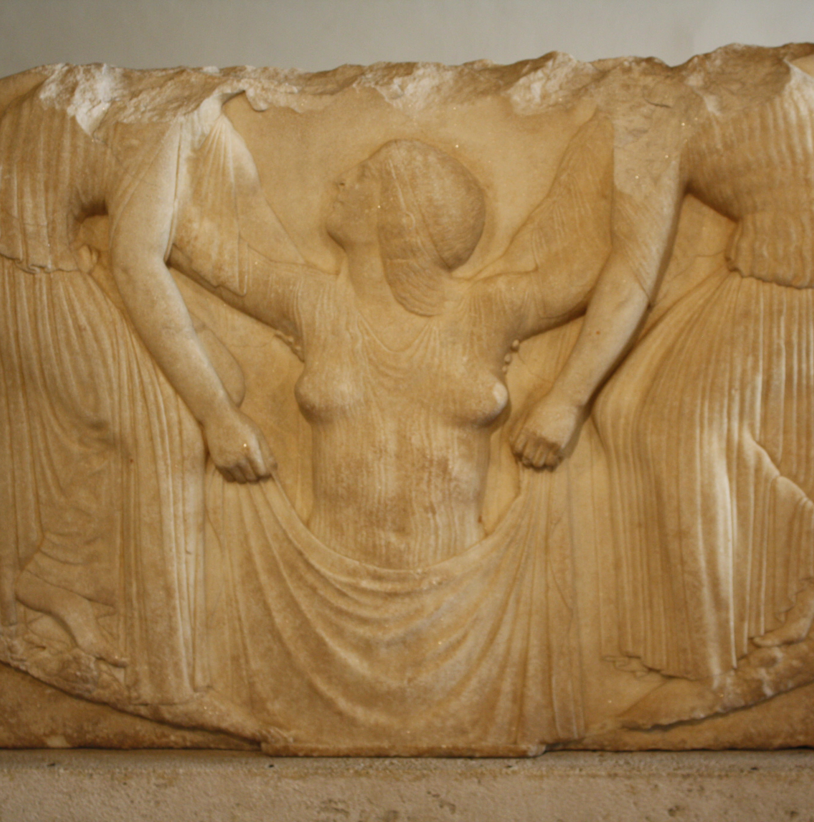

Slide 38
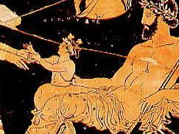
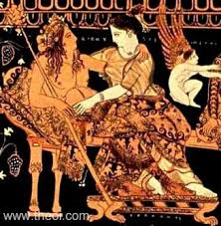
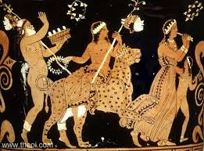

Slide 39
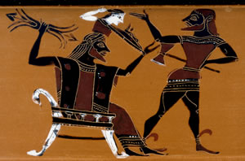

Slide 40
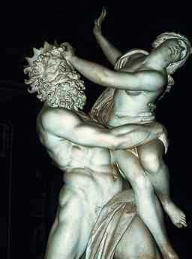
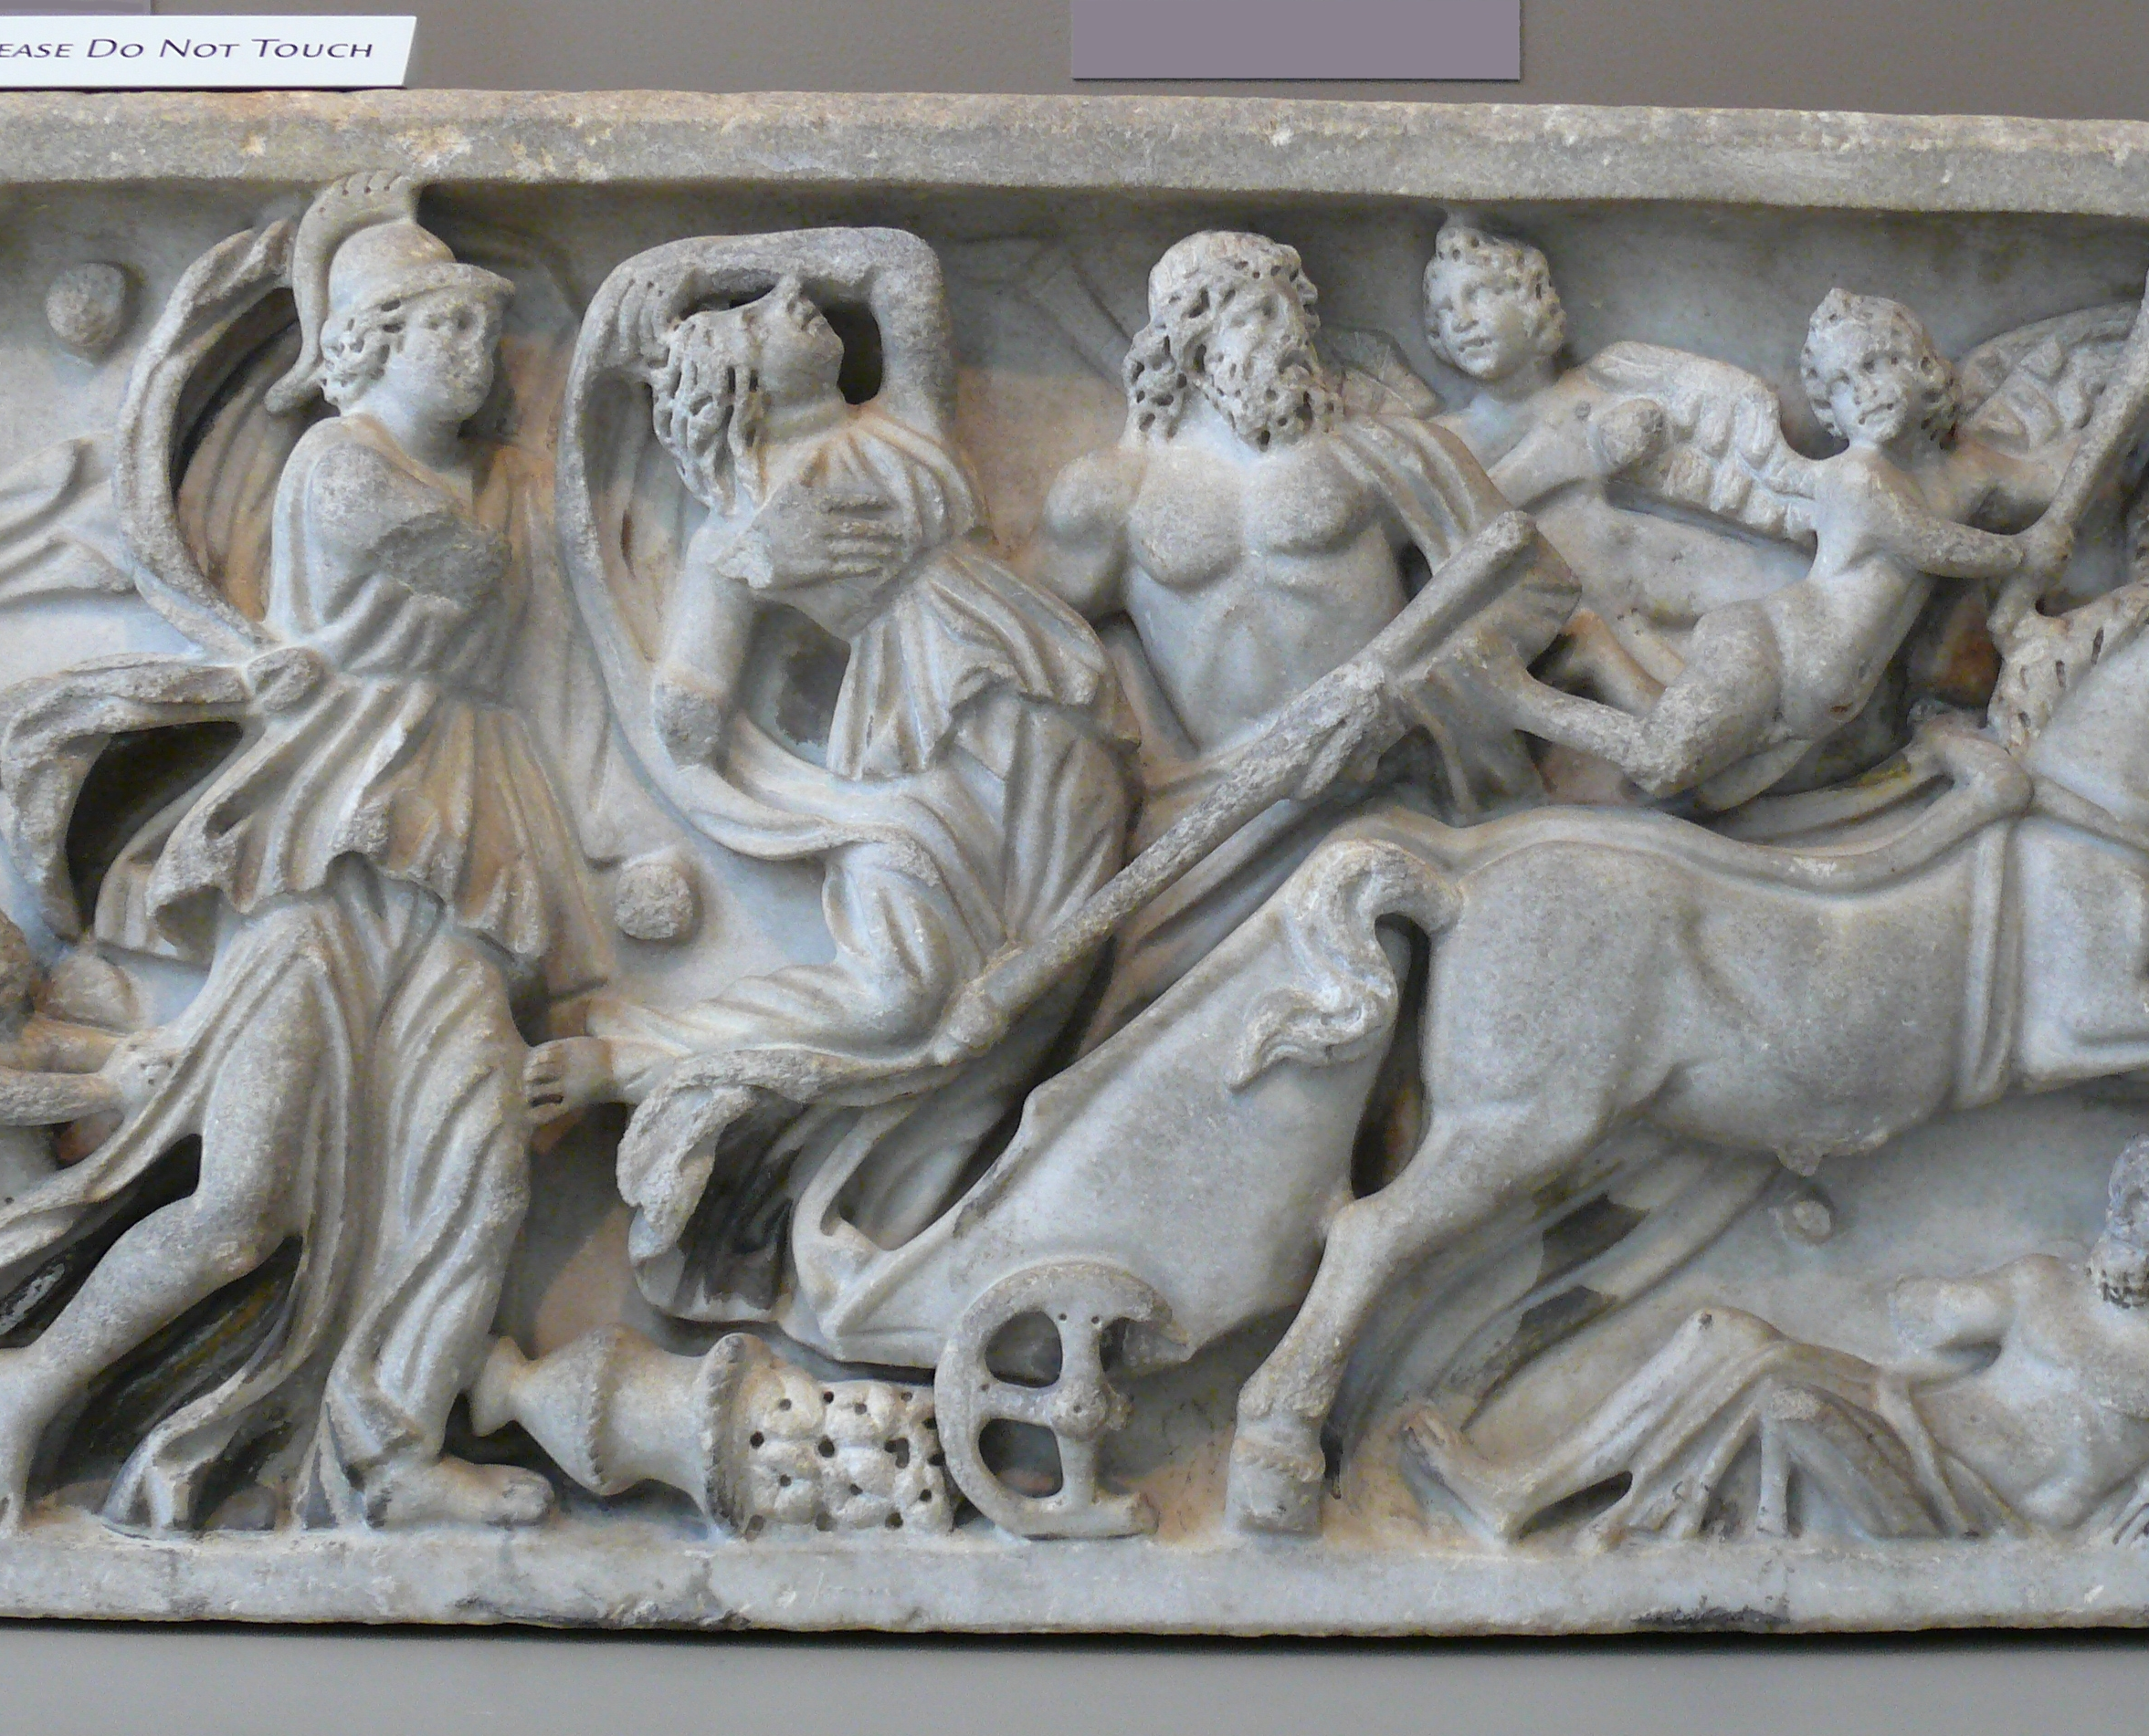

Slide 41
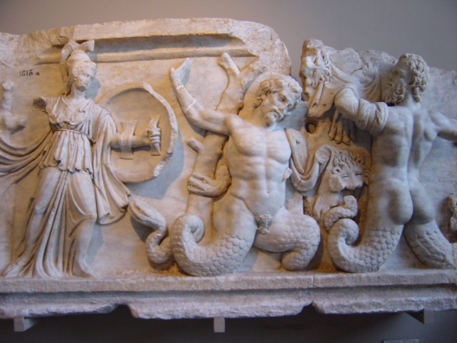
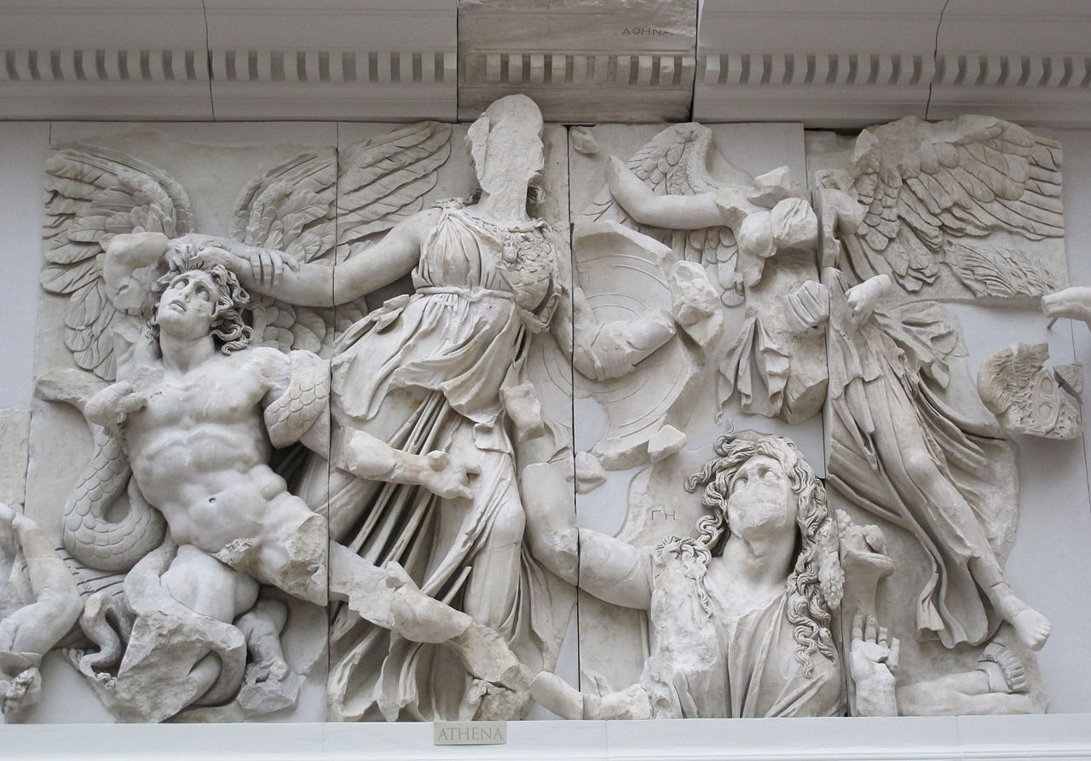

Slide 42
