Slide 1
Hades
God of the Underworld

Slide 2
Demeter, Persephone and Hades
This is the story of how Persephone became Pluto’s wife and Queen of the underworld.
Demeter was goddess of plants and harvests. She made everything grow and ripen.
Her daughter, Persephone, was her companion and helper.

Slide 3
Hades admired Persephone and decided he wanted her as a wife.
He asked Zeus for permission but he didn’t get a firm answer as Zeus knew Demeter would never agree, but he didn’t want to offend his brother by refusing.

Slide 4
One day Hades found Persephone alone and, since Zeus had not forbidden him to marry her, he seized her and took her to the underworld.

Slide 5
When Demeter found her daughter had gone, she neglected the plants and trees to search for her.
Without her care the harvest failed and everything withered and died.

Slide 6
After a long search, she discovered that Persephone was in Hades prisoner and pleaded with Zeus to release her.
The Gods agreed that Zeus should do something as humans were in danger of starving since no crops would grow.

Slide 7
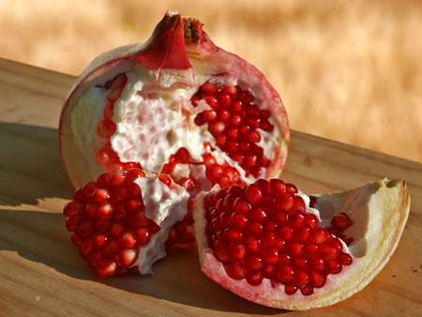
Zeus said Persephone should be freed, as long as she had not tasted any food of the dead.
In her misery she had not eaten at all, but, just before her release Hades tempted her to try a few pomegranate seeds (some stories say dates) from his garden.

Slide 8
“since you have eaten from Hades garden” said Zeus to Persephone, “you must spend part of each year in Hades with him. The rest you may spend on Earth with your mother”

Slide 9
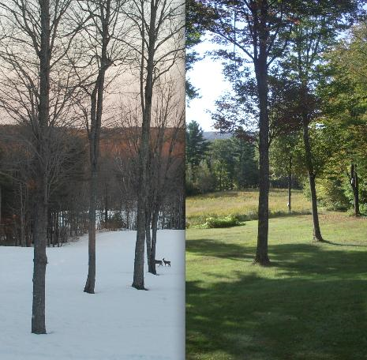
So every year, when Persephone was with Hades in the underworld, Demeter would mourn. Plants would die and it was winter.
When Persephone returned Demeter was happy again, things began to blossom and it was spring.

