Slide 1
Portfolio of Iliad Characters
2nd Year Classics
Notes:
Fill in information about characters as students do.

Slide 2
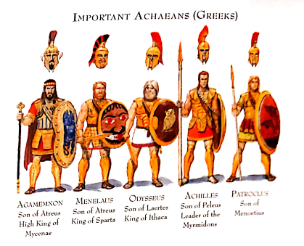

Slide 3
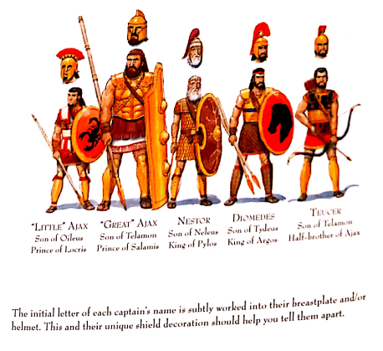

Slide 4
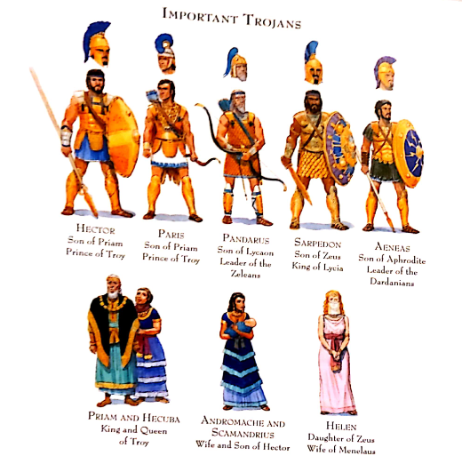

Slide 5
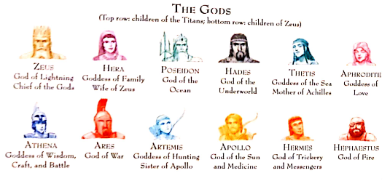

Slide 6
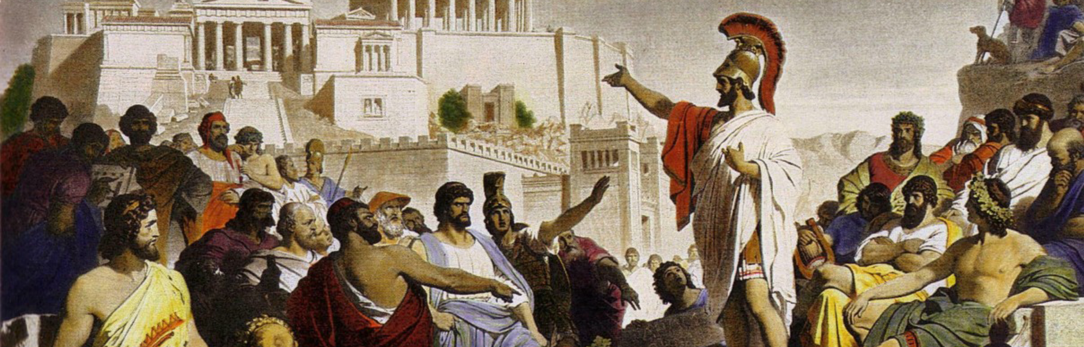
Greek Warriors
In the Iliad

Slide 7
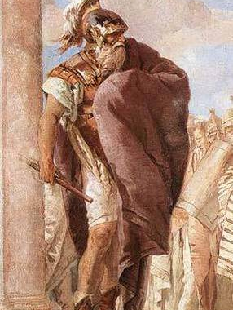
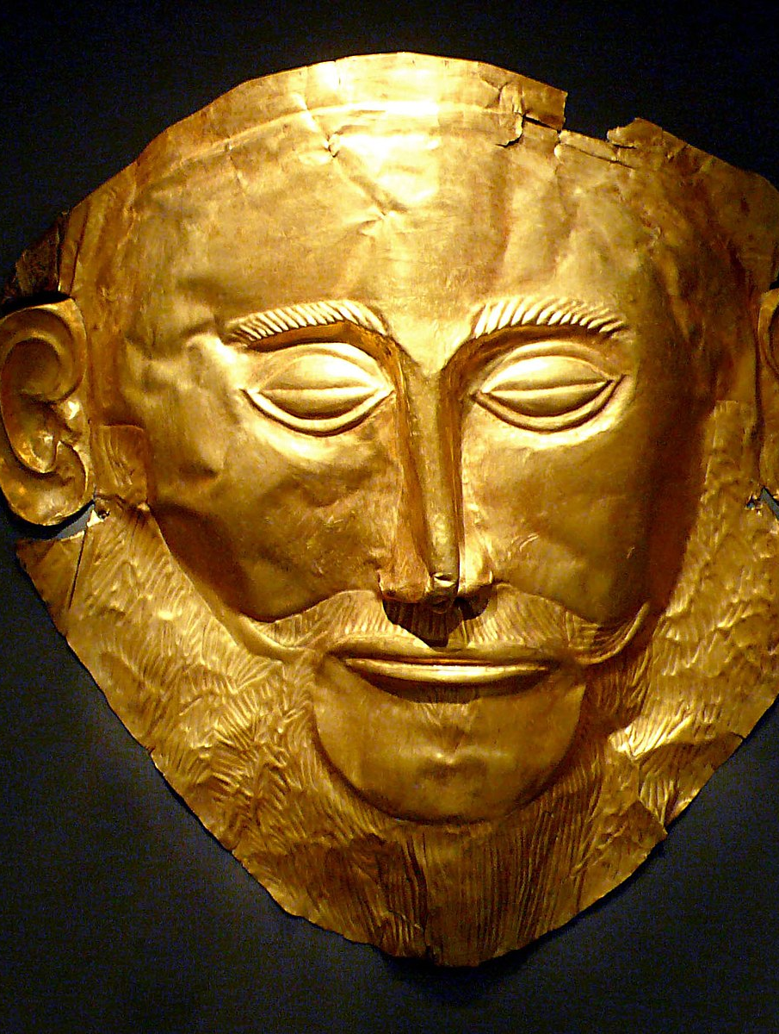
Agamemnon
Characteristics:
Role:
Family:
Epithets:
Death mask of Agamemnon

Slide 8
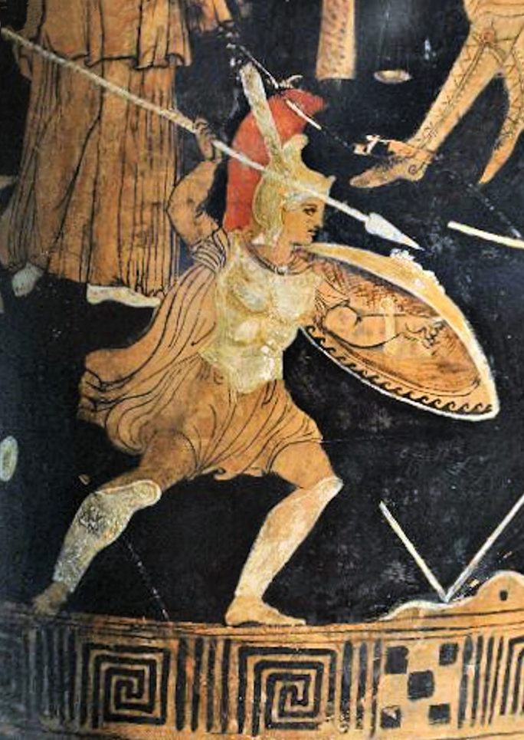
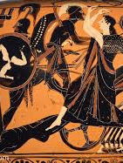
Achilles
Characteristics:
Role:
Family:
Epithets:

Slide 9
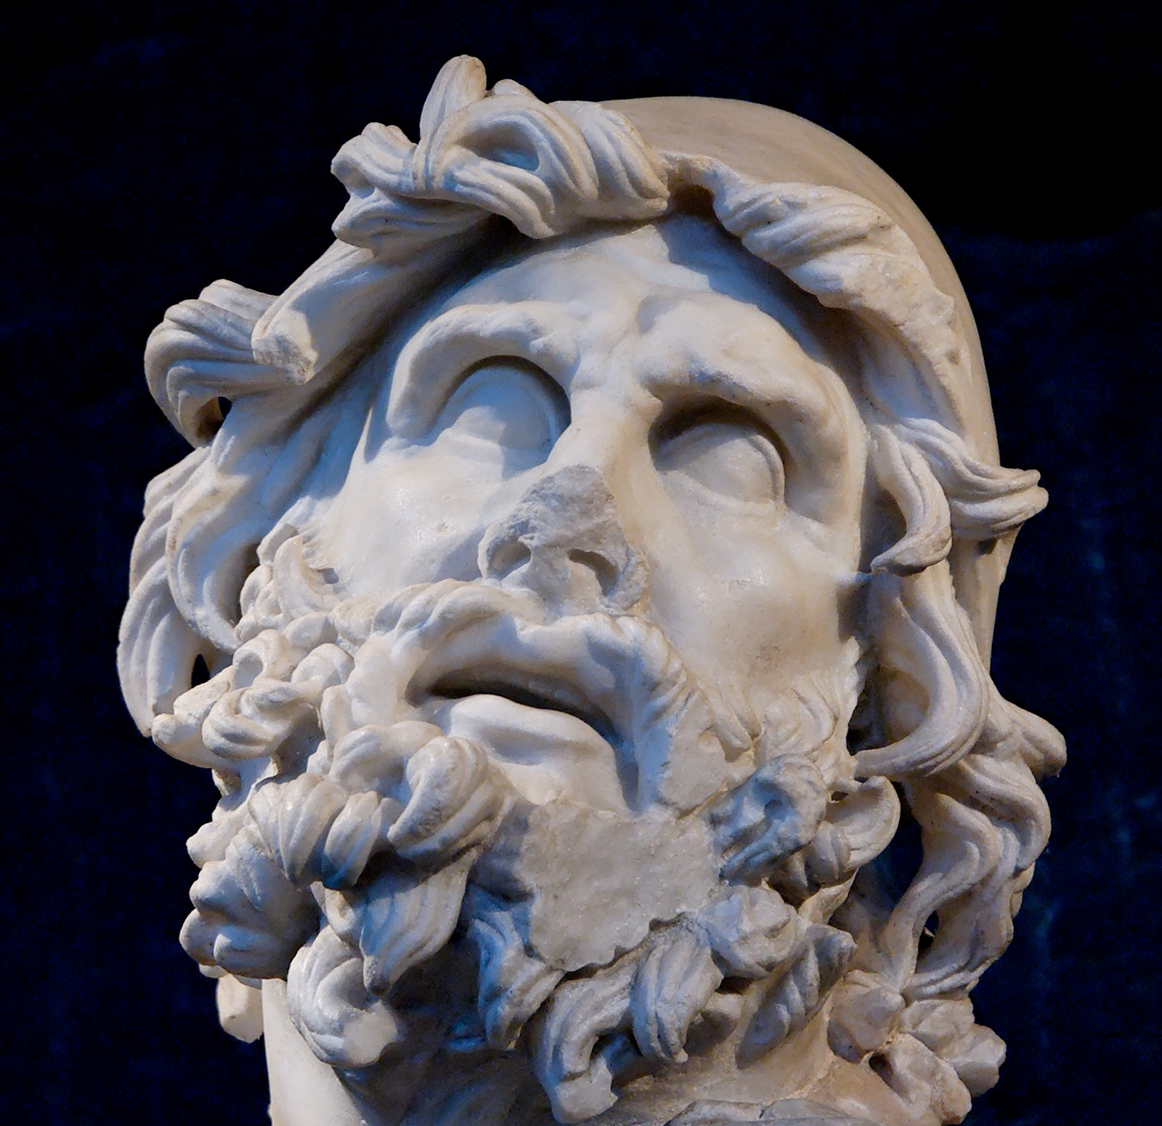
Odysseus
Characteristics:
Role:
Epithets:

Slide 10
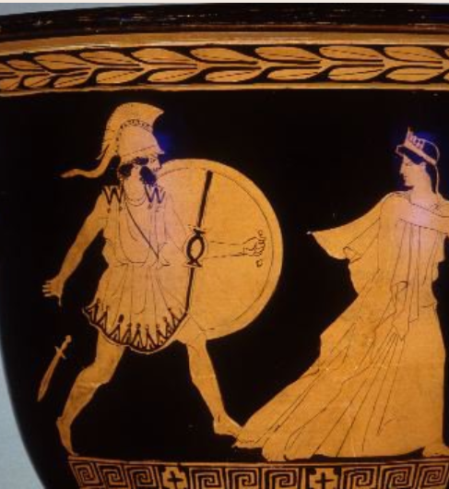
Menalaus
Characteristics:
Role:
Family:
Epithets:

Slide 11
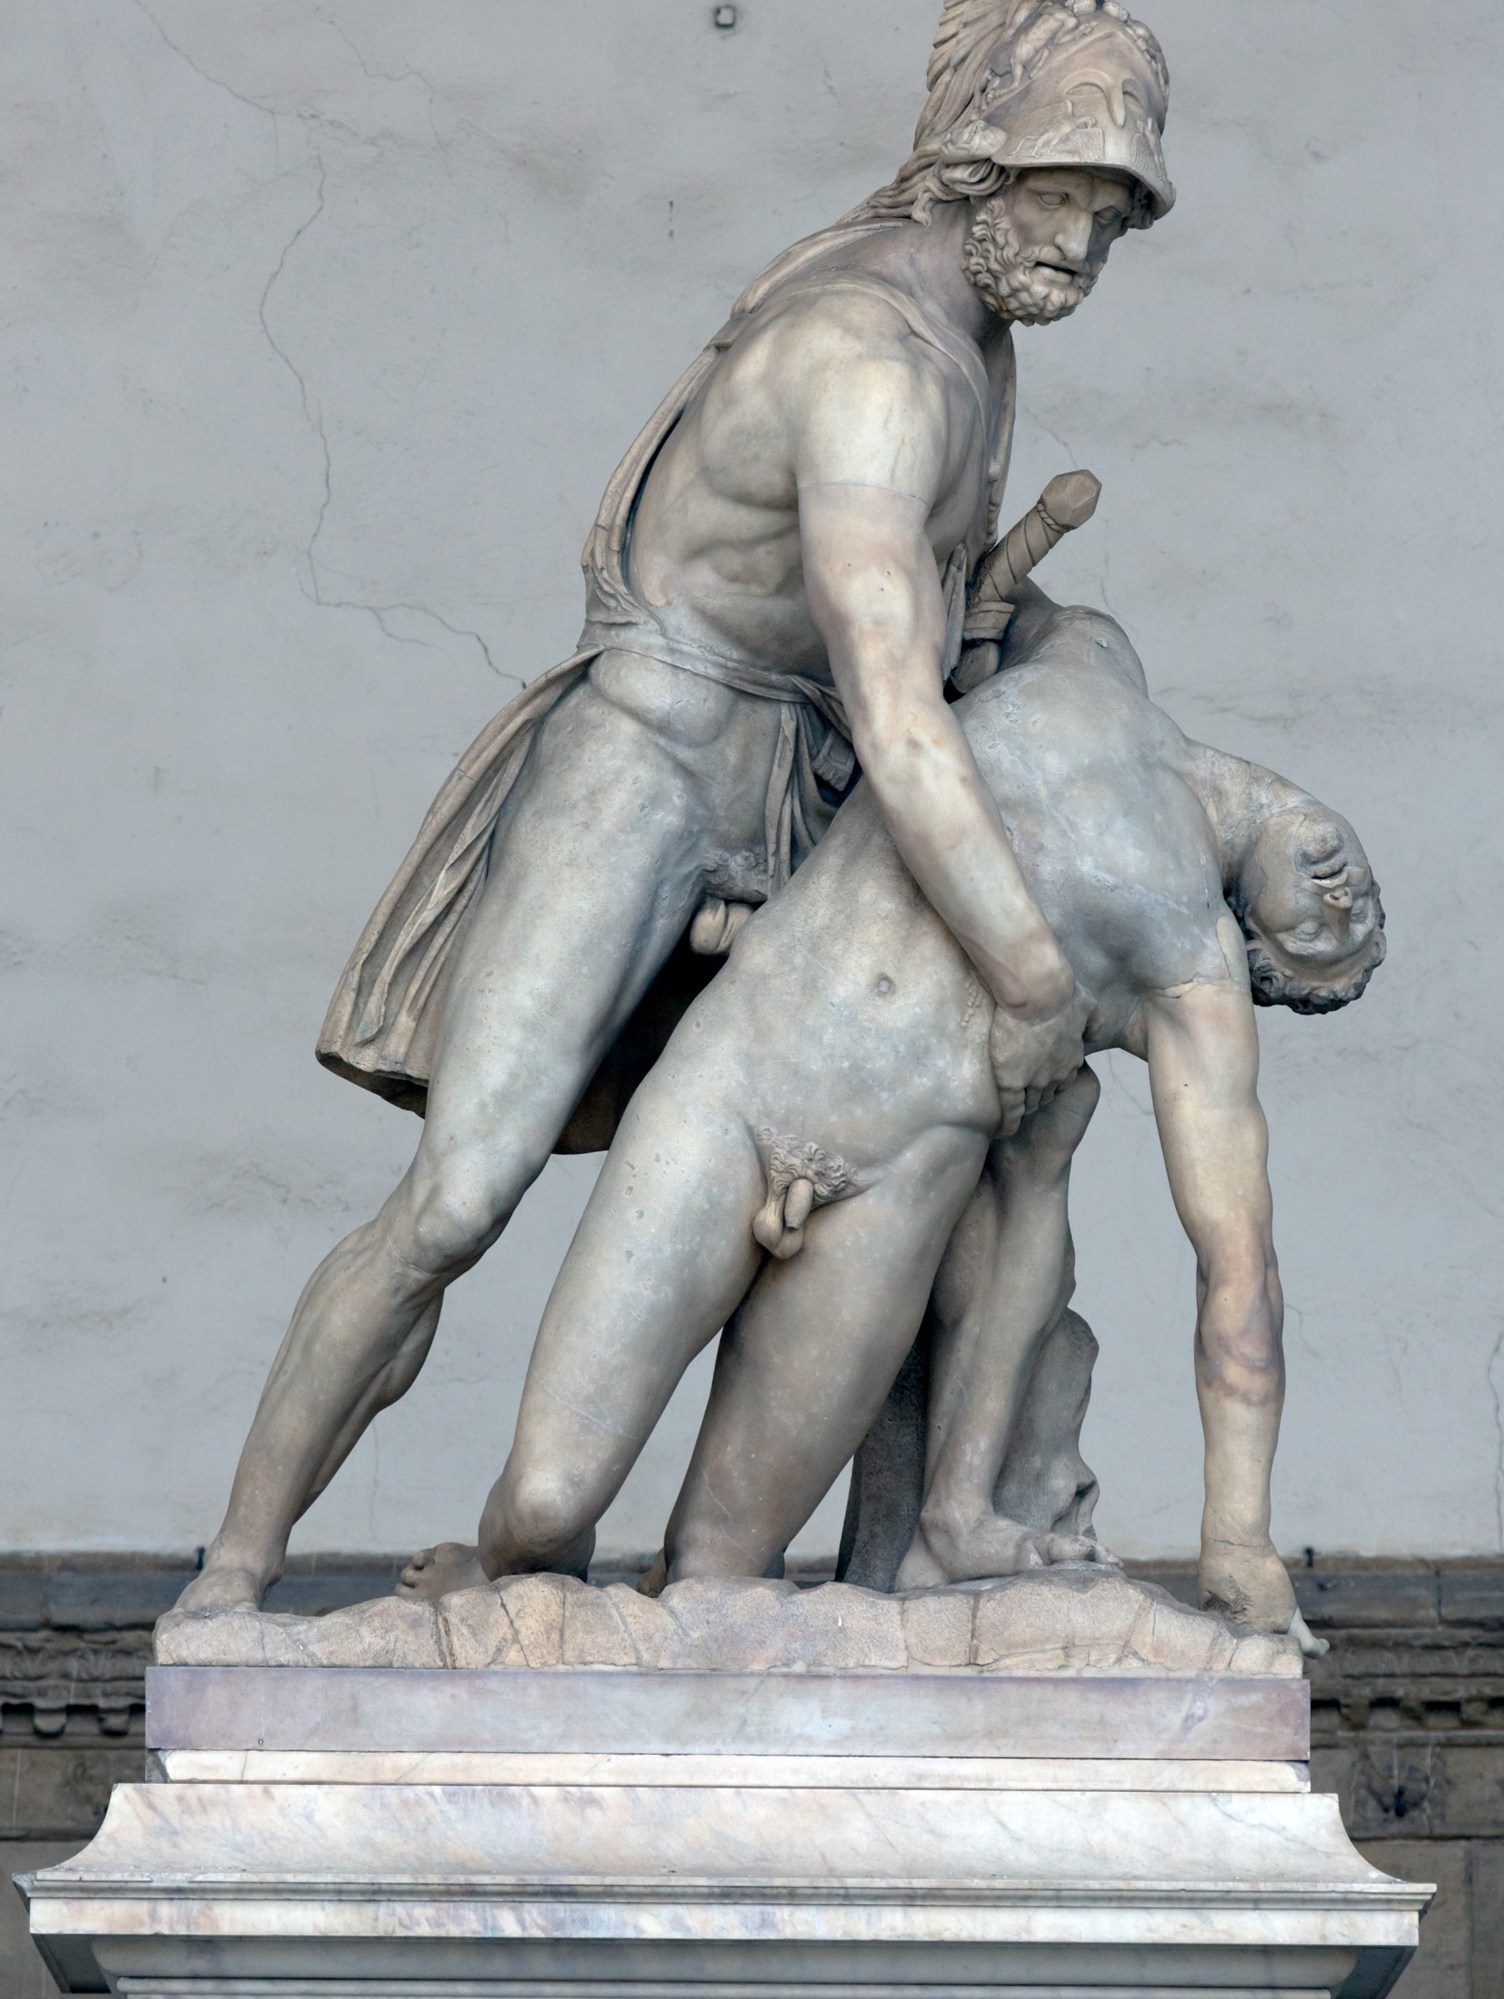
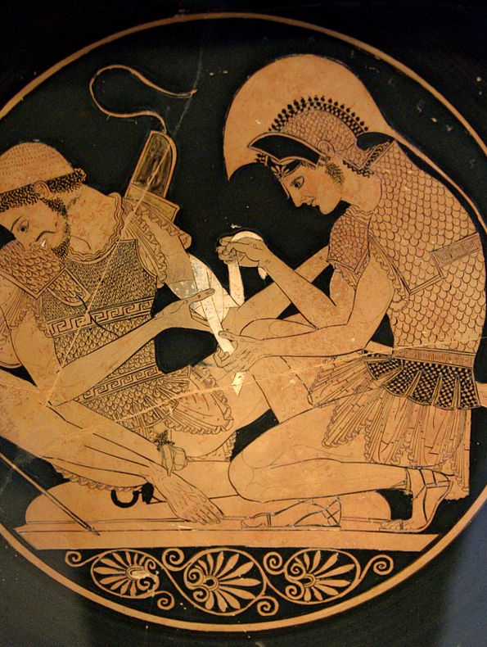
Patroclus
Characteristics:
Role:
Epithets:

Slide 12
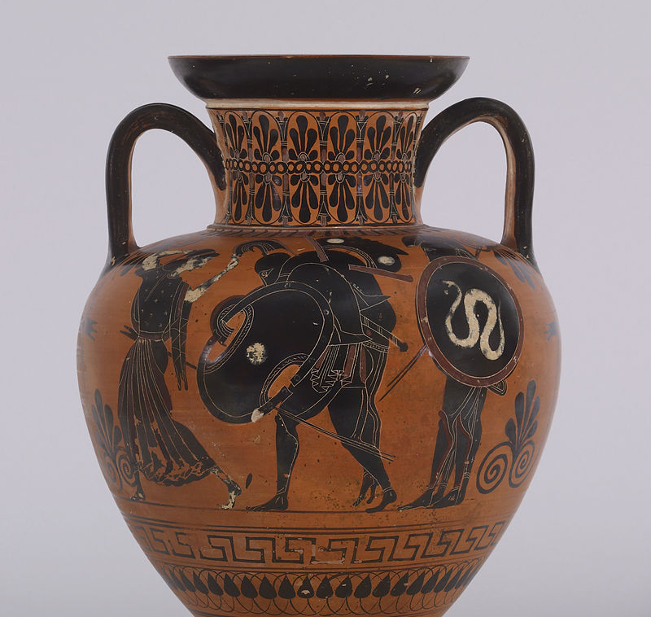
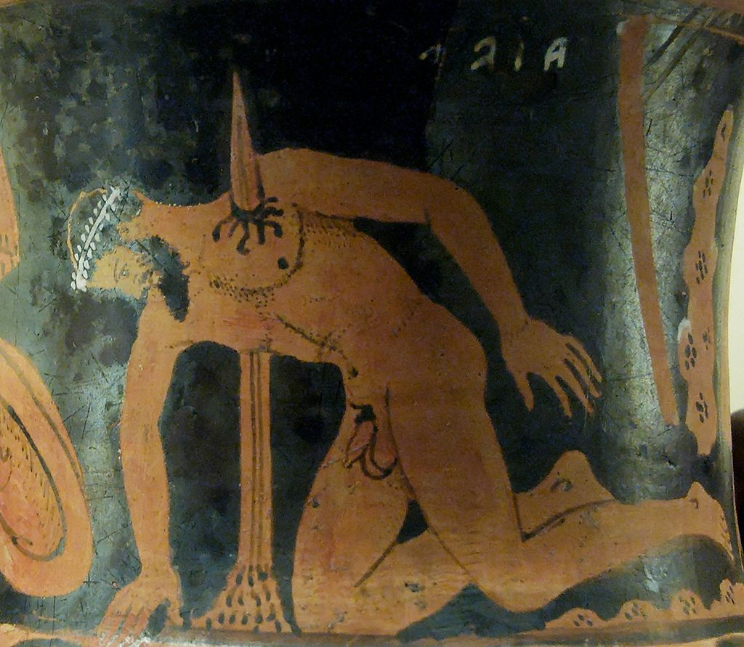
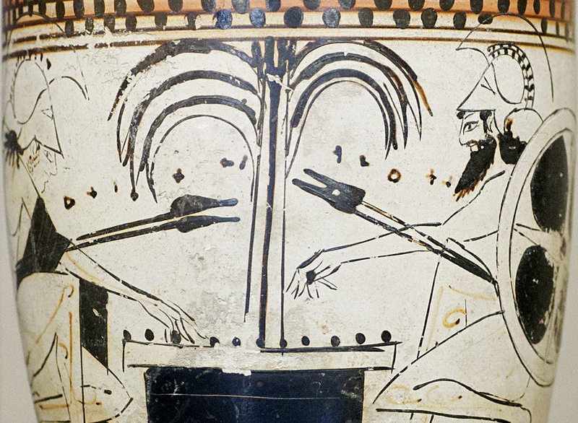
Greater Aias/Ajax
Characteristics:
Role:
Family:
Epithets:

Slide 13
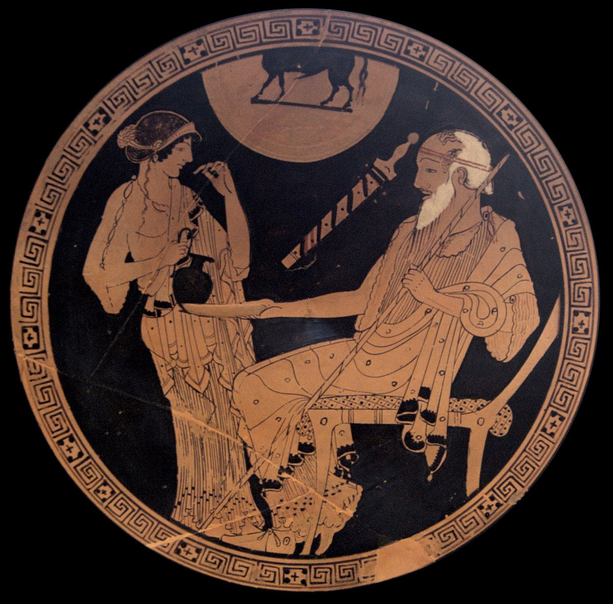
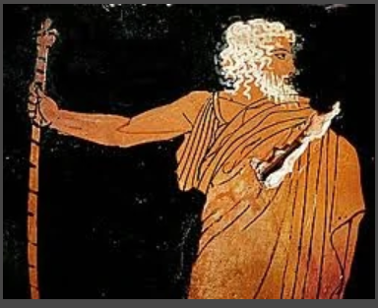
Nestor
Characteristics:
Role:
Epithets:

Slide 14
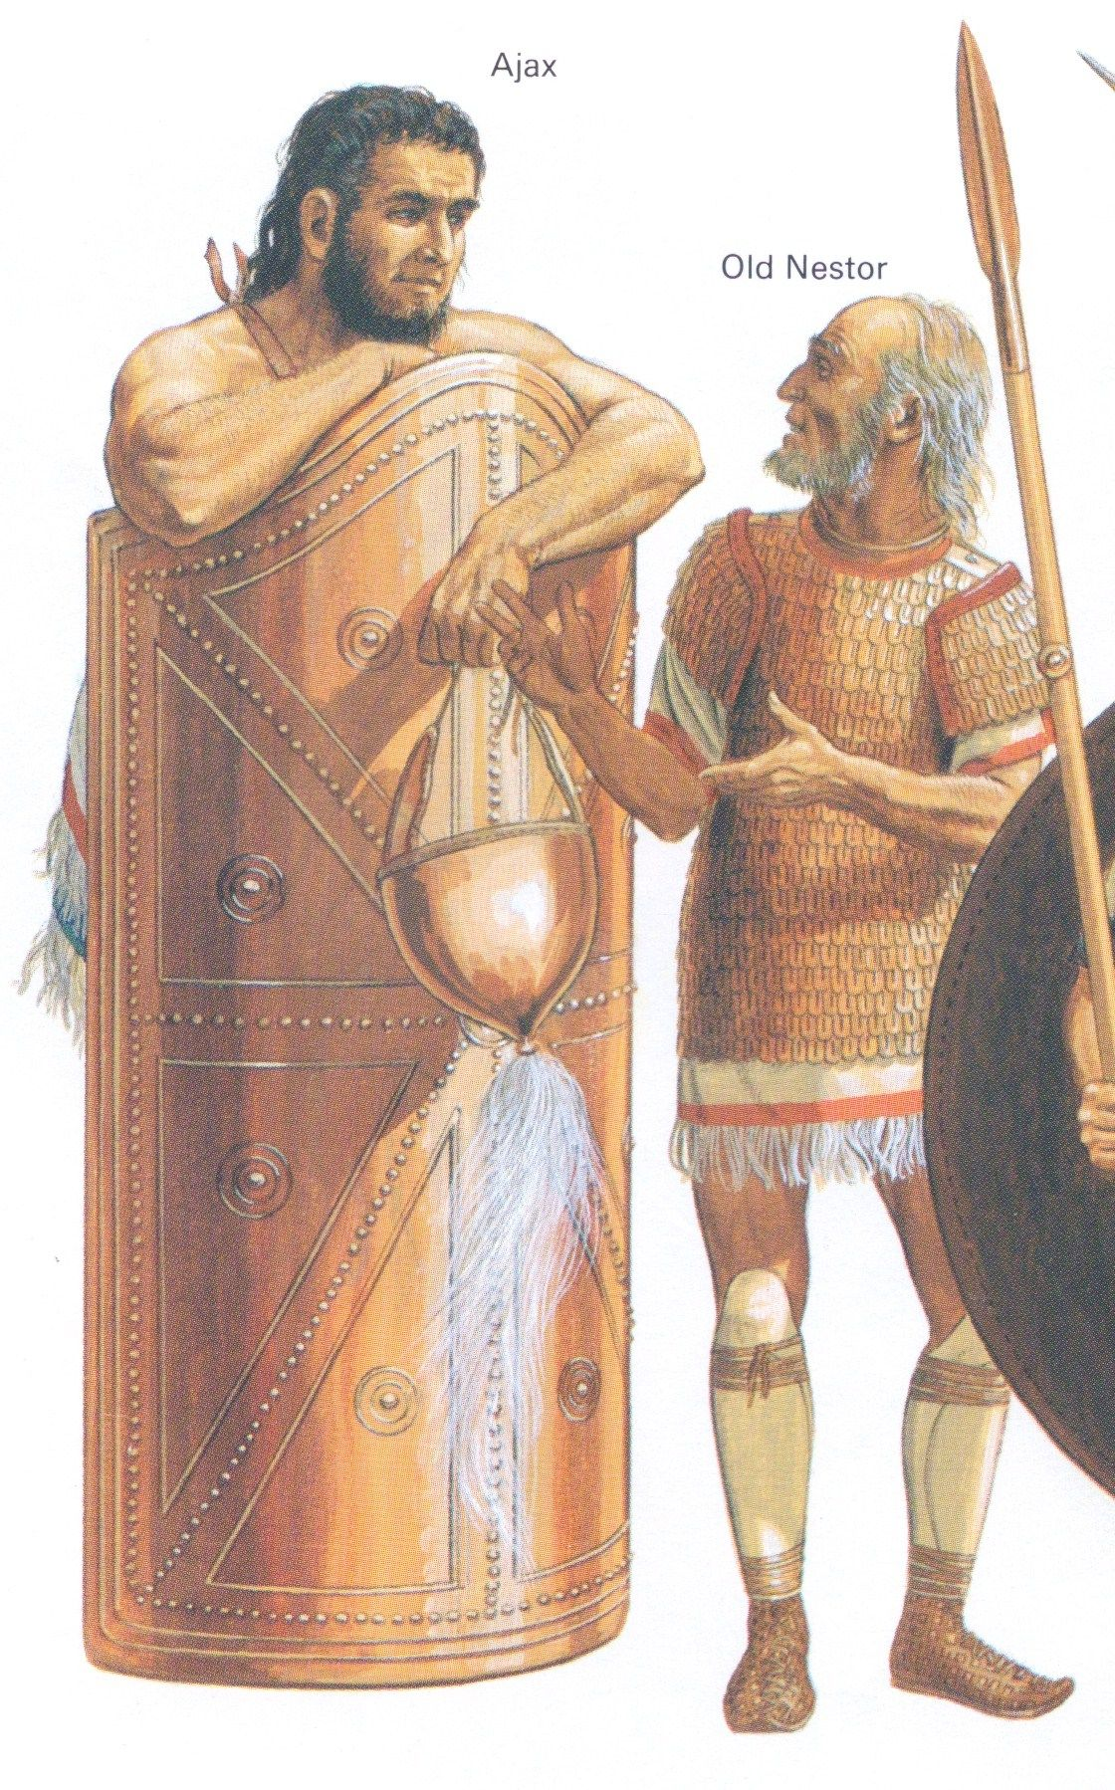

Slide 15
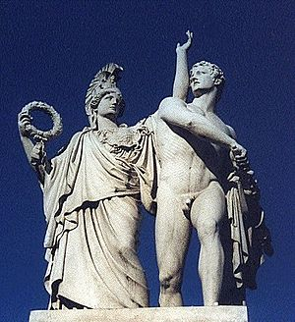
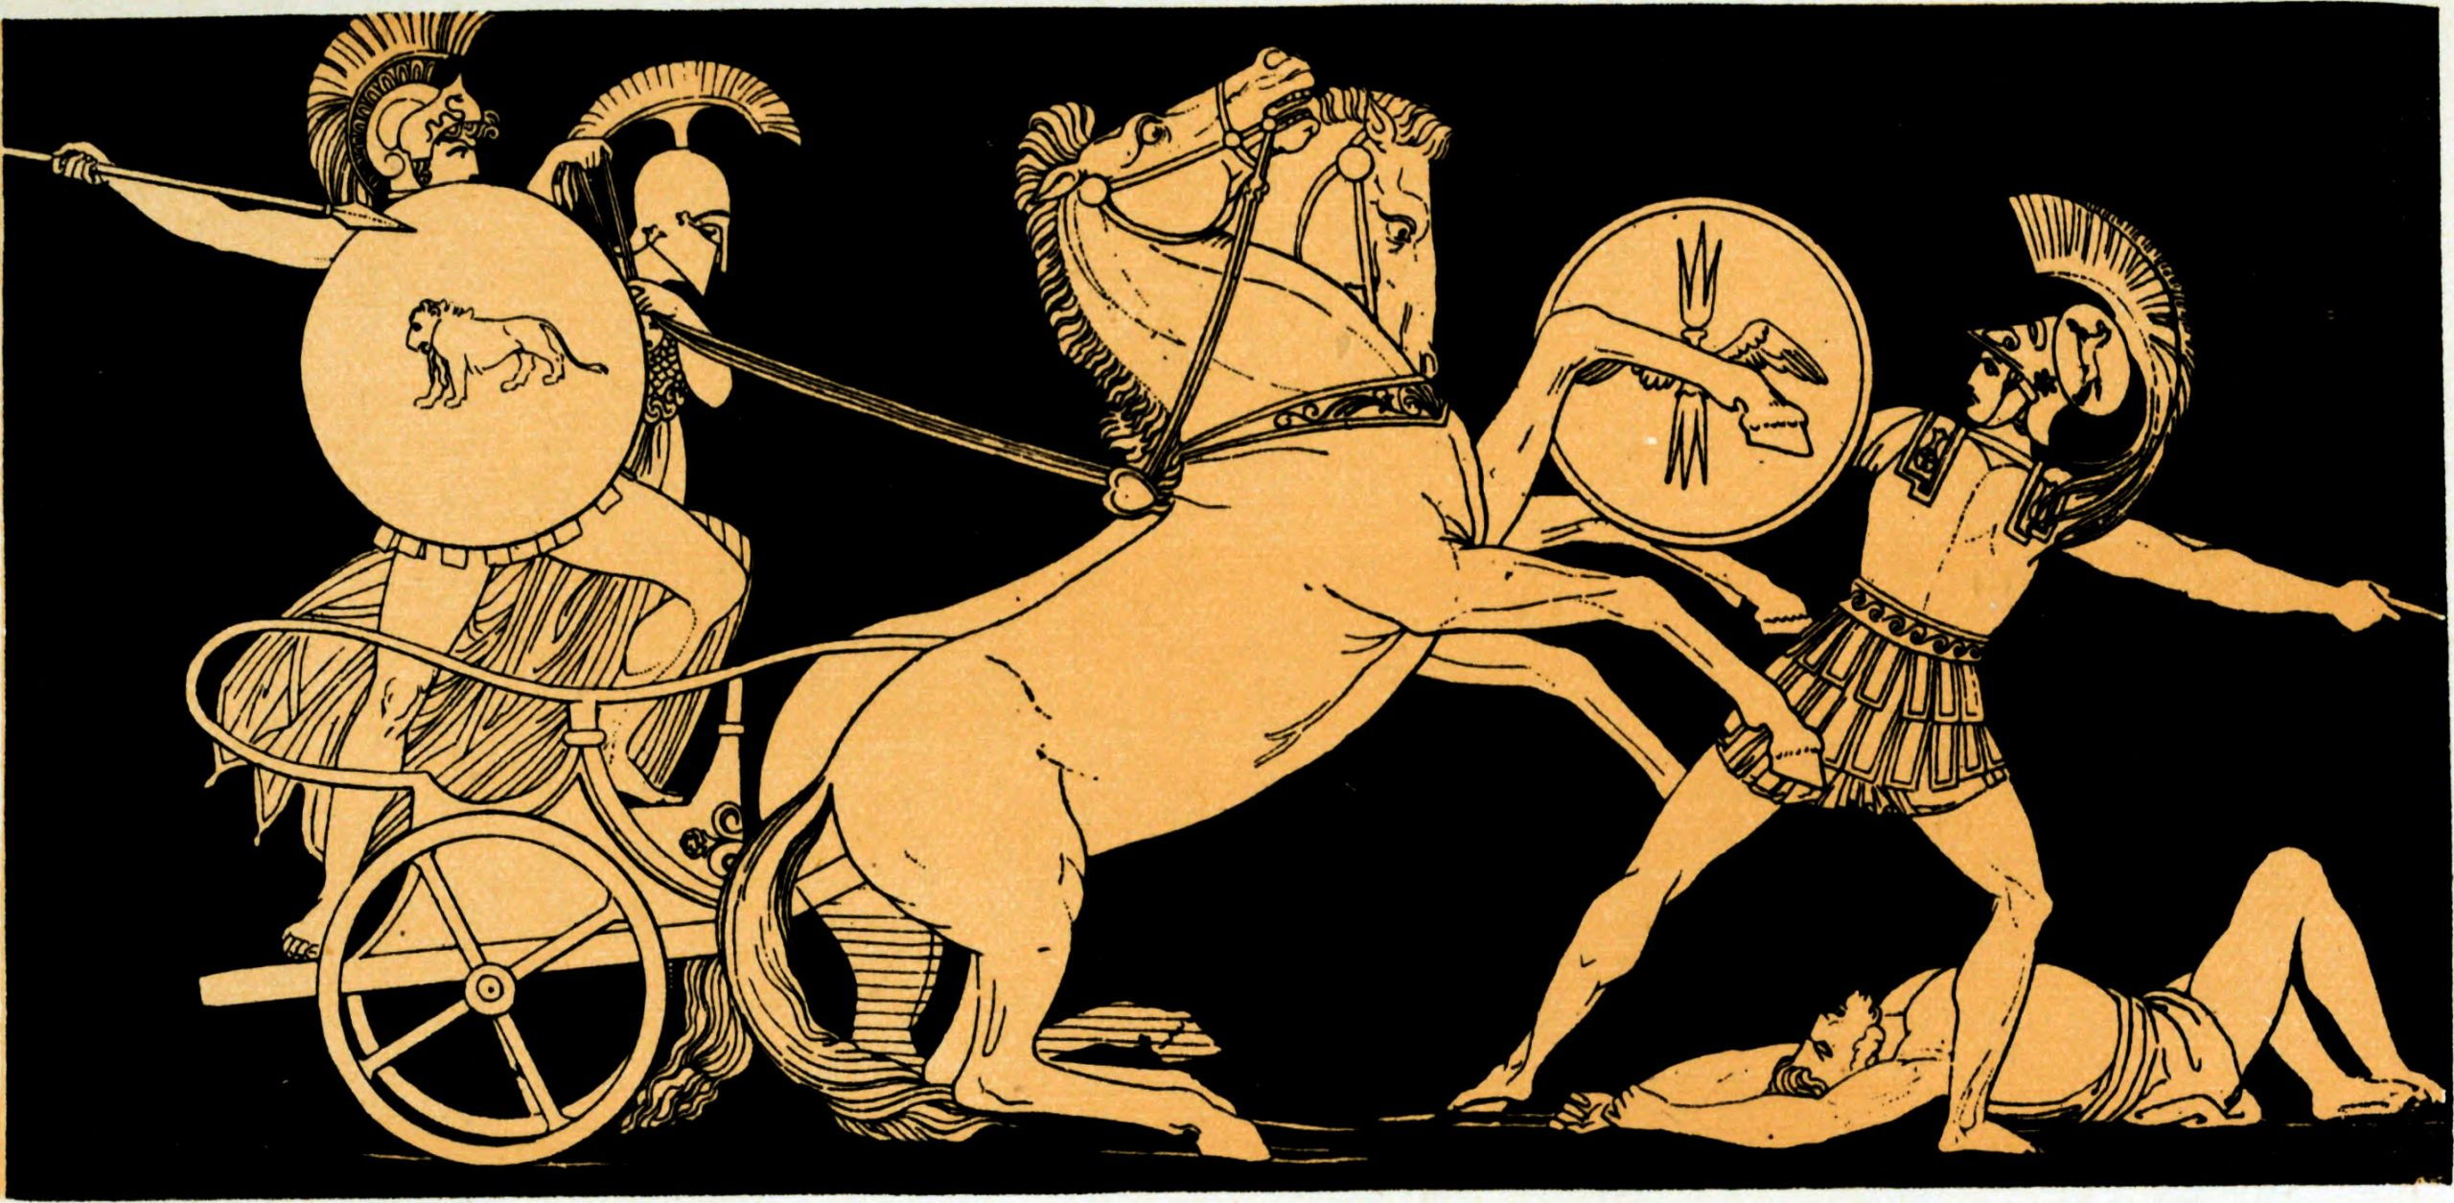
Diomedes
Characteristics:
Role:
Epithets:

Slide 16
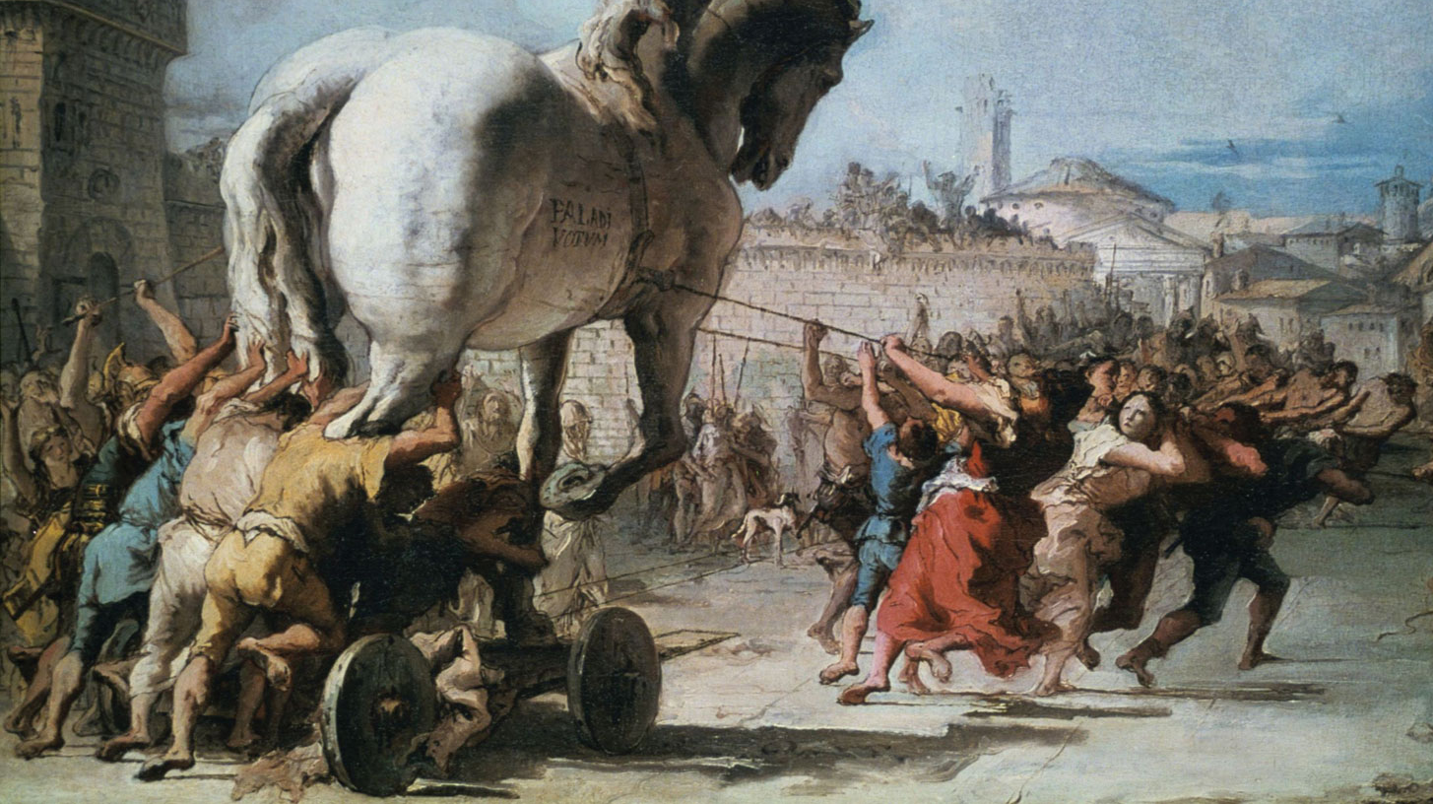
The Trojans:
In the Iliad

Slide 17
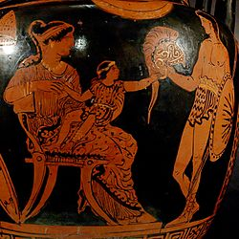
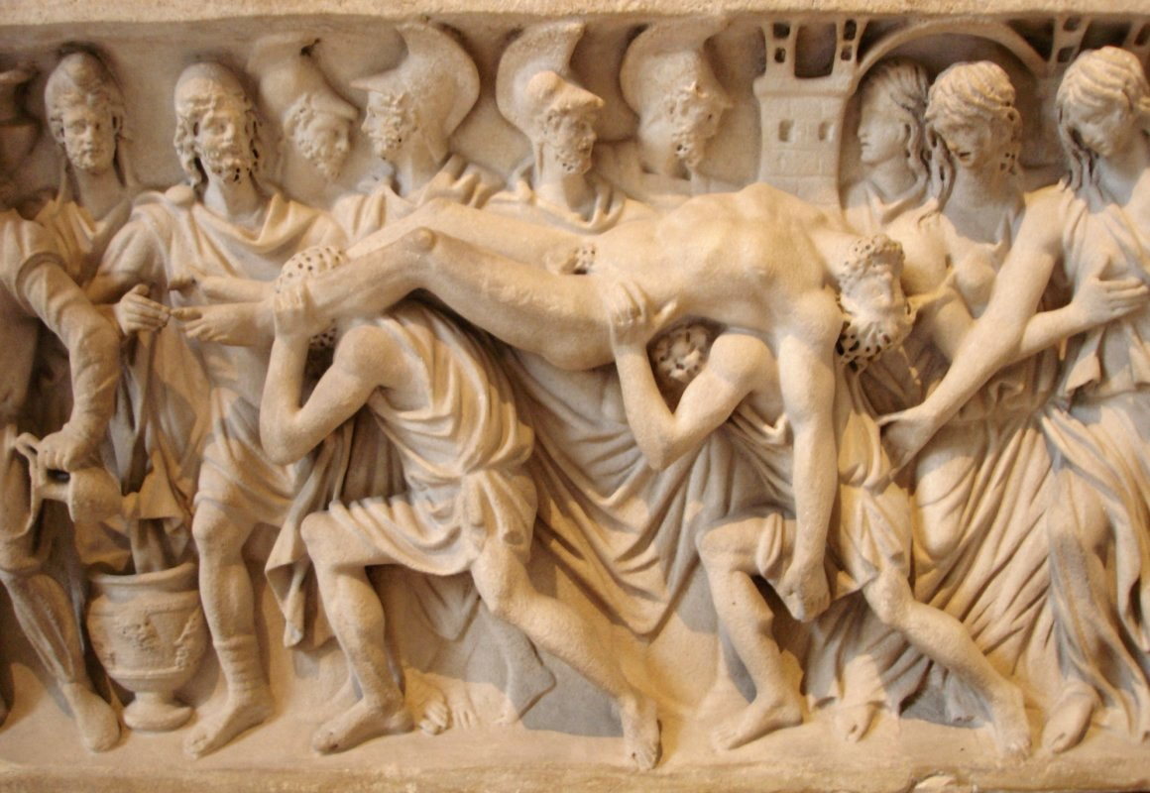
Hector
Characteristics:
Role:
Family:
Epithets:

Slide 18
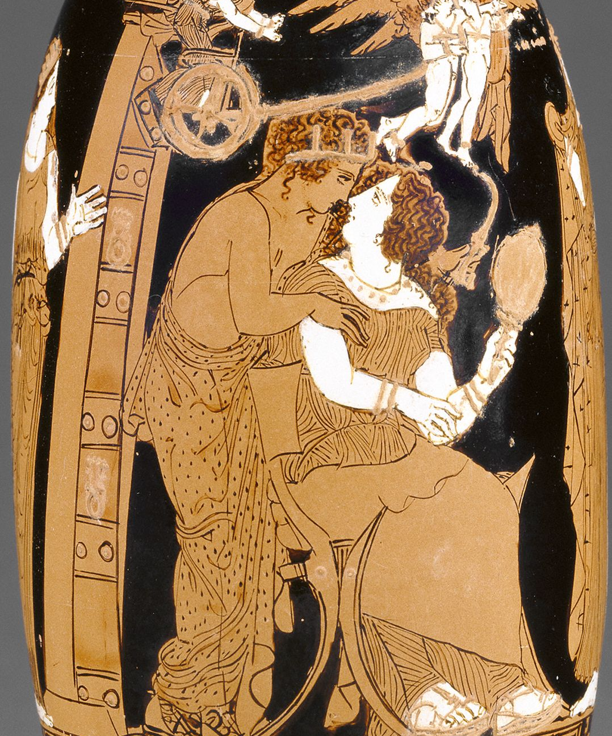
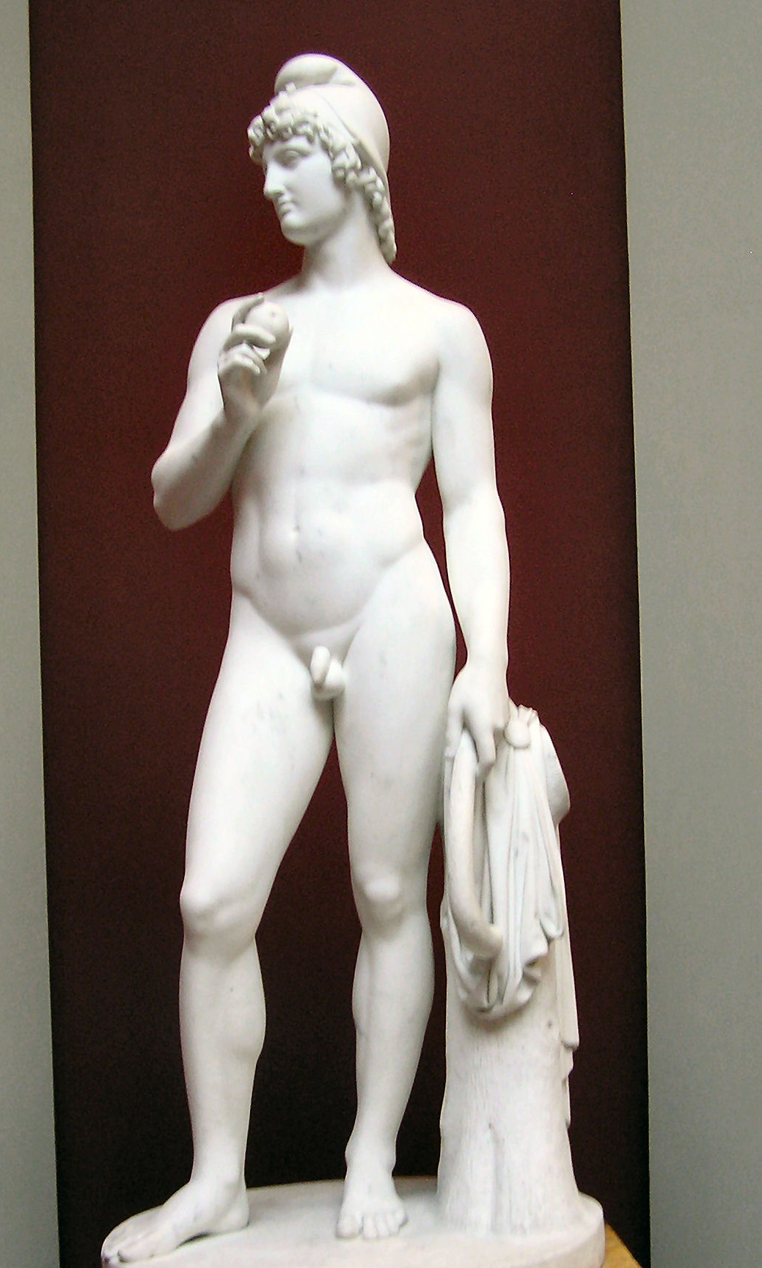
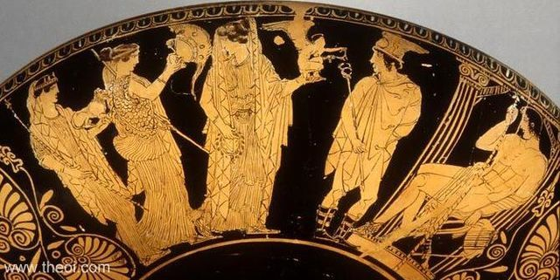
Paris
Characteristics:
Role:
Family:
Epithets:

Slide 19
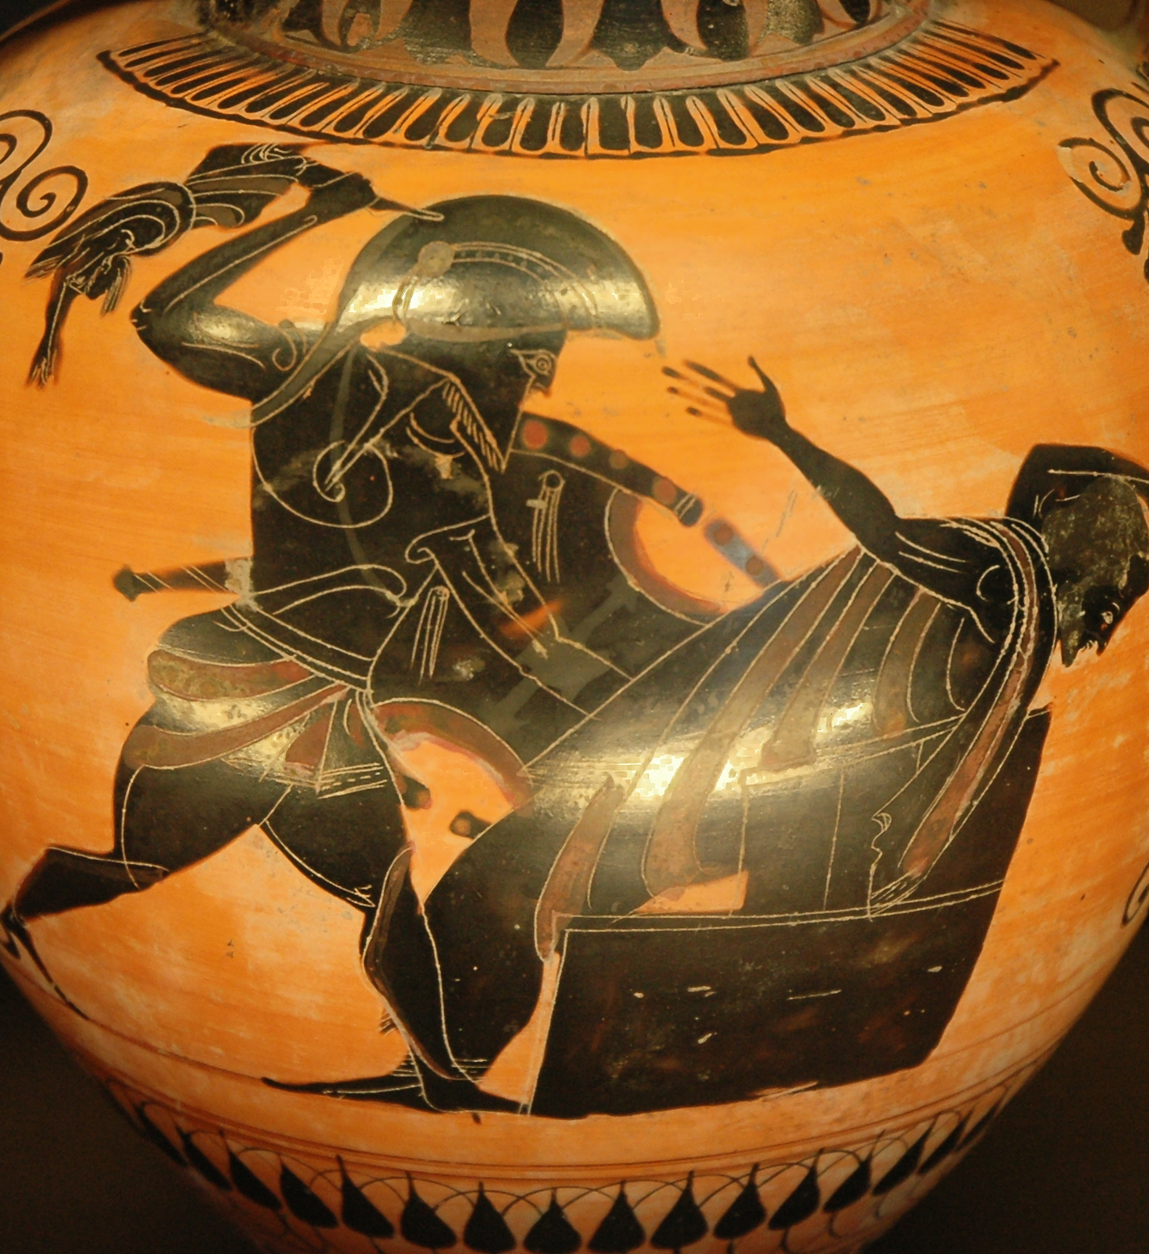
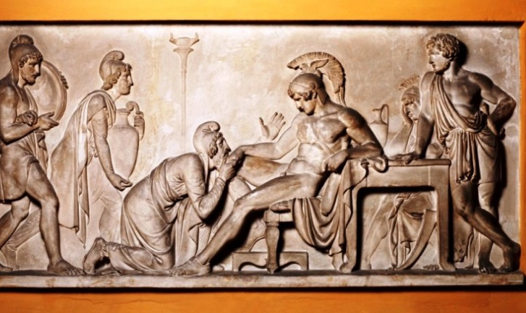
Priam
Characteristics:
Role:
Family:
Epithets:

Slide 20
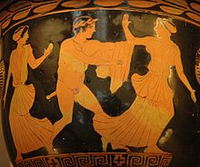
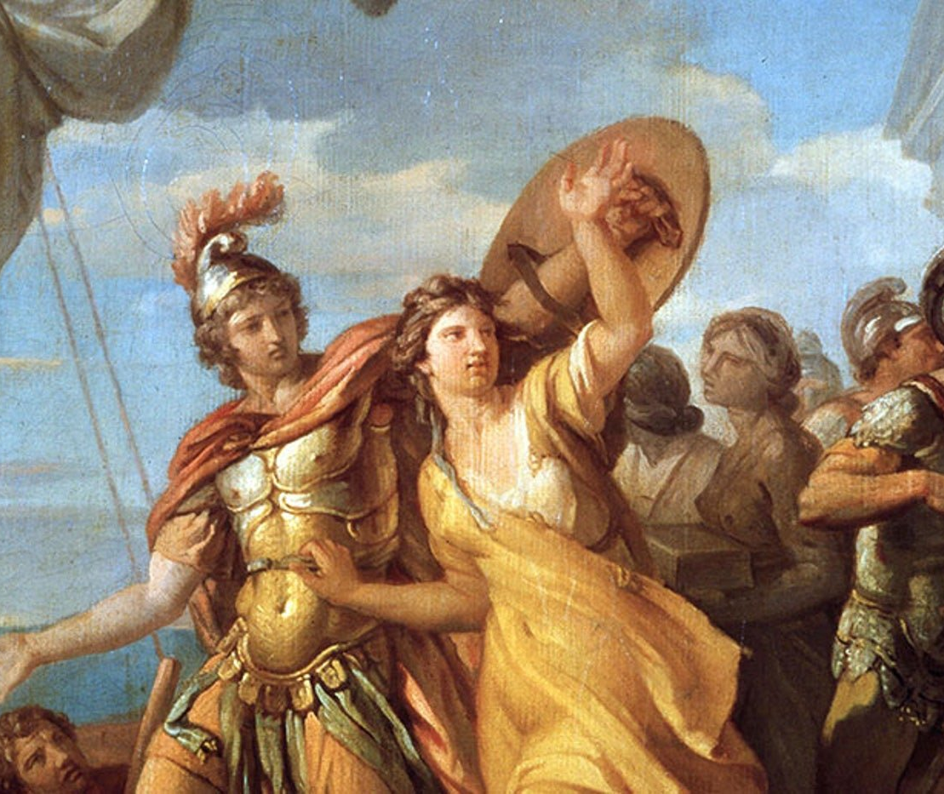
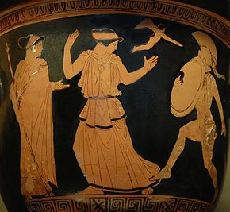
Helen
Characteristics:
Role:
Family:
Epithets:

Slide 21
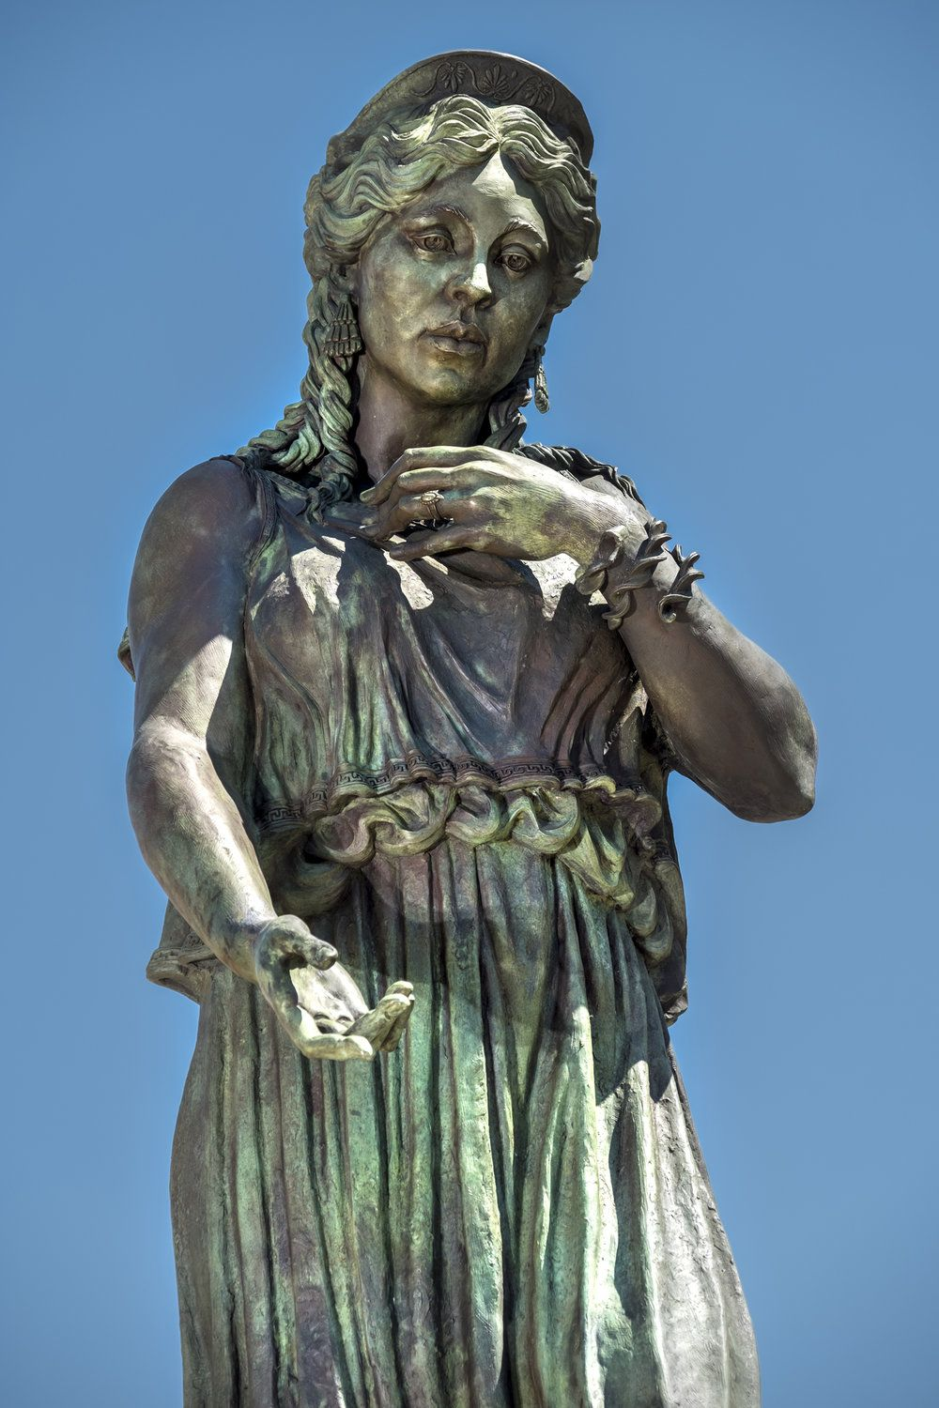
Hecuba
Characteristics:
Role:
Family:
Epithets:

Slide 22
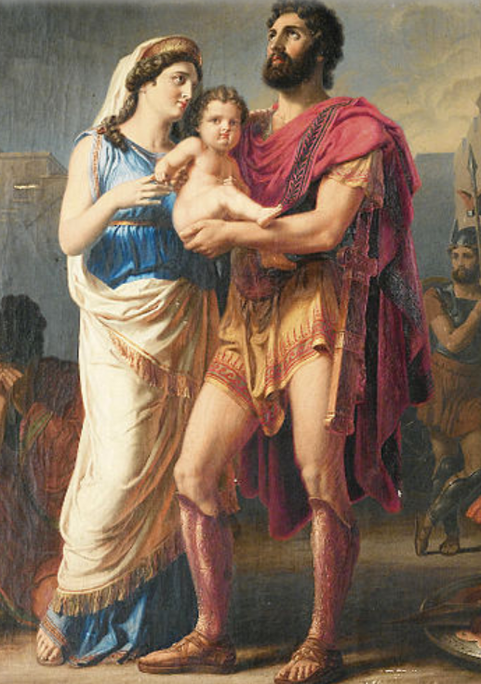
Andromache (& Astyanax)
Characteristics:
Role:
Family:
Epithets:

Slide 23
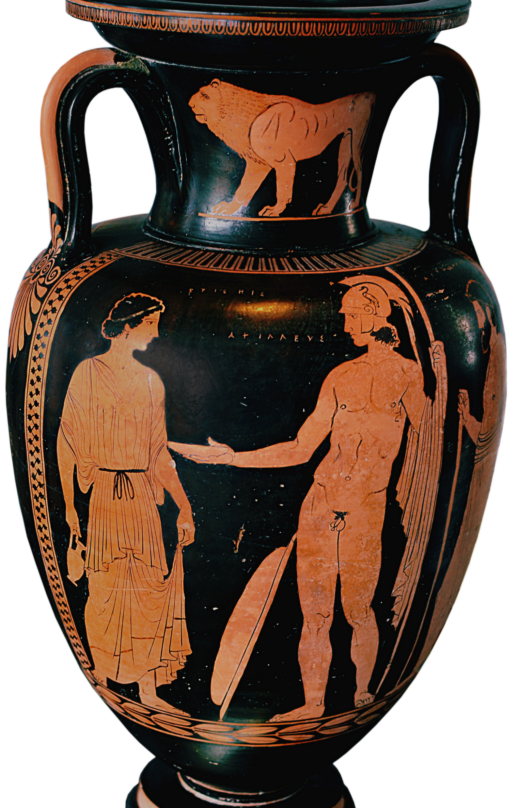
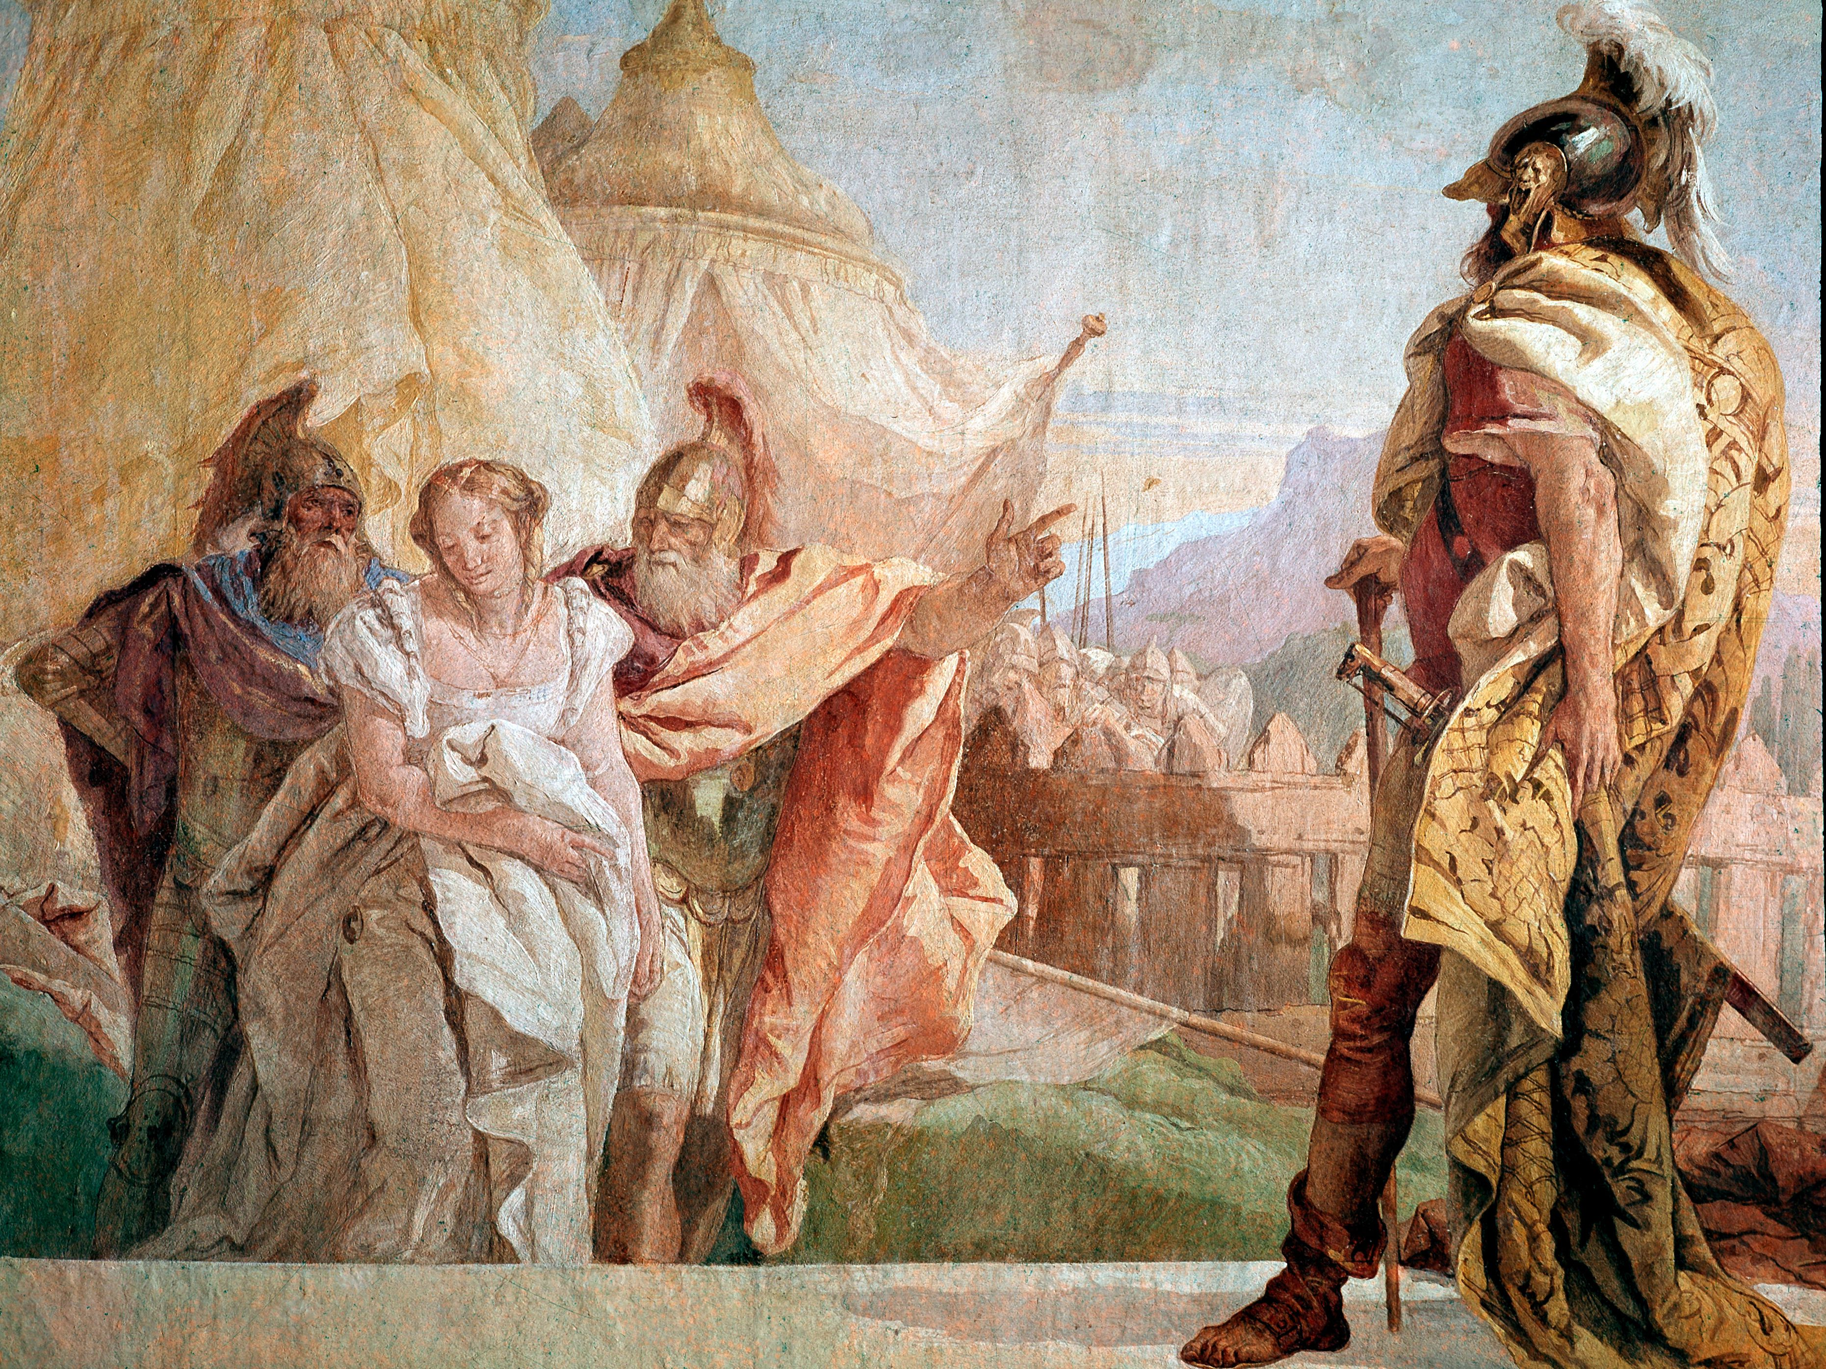
Briseis
Characteristics:
Role:
Family:
Epithets:

Slide 24
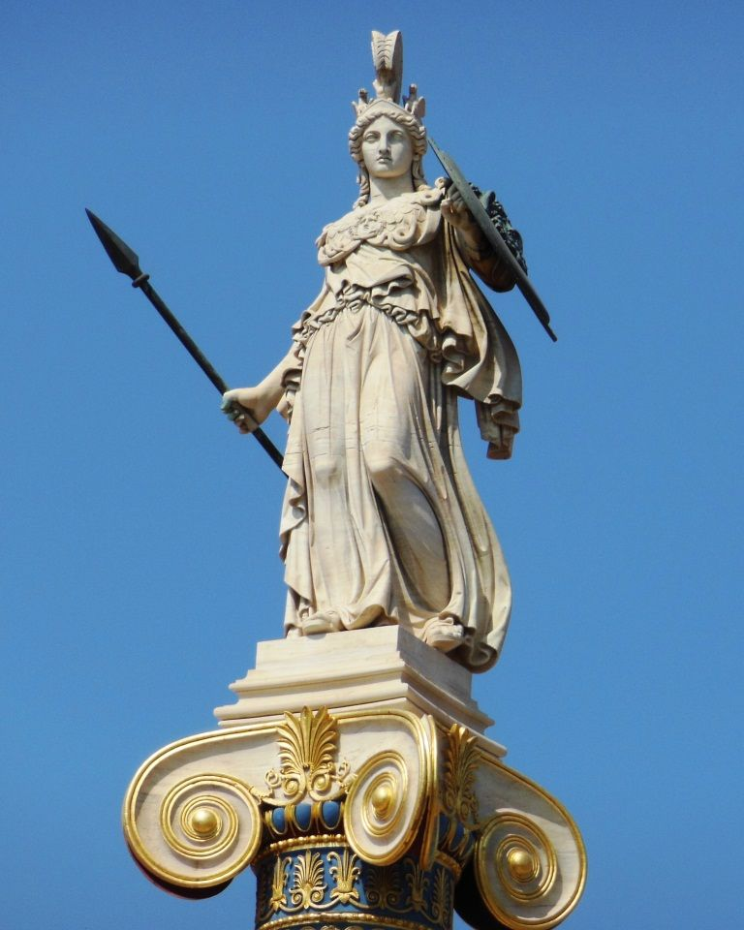
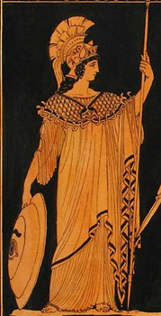
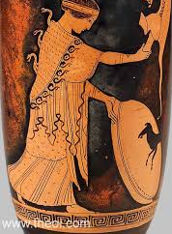
Athena
Characteristics:
God of:
Side in War:
Family:
Epithets:

Slide 25
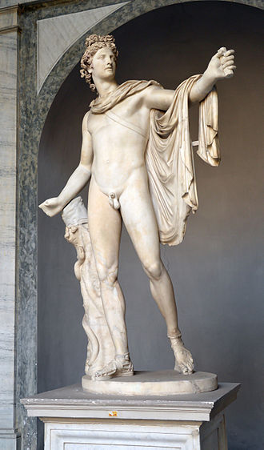
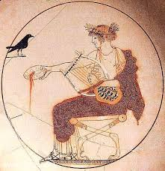
Apollo
Characteristics:
God of:
Side in War:
Family:a
Epithets:

Slide 26
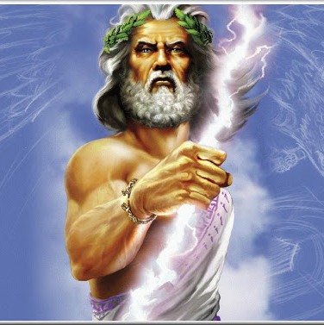
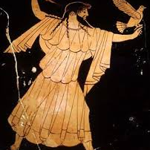
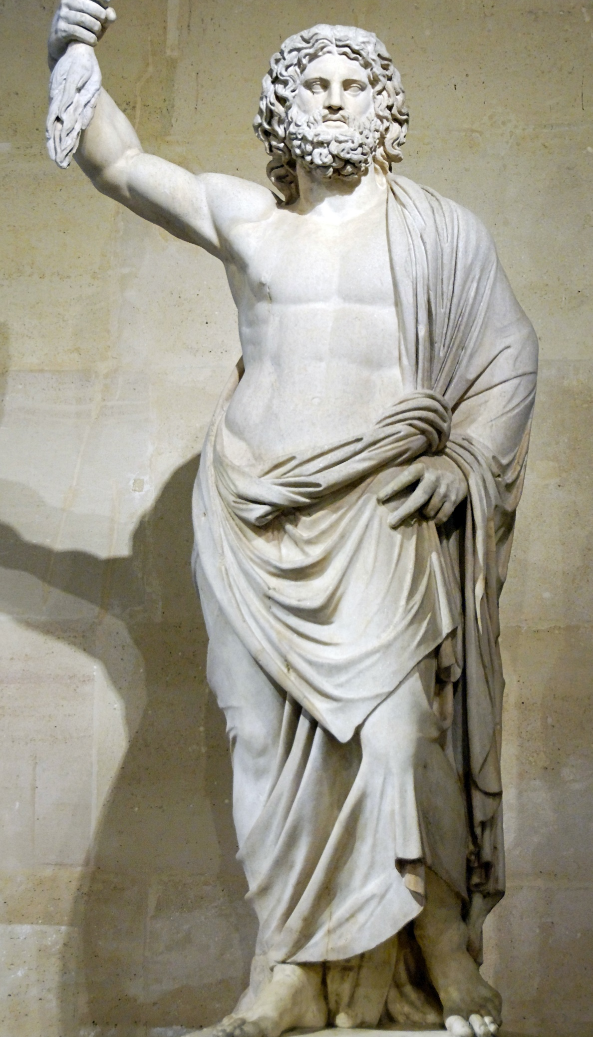
Zeus
Characteristics:
God of:
Side in War:
Family:
Epithets:

Slide 27
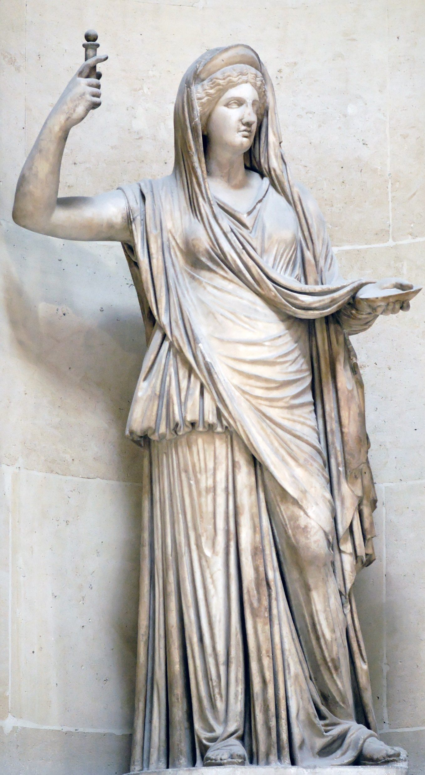
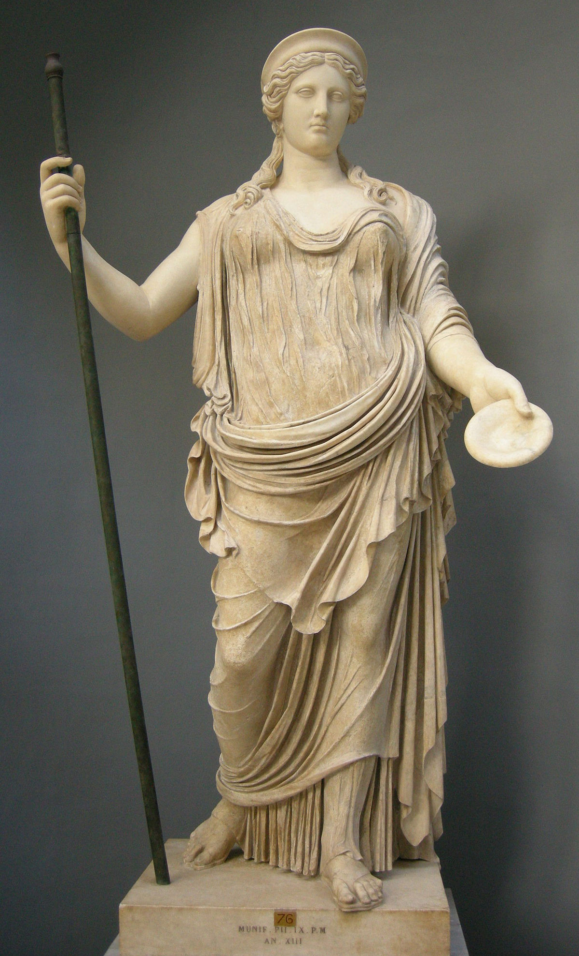
Hera
Characteristics:
God of:
Side in War:
Family:
Epithets:

Slide 28
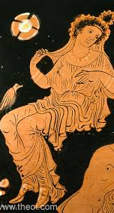
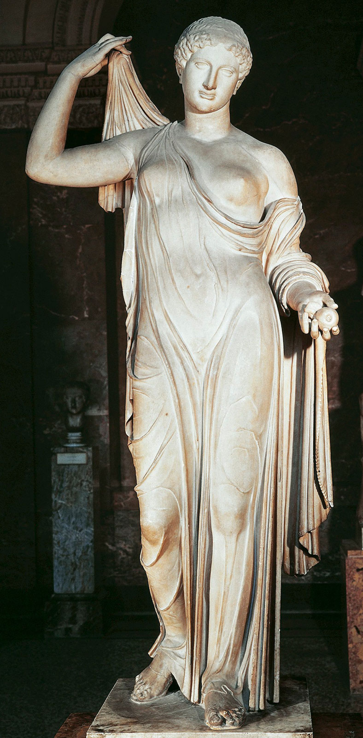
Aphrodite
Characteristics:
God of:
Side in War:
Family:
Epithets:

Slide 29
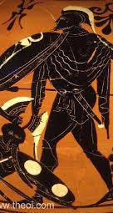
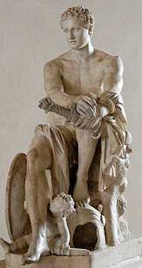
Ares
Characteristics:
God of:
Side in War:
Family:
Epithets:

Slide 30
Thetis
Characteristics:
God of:
Side in War:
Family:
Epithets:

Slide 31
Hermes
Characteristics:
God of:
Side in War:
Family:
Epithets:

Slide 32
Hephaestus
Characteristics:
God of:
Side in War:
Family:
Epithets:

Slide 33
Poseidon
Characteristics:
God of:
Side in War:
Family:
Epithets:

