Slide 1
Latin For Literacy

Slide 2
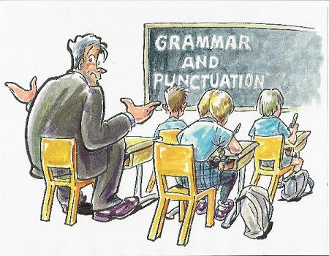

Slide 3
J.C English Chief Examiner’s Report
The technical aspects of language – spelling, grammar, punctuation, paragraphing and syntax – need to be addressed further.
Take time to learn about the grammatical rules and conventions of the language. Ask your teacher to explain points of grammar which puzzle you.
Experiment with tenses. You don’t have to be stuck with present, past and future. Other tenses can add clarity and subtlety to your writing.

Slide 4
Take particular care with spelling and punctuation. English written in your examination answer book will be more complex and varied than that used for texting on your mobile phone. Good spelling and well-used punctuation add clarity and precision to your writing.
COMMON GRAMMAR ERROR:
I should of went to the theatre yesterday…
COMMON SPELLING ERROR:
The discription of the confrence …

Slide 5
Latin Lesson
Signposted Prepositions
de populo
Possessive Case
Genitive: vox populi
NO Auxiliary Verbs in Latin
voco: I am calling or I call.
vocavi: I have called or I called

Slide 6
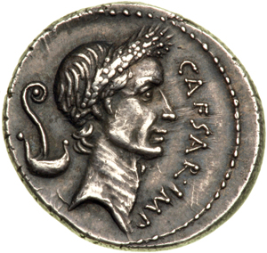
Common Error
When he came.
He saw it.
Which he conquered.

Slide 7
Latin Lesson
Sentence Structure and Components
Subject object verb
phrases, fragments, sequence of tenses
Main Clause vs. Subordinate Clause
Relative Clauses in Latin
Antecedent and relative pronouns
Roma erat magna urbs, quam Romulus constituit.

Slide 8
Vocabulary & Spelling
scribo, scribere scripsi, scriptum
Scribe, inscribe, scriptures, description, prescription, scribbles
scribo
scríobhaim → Irish
écris → French
escribo → Spanish
scrivo→ Italian

Slide 9
Latin is ALIVE & all around us
Mottos:
Ad astra
Superbia in Proelia
Phrases:
et cetera
quid pro quo
Inscriptions
Church Latin:
♫ dona nobis pacem ♫
♪ adeste fideles ♪

Slide 10
Latin is MODERN & Innovative
ICT: Apps, websites, and more
http://www.cambridgescp.com/Lpage.php?p=clc^oa_book1^intro
http://youtu.be/IIAdHEwiAy8
https://www.youtube.com/watch?v=B-J4Mdw5MEg
https://www.youtube.com/watch?v=25hvBya6MjE

