Slide 1
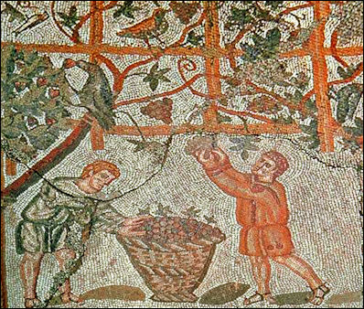
Professions and Politics
- Pompeii

Slide 2
Public Life - Government
Officials | Duties | Term of Office | How Appointed
Decuriones (about 100) | Town councillors for overall supervision. | life | Appointed by the council itself (you had to have property – and connections).
Duoviri (2) | Chief officials for the administration of justice. | 1 year | Elected by all Pompeii’s Roman citizens (male).
Aediles (2) | Officials for the maintenance of public buildings and order. | 1 year | Elected by all Pompeii’s Roman citizens (male).
Seviri Augustales (6) | Priests of the state Religion. | life | Appointed by the council
The Pompeiians like the Romans had a complex city and society to run.
Unlike today, towns and cities in the Roman empire had a lot more power to self-govern.
For this reason they needed several elected/appointed officials for things to run smoothly.
In order to become one of these official you had to belong to the right family – trained from a young age for public speaking.
He would also have to gain a name in the military or the courts – knowledge of the law and speaking at court was a sign of respect and honor in Rome and Pompeii.

Slide 3
Agriculture
Most people living around Pompeii would have made a living directly or indirectly from farming.
The fertile soil enabled the growing to two main crops each year, possibly even a third minor crop in between.
The main crops grown: vines, olives, wheat, and barley (for bread). Some evidence of chickpeas, beans, and a special kind of cabbage too.

Slide 4
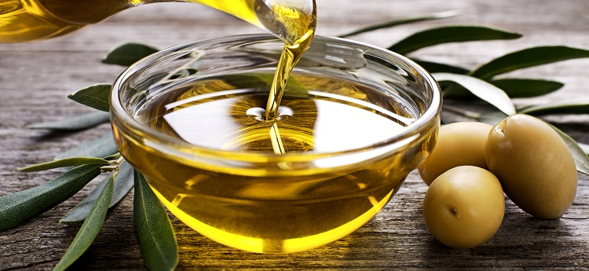
Agriculture: Wine and Oil
The wine produced in Pompeii was very popular – considered of high quality.
There are over 130 bars and inns known in Pompeii.
The wine was usually stored on the farm and sold to the inns as needed.
One farm near Pompeii had storage space for 22,000 gallons (100,000 litres) of wine.
Olives were grown in similar quantities.
The oil would be extracted from the olives in presses made from the local volcanic rock.
It would be used for bathing, lighting, and cooking.
The oil would be stored on the farms till needed.

Slide 5
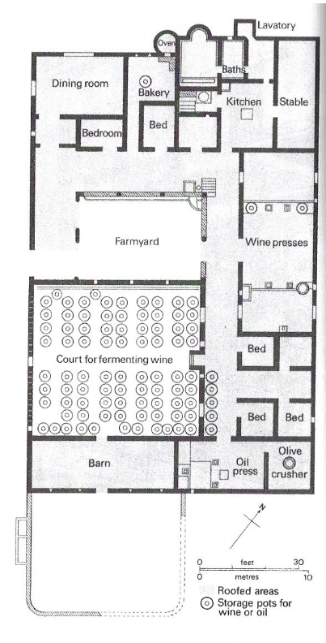
Agriculture: Farms
Farms came big and small – some only enough for a farmer and his family.
Others were large farms with many slaves working on them – both from old noble families and new merchant class families.
See a plan for a farm at Boscoreale in the countryside not far from Pompeii.

Slide 6
Shops
The city of Pompeii owned many of the shops which they rented to private citizens. Most shops were public owned, though there would have been some privately owned shops, baths, and inns.
These shops were often made by altering the private house to a new use. For instance, a retired centurion rented out premises in his house to an ex-soldier of his who was working as a cobbler.
Marcus Vesonius Primus, a fuller, had the vats, ovens, and wheels used in his trade in his own house.
A shop usually consisted of two rooms, a backroom used for living in and working in, and front room with a large opening on to the street where goods were sold. Shops selling similar goods would have been together
Advertisements would have been on the walls. An innkeeper wrote: ‘Once on of my hams is cooked and set before a customer, before he tastes it, he licks the saucepan in which it was cooked.’

Slide 7
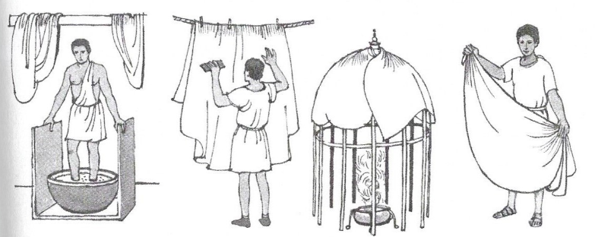
Fulling
One of the most important professions in Pompeii were the Fullers – they even had there own guildhall in the forum.
Fullers were people who bleached and dyed cloths.
We know a lot about this process because Lucius Veranius Hypsaeus had paintings of the various stages on the walls of his mill.
Raw wool was washed, stretched and dyed in the fulling mills and dirty garments were cleansed.
There were small vats in which the wool or cloth was cleaned by workers who trod it in a mixture of fuller’s earth, potash, carbonate of soda and urine.
After this treatment the cloths was rinsed in larger vats and then hung over canes or lines to dry in the sun.
The wool was dyed with mineral or vegetable dyes. The colours were made fast by soaking the cloth in vinegar, or something similar, and heated in stoves.

Slide 8
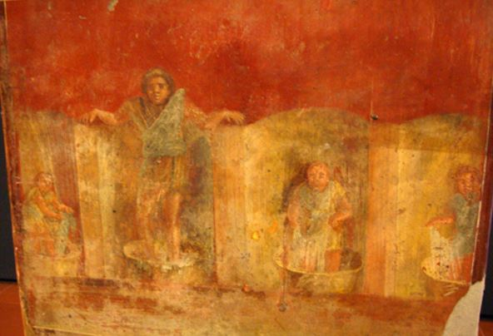
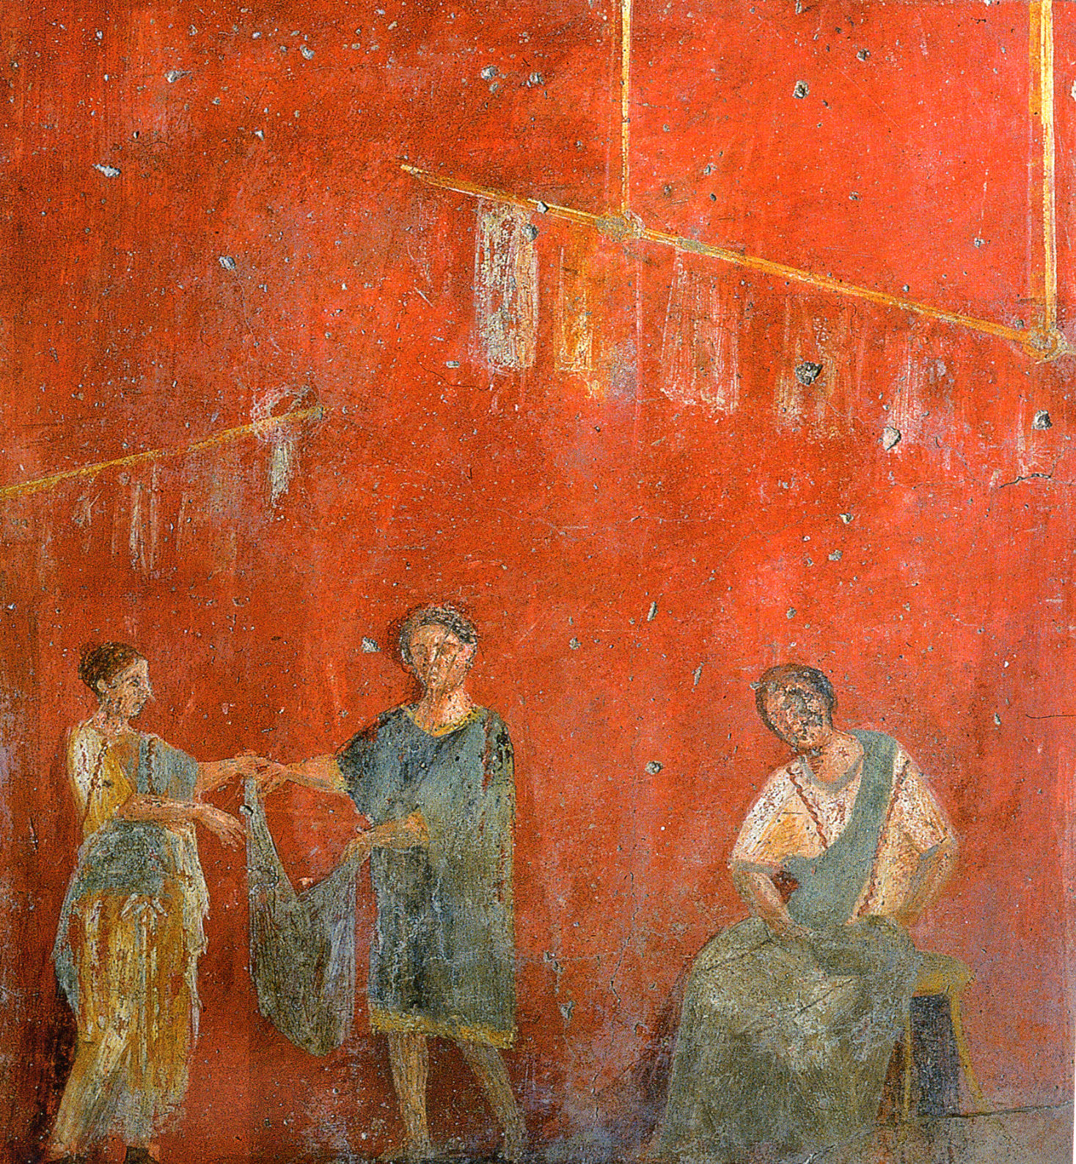
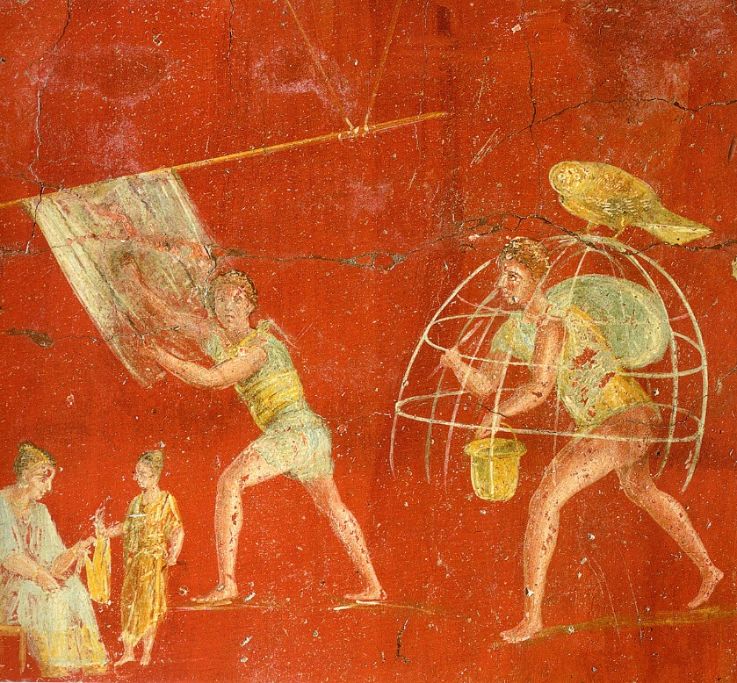
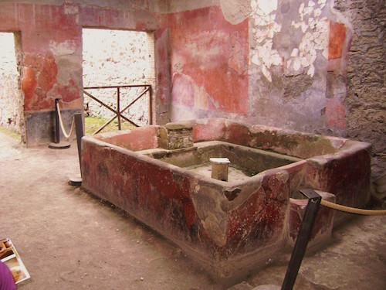

Slide 9
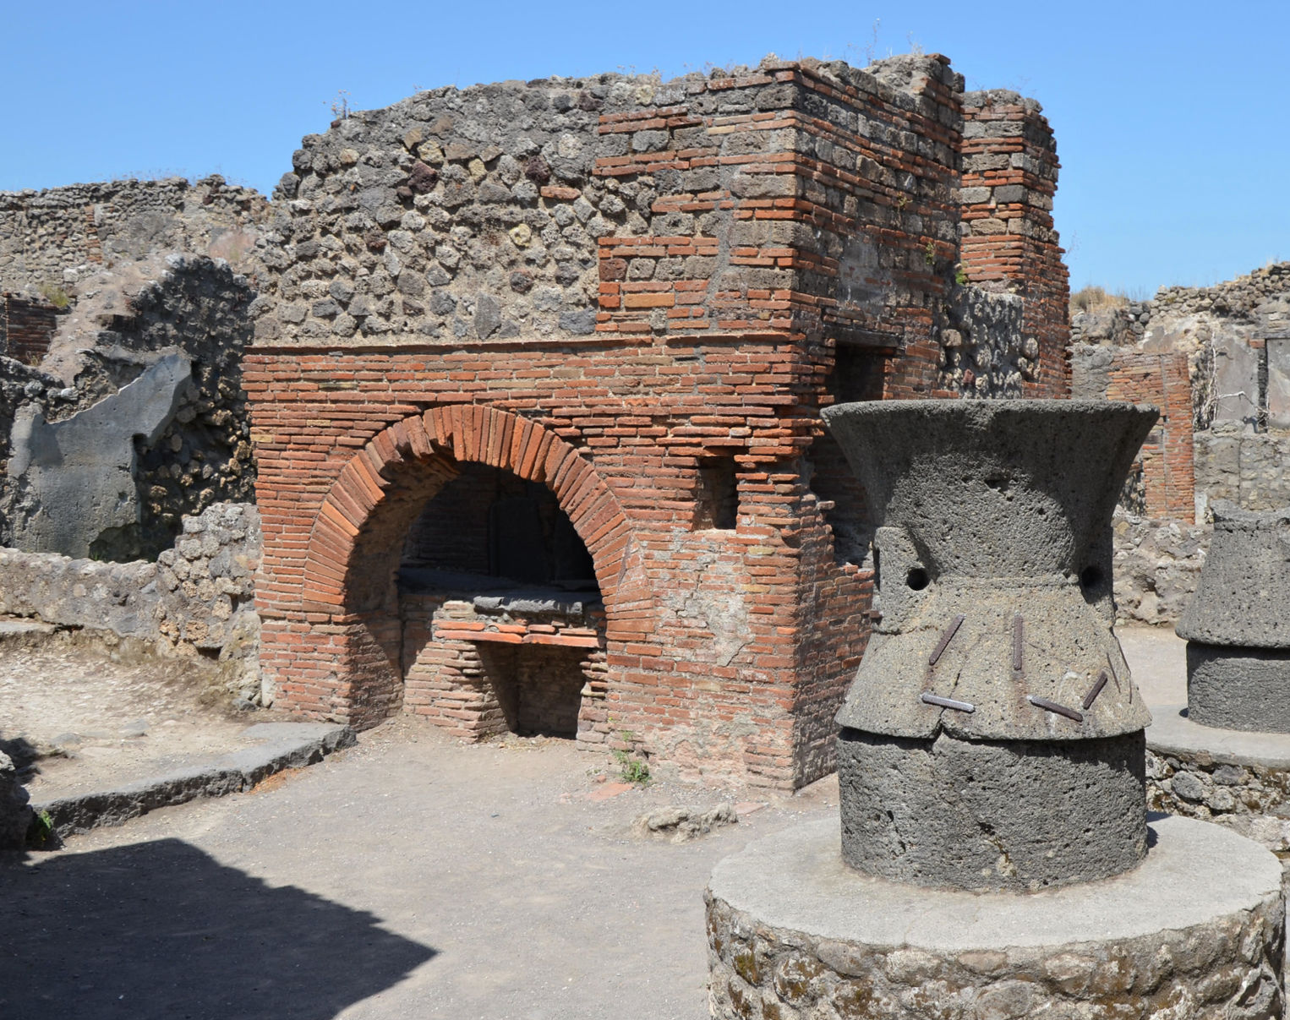
Baking
Baking bread was another important job.
The grain was ground in mills made of a fixed stone with a second stone rotating on top. The grain was fed through a hollow that ran down the centre of the upper stone.
The flour would come out at the sides where the two stones met.
Sometimes the mill was turned by a donkey, but often slaves had to do this hard task.
Once separated from the bran (or husks), the flour was mixed with water and other ingredients to make dough. The dough was made into round loaves and baked. Then sold.
This took place in one building.
We know a ten kinds of Roman bread and dog biscuits.
Some loaves were found during excavations.

Slide 10
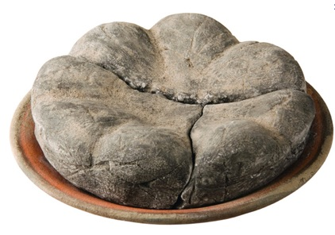
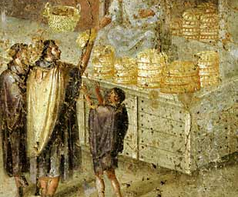
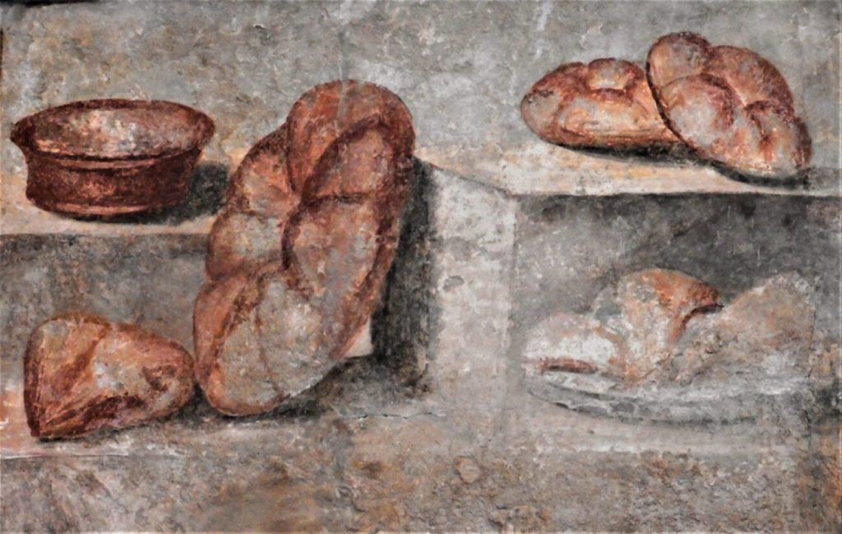

Slide 11
Inns
Inns would serve cooked meals as well as drink.
Judging from their large numbers, these inns employed several hundred people.
Inns advertised by a picture, perhaps of a gladiator or a painted notice.
Pompeii was covered with notices painted on the walls of inns, shops, public buildings and eve private homes.
Often the prices of wines or goods were shown.

Slide 12
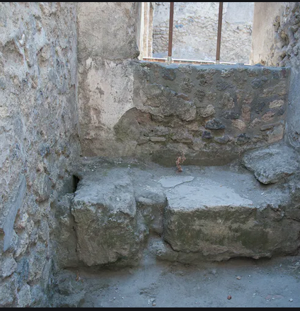
Other Shops/Trades:
Other industries included butchers, wineshops, potters, leatherworkers, ironmongers, coppersmiths – there was even a garum shop.
Further to the inns their were also brothels in Pompeii. One was owned by a woman called Asellina upstairs in her tavern.
An inn sign with a phallus might indicate that prostitutes could be hired out there.
Cheaper brothels would have only had small cubicles separated by curtains with obscene paintings on the walls.

Slide 13
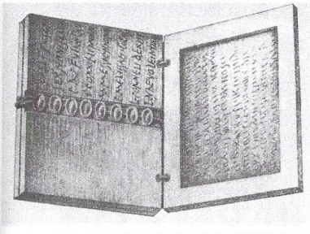
Keeping Accounts
Pompeii was wealthy. So many bankers and money changers would have set up stalls in the forum.
We have an illustration of a one, L. Caecilius Jucundus. 127 of his tablets were found – most of them business receipts or presciptio in Latin.
Most of these were made of three pieces of wood (13cm by 7.5cm) joined at the edge to form a book of 6 pages. 1 and 6 were covers; 2, 3 and 5 were hollowed out, filled with wax and written on with a stylus.
The receipts were written on pages 2 and 3, and the seals of witnesses in was were fixed over the groove in the middle of page 4 (holding the wood together). Signatures were beside the seals. A summary of the receipt was on page 5.

