Slide 1
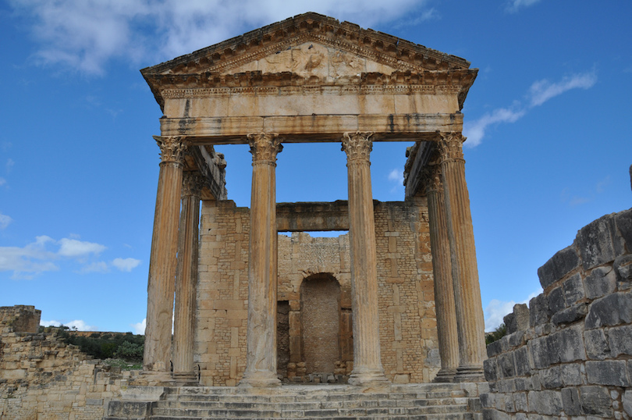
Religion & Temples
Pompeii

Slide 2
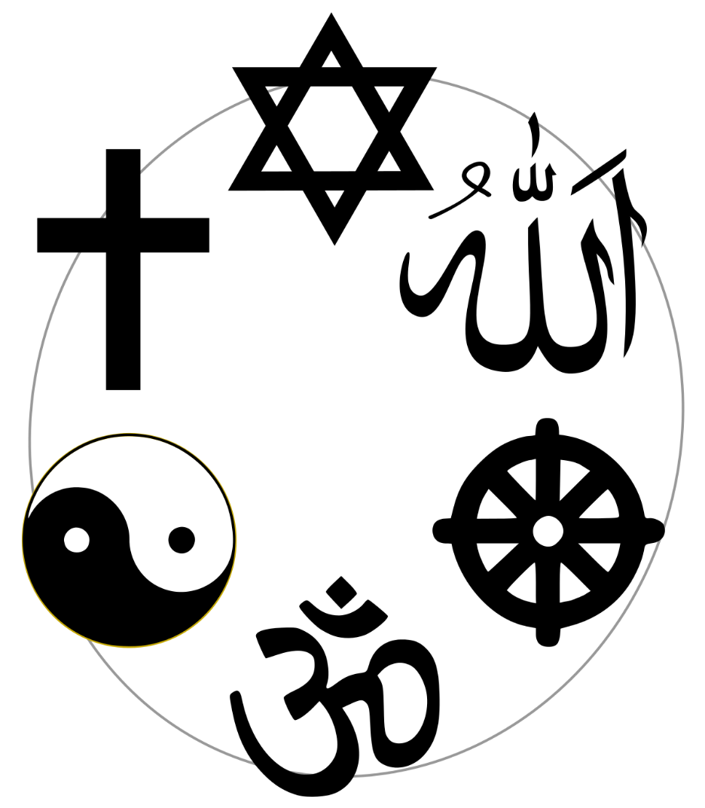
What different Religions do we follow today?
Most western religions today are monotheist meaning they worship one god.
Many of these religions follow the Abrahamic god – Jehovah, Yahweh, Allah, or simply God. E.g. Christianity, Judaism, and Islam.
These religions follow doctrine or dogma – meaning that each religion can be broken down into groups who follow a single agreed upon believe (these are sects). E.g. Catholicism, Anglican Protestant, Presbyterian Protestant, Shia or Sunni Islam.
However, Hinduism and other eastern religions are polytheist meaning they worshipped more than one god – in fact they often have hundreds if not thousands of gods.

Slide 3
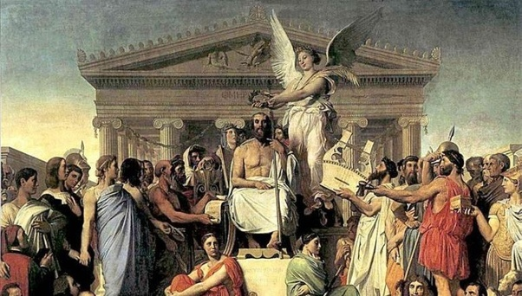
Roman Religion
Traditional Roman religion was polytheist. The Romans worshipped many gods and many different types of Gods. They also often added new gods to there religion – some Greek, Egyptian, or Persian Gods were praised.
It’s easier to adapt new god to your Pantheon (selection of gods) if you accept that there is more than one of them
Roman’s also didn’t have strict dogma for their polytheist religions. While the followed customs for sacrificed and lived according to a religious honour system, and told stories of their gods – as we have seen their myths will often vary.
In Pompeii, we have Temples for the traditional gods, for the household and local gods, and for the new cults (a cult is a part of a polytheist religion that praises a particular god).

Slide 4
Roman Gods-Greek Gods
Greek | Roman
Zeus | Jupiter
Hera | Juno
Athena | Minerva
Demeter | Ceres
Hermes | Mercury
Ares | Mars
Aphrodite | Venus
Artemis | Diana
Apollo | Apollo
Hades | Pluto
Poseidon | Neptune
Hephaestus | Vulcan
Hestia | Vesta
Herakles | Hercules
Dionysus | Bacchus
The Romans did not steal their gods from the Greeks – as is often believed. But, they did align and adapt their gods to the Greek gods.
Notice that Apollo is the same in both religions.
Many of these gods played the same role in both religions – for example Jupiter and Zeus are both the kings of the gods and the lords of the weather/thunder. That is why it was so easy for the Romans to align their gods to the Greeks – and to adapt their believes and myths into their own religion.
However, there are also some key differences. Mars is a lot less violent that Ares; Vesta is a lot more important to the Romans than Hestia was to the Greeks; Bacchus was a foreign god and cult introduced to Rome much later than the others – he didn’t have the same standing as Dionysus did in Greece.

Slide 5
Temples in Rome

Slide 6
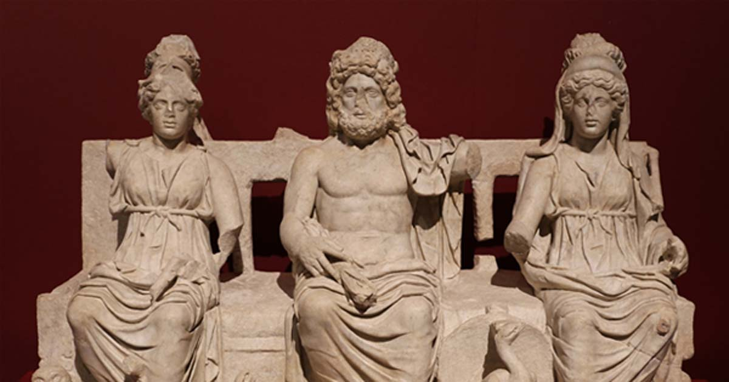
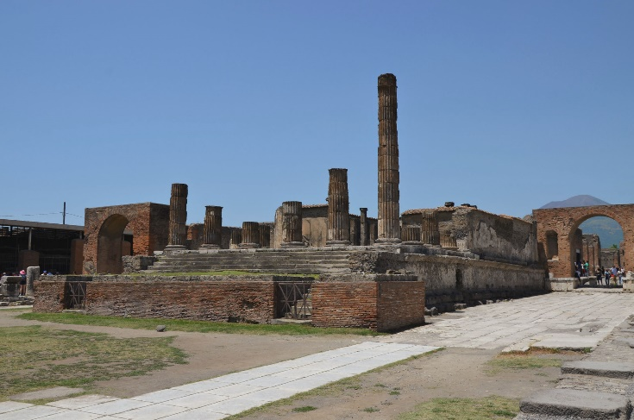
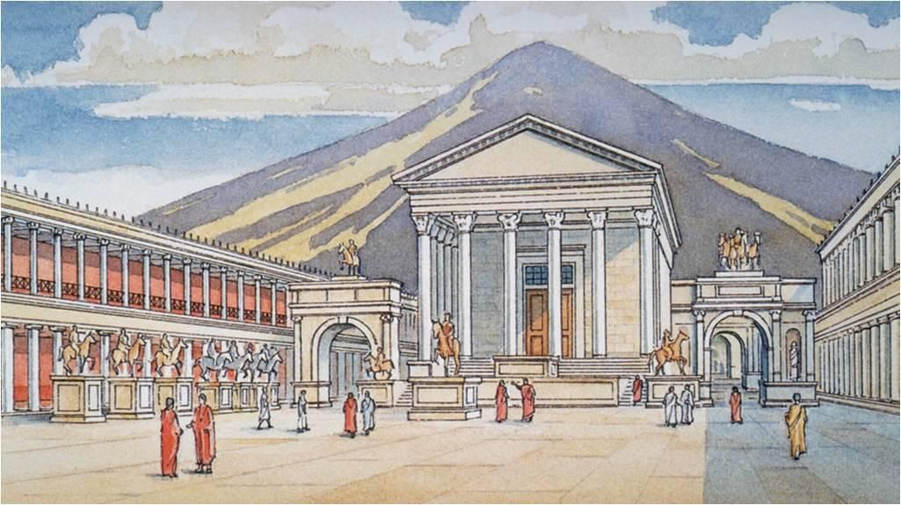
Temple of Capitoline Jupiter
In the centre of Pompeii is the temple of Capitoline Jupiter – thought this was a temple dedicated to three gods – Jupiter, Juno, and Minerva. The Capitoline Triad.
In Roman tradition these were their first 3 gods. The origins of these Roman gods is with the Etruscans (an ancient civilization from Tuscany, Italy – not Greek).
There was a similar temple (but much larger) on the Capitoline Hill in the centre of Rome.
All Romans/Pompeiians would believe in and worship these Gods.
The temple itself would have had flanking statues of horsemen. At its finest – before a damaging earthquake in 62 A.D. - this temple would have had statues paintings and decorations of ivory, silver and gold.

Slide 7
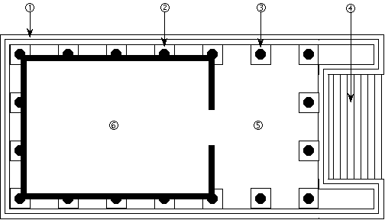
Temple Structure
Roman Temples followed a standard plan. The temple building sat on a raised platform, with steps leading up from the front; the front would have a portico of columns, and a pediment (triangular roof) at the front; the main temple would have four walls and sometimes columns along the two side walls and the back wall.
Inside there would be a cult statue to the god/goddess/gods. Here the priests or people would lay offerings.

Slide 8
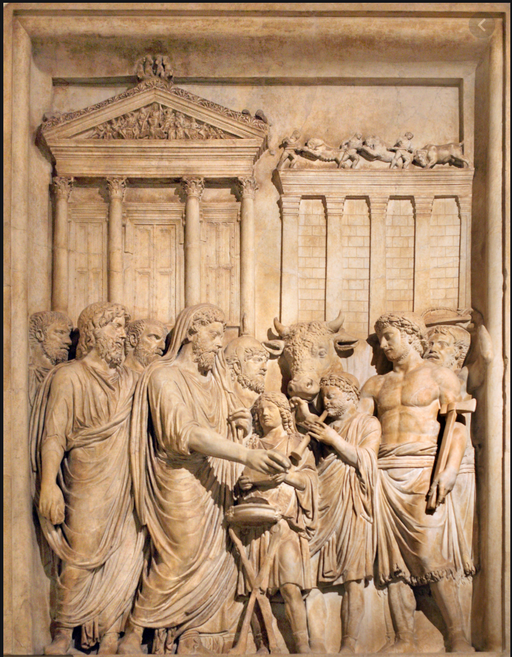
Sacrifices
As we saw, the Paterfamilias performed the sacrifices in the family homes at the Lararium. This may not have been cooked meat as a offering, but in fact it was more often a special honey cake.
Cows and goats would be more common at the main temple.
Sacrifices (burning of the fat and bones of a sacrificed animal) would be conducted on an altar outside the temple or sometimes inside the temple. The priests or head-priests (usually elected) would perform these sacrifices – cutting the animals neck so the blood would spill on the altar. Then cooking the meat for people to eat and the bones wrapped in fat for to burn for the gods.
The idea of a sacrifice is to surrender something you need to a god so they grant you favour – good weather, good marriage, strong children, life etc.

Slide 9
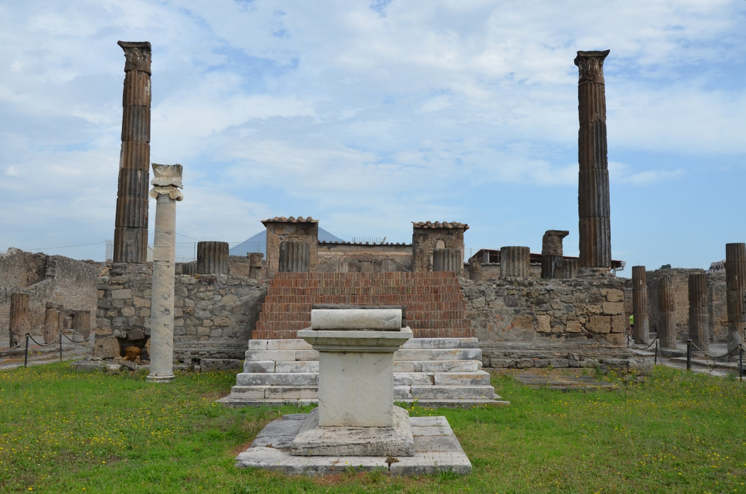
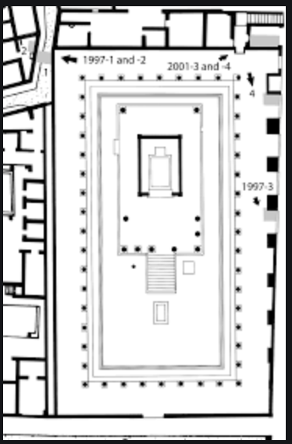
Temple of Apollo
Exam this picture of these pictures of the temple of Apollo in Pompeii.
What evidence can you find to support what we have just learned about Roman Religion and temples?

Slide 10
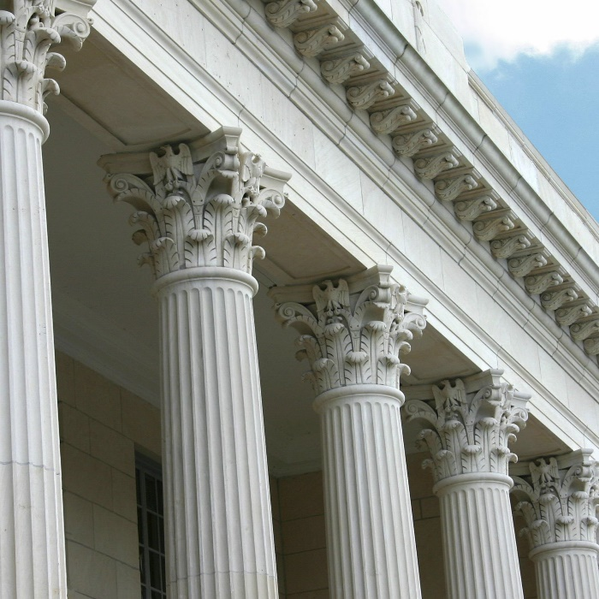
Temple of Apollo
The Temple was built in the 6th Century B.C. Nothing of the earlier building remains, only later newer versions.
The present ruins include a colonnade of 48 columns that stretch round all four sides of the temple – this is unusual in Roman temples and resembles Greek styles.
The raised platform, upon which the temple itself stands, is crowned with Corinthian columns. Inside the central part of the temple, the cella, which is painted, is the oval stone, called Omphalos, which was a symbol of Apollo.
In front of the temple on the right side of the courtyard looking towards the temple is a bronze statue of Apollo himself. The bow once held, with which he slew the serpent Python, is now missing. There are signs that there were statues of Diana and Mercury too.
There is also a column of marble, once crowned with a sundial, set up beside the temple by two town officials Erennius and Sepunius.

Slide 11
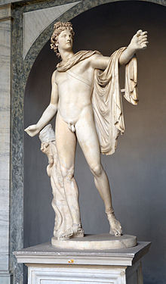
Temple of Apollo
Apollo is the gods of the Sun, god of music, god of medicine and healing, and he’s the god of prophecy. He is the god of logical and rationality. If you visit his temple you are usually looking for insight into your life and destiny.
Usually you would be presented with a prophecy. And it is your insight that would determine whether the prophecy has a positive or negative outcome.
Apollo was probably introduced to the Romans from the Greeks.

Slide 12
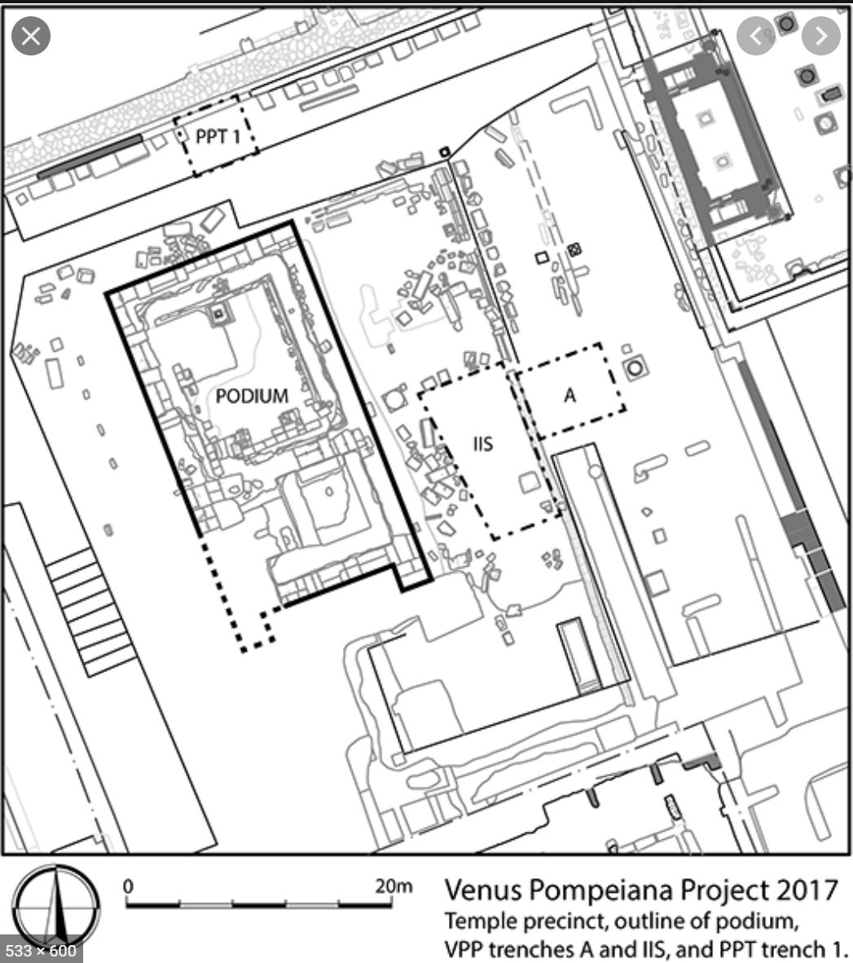
Temple of Venus
Venus was the patron god of Pompeii and so had a special place in their lives.
Her temple stood next to the large Basilica – a large building used as courts and for public assemblies.
Her temple would have been visited regularly.
Its plan is much more typical of a Roman temple plan than that of Apollo’s

Slide 13
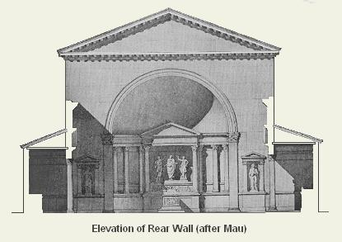
Sanctuary of the Public Lares
Just as the Paterfamilias made offerings to the household Lares, so too would public officials make sacrifices to the city Lares – local/clan gods.
This would happen at the Sanctuary of the Public Lares sitting opposite the temple of Apollo in the Forum Pompeii.
This would originally have been a location for shops.
Regularly there would be sacrifices made to the lares and the Roman Emperor.

Slide 14
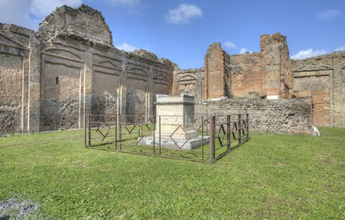
Temple to the Emperor Vespasian
Once Rome was a kingdom. After 7 Kings the Romans ousted their kings and founded the republic – around 500 B.C. For around 5 hundred years the Romans elected their leaders – consuls and senators – and conquered a huge empire. However, this system was slowly corrupted by the wealth, ambition, and gain of empire, and soon one man dominated the scene – after several decades of civil war. This man’s name was Augustus Caesar – the 1st Roman Emperor. Rome would be an Empire for the remainder of its history.
The Romans believed that men could become gods through great deed in life and death. The 1st Romans to achieve this were Romulus and centuries later Julius Caesar achieved this too.
Soon, all Roman Emperors founded their own cults across the Emperor – the Emperors following in the line and example of Julius Caesar were divine.
The latest Emperor at the time of Pompeii’s destruction was Titus. There was a temple to his father Vespasian in the centre of Pompeii’s forum.
This was an important cult to ensure that people recognised the divine authority of the Emperor and felt they could communicate to him and ask favours.

Slide 15
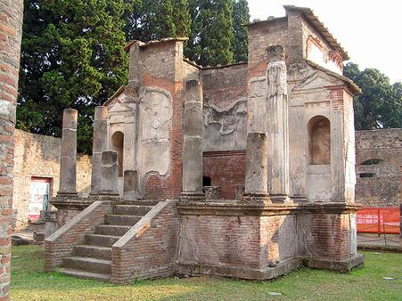
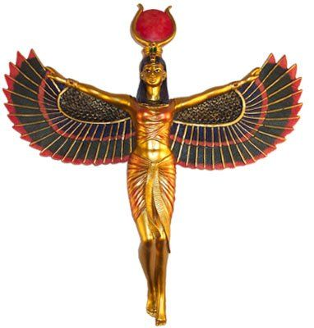
Temple of Isis
As mentioned above, the Romans often adopted new gods.
Several of these cults included Bacchus, Mithras, and Christianity. Some like Bacchus and Christianity were even seen as fanatical and threatening and were banned.
One of the most popular of these cults was to the Egyptian goddess Isis – queen of the gods, god of magic and life, and protector of women and children.
Her cult was as popular as Christianity and had the potential to be adopted by the Emperors as a major religion in the Roman Empire. Only the emperor Constantine chose Christianity instead.
A small temple of Isis, possibly privately owned, was in the Pompeii Forum.

Slide 16
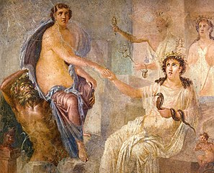
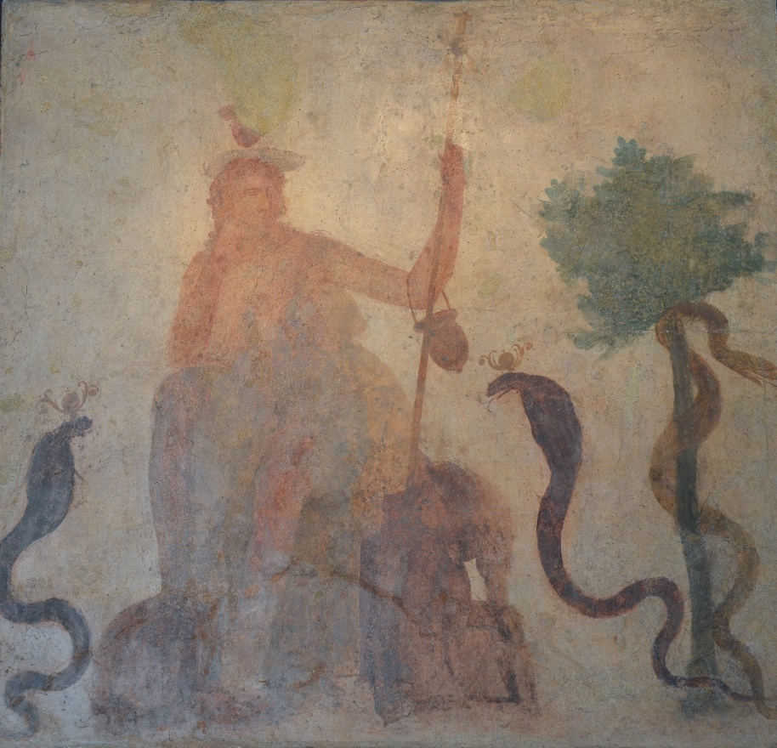
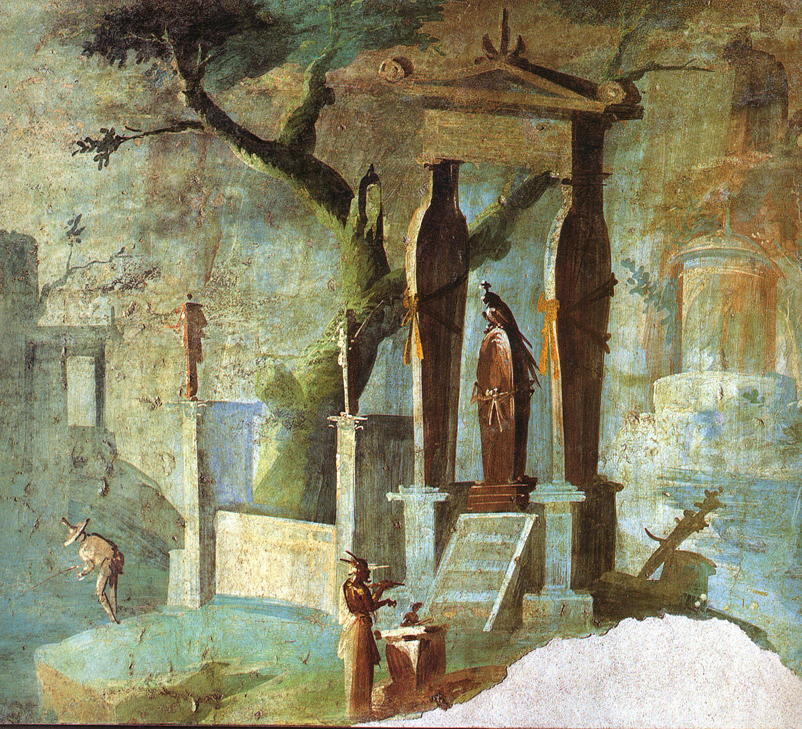
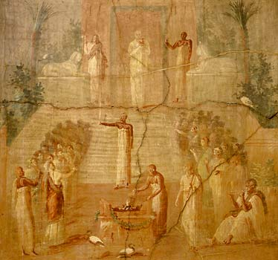
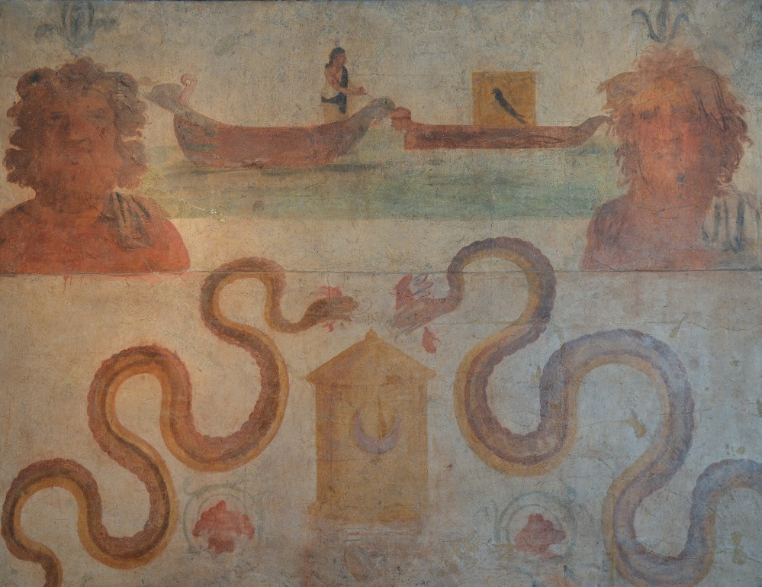
These frescoes from the temple of Isis in Pompeii are wonderful pieces of art using perspective, depth, and colour to decorate the temple of this mysteries “foreign” goddess.
Do you notice any motifs (recurring symbols) in these pictures?

Slide 17
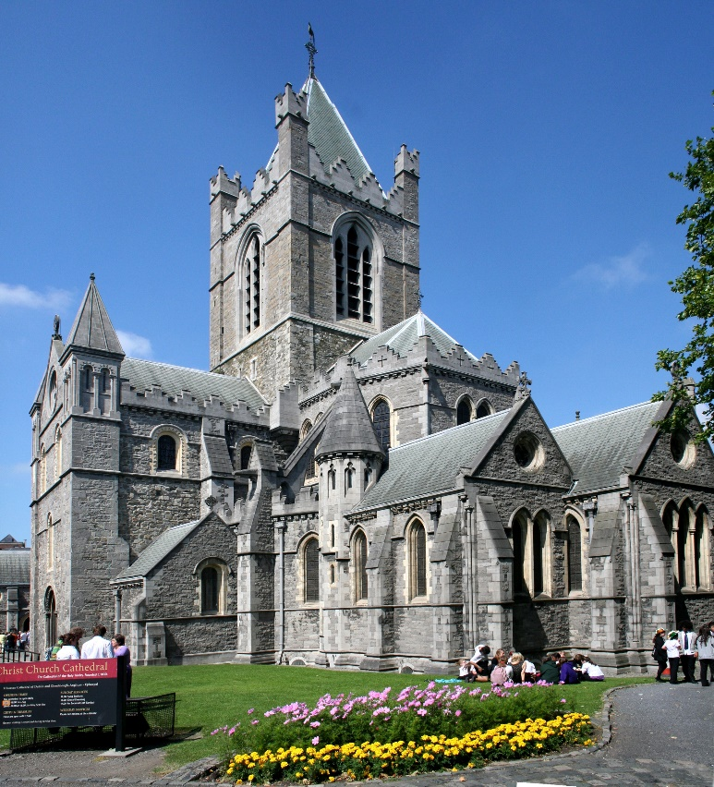
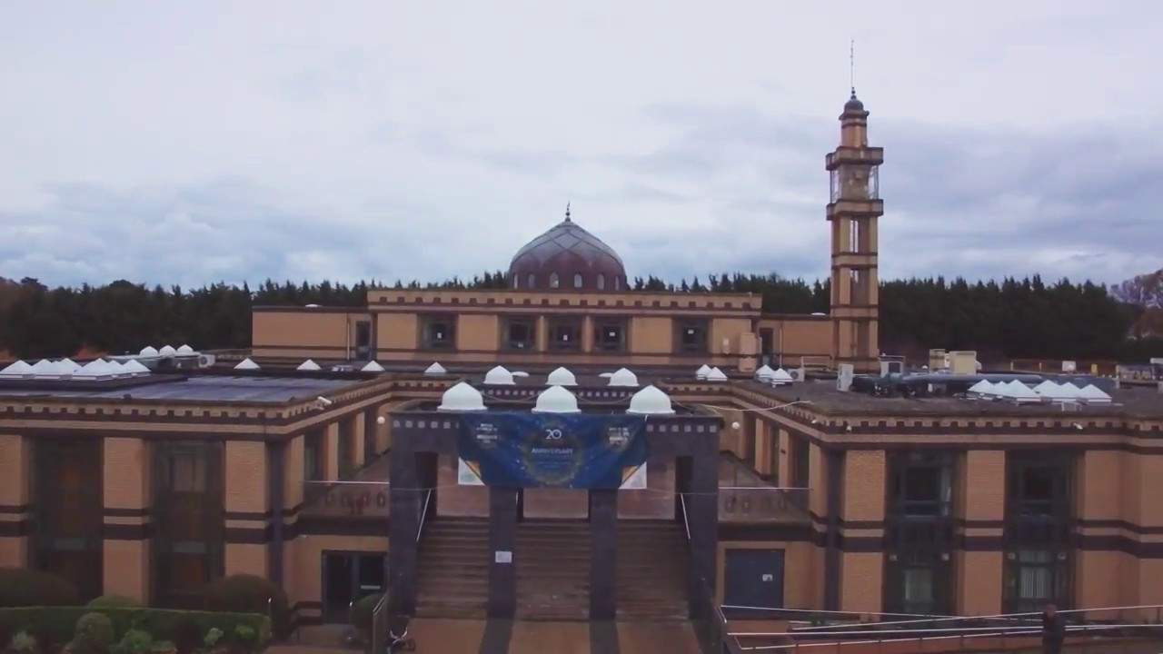
Compare: how do the temples of Pompeii compare with modern places of worship?
List 5 similarities.
List 5 differences.
Explain.

Slide 18
Create: Design your own temple for a Roman God.
Write a short paragraph describing the temple to your chosen god.
Include a description of the plan (columns, platform, roofs, steps, etc.) What type of columns would you use?
Include a description of the statues (inside and outside).
Include a description of the decorations (inside and outside) – e.g. frescoes, mosaics, gold and ivory, silver decorations.
Say where the temple would be in the Roman town.

