Slide 1
On the March

Slide 2
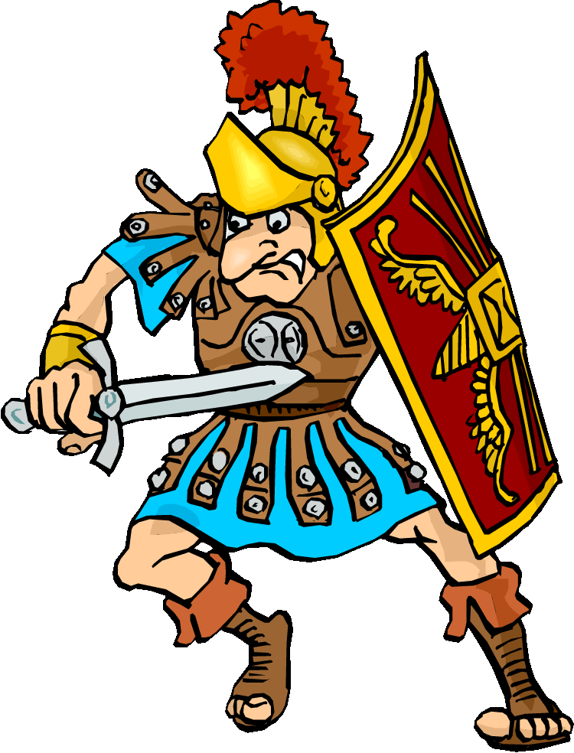
On the march…
The Roman army would move very quickly from place to place – why?
They could march around 40km per day
The soldiers would march in a specific formation

Slide 3
Novissimum agmen
Primum agmen
Most legions
Baggage and Artillery
Rearguard
Road Engineers
Scouts

Slide 4
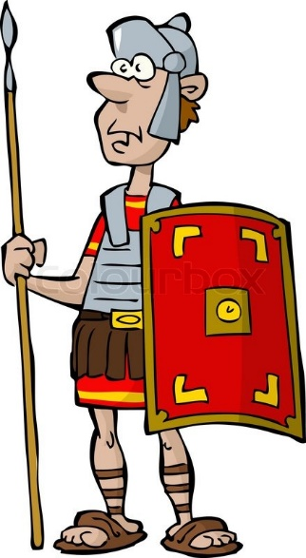
If you were a Roman soldier, how would you feel on a march?
Physically and b) emotionally
If you were a barbarian tribesman, would you fight or surrender to the Romans? Why?

Slide 5
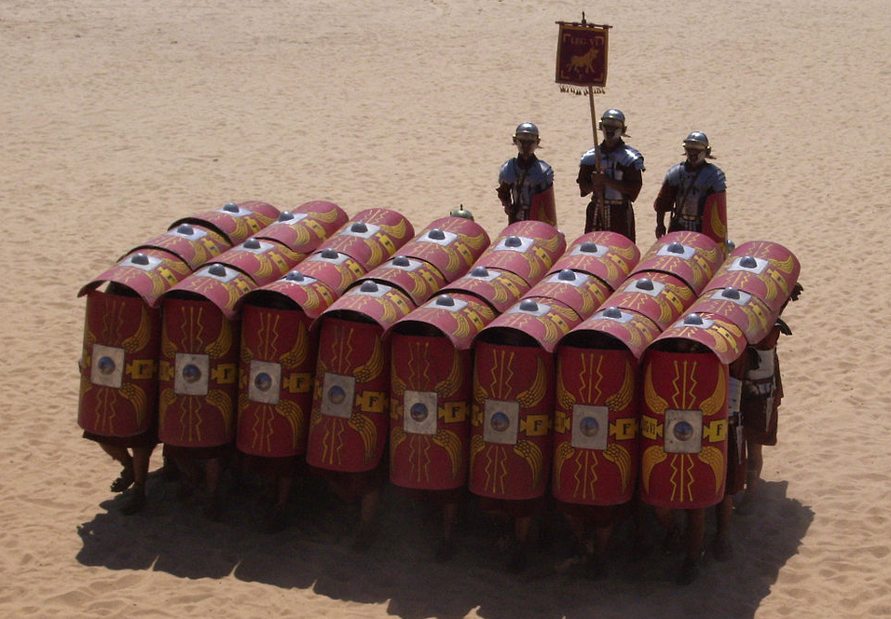
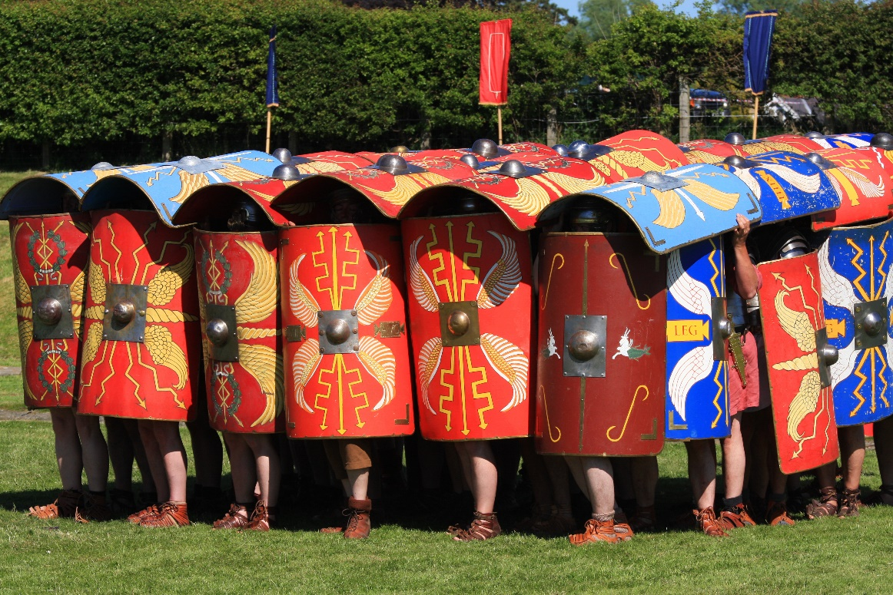
Formations
The army also used formations in battle
One type is the testudo
Testudo means ‘tortoise’

Slide 6
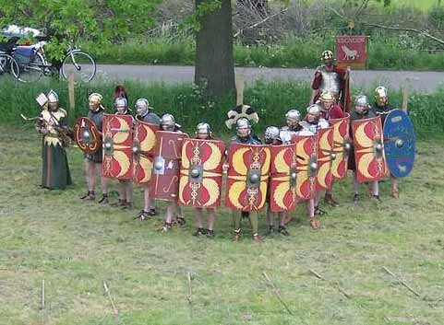
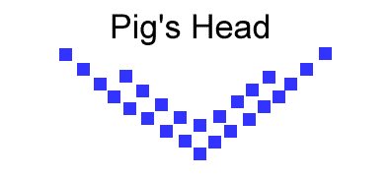
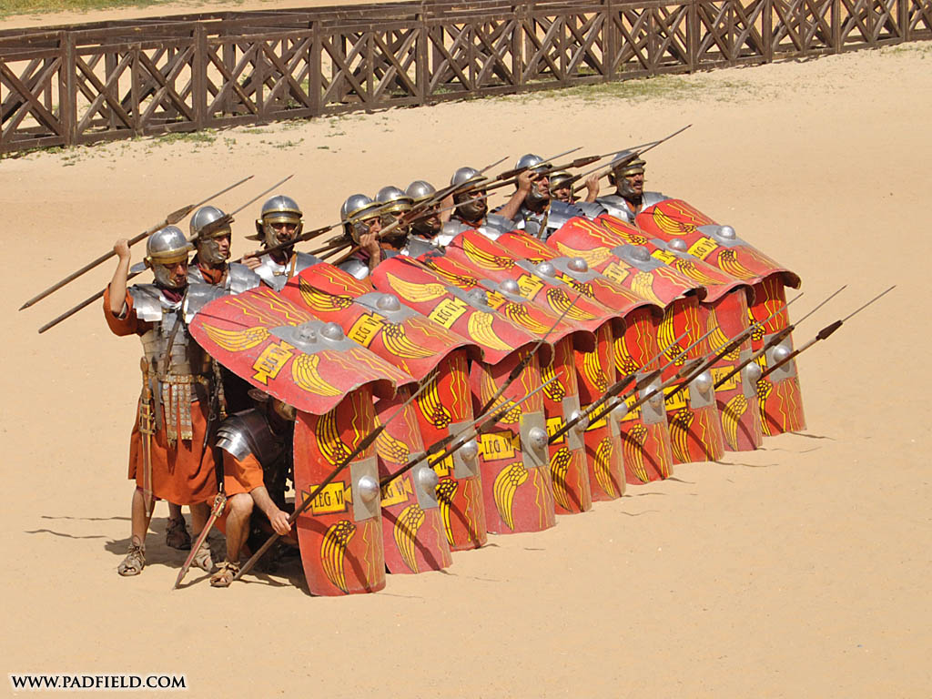
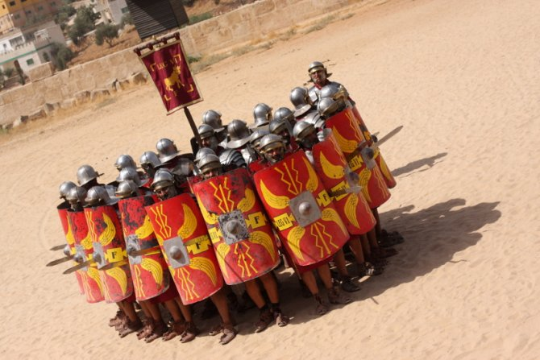
Pig’s head/Wedge
Orbis
Repel

Slide 7
Roman Sieges

Slide 8
Sieges
What is a siege?

Slide 9
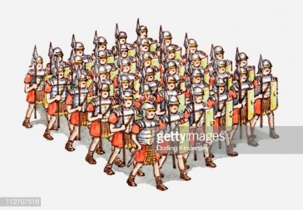
Sieges
What is a siege?
When an army surrounds a town, cutting off its supplies, and trying to force it to surrender
https://www.youtube.com/watch?v=agrb2Wrr0bs
https://www.youtube.com/watch?v=HX4KKkSKZAY

Slide 10
Roman Sieges
The Romans were excellent at siege tactics and engineering
A few of their most famous sieges were at Alesia and Jerusalem
They had great ways of protecting their soldiers as they laid siege, which included:
1) Siege towers (up to 30 metres tall) which were covered in animal hides or metal plates

Slide 11
Roman Sieges
2) Hide-covered galleries (which were like little huts on wheels)
3) The famous testudo or tortoise formation
Some of the weapons used in attack were:
1) Catapults which fired arrows
2) Ballista which fired lead shots or stones (up to 45 kilo in weight)
3) Battering rams made of wood and metal, housed in galleries

Slide 12
Roman Sieges
Earthworks were used to get up close to the defending walls
Siege towers, often with drawbridges, were used to gain height on the enemy

