Slide 1
Roman Army: Weapons

Slide 2
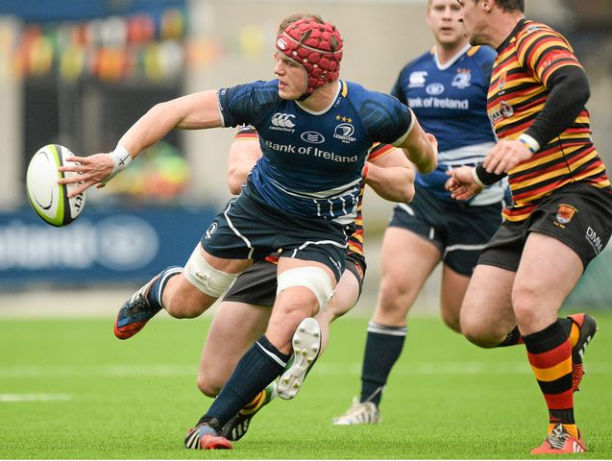
Designed for a purpose…

Slide 3
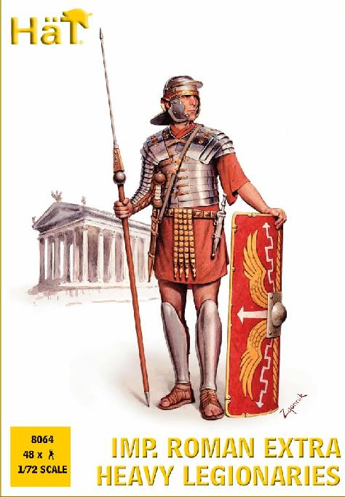
The Legionary

Slide 4
The Legionary
Pilum
Gladius
Galae
Lorica Segmentata
Cingulum
Pugio
Caligae
Scutum

Slide 5
The Legionary
Pilum = Javelin
Gladius = sword
Galae = helmet
Lorica Segmentata = armour
Cingulum = belt
Pugio = dagger
Caligae = sandals
Scutum = shield

Slide 6
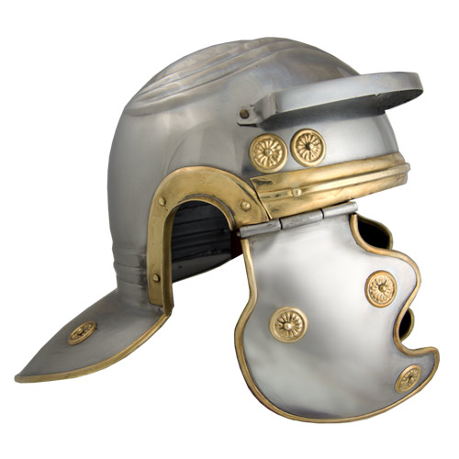
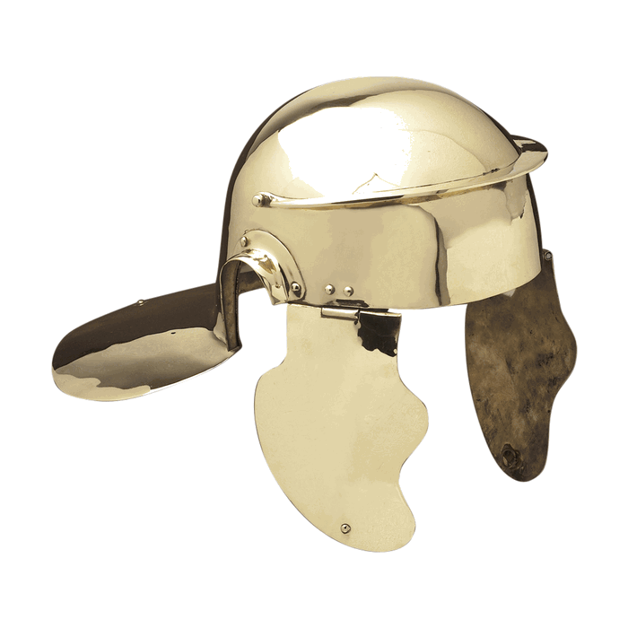

Slide 7
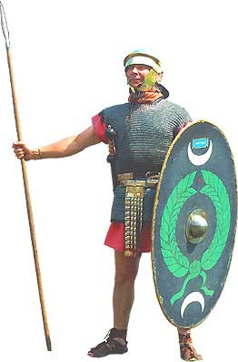
The Auxiliary

Slide 8
The Auxiliary
Hasta = stabbing spear
Scutum (oval)
Chainmail
Archery (Syria)
Horse-riding and catapults/slingshots (Balearic Islands)
Not a citizen
Stationed away from home

Slide 9
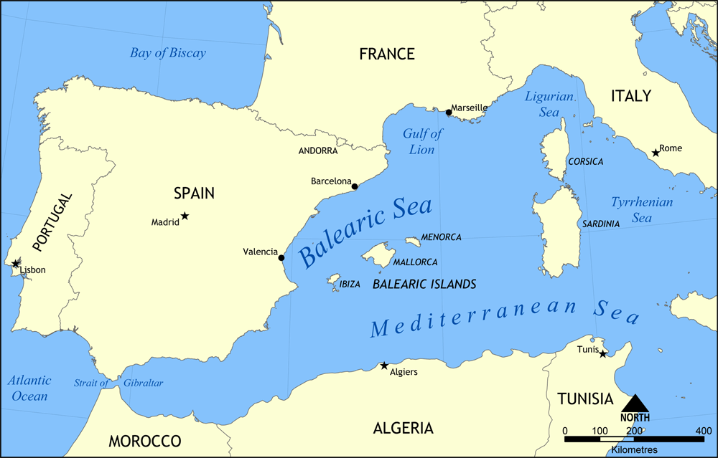
Balearic Islands

Slide 10
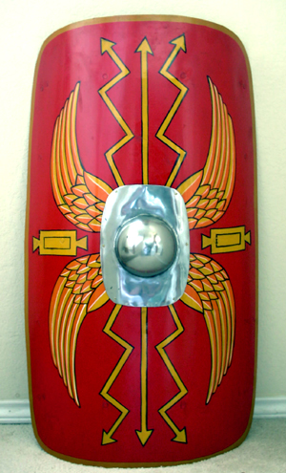
Design your shield
Draw all of the other items of legionary’s armour on the inside
Give a brief description of what each one does
Galae scutum pilum
Caligae cingulum lorica segmentata
pugio gladius boss

Slide 11
The Structure of the Army
COHORT
480 men
800 men
5300 men
1ST COHORT
X 6
LEGION
80 men
CENTURY
X 10
8 men
CONTUBERNIUM

