Slide 1
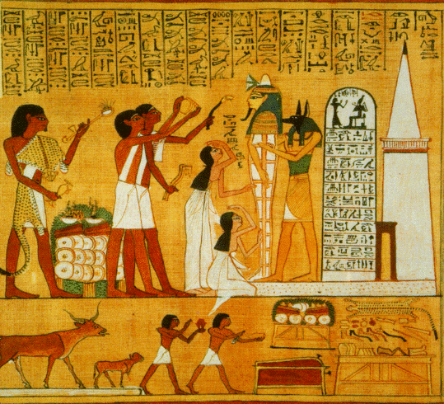
Journey Through the Duat
Ancient Egypt

Slide 2
What do you believe happens after we die?

Slide 3
Note on Apophis
Another name for Apophis – the snake/god of chaos in the Underworld – is Apep.

Slide 4
Myth Analysis: The Book of the Dead
Outline the Egyptian Journey to the Afterlife.
What does this Myth tell us about Egyptian values?
How do the Egyptians believe they will be judged?
Is there an underlining message to this Myth?

