Slide 1
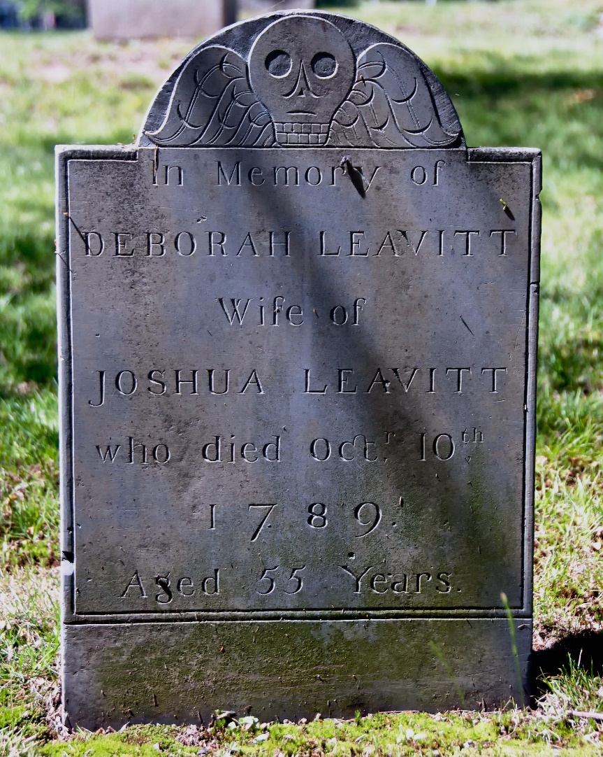
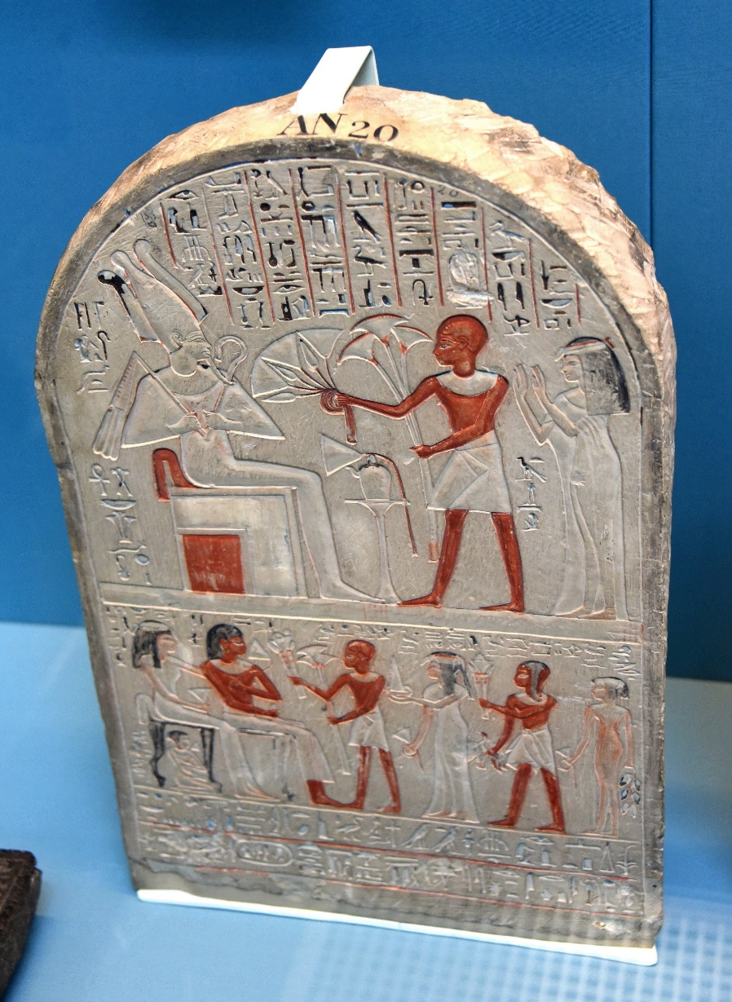
Middle Egyptian
Translating Inscriptions

Slide 2
Learning Intentions: Today we will learn to…
Recognise Egyptian Hieroglyphs common to Stela/Gravestones.
Connect Hieroglyphs to their transliteration.
Pronounce Egyptian words in transliteration.
Draw Egyptian Hieroglyphs from the Sobekemhab Stela.
Compare modern funerary practices to Egyptian ones.
Create our own Stela in the style of the Ancient Egyptians.

Slide 4
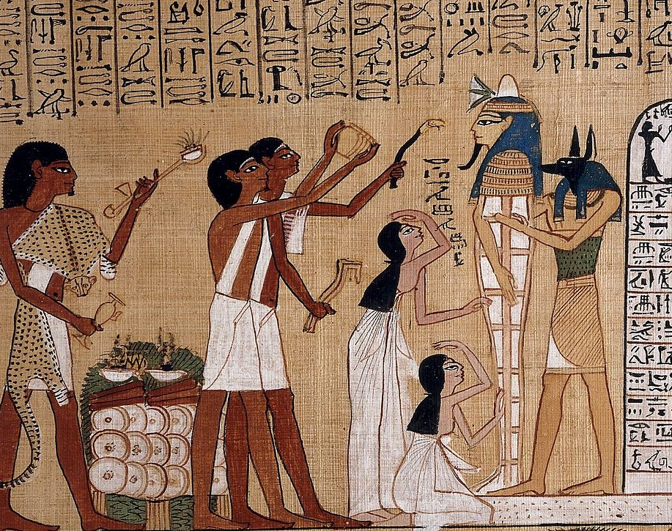
Egyptian Funerary Practices
In the inscriptions, the deceased asked the king for offerings, but in reality family members placed food and drinks in the tomb during the funeral and later at funerary feasts.
According to Egyptian belief, each human being had a ka-soul, and a akh-soul and a ba-soul. These terms are difficult to translate exactly as there is no equivalent in English.

Slide 5
What are our funerary practices? What do we inscribe on our tombs?

Slide 6
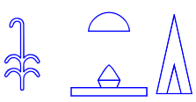
Requesting an Offering
The ancient Egyptians are famous for their funerary culture.
Inscriptions on stone slabs and tomb walls record the request of the dead for food in the afterlife.
In fact, when you visit the gallery of an Egyptian Museum, you will notice that many hieroglyphic inscriptions being with the group of signs:
ḥtp dj njswt – (An offering which the king gives)
This phrase is then followed by the name of a god, e.g. Ptah-Sokar-Osiris (a god formed from Ptah, Sokar, & Osiris – The Egyptians do like to confuse their gods!)

Slide 7
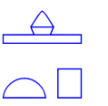
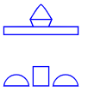
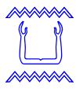
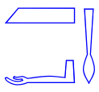
This phrase is then followed by the name of a god, e.g. Ptah-Sokar-Osiris (a god formed from Ptah, Sokar, & Osiris – The Egyptians do like to confuse their gods!)
The ḥtp (offering), a word sometimes also spelled ḥtpt with an additional , included drinks and food.
They were given n kꜢ n (to the ka-soul of) the deceased who was declared mꜢꜤ-ḫrw, literally true of voice – once he had passed a moral interrogation in the afterlife.

Slide 8
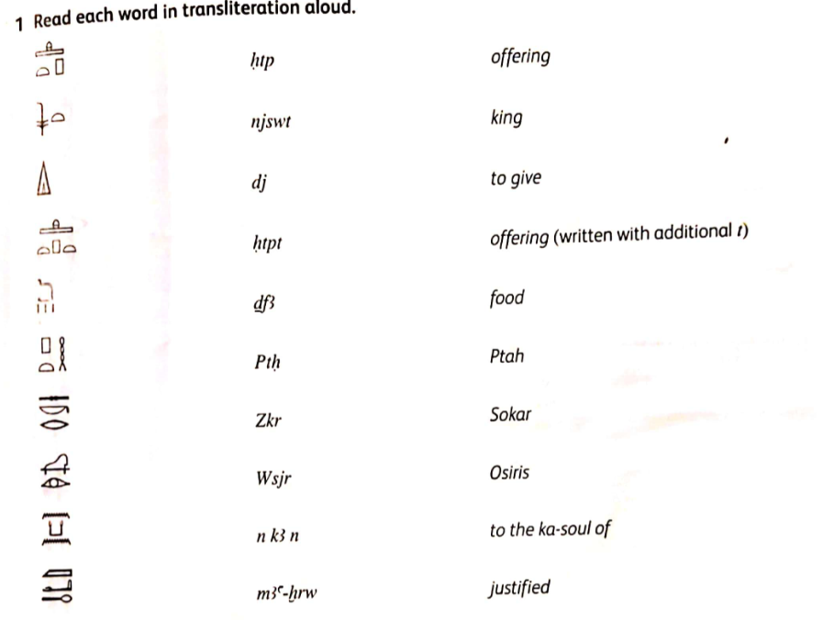

Slide 13
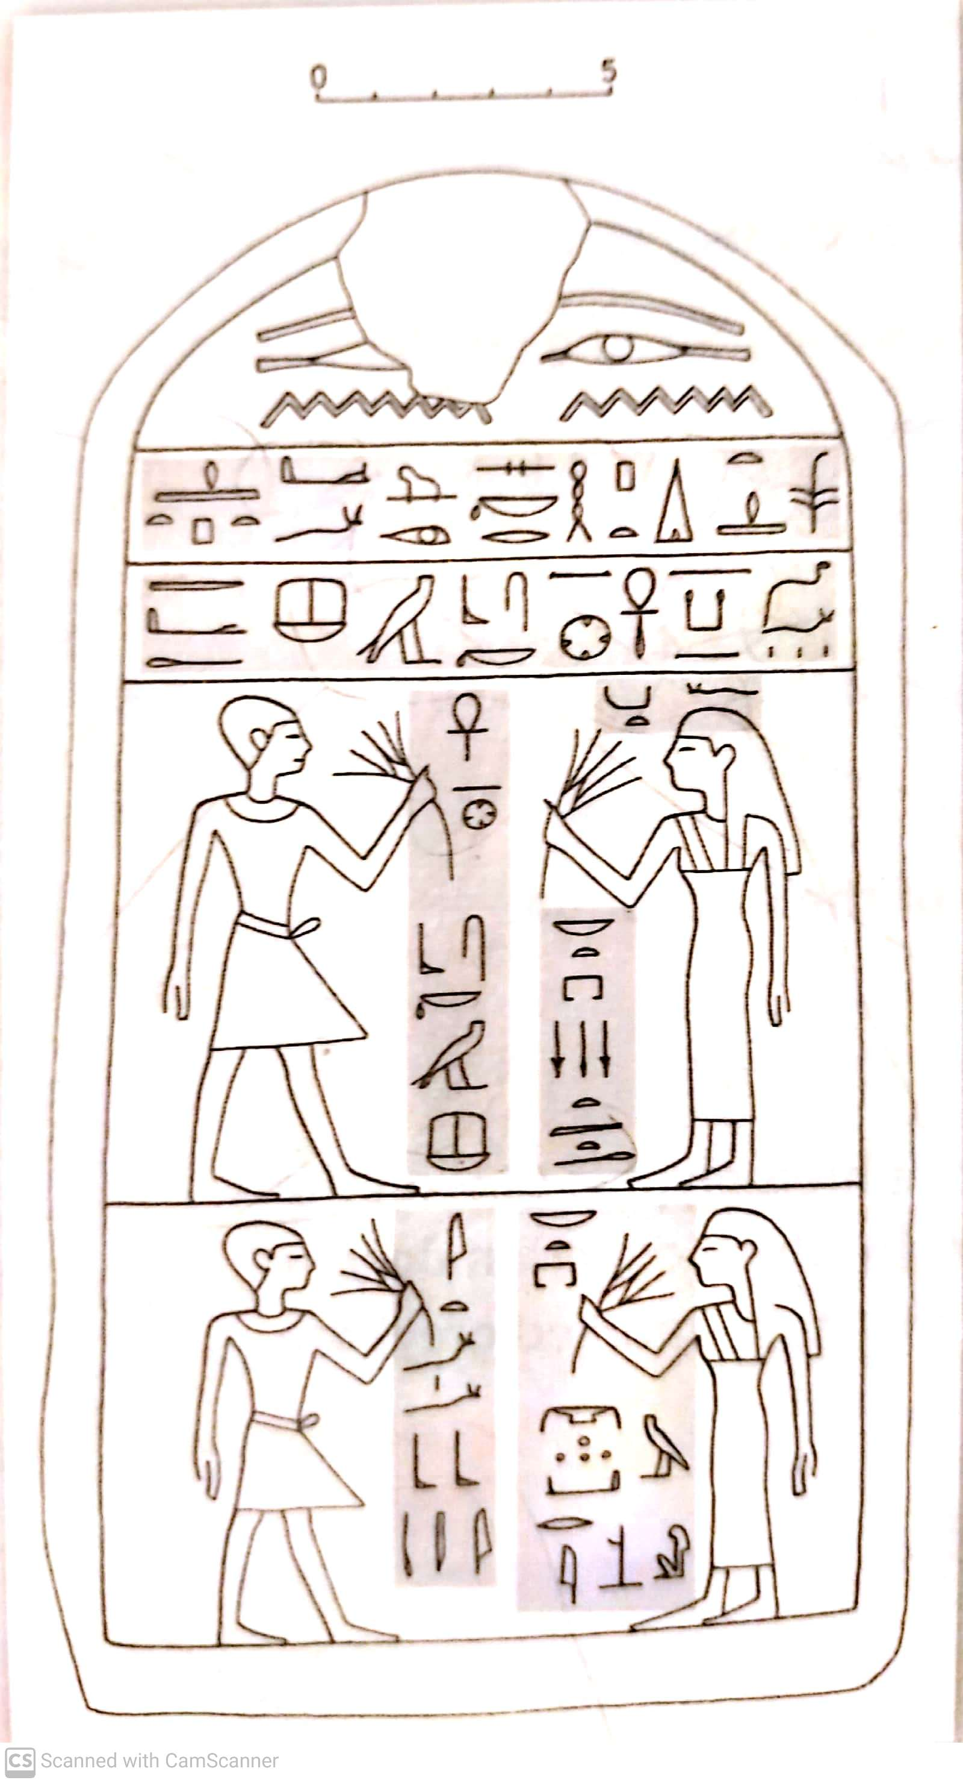
The Stela of Sobekemhab
Egyptologists call an inscribed stone slab, either round-topped or rectangular, a ‘stela’ (pronounced ‘Stéela’).
This stela belongs to an official calle Sbk-m-ḥb who lived around 1800 BCE.
His name means Sobek-is-in-festival.
This could indicate that Sobekemhab was from Fayum, where the god Sobek was worshipped.
Sobekemhab held the low-ranking military title ꜥnḫ n njwt officer of the town regiment.
The individuals depicted on the stela are smelling the scent of a lotus flower.
The inscriptions on the stela of Sobekemhab are typical of many others, so if you understand the pattern of the hieroglyphs you will be surprised at how many other examples you will be able to read next time you visit and Egyptian Museum.

Slide 14
The inscription on the upper two lines:
ḥtp dj njswt Ptḥ-Zkr-Wsjr dj=f ḥtpt
ḏfꜢ n kꜢ n Ꜥnḫ n njwt Sbk-m-ḥb mꜢꜤ-ḫrw
Can you Pronounce this?
An offering that the king gives to Ptah-Sokar-Osiris. May he give an offering and food for the ka-soul of the officer of the town regiment Sobekemhab, justified.

Slide 15
b. The inscription in front of the man on the upper left
Ꜥnḫ n njwt Sbk-m-ḥb
The officer of the town regiment Sobekemhab
Can you Pronounce this?

Slide 16
c. The inscription in front of the man on the lower left
jt=f Bbj mꜢꜤ-ḫrw
His father Bebi, justified
Can you Pronounce this?

Slide 17
d. The inscription in front of the woman on the upper right
Nbt pr Snwt mꜢꜤt-ḫrw
The mistress of the house Senut, justified
Can you Pronounce this?

Slide 18
e. The inscription in front of the woman on the upper right
ḥmt=f
His wife
Can you Pronounce this?

Slide 19
f. The inscription in front of the woman on the lower right
Nbt pr Nbw-m-rsj
(the name is difficult to make out)
the mistress of the house Nebuemresi
Can you Pronounce this?

Slide 20
Write Your Own Funeral Inscription:
Having read the Inscription on the Stela (gravestone) of Sobekemhab.
Imitate the style to write an inscription for your own Stela.
Include:
An offering of food to the gods from the king/queen/president;
Information about your job (student)
Information about your family
A Picture (simple picture) of you and your family.

