Slide 1
Athenian Democracy
Demos-Kratia = People-Power The Athenians tried to allow as many citizens as possible to engage in politics and allowed for several thousands to engage in political matters during their meet-ups at the Ekklesia, where thousands could come to propose laws, report lawsuits, or discuss matters of state.
However, a “citizen” only meant an Athenian adult male, so non-Athenians, women, children and slaves could not vote or change laws.

Slide 2
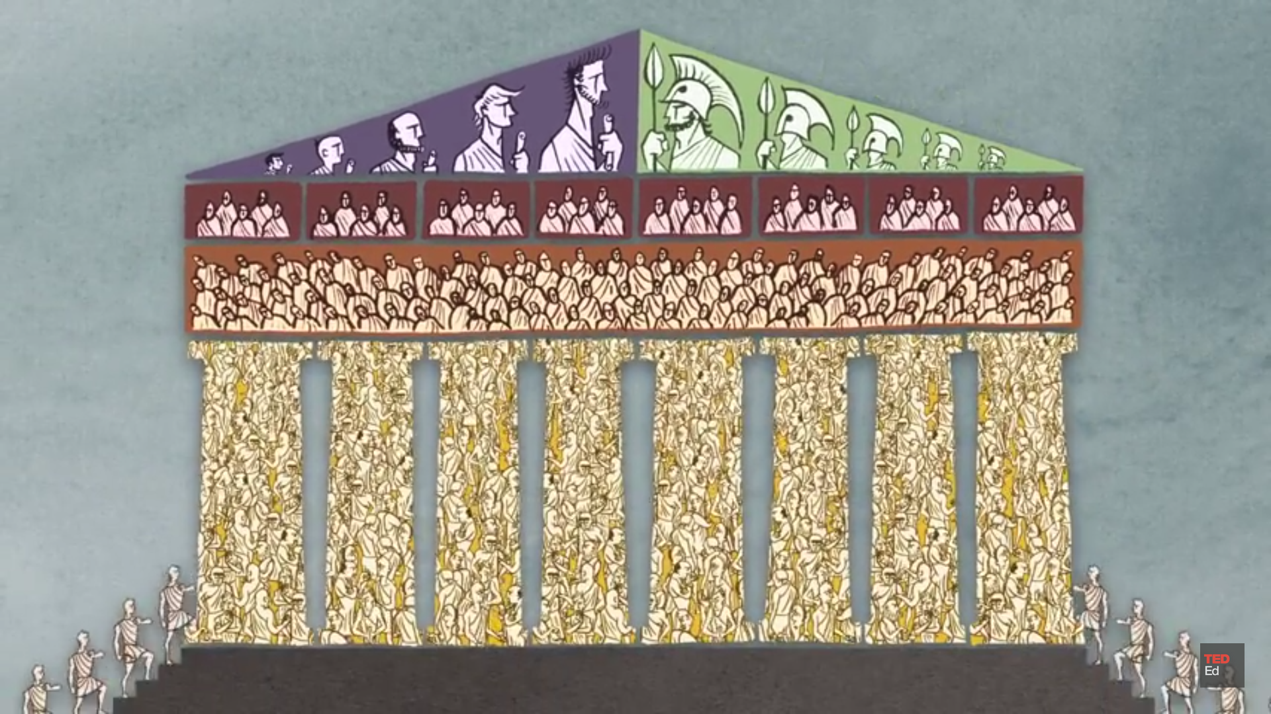
Sorted Magistrates had a number of different roles, like our ministers today.
Elected Magistrates (e.g. Strategoi). These needed to know what they were doing or Athens would collapse.
Sorted Judges made rulings on legal matters.
Ekklesia made up of any number of Athenian citizens (could measure in the thousands
500 Sorted Boule, to oversee Ekklesia and coordinate with Magistrates.

Slide 3
Sortition (The Kleroterion)
The Ekklesia was a gathering of any number of citizens who wished to talk in the assembly.
Some magistrates were elected by votes out of a necessity to have a skilled official in their position.
However, all other positions were given by sortition. This meant that they were chosen entirely randomly, so that positions were given as fairly as possible.
The device they used to decide this was a Kleroterion, as shown on the next page. It was a large slab of stone with holes going down its face, where plates with the names of citizens would be placed, and a tube where black and white stones would be placed. The column of names which were in line with the white stone would then be chosen for the given position.

Slide 4
Α
Α
Β
Γ
Δ

Slide 5
Α
Α
Β
Γ
Δ

Slide 6
Α
Α
Β
Γ
Δ

