Slide 1
Bellerophon

Slide 2
Bellerophon was the grandson of Sisyphus.
He was wrongly accused of trying to seduce the wife of king Proteus of Argos.
Angrily Proteus sent Bellerophon from his court with a letter to the king of Lycia.

Slide 3
The letter asked the king of Lycia to kill the person who brought it but he did not want to offend the furies by killing a guest.
Instead, he asked Bellerophon to kill the beast called Chimera to pay for his hospitality.

Slide 4
The Chimera was a fire-breathing monster with the head of a lion, the body of a goat and a serpents tail.
The king was sure Bellerophon would fail and be killed.

Slide 5
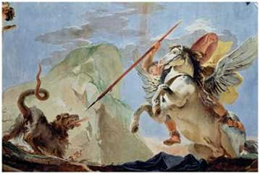
Athene decided to help Bellerophon.
She lent him her winged horse, Pegasus, and he flew over Chimaera and plunged his spear down its throat.

Slide 6
Bellerophon then helped the king by flying above his enemies and pelting them with rocks.
The King could not believe the hero deserved to die after this and they became friends.
Bellerophon even married his daughter.

Slide 7
After a while Bellerophon became too proud.
He tried to fly to Olympus on Pegasus.
No human was allowed in the home of the gods without an invitation, so Bellerophon had to be punished.
Zeus sent a fly that drove Pegasus wild.
The hero was thrown from his back and landed in a thorn bush.
He was blinded and lamed, ending his life homeless and alone.

