Slide 1
Classroom Based Assessment
2nd Year
Retelling Myths

Slide 2
Myths
You’ve learned many Greek/Roman Myths.
The word Myth is just the Ancient Greek word Mythos which means “Story”.
Understanding the stories the Greeks and Romans told helps us understand them better – their stories are also just fun!
Now, can you tell your own Myth?

Slide 3
Plan
The Classroom Based Assessment – Storytelling with Myth is to be done over a 3 week period.
By the end of this 3 week period you will have told your own Myth.
Plan:
Week 1 (at least 2 classes): Scoping, Framing, and Refining – you have a handout to accompany this PowerPoint; fill it in as we go.
Week 1-3: Work on your Myth. You should be able to do most of the work in the class.
Week 3: Write a Reflection

Slide 4
Reflecting
As we go through the CBA, it’s important that you reflect. At the end of each section on your handout, I’ve given you a space to reflect. You will complete these for homework.
You will also be encouraged to include some of these Reflections in your final display – if appropriate.
You will then complete a reflection at the very end of the CBA too.

Slide 5
Assessment
This is one of two CBAs required for your Junior Cycle Classics.
This does not contribute to your final grade.
But one of the following descriptors of your project will be included on your Junior Certificate Profile of Achievement:
Not in line with expectations.
In line with expectations.
Above expectations.
Exceptional

Slide 6
CBA Steps
Scoping: Discussing the Myths we’ve studied.
Framing: Exploring the aspects of your chosen Myth.
Refining: Choosing the mode(s) you will tell your myth – the “display” you chose for your myth.
Displaying: Display your Myth and Reflect on the process.

Slide 7
Scoping
What Myths have we studied?
What do we know about them?

Slide 8
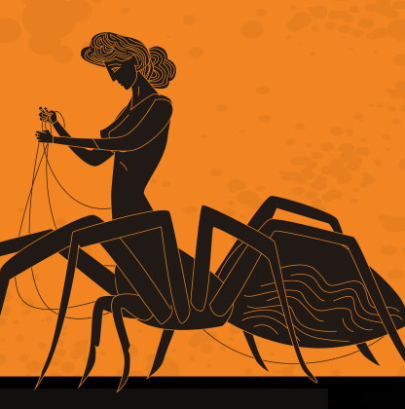
Reflecting on Myth.
What makes a story a Myth?
What Greek and Roman Myths have you already studied?
Answer: Mentimeter (Make Mentimeter)

Slide 9
What makes a story a Myth?
It can have some fantastical, cosmological (relating to the universe) themes.
Can be used to explain natural phenomena
Includes Heroes and/or Gods – exploring their relationships, actions, and thoughts
Inspired by the values and beliefs of the society; exploring these believes.

Slide 10
What Myths have we studied as a class?
The Titans and the Olympians
Arachne Myth
Theseus and the Minotaur
Herakles
Jason and the Argonauts
Jason and the Golden Fleece
The Amazons
Cupid and Psyche
Bellerophon
Sisyphus
Prometheus
Pandora’s Jar
Atlanta
Achilles
The Judgement of Paris
Troy
Orpheus and Eurydice
What other Myths do you know?
Visit classicsteachers.com for more myths.
(Change according to Myths covered in class)

Slide 11
Group Discussions: In group discuss the following aspects of the Myths you’ve studied.
Discuss the Myths from the above list – or Explore new Myths.
Which Myths interest you? Can you explain what interests you about them?
Can you think of possible project ideas from these Myths?
Do you want to explore this Myth on your own or in a group?

Slide 12
Framing
What are the features and characteristics of your Myth?

Slide 13
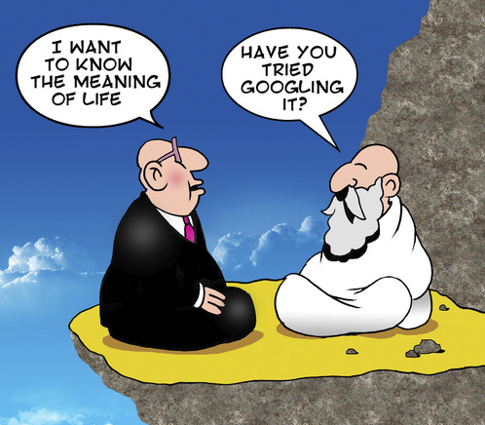
What is the meaning of life?
Greek and Romans loved asking Big questions about the meaning of life? What it is to live a good life?
Their Myths often ask these questions.
Often these questions are explored through metaphor.
Can you think of any Greek/Roman stories that explore the good life?
Does your chosen myth explore what it is to have a good life?
Notes:
Possible Stories: Pixar: Up, Inside Out, A Bugs Life, Monster Inc, Toy Story… others The Grinch…

Slide 14
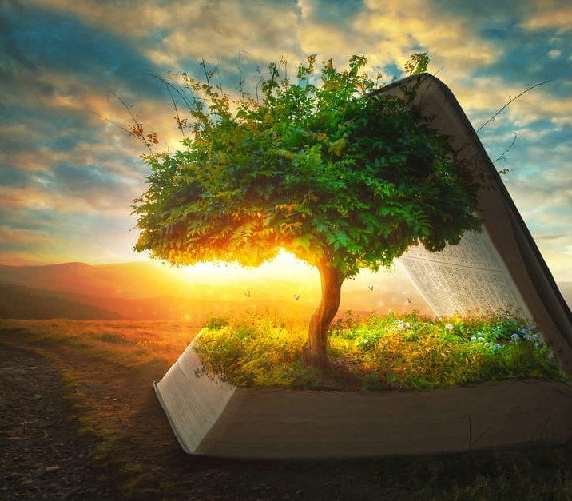
Explaining Nature
Myths also often explain natural phenomena or the creation of the universe, man, or women.
Common Examples: Genesis, The Big Bang etc.
How did the Greeks explain Creation or Nature?
Does your story explain nature, the nature of the universe, creation of man or women?

Slide 15
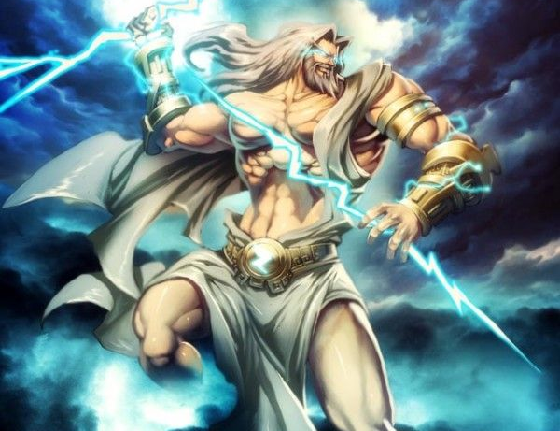
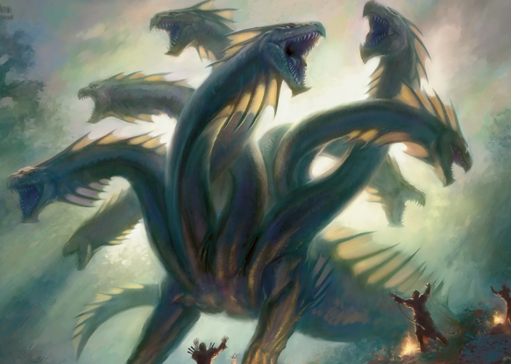
Non-Human Characters
Myths often have non-human characters…
Monsters, Gods, Goddess, Demons etc.
Do you have any favourite Greek/Roman examples?
Does your Myth include any Non-Human Characters?

Slide 16
Set in an alternative world
Myths are often set in an alternative or imagined world.
Modern genres of Fantasy and Science Fiction often have alternative worlds.
What alternative/imagined worlds did the Greeks/Romans have?
Does your myth have an alternative or imagined world?

Slide 17
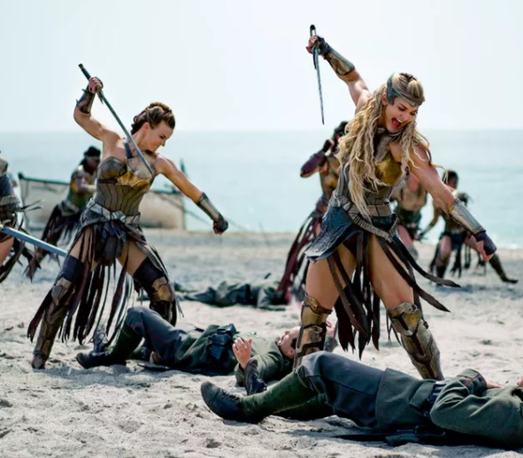
Sometimes the stories contradict the normal
Modern Examples: Superheroes
Can you think of Greek examples of storied that contradict their normal?
Does your Myth contradict the normal?

Slide 18
Supernatural Explanations - Magic
Myths often have magical explanations for things.
How does magic work in modern stories?
Does your Myth have any of supernatural events or explanations - magic?

Slide 19
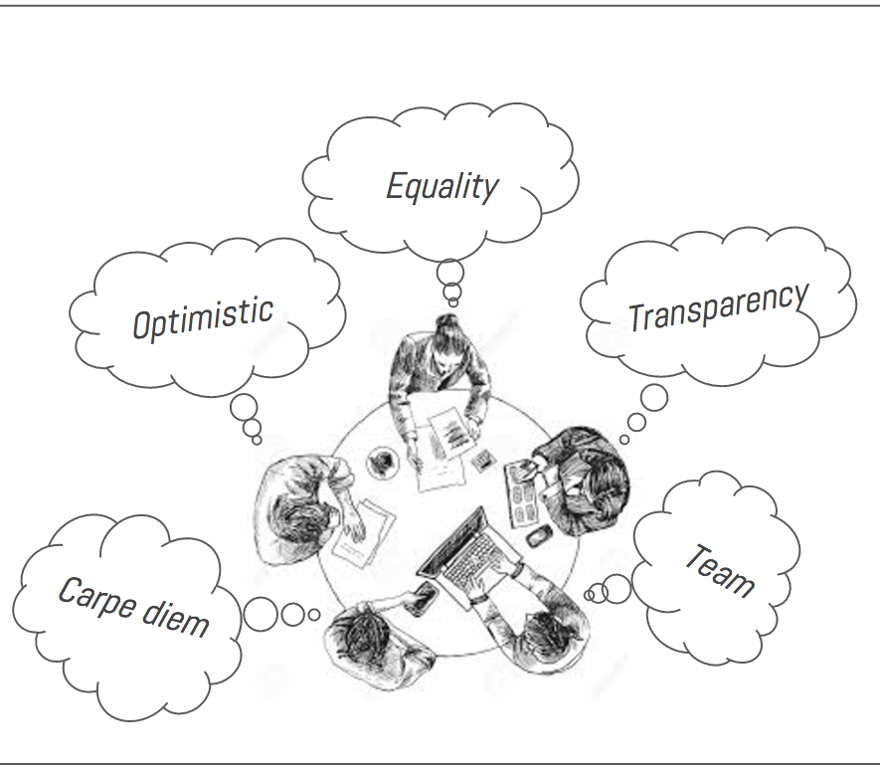
Representing Values or Beliefs
Myths very often represent the values/beliefs of a society.
From the Myths we’ve studies, what are the most common Greek/Roman values/beliefs?
Does your Myth explore any Greek/Roman values/beliefs?

Slide 20
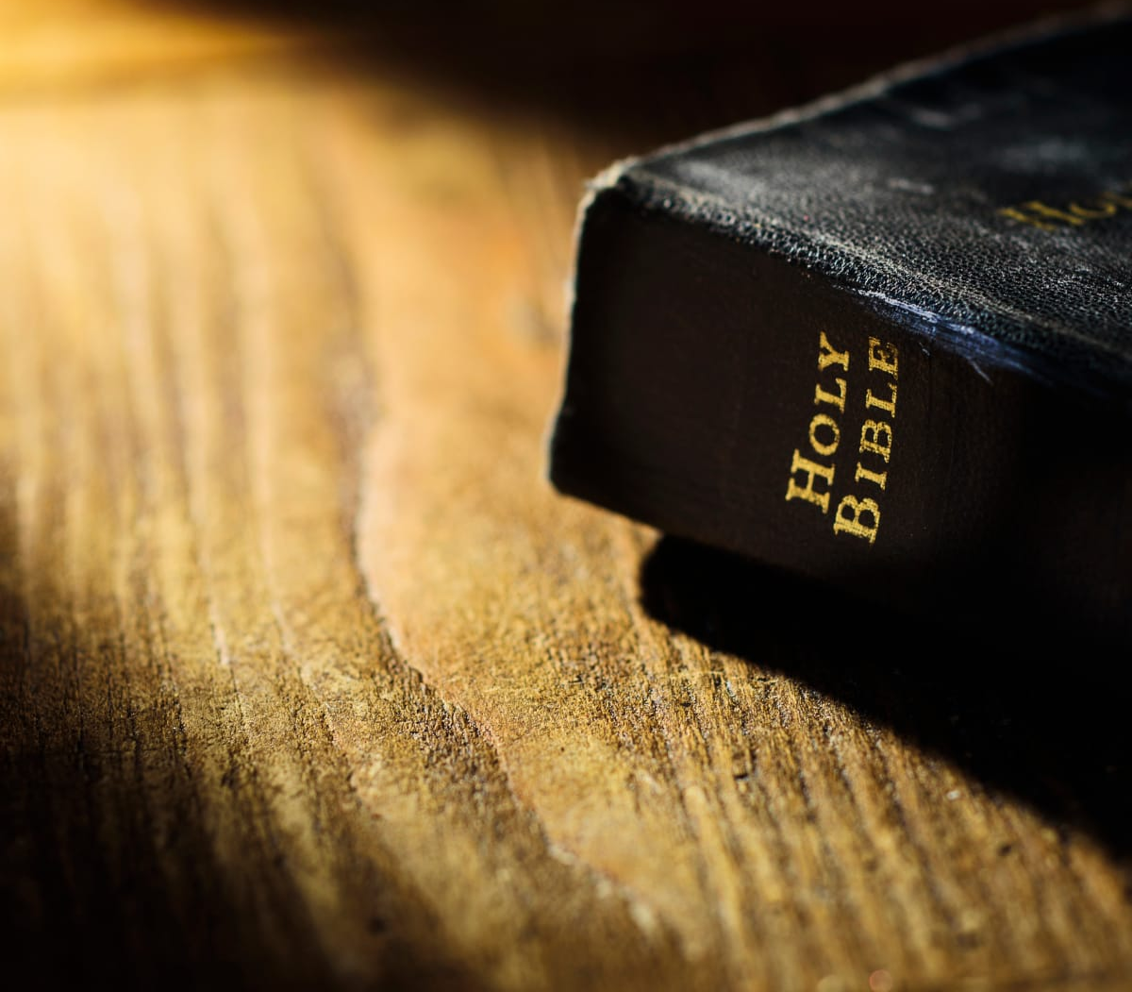
The Sacred/Holy
Myths often have religious aspects.
They often tell us how to relate to the sacred/the gods.
The most common example you would be examples from sacred texts like the Bible.
Does your Myth explore any sacred/religious themes?

Slide 21
Refining
Choosing how you will present your Myth.

Slide 22
Ancient Story Telling
The Ancient Greeks and Romans had many different ways of telling stories…
Can your explain what each of these are based on the following pictures?

Slide 23
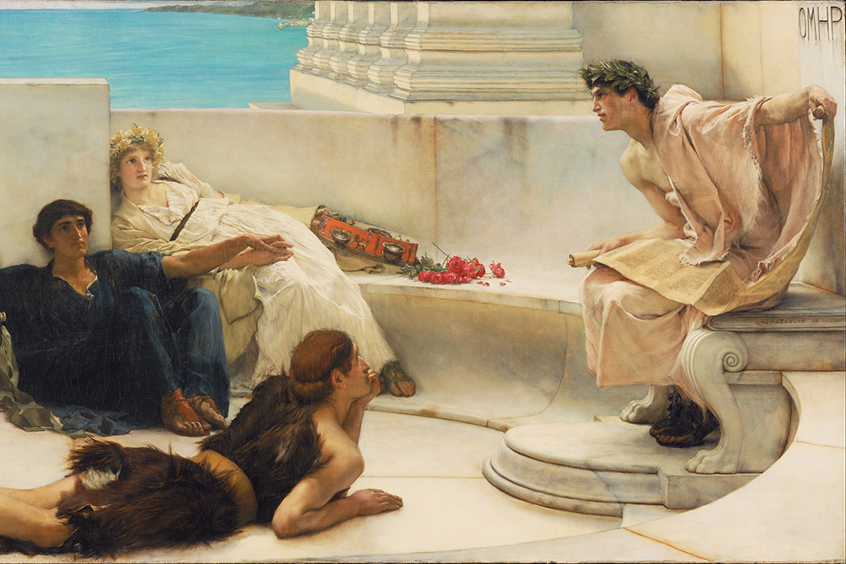

Slide 24
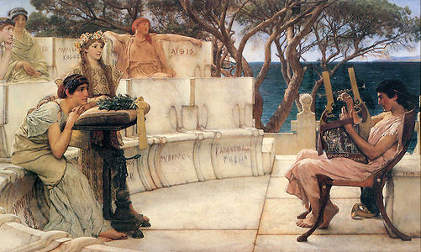

Slide 25
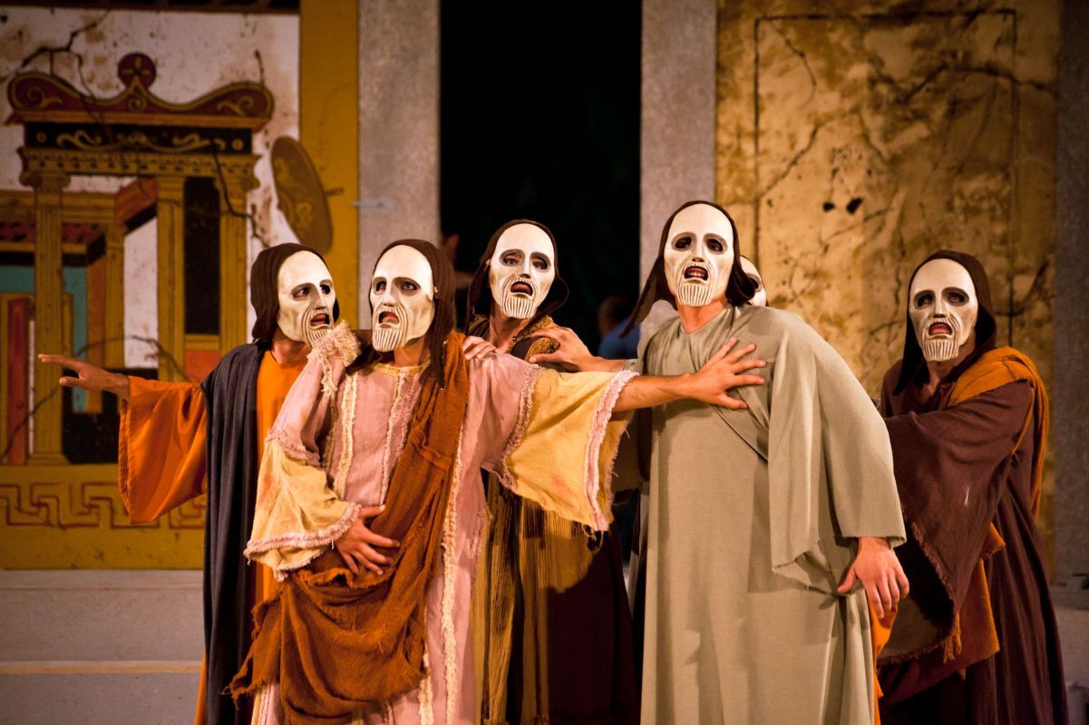
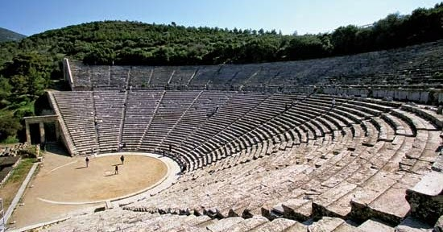

Slide 26
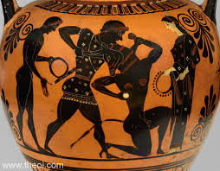
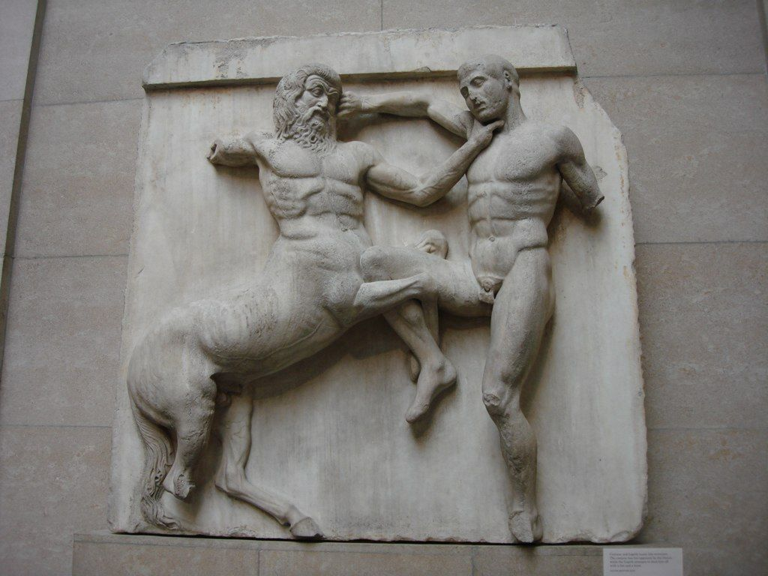

Slide 27
Modes for Myth Retelling: Digital or Analog – One or more
Written text
Play Script
Display folder or Booklet
Graphic Novel
Cartoon
Short Film
Dramatic Performance
Oral Presentation
Photographs
Images
Timelines
Audio-visual Recordings
Models
Artefacts

Slide 28
How to decide?
What are your particular set of talents/skills? Can you draw, act, sing, write, use technology, film etc.
What is the best mode(s) suited to you to present your Myth the best way possible?
What are you comfortable doing in the time allotted?
Which mode will be best for presenting your Myth? Is it visual? Is it best as a story? Is it musical? Is it dramatic?

Slide 29
Success Criteria for Display
The display demonstrates a good/well-developed/highly developed sense of awareness of both the purpose and key features of mythical storytelling.
The display uses storytelling conventions and techniques to a good/well-developed/highly developed standard.
The overall shape and structure of the display is appropriate in terms of its originality, creativity and coherence.

Slide 30
Guide for Creating my own myth/ adapting an existing myth:
What is the purpose or essential message/moral that my story will address?
What will the plot be?
How will characters be developed?
What will their motivation be?
If my display has a visual dimension (for example, a cartoon), how will I develop the visuals?

Slide 31
Telling the story to the class/ acting out the story to the class/ creating a short film or audio:
What storytelling techniques will I employ?
Spontaneity (i.e. learning the story but not necessarily memorising, being able to respond to audience reaction)
What dramatic techniques will I employ?
pace, tension, emphasis, repetition, pause
What vocal skills will I employ?
volume, articulation, projection, different voices for different characters, dialogue
What physical skills will I employ
movement and positioning, posture, gesture, facial expression
How will I keep my audience in mind?
Communication skills-stylistic awareness, choice of language
stimulating the audience’s senses: see vivid images, feel, smell, touch, listen

