Slide 1
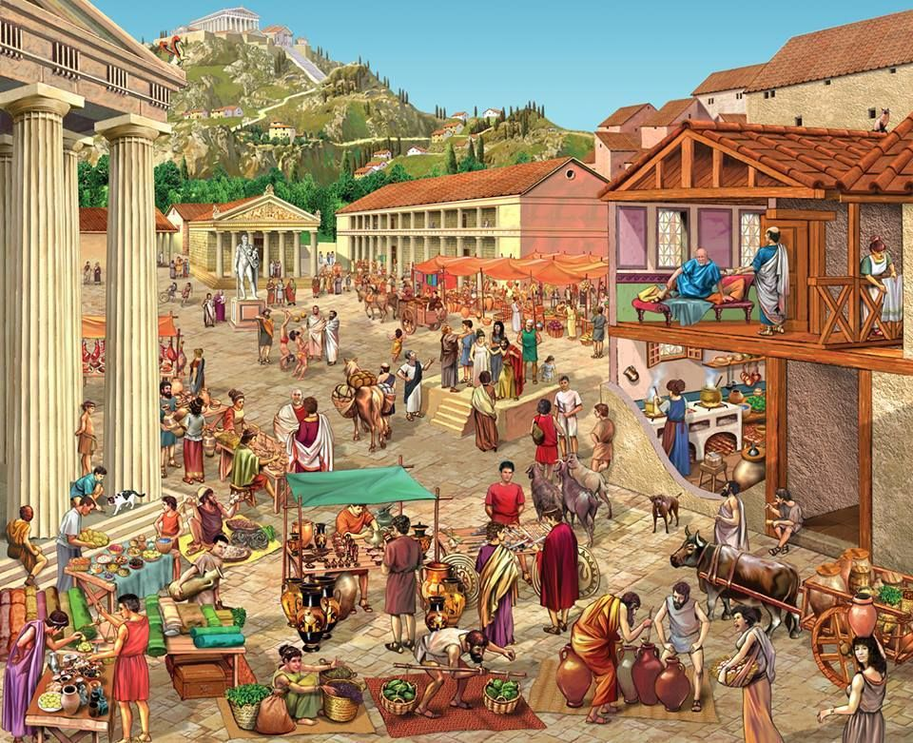
Daily Life!
In Ancient Greece

Slide 2
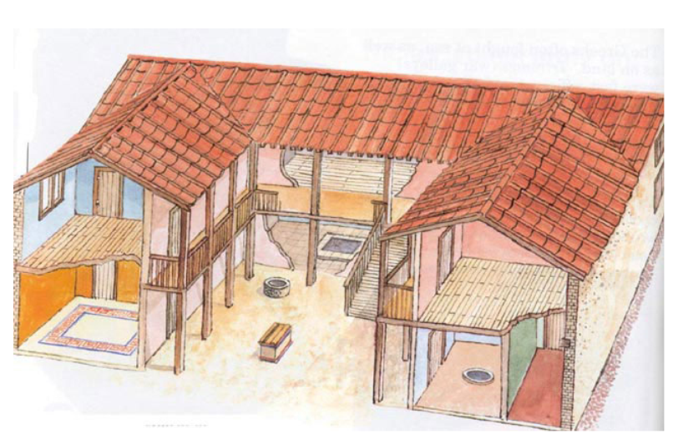
Homes
Ancient Greece

Slide 3
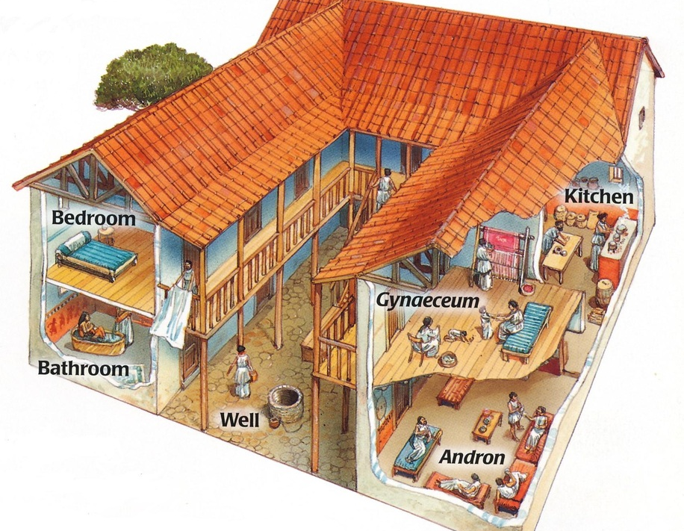
Most houses in Ancient Greek towns were built from stone or clay.
The roofs were covered with tiles, or reeds, and the houses had one or two storeys.
The floors of the rooms were tiled to keep them cool, although in winter fires in metal baskets were sometimes needed.
Larger homes had a kitchen, a room for bathing, a men's dining room, and sometimes a woman's sitting area.
The houses were planned around a courtyard and had high walls and a strong gate. Much of ancient Greek family life centered around the courtyard.
As well as having separate roles in life, men and women lived in different parts of the house. Women had the back and upstairs part.

Slide 4
What can you tell me about the houses and homes so far?
British Museum - Daily Life in Ancient Greece - Explore

Slide 5
Food
Ancient Greece

Slide 6
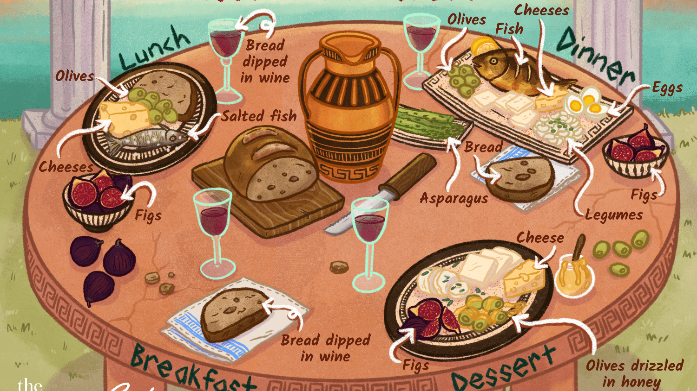

Slide 7
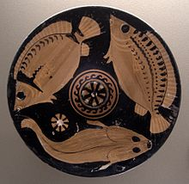
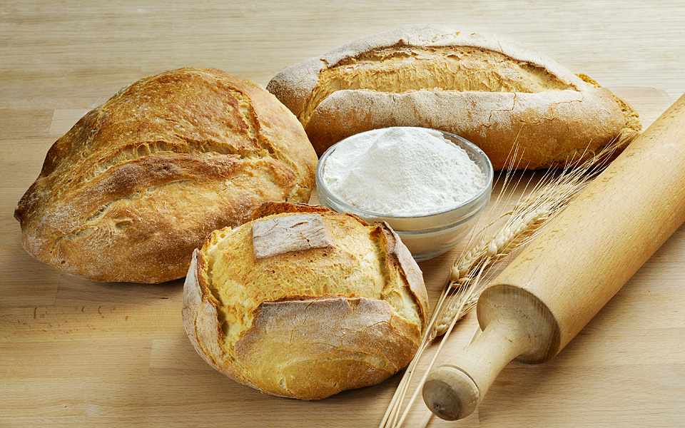
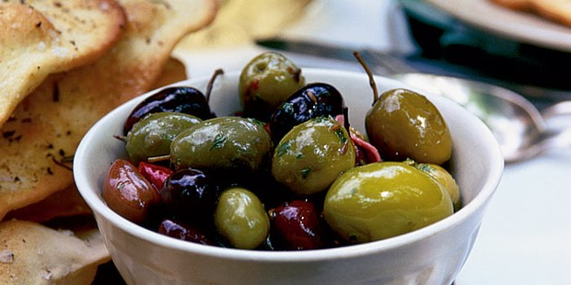
The Ancient Greeks grew olives, grapes, figs and wheat and kept goats, for milk and cheese. They ate lots of bread, beans and olives.
In the Summer months there were plenty of fresh fruit and vegetables to eat
In the winter they ate dried fruit and food they had stored like apples and lentils. As most of the Greeks lived very near the sea, they also ate a lot of fish, squid and shellfish.

Slide 9
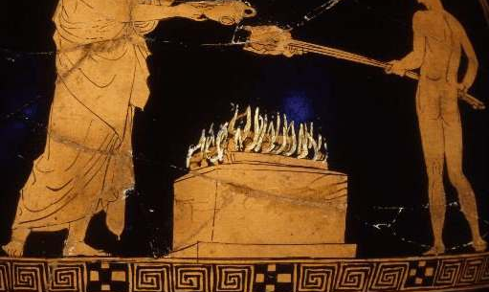
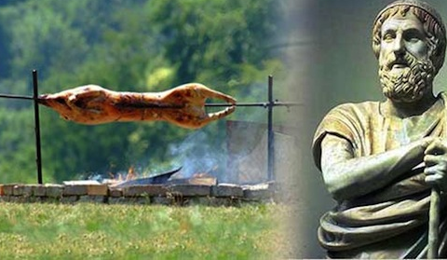
Meat was rarely eaten as the Greeks felt that just killing and eating a domesticated animal (like a goat) was wrong. The Greeks would often sacrifice the meat to the gods first and then might eat some of the meat.
Examples of this can be read about in Homer’s Iliad.

Slide 10
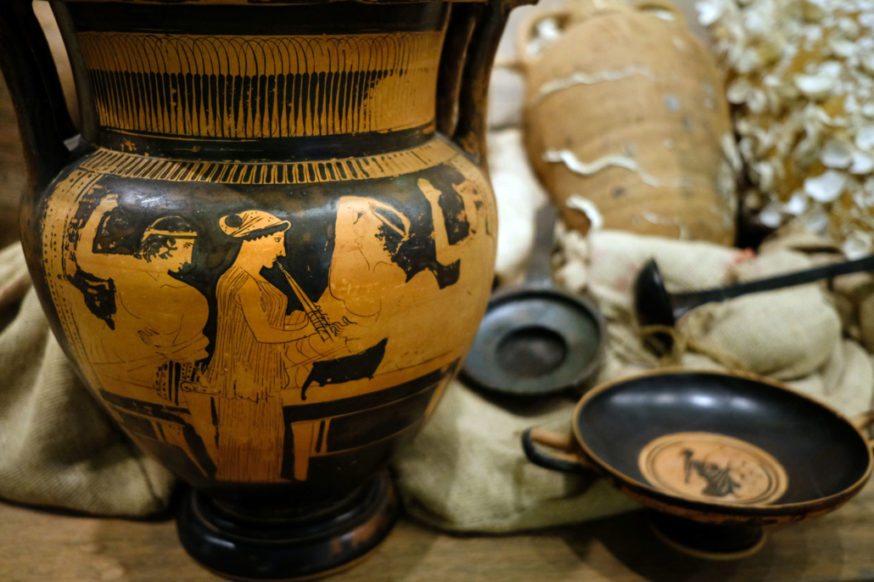
Wine
The Greeks also loved their wine which was made from the grapes they grew.
The wine would be kept in amphora or jars.
The wine would be enjoyed at the Greek dinner party – a Symposium.
They even had a god of wine – Dionysus.

Slide 11
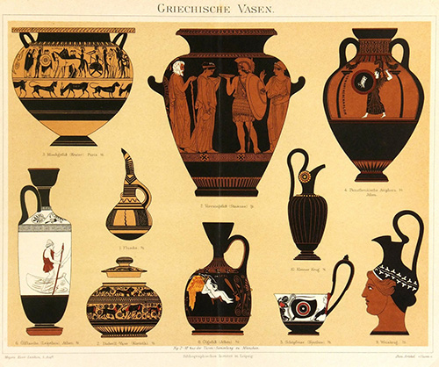

Slide 12
Clothes
Ancient Greece

Slide 13
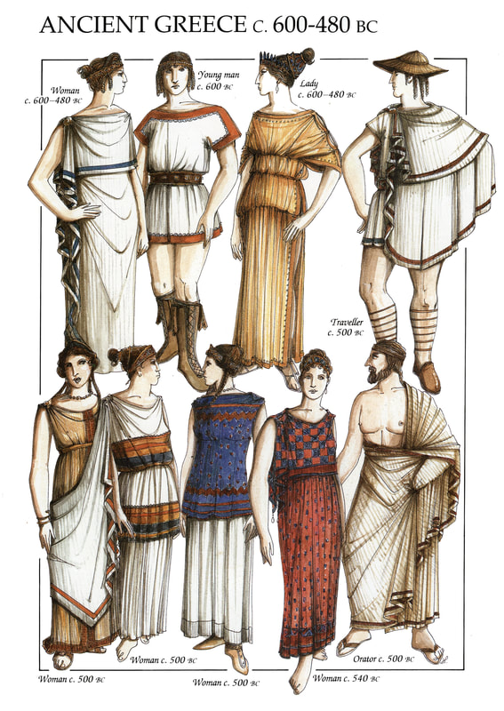
The Greeks wore light, loose clothes.
Long pieces of colourful fabric were used to make the Greek clothes.
The main item of clothing for men was a tunic. They were big squares of cloth, held in place by pins at the shoulders and a belt round the waist. They were made from wool in the winter or linen in the summer.
Women also wore similar clothing. Unlike the men's, the dresses always went down to the ankles.
The ancient Greeks could buy cloth and clothes in the agora, the marketplace, but that was expensive.
Many of the clothes were made by the women and female slaves.

Slide 14
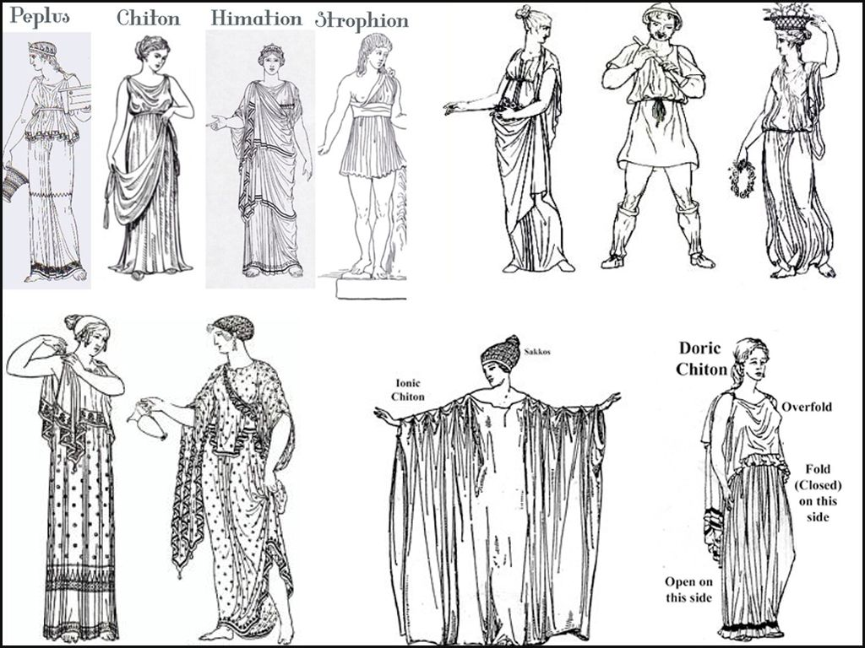

Slide 15
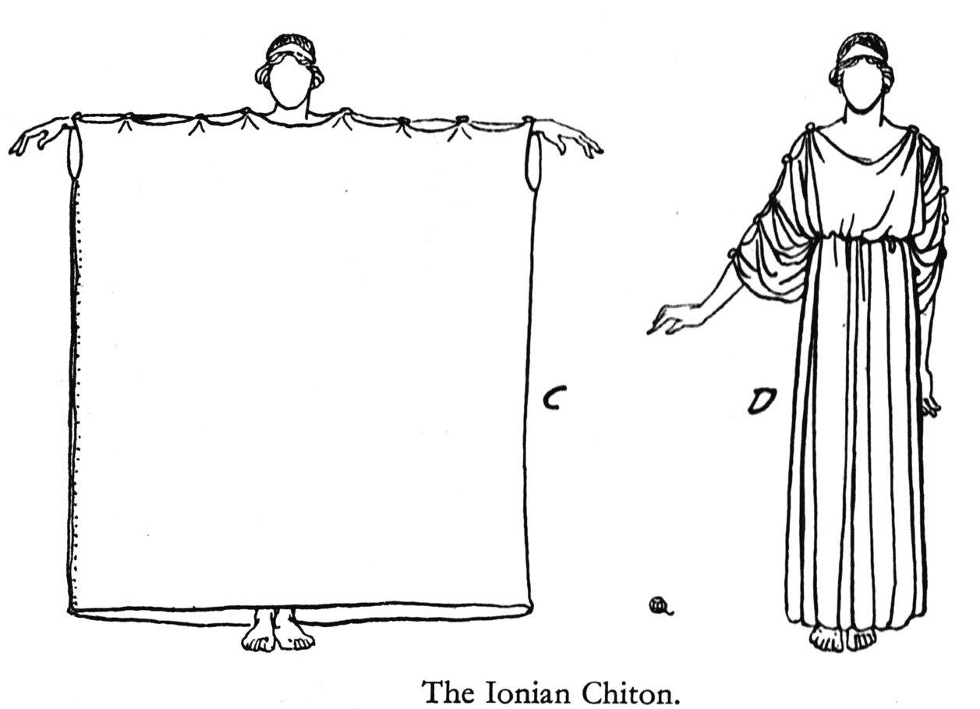

Slide 16
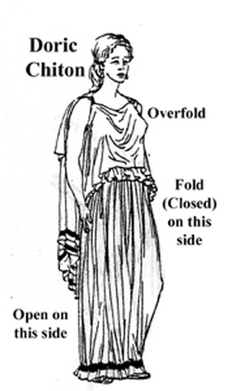

Slide 17
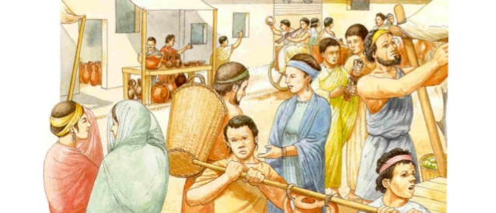
Jobs
Ancient Greece

Slide 18
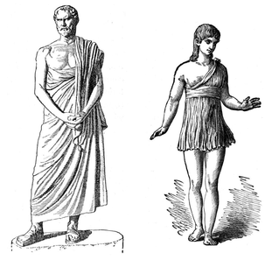
Depending on you class and gender, you could do very different jobs in Ancient Greece.
Which of the jobs on the slides below do you think men, women, slave or freedpeople would do?

Slide 24
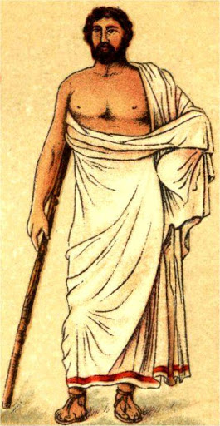
Men
Men had a much better life in Ancient Greece than women. Only men could be full citizens. Only men made the important decisions. Normally, only men fought in armies, took part in sports and met in public.

Slide 25
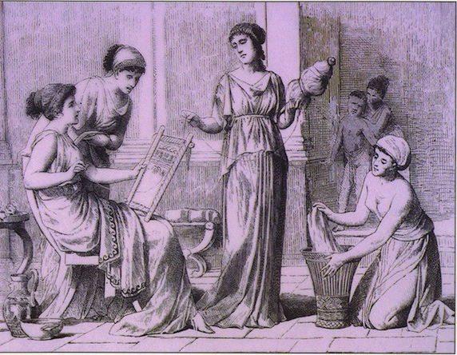
Women
Spartan women were taught reading and writing and skills to protect themselves in battle. They had more freedom than women and girls living in Athens. As well as looking after the house, making clothes
Women in Athens were taught skills they would need to run a home such as cooking and weaving. They were expected to look after the home, make the clothes, and bear children.

Slide 26
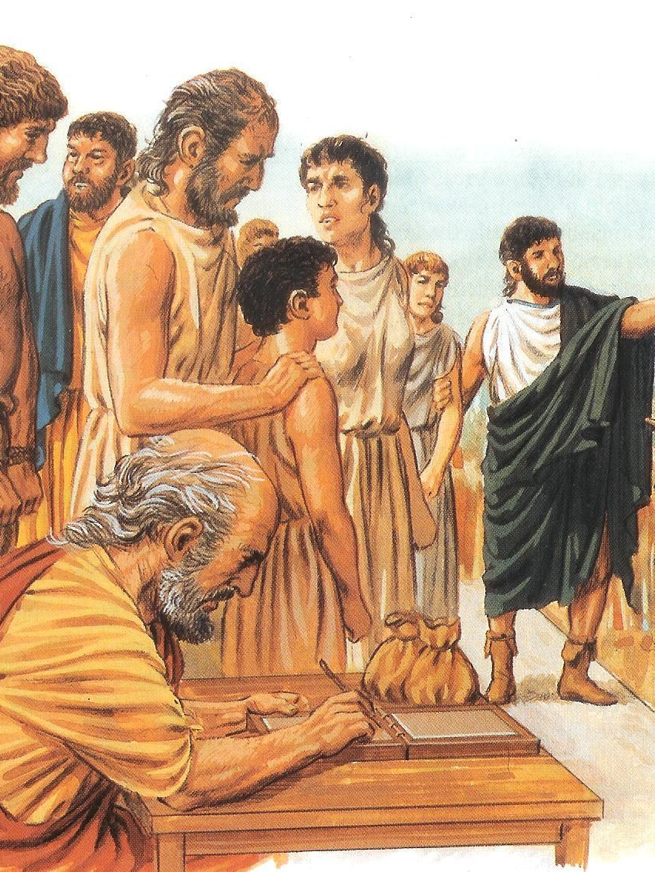
Slaves
Only in the poorest homes were women expected to carry out all the duties by herself. Most homes had female slaves who cooked cleaned and collected fresh water every day.
There were also male slaves. Their responsibilities included protecting the home and tutoring male children.

Slide 27
Marriage
Ancient Greece

Slide 28
Describe a wedding today.
What different kinds of weddings do we have?
How do you think the Greek weddings would differ?

Slide 29
Describe what is happening in these pictures.

Slide 30
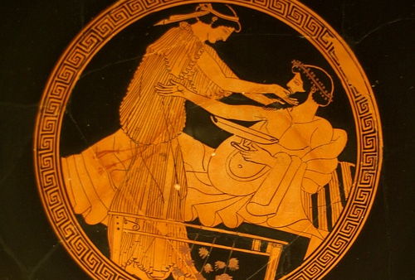
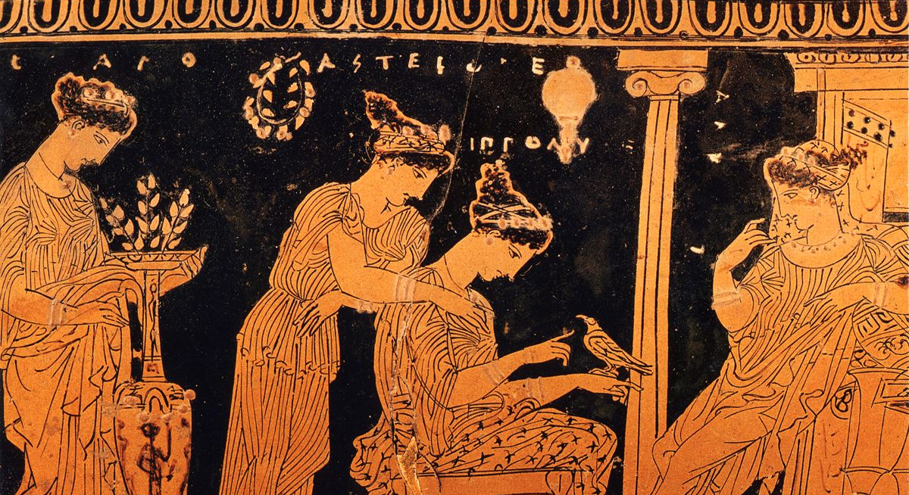
Girls had to do exactly as their father told them and this included marrying the man their father chose for them.
Even when married, a women was not free. She had to do as her husband wished. She was not allowed out on her own and was not often seen by people other than her own family.
Most girls were married by the age of 14 while their husbands were at least 30.
Polygamy was popular during this time. Rich men could have several wives.

