Slide 1
Roman Army

Slide 2
Why would you join?

Slide 3
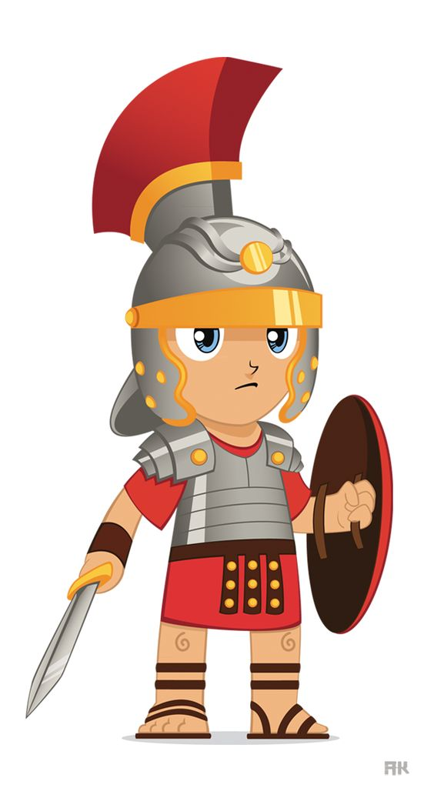
Why would you join?
Food and shelter
Steady salary (300 denarii), but deductions for equipment and funeral costs
A way out of debt/poverty
Adventure and travel
Personal glory
Land and a pension in old age

Slide 4
Do you think the army was a tempting career for young men in the ancient Roman empire? Why/why not? (give at least 2 reasons)

Slide 5
If you want to join, you must be...

Slide 6
If you want to join, you must...
Be age 17+
Have no serious criminal record
Be male
Be at least 5 foot 7 inches
Be single (or willing to leave your wife)
Be in good physical condition (perfect eyesight)
Have a letter of recommendation
Do an interview

Slide 7
Compare: to join the Irish army you must...
Be age 18+
Be an Irish citizen
Be in good physical condition
Be willing to travel abroad
Do an interview
Have no criminal record
Have 2 letters of recommendation

Slide 8
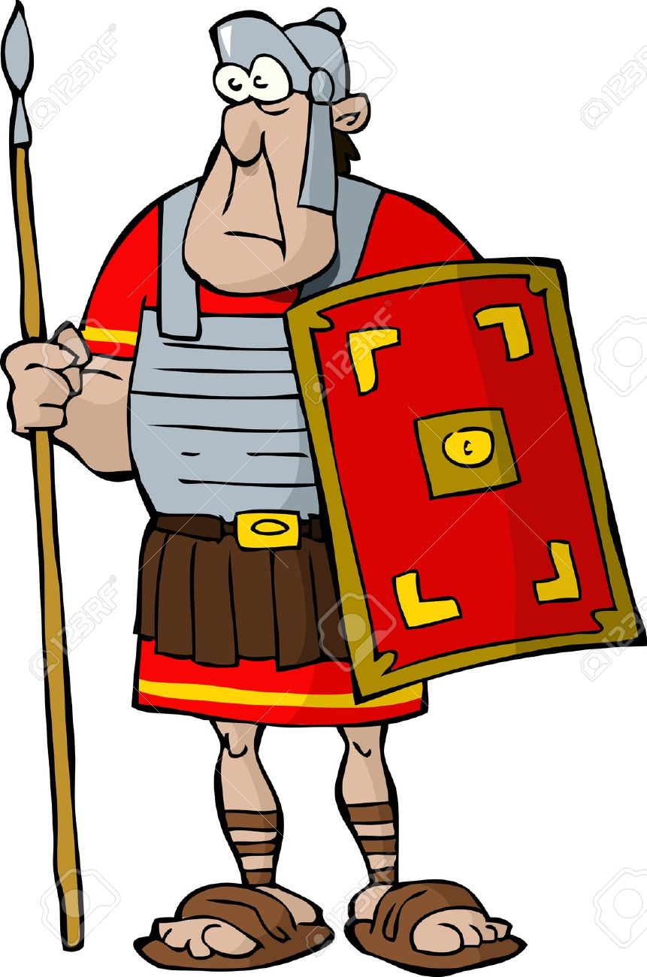
Now that I've joined...
After your successful probatio you need to take the sacramentum (oath of allegiance)
You are assigned to your contubernium (group of 8 men in your legion)
You must serve for 20-25 years
Try to survive!

Slide 9
Task: Create a recruitment brochure or poster to tempt young men into joining the army.
Include as much info as possible.

Slide 10
The Structure of the Army
COHORT
480 men
800 men
5300 men
1ST COHORT
X 6
LEGION
80 men
CENTURY
X 10
8 men
CONTUBERNIUM

Slide 11
Legate
Tribunus Laticlavus
Praefectus Castrorum
Tribunes
Primus Pilus
Centurion
Principales

Slide 12
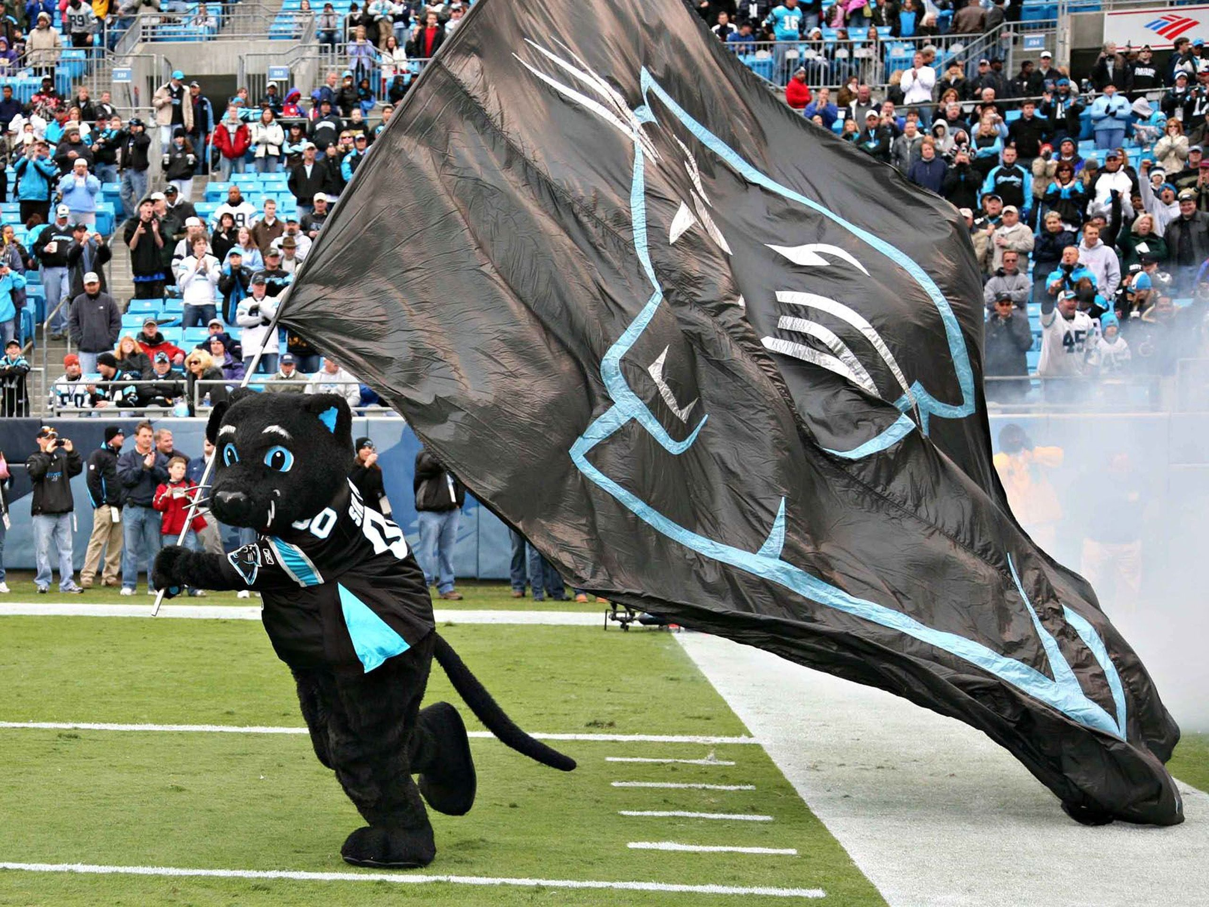

Slide 13
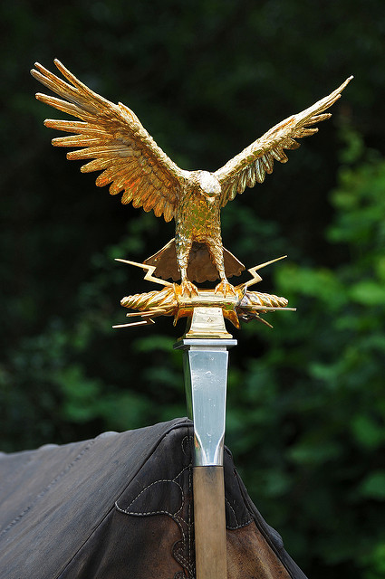
Standard-bearers
Who are they?

Slide 14
Standard-bearers
Who are they?
Soldiers who carry the symbols of the army

Slide 15
Aquilifer
Senior standard-bearer
Carried the 'aquila' (eagle)
Sacred image that carried the honour of a legion
If lost, a legion could face serious punishment

Slide 16
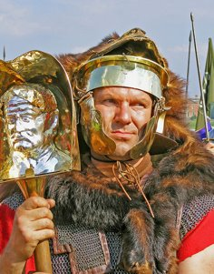
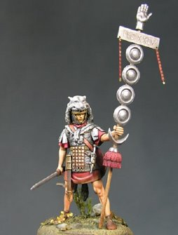
Imagnifier Signifier
Carries the image of the emperor into battle
Represents the oath that soldiers took
Holds their pensions

Slide 17
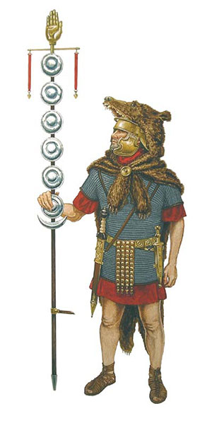
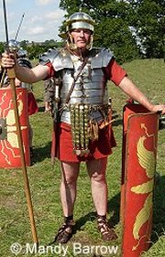
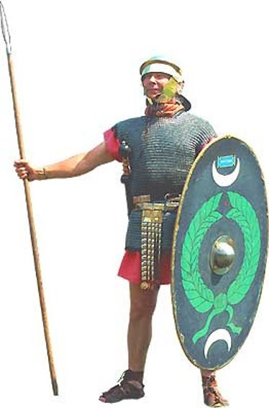
Who am I?

Slide 18
Part I
Part II

Slide 20
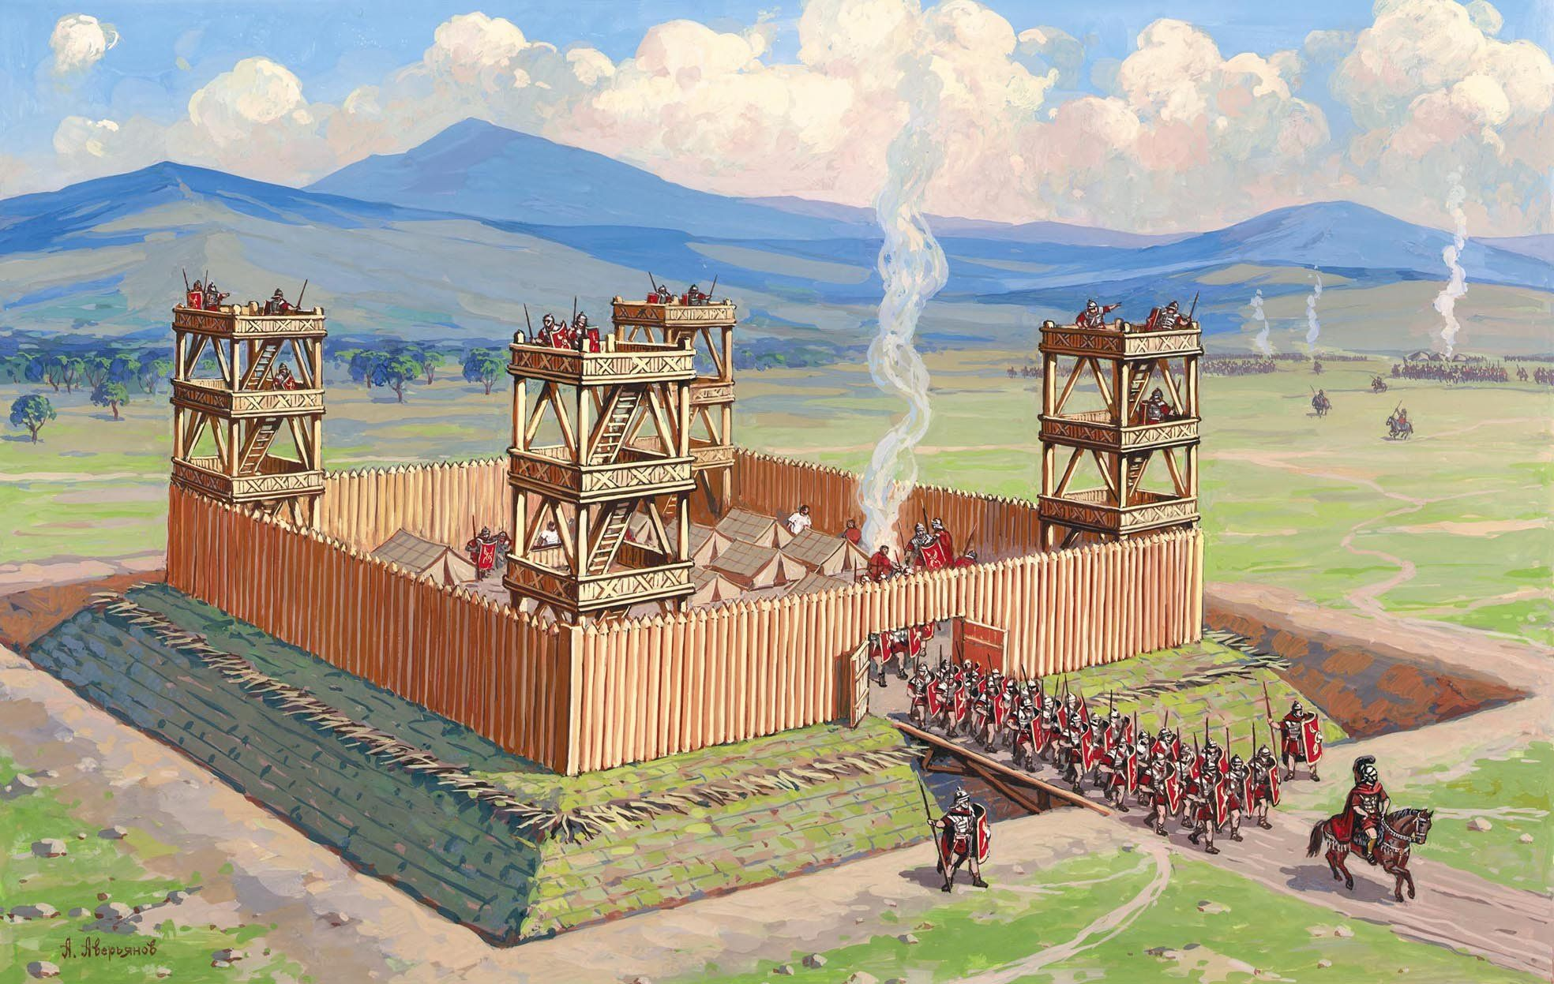
Choosing a place to build
What do you need to consider?

Slide 21
Choosing a place to build
What do you need to consider?
Near a road
Near a water supply
Food supply/building supply
A location that can be defended easily

Slide 23
Defences
https://www.youtube.com/watch?v=MTPKUI9zs_o
Note down what materials are needed for building.
If you were a local tribes-person in Gaul, what would you think of this structure?

Slide 24
Building the camp
How would you measure straight lines and right angles without modern tools?

Slide 25
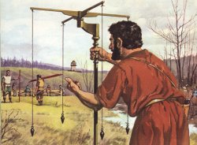
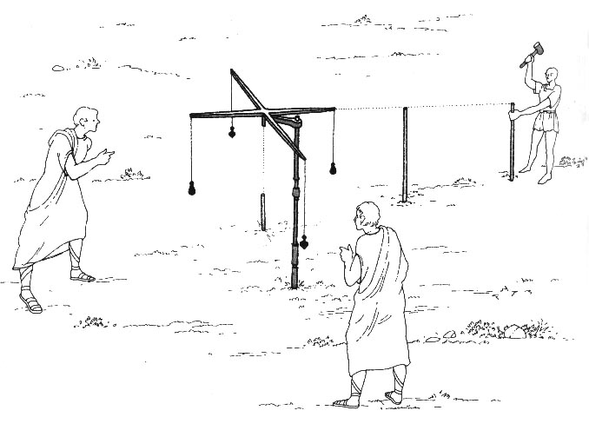
Building the camp
How would you measure straight lines and right angles without modern tools?
Groma
Also need: pick axes , mallets, shovels

Slide 26
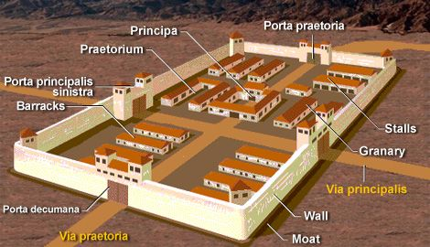
Headquarters
Principia
Has a shrine which holds the legion's eagle
Holds the legion's treasury
Legate lives nearby, in a luxury villa called a praetorium

Slide 29
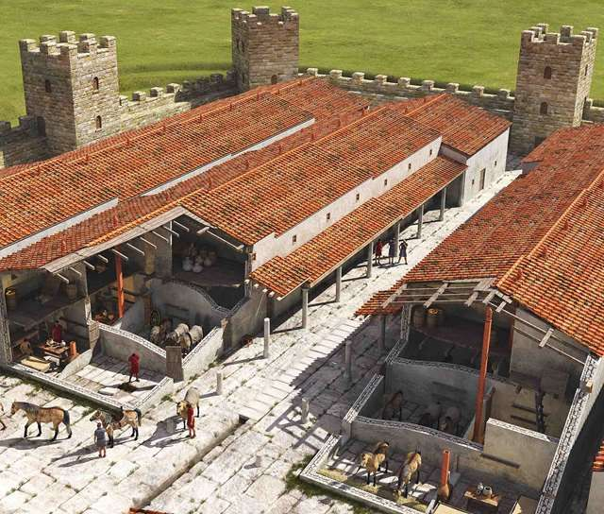
Barracks

Slide 30
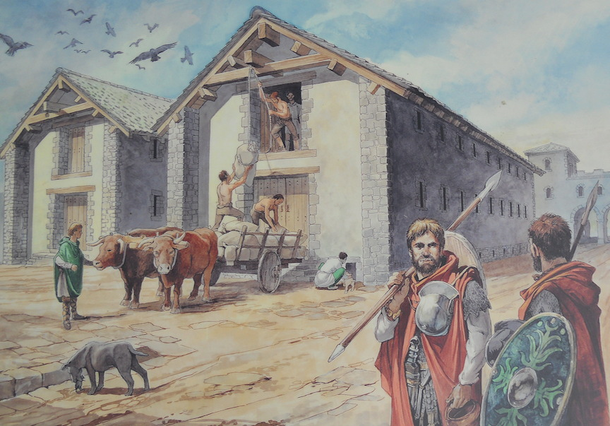
Granary

Slide 34
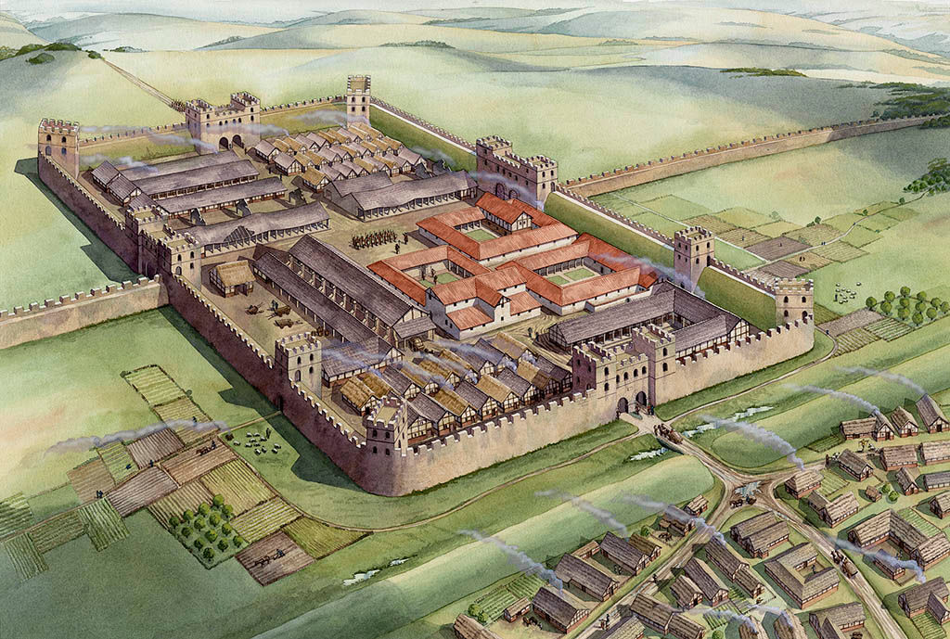
Create an instruction manual on how to build a Roman fort
Aimed at centurions
Must have at least 10 instructions
The more detail the better!

Slide 35
Go to:
Discover the Romans
Chapter 3: build a fort (find at least 3 new facts)
Chapter 2: dress a legionary and auxiliary

