Slide 1
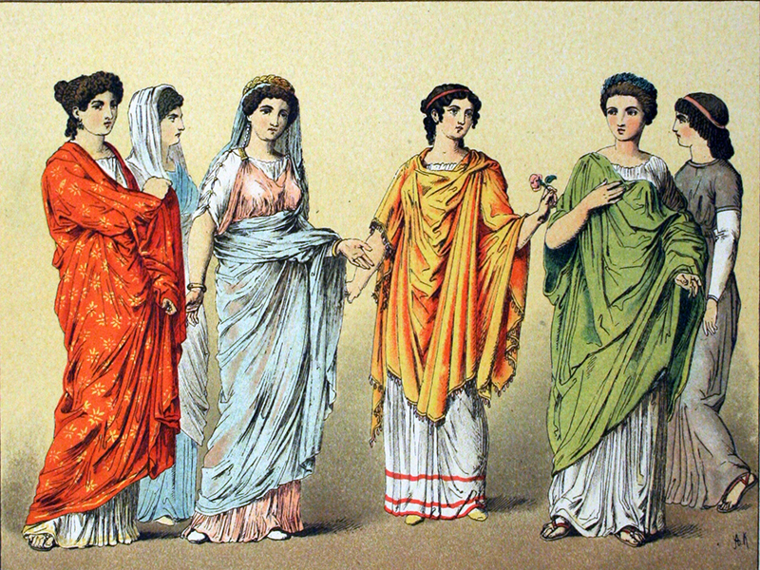
Women Clothing& Food in Pompeii

Slide 2
Women in Ancient Pompeii: Ted-Ed: Four Sister's in Ancient Rome
Outline the daily life of a young Roman girl
What can Roman women/girls not do?
What can the Roman men do?

Slide 3
Daily Life a Teenage Boy: Ted-Ed: A Glimpse at a teenage life in Ancient Rome
Summarise the daily life of the teenage boy
List at least 5 differences between the daily life of a young boy and the daily life of a young girl in Ancient Rome.
List at least 5 similarities between the daily life of a young boy and the daily life of a young girl in Ancient Rome.
Contrast the daily life of a typical Roman with life today.

Slide 4
Life of Pompeii: Town Plan

Slide 5
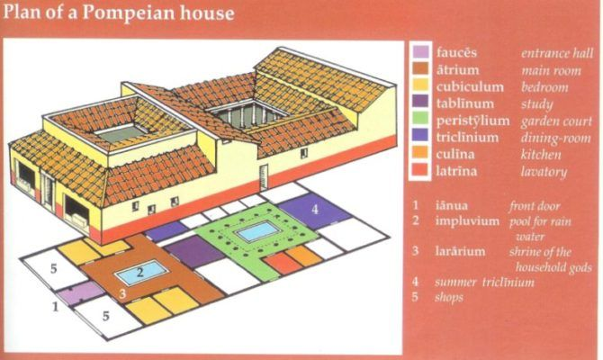
Life of Pompeii: Houses and Homes

Slide 6
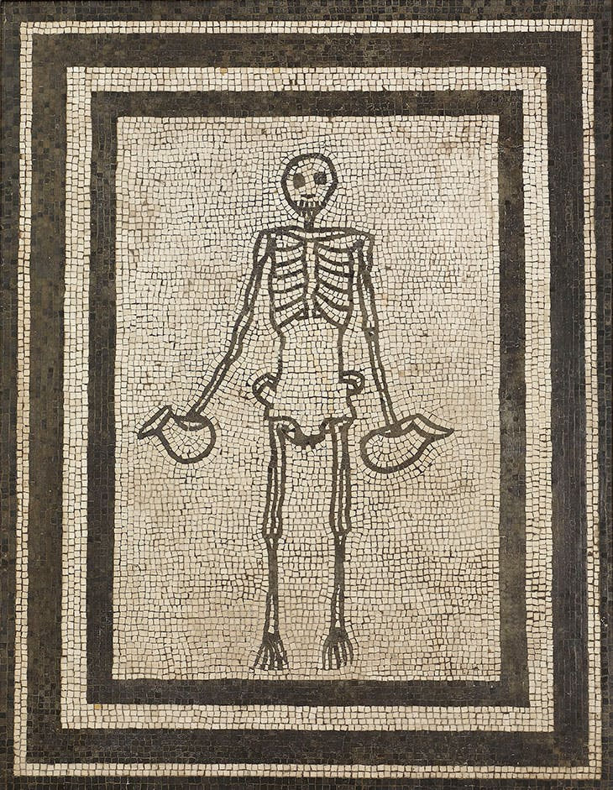
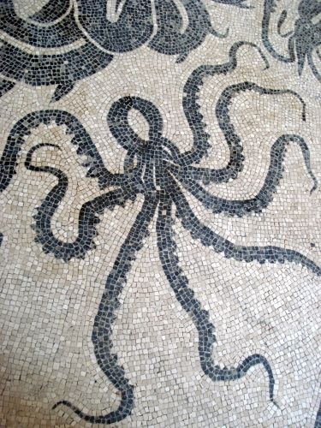
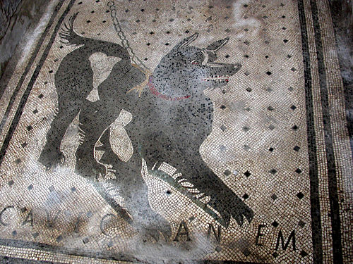
Mosaics:
Mosaics are pictures that are created from 100s of cut pieces of tile placed on a floor or wall surfaces, and stuck together with mortar.
Most wealth Romans would decorate their homes with these elaborate pieces of art – usually depicting all sorts of subjects…

Slide 7
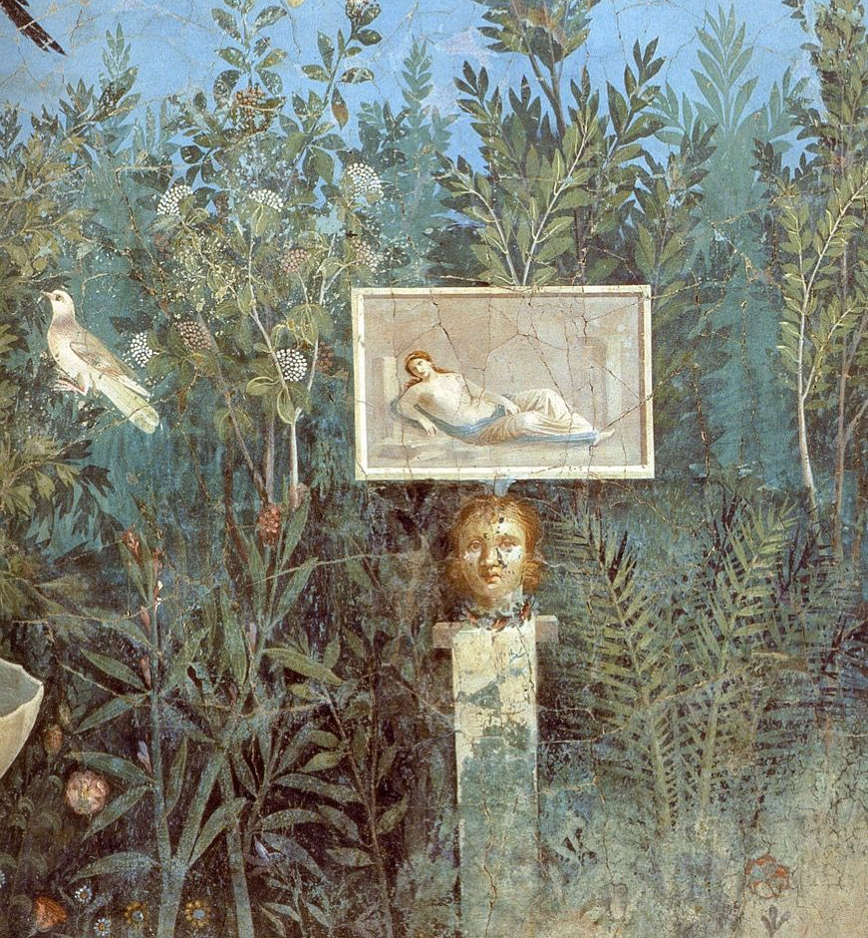
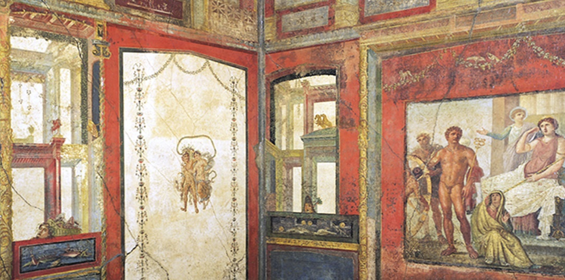
Frescos:
Frescos are wall paintings that decorated the villas of Pompeii.
The painting is usually painted onto the wall while the plaster is still wet – this ensures that the painting last longer.
However, many of these painting no longer survive – the weather effecting them.
The could be of a variety of subjects from ordinary life, history, or mythology.

Slide 8
Decorate your own room – Roman Style:
Take inspiration from Pompeiian Villas…
If you were to decorate your room with mosaics and frescos, what would the pictures be of? What colours would you use? (Mosaics would be on the floor, and the frescoes on the 4 walls).

Slide 9
Villas were for the wealth – or super-wealthy
Do you recognise these houses?
Where do you think they are located?
How do the lives of the people who live in these houses differ from most people?

Slide 10
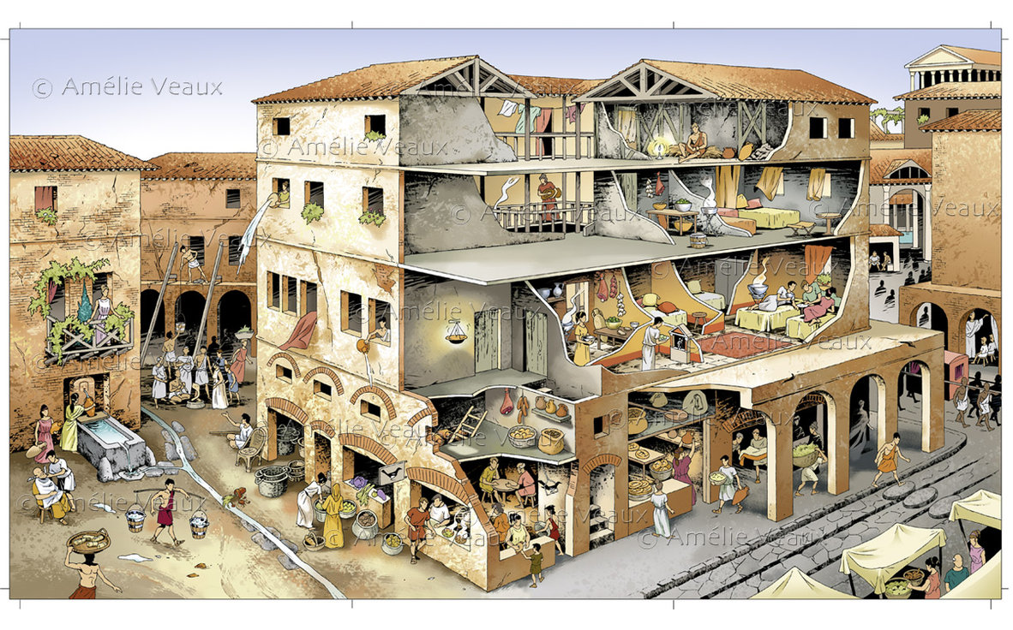

Slide 11
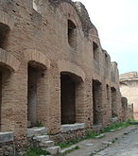
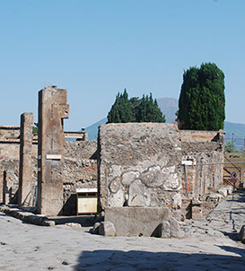
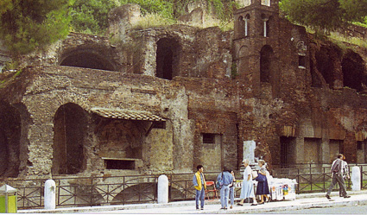
Insulae
Most Romans lived in flats…
These could be 5 or 6 stores high.
The ground floor hosted shops, bakeries, food stores etc.
The 1st floor was the wealthier apartments – not quite as wealth as the villa owners, but somebody around middle class.
The other stores got worse and worse as they rose higher – small rooms, no kitchen (culina), no windows: they were sleeping places (sometimes for whole families)
Tenement Flats in Dublin would have been of similar quality
The insulae were extreme fire-hazards because they were mostly made from wood (at least eh upper stores), and the streets of Roman towns were very narrow.

Slide 12
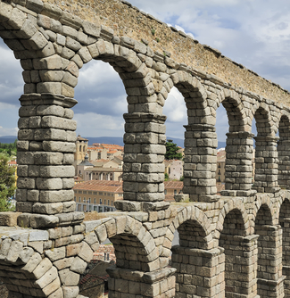
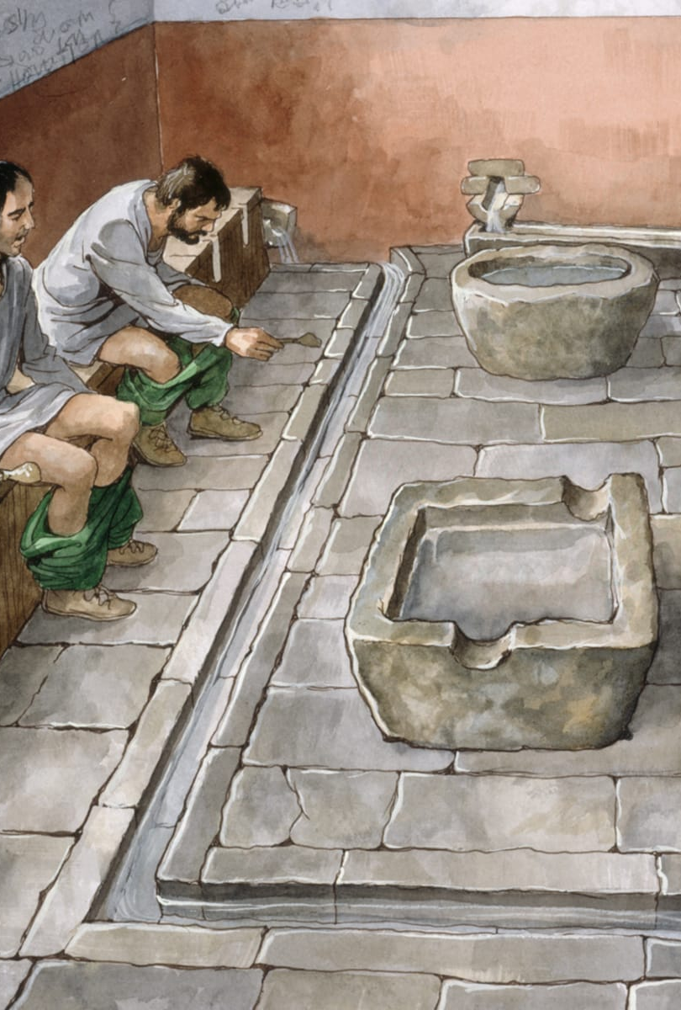
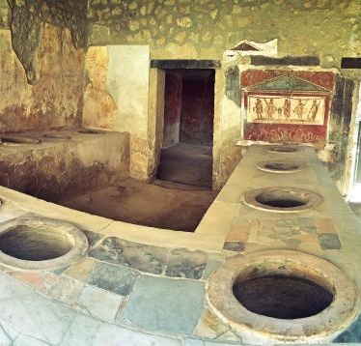
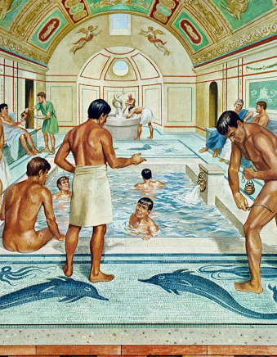
Insulae… continued
The residents of the insulae (excluding the better off living on the 1st floor) would have no access to water, food, and toilets in their apartments.
This is why Romans had so many public fountains, baths, public toilets, and fast food restaurants.

Slide 13
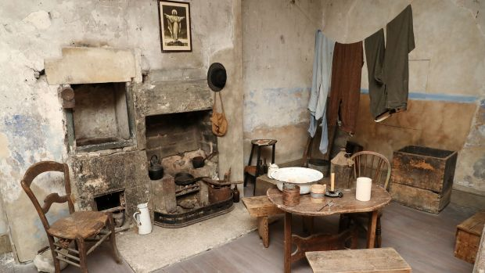
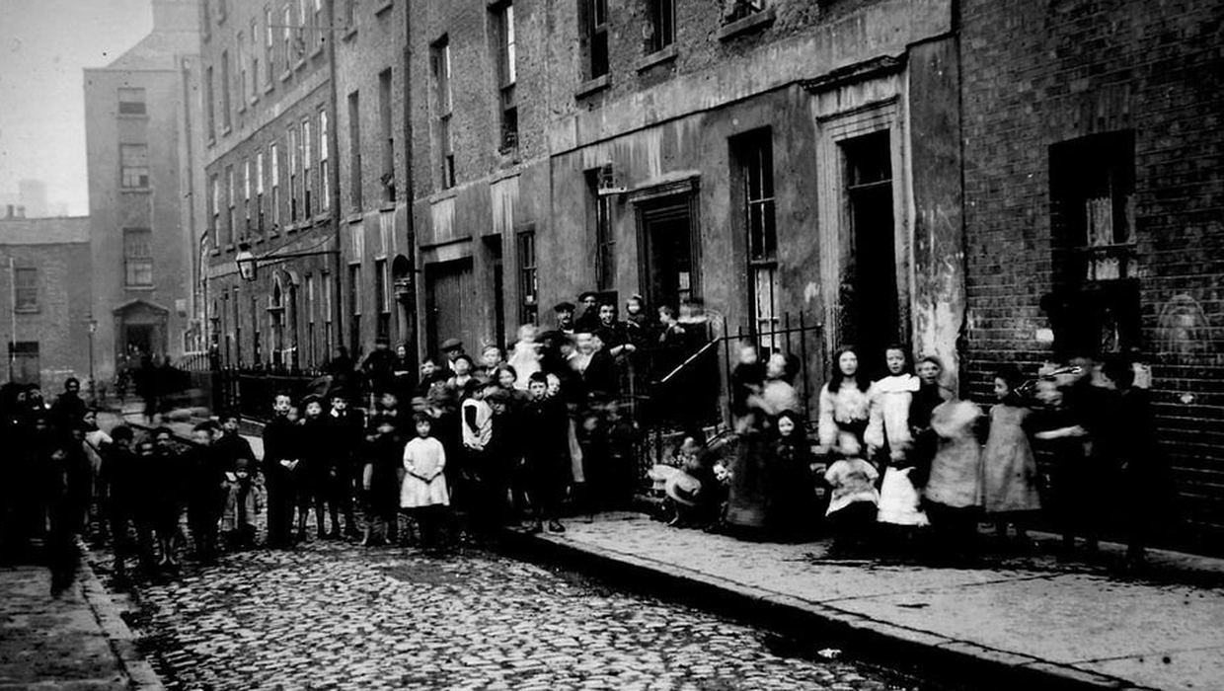
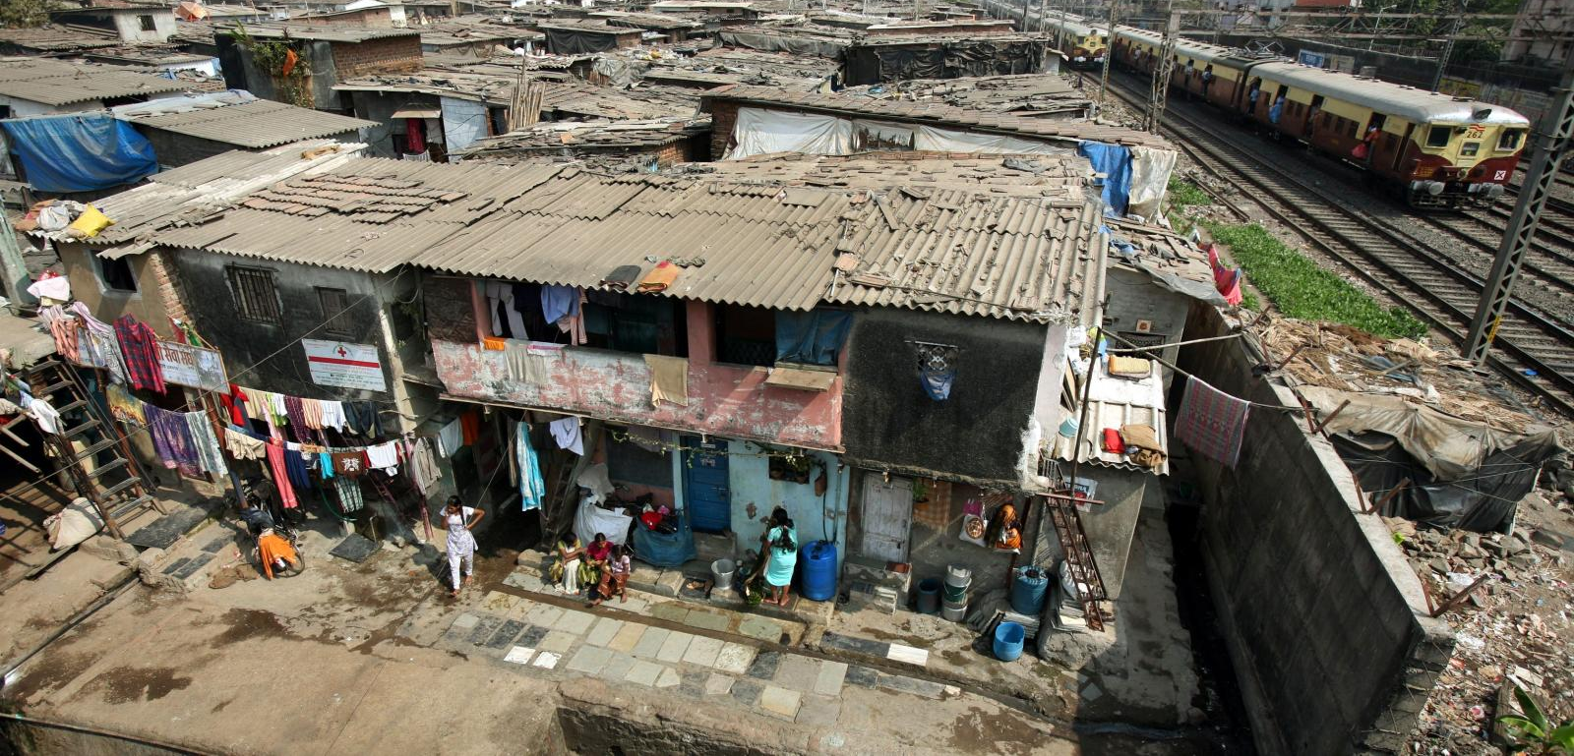
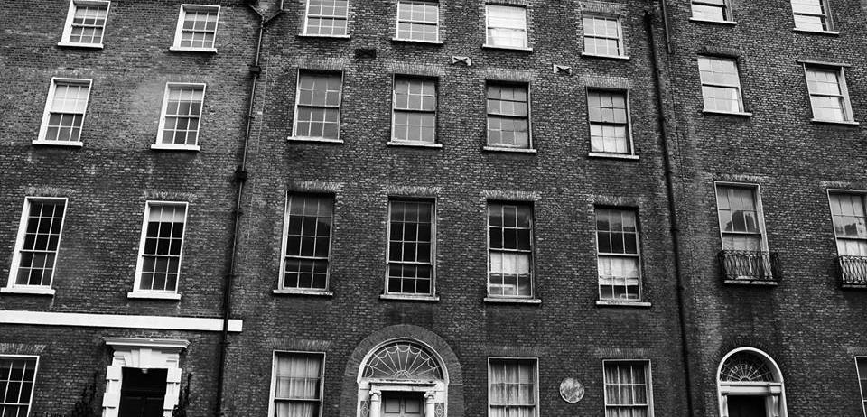

Slide 14
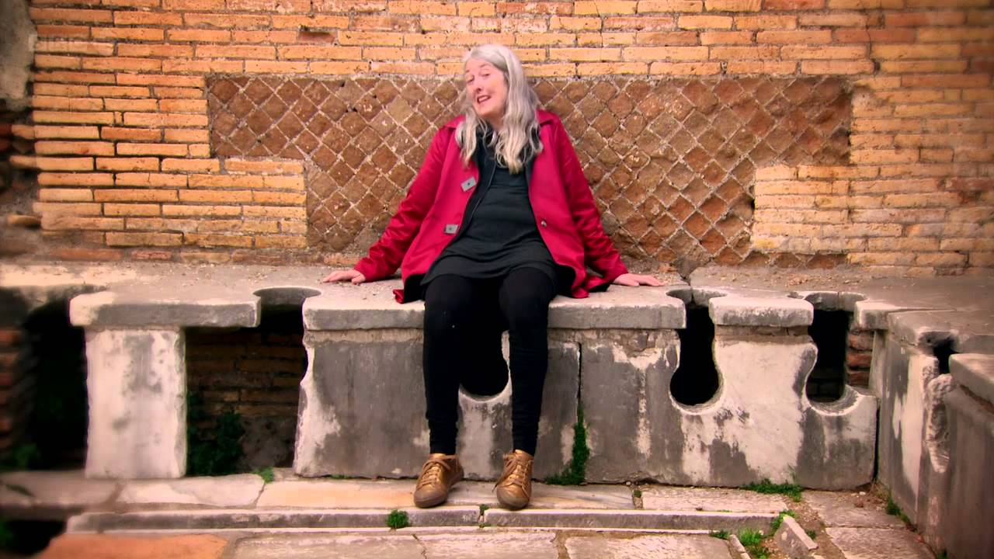
As you watch this documentary with Mary Beard, ask yourself the following (write an answer):
What were the conditions of the Ancient Roman like?
Do you think living in Pompeii would have been any better? Why?
How similar or different is their life to ours today?
Ordinary Romans: Life in an Insula

Slide 15
Comparison Task: how did the Pompeiians home-lives compare to ours?
Pompeii:
Today:

Slide 16
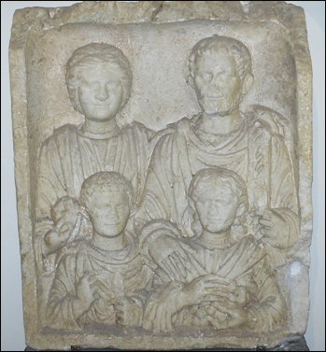
Ancient Roman Family
Pages 63-65 (Roman history, Social Life, and Civilisation

Slide 17
Ancient Roman Family: Compare Ancient Family to Modern Family
Ancient Roman Family
Modern Family

Slide 18
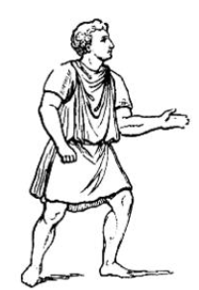
Roman Clothing: Men
Tunic: Undergarment.
Senators Tunic: Purple Stripes at the front.
Equites Tunic: two narrow stripes.
Toga: long cloak wrapped round body over Tunic.
Consul’s Toga: had a purple band along one of the long sides.
Emperor’s Toga: was completely Purple.
Boys Younger than 16: wore a Toga Praetexta: plan white woollen garment with a broad purple band.
Boy older than 16: wore a Toga Virilis. Plain white.

Slide 19
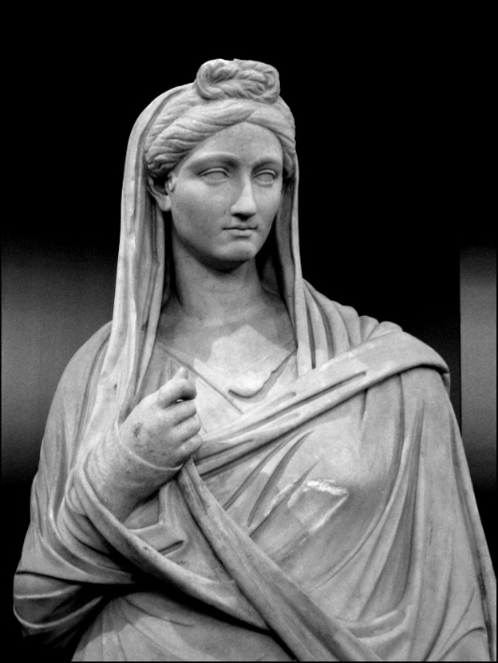
Roman Clothing: Women
Women also wore a short-sleeved knee-length tunic.
Unmarried women wore a longer Tunic as well over this.
Married women wore a long robe called a stola – which reached to the ankles and had a wide flounce attached to the hem.
Women also wore a rectangular shawl, known as a palla. It was either draped around their shoulders or looped over the head like a hood.

Slide 20
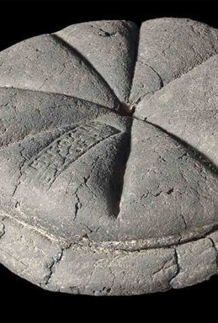
Roman Food
As we already saw, there are lots of different types of Romans from different classes. Some poorer Romans would only get some grain and water – and make simple bread for themselves (see picture).
However, there was also fast food and there was less difference between the rich people and poor people diets than you might have expected.
They had three meals:
Ientaculum: Breakfast. A drink of water or wine. Piece of bread or wheat biscuits sweetened with honey.
Prandium: Lunch. Eaten at midday. Consisting of eggs, cheese, cold emat and fruit.
Cena: Eaten in the afternoon. In the republic it was a simple meal – wheat eaten as porridge with sauces and vegetables. This improved to include poultry or fish. Poorer Romans would have bread, porridge and stew.

Slide 21
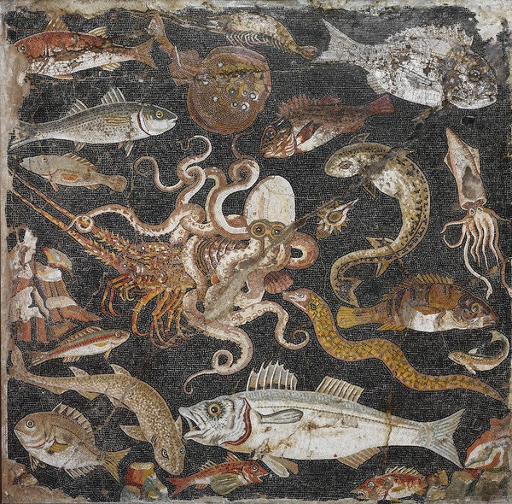

Slide 22
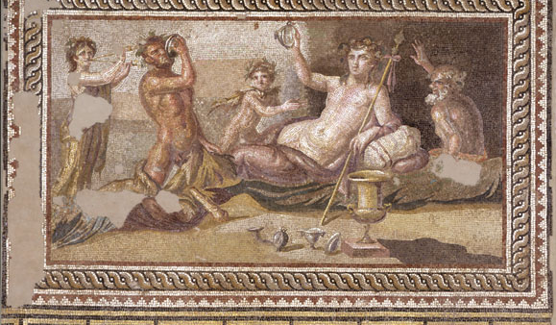
Wine and Water
The Romans drank lots of wine and they could choose from around 200 types. Wine was often spiced, sweetened with honey, and usually diluted with water. – it was usually considered disrespectful or unwise to drink unmixed. Alcohol content in Ancient wine was much higher than today.
Romans would also drink grape juice and goats milk – or they could drink from public fountains.
However, they drank water less often – as water was rarely clean.

Slide 23
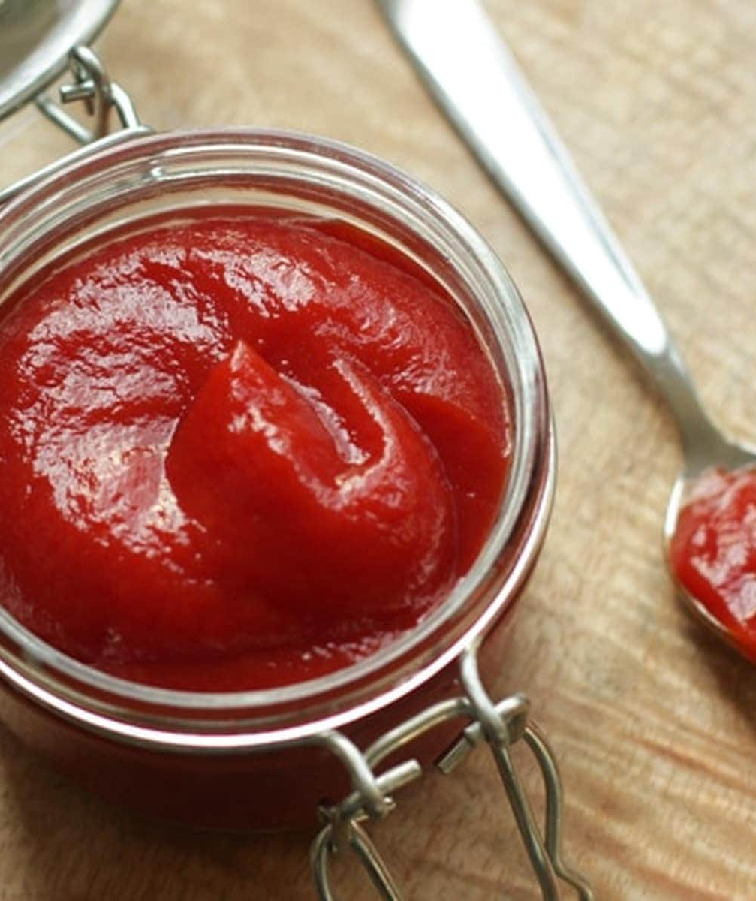
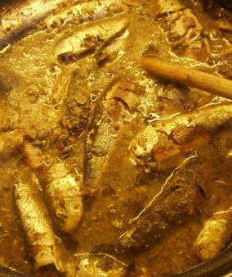
Roman Sauces
Romans loved spicing up their food with special sauces.
This most popular sauce was called Garum. It was thick, salty, and made from pickled fish.
They would put this sauce on everything – the true Ancient Ketchup.
There are attempts to replicate it today.

Slide 24
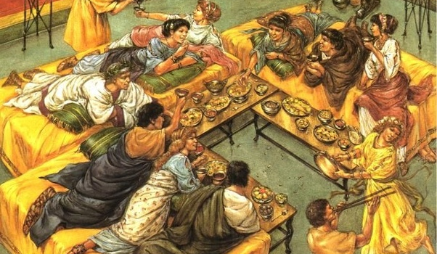
Cooking and Dining
Poor Romans would eat out – at fast food or restaurants.
Richer Romans would have their slaves cook food in the culina and serve them in the triclinium – or in the exedra if the weather was warm.
Sometimes they would have dinner parties:
Starters: radishes, mushrooms, shellfish, sardines, and eggs – followed by a drink of mulsum (wine sweetened with honey).
Main course: fish, game (wild animal meat), poultry, pork. Served with vegetables – beans, beetroot, garlic, marrows, and onions – and sauces.
Dessert: honey cakes, stuffed dates, nuts and fruits – grapes figs.
Lavish dinners could include delicacies such as dormice in honey, pig stuffed with blood puddings and sausages, flamingo’s tongues, even elephant trunks.

Slide 25
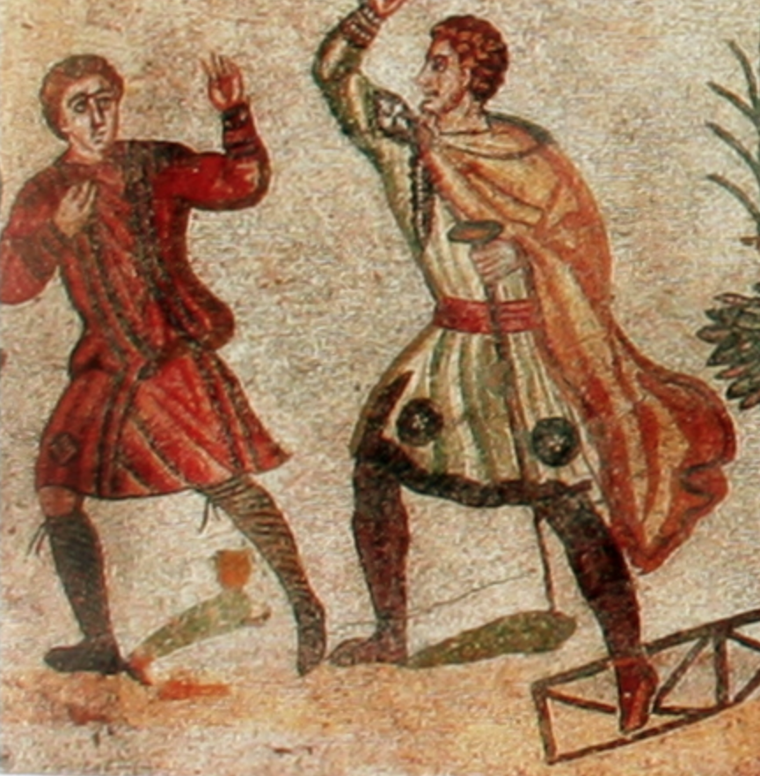
Slavery
Pompeii

Slide 26
Slavery Task:
What jobs do each of the slaves do?
Were they happy with their job?
Do they have any hope for the future?
What is the worst thing they experience as a slave?
What is the best thing they experience as a slave?
Slave 1: Flavius
Slave 2: Myrtilla
Slave 3: Panos
Slave 4: No Name

