Slide 1
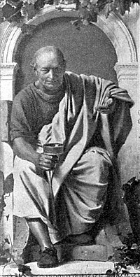
Horace
His life and poetry

Slide 2
Horace’s Life: The Son of an Ex-Slave
In 65 B.C., Horace was born in the region of Samnium in Southern Italy – there people were not Roman but allies (subject peoples) of Rome.
Horace’s father was a libertus or freedman. He had probably been enslaved during the Social War in 80 B.C. – a war over full Roman citizenship for all of Rome’s Italian allies. He would have been freed soon after and given Roman citizenship.
Horace had a close relationship with his father, who spent a lot of money to ensure his son had a good education in Rome.

Slide 3
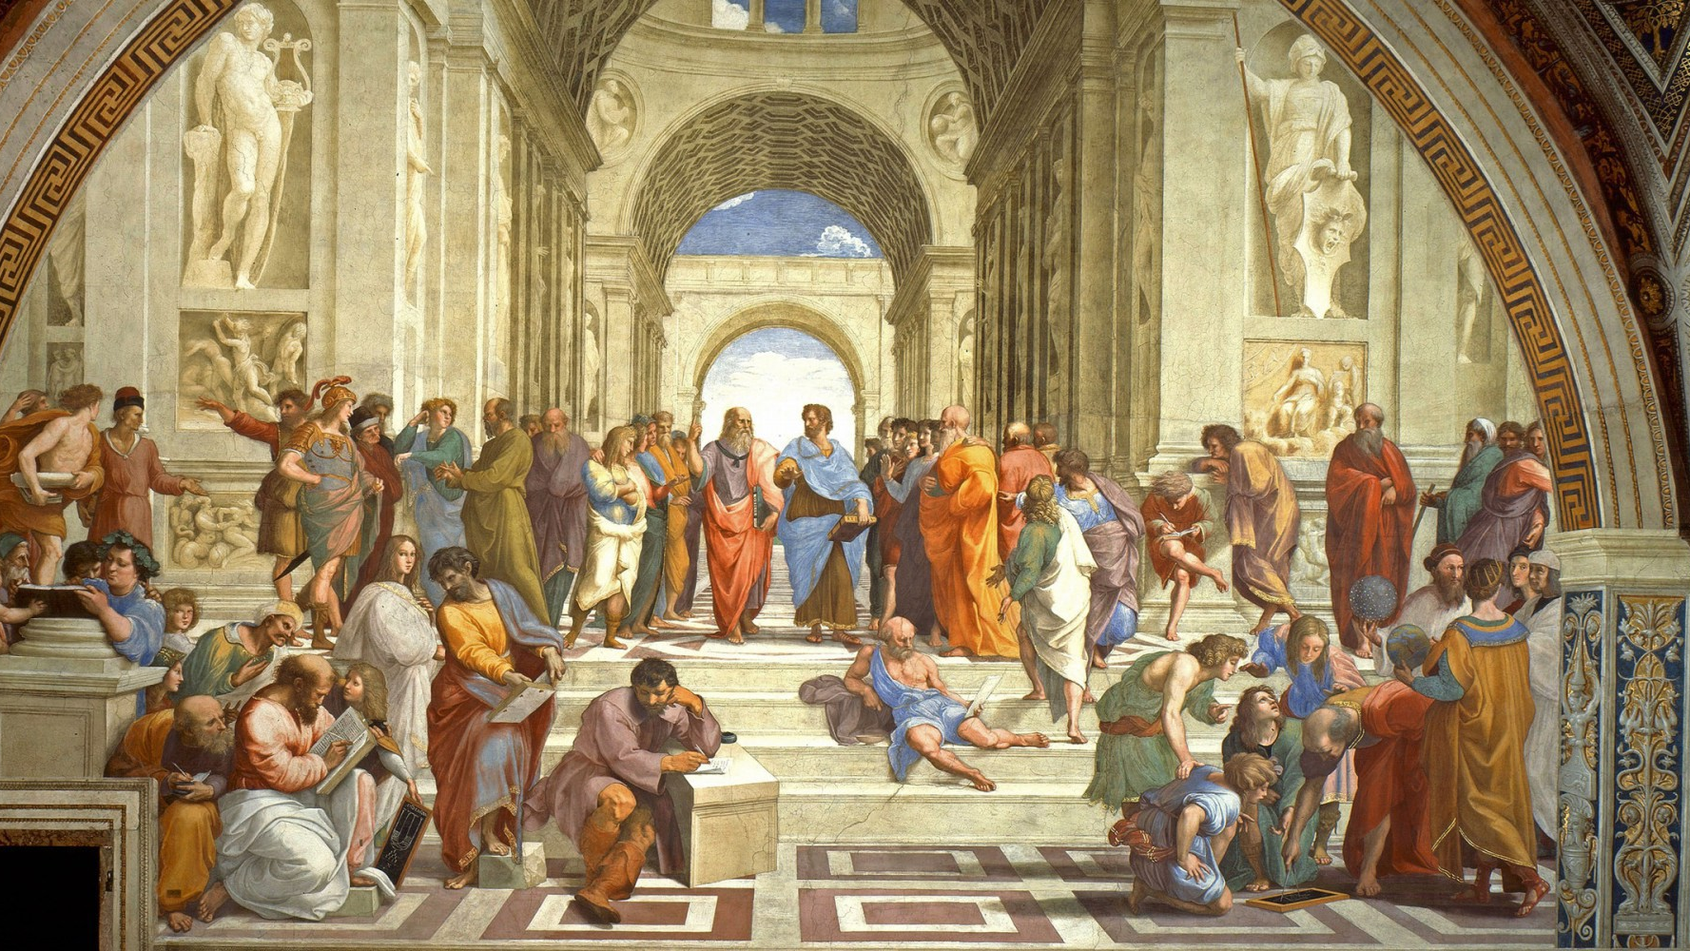
Horace’s Life: Philosophy and the Army
As a young adult, Horace left Rome and headed for Athens, Greece. Here he studied philosophy in Plato’s Academy – Plato was long dead. But, in Horace’s day the primary philosophers teaching there would have been Epicureans and Stoics. Here he also probably became friends with the son of Cicero, - Marcus Cicero.
Horace would have gained access to the public libraries and become acquainted with Greek poetry, art, and philosophy.
In 44 B.C., Julius Caesar was murdered and the Roman world was turned up side down. Caesar’s murderers, Cassius and Brutus, came east to Greece looking for young men to join their army to fight the supporters of Caesar, Mark Antony and Octavian (later Augustus). Horace joined and was made a military tribune (officer) because of his education. This was an unusual role for the son of an ex-slave.

Slide 4
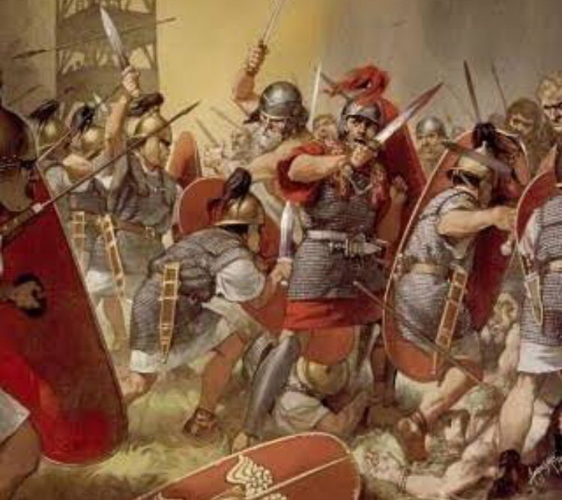
Horace’s Life: Defeated, Homeless, Poetry
In 42 B.C., Brutus and Cassius were defeated by Octavian and Mark Antony at the Battle of Philippi.
Horace tells us – in a humorously self-deprecating way – that he apparently fled the battle, dropping his shield as he did so; a humiliating and cowardly act.
He immediately sought a pardon from Octavian, which was granted. However, Octavian was confiscating land from Romans – particularly supporters of his enemies. He took Horace’s family estate.
Horace says he was destitute, but he probably had a mediocre job as a civil servant in Rome. It was then he turned to poetry.

Slide 5
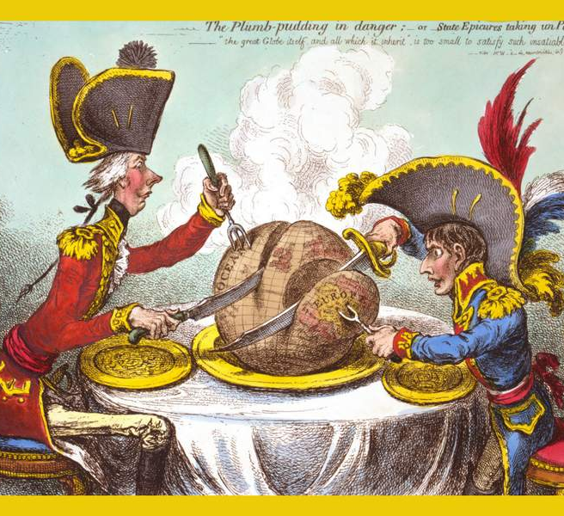
Horace’s Poems
Horace began his journey as a poet by writing Satires (Written 35-30 B.C.). This is not exactly like what we think of satire today – it’s not political, mocking, sarcastic cartoons. Rather it is a style of poetry or writing that equally critiques, moralizes, and his humorous. It was a very Roman genre. Satires were also a hybrid genre of many different styles and themes – sometimes surreal, sometimes stories, sometimes long rants.
Epodes, Epistles, Ars Poetica are all other works, but you don’t study these.
Odes were Horace’s major work (written 23 B.C. and 11 B.C.). There are more serious – though still lighthearted. However, again what we think of as an “ode” (a poem of praise) isn’t exactly what Horace was all about. Sometimes he praised. But, most of the time he focused on what it meant to live a good, content, and happy life.

Slide 6
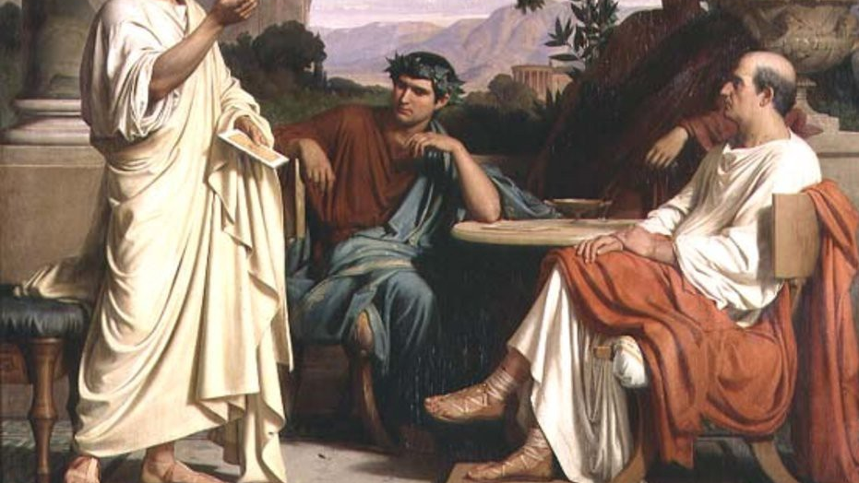
Horace’s Patron
Horace’s satires were written while Horace was a civil servant – and made him his name.
He came to know Virgil (his closest friend) and was introduced to the patron of poetry Maecenas – a close ally of Augustus.
Horace developed a close relationship with Maecenas.
As is often the case with Patrons, Maecenas gifted (a sort of bonus) a farm to Horace. Horace would spend most of his time here thereafter.
Horace was also made a equites around the time he wrote the Odes. This was a major promotion for a man who had fought against Augustus, was not from Rome originally, and was the son of an ex-slave.
Through Maecenas, Horace did become closer to the Emperor and began to respect him – despite his possible Republican sympathies.
Horace and Maecenas died within the same year and were buried near each other – proving the value they placed on their friendship.

Slide 7
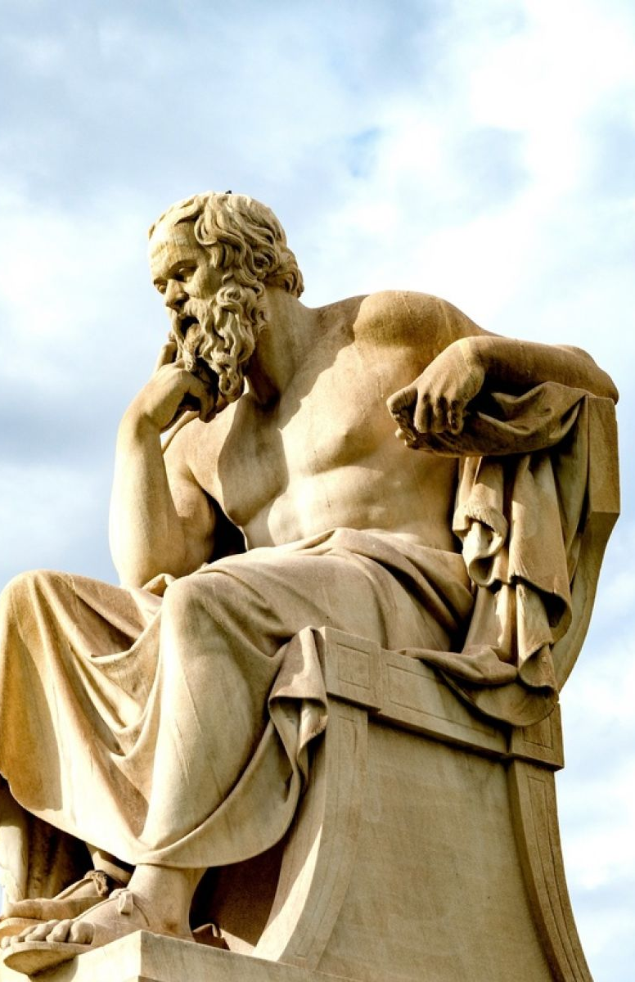
Themes: Philosophy and Humour
Despite what you might think: philosophy is not always a boring, longwinded conversation. Philosophy can often be expressed through more creative means. Horace was an expert on this. Ask yourself: what is the moral philosophy behind your favorite movie, book, or song, or work of art? There is usually a philosophical principal or question centre to it – even if that is just why should I love this person anymore or what’s the best clothes to were today…
All of Horace’s poetry is shaped by a philosophical point of view. And when discussing the philosophy you can draw on any of the poems – best practice is to select 3 (or 4) poems and discuss what Horace is trying to say. However, be careful: sometimes the message isn’t as straightforward as it might appear.
There are some central ideas behind Horace’s philosophy. They’re laid out on the next slide.

Slide 8
Carpe Diem
Carpe Diem – seize the day – is a quote from Horace and a common phrase today. However, it is also misinterpreted too.
What you might consider Carpe Diem is to seize any opportunity no matter what it is. However, it is actually more complex than that, because Horace also supports the idea of a quiet, simple life.
This is because the two most popular philosophical schools of thought at the time were Epicureanism and stoicism. The former is probably the one that had the bigger influence on Horace.

Slide 9
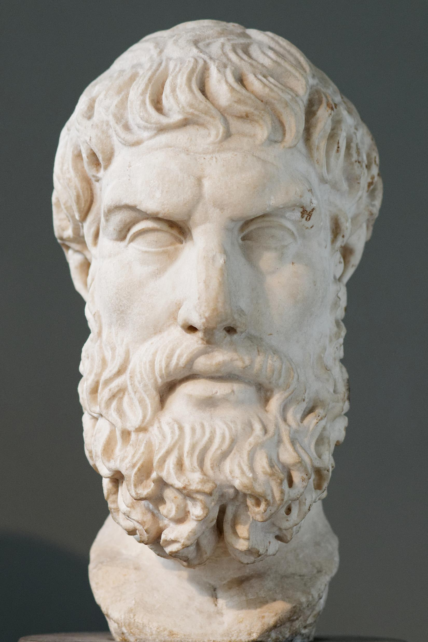
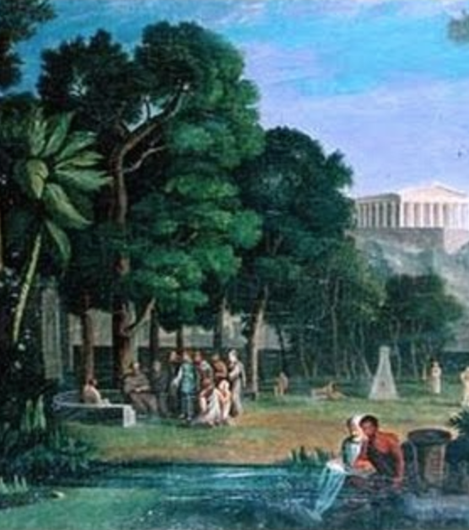
What is the Philosophy of Horace: Epicureanism
The philosophy Horace probably studied include Epicureans. This philosophy was founded by a Greek called Epicurus (340-271 B.C.). He thought this philosophy in what he called The Garden in Athens.
The main principals are:
We need not fear death because it is inevitable and when we die the atoms that make up our body and soul separate – there is no life after death so there is no suffering.
The gods are immortal but do not have an interest in human affairs.
We should seek a state of tranquillity and free from bodily pain – this is a state that is closest to a gods existence
The way to achieve this is to look for pleasure.
But we must practice moderation. Not all pleasure has positive results. Only pleasure in simple, modest things leads to tranquillity.
We should not pursue politics – because power and wealth are pleasure with negative consequences.
We should not pursue bodily desires like lust or gluttony but pleasures of the mind: the latter is what leads to tranquillity.
Instead of a political society, we should pursue a life of quite reflection with friends.

Slide 10
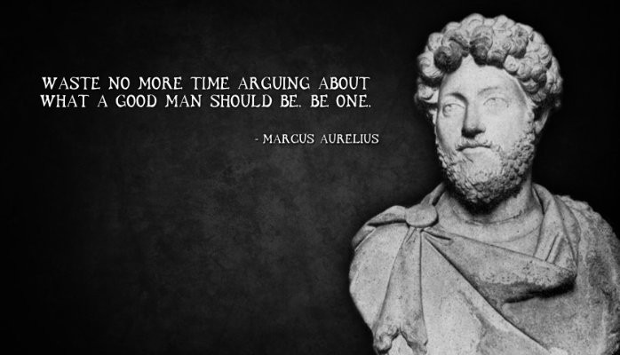
What is the Philosophy of Horace: Stoicism
Another major philosophy was Stoicism. Founded by Zeno of Citium (334 -262 B.C.). This philosophy was a derivation of the Cynics.
The main principals are:
Death is inevitable and all fate is predetermined – so there is no need to fear death.
When we die, our atoms disperse into the material world, but our soul returns to the cosmic force, god or Jupiter.
The gods are in fact all symbolic of the difference powers and aspects of a single god whose energy runs through the universe.
Pain is inevitable in life. The best thing a man can do is spend is life in humble pursuit of the greater good: pursuing a career in public service or in philosophy.
We should reject all desires and live a life of virtue, without sin.

Slide 11
What is the Philosophy of Horace: Traditional Roman Values
What made Romans Roman?
All peoples, societies, and communities have things that make us belong to that society – these are our values.
From these values we shape our view of what we consider a norm.
Can you think what the values of our community or society are?
Here is a list of what the Romans valued – a normal man would embody some (or all these). How do these match the two Greek Philosophies? How much of these can be found in Horace (or other Roman writers)?

Slide 12
Horace’s Philosophy Simplified:
You do not need to know these philosophies or values in detail – but having looked at them will help you more accurately interpret the Philosophy Horace presents to us in his poetry.*
Here are the main principals you will find in Horace:
Death is inevitable: you cannot avoid death, prolong your life, or change your fate.
Enjoy the present: since we cannot live forever and life moves very quickly, we should make the most of what we have today.
Quiet and simple life is best: all men crave peace and quiet – the happiest man it the one with little because he has less to worry his mind (or soul).
Friendship and love are the best: friends give more pleasure than anything else. By loving our friends we will lead a happier life.
*When answering do not discuss anything not from the texts (poems): if it doesn’t say, Roman value, Stoicism, or Epicurus you cannot prove that this is Horace’s philosophy. Focus on the Principals above instead.

Slide 13
Horace Humour:
Horace was a funny man. He had a good sense of humour. But this humour would almost always have a moral behind it – he was a fan of philosophy after all.
Here are some examples of what to look for in his humour:
Sarcasm or Irony: to say one thing but imply another (the opposite) often with some criticism: sarcasm. You’ll often hear him moan sarcastically about something.
Hyperbole/exaggeration: Horace often exaggerates a situation or a person’s funny characteristics (often himself).
Self-Deprecation: Horace always makes fun of himself. He doesn’t take himself at all seriously.

Slide 14
Exam Questions:

