Slide 1
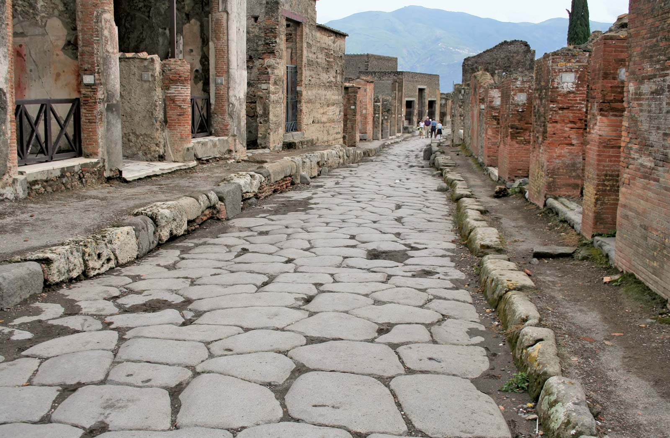
Pompeii

Slide 2
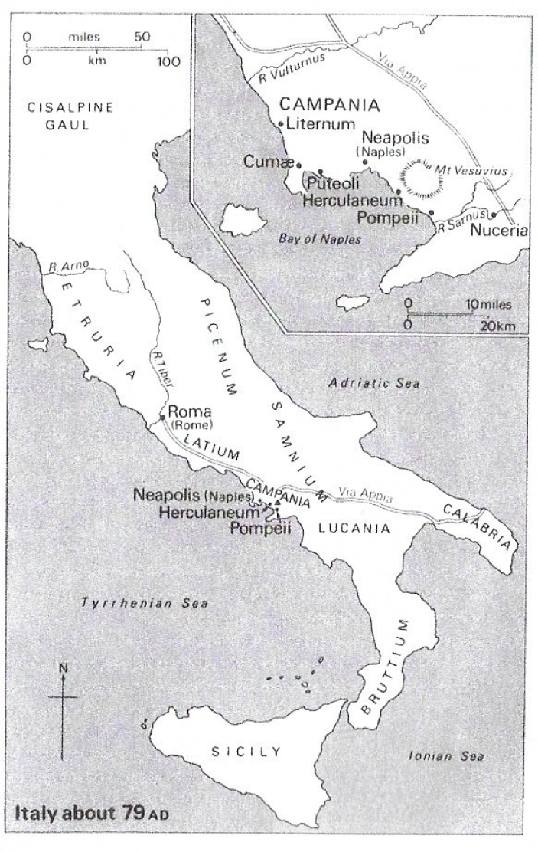
Foundation of Pompeii
Pompeii was a city located in central Italy – Campania.
It was built by the Oscan around 800-750 B.C. – Oscan language was still spoken in Pompeii up to 80 B.C.
The Greeks came first in the 8th Century B.C. Conquering the city and founding colonies in Campania.
The Etruscans (a powerful people during the 8th-6th Centuries) became influential in the region. But this influence ended with a Greek naval victory in 474 B.C.
In 310 B.C., the Romans came to the region. The city survived many of the trials of the early Republic such as Hannibal’s invasion.
In 90 B.C., the Social War tore Italy apart. Pompeii sided with the “allies” of Rome who were fighting the Romans for equal citizenship/rights.
The allies lost the war but were given citizenship as a compromise.
Pompeii was turned into a Roman military colony – and from here on it would be very much a Roman town.

Slide 3
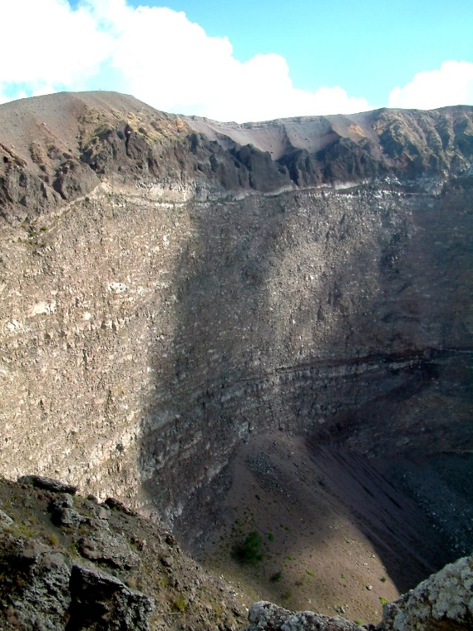
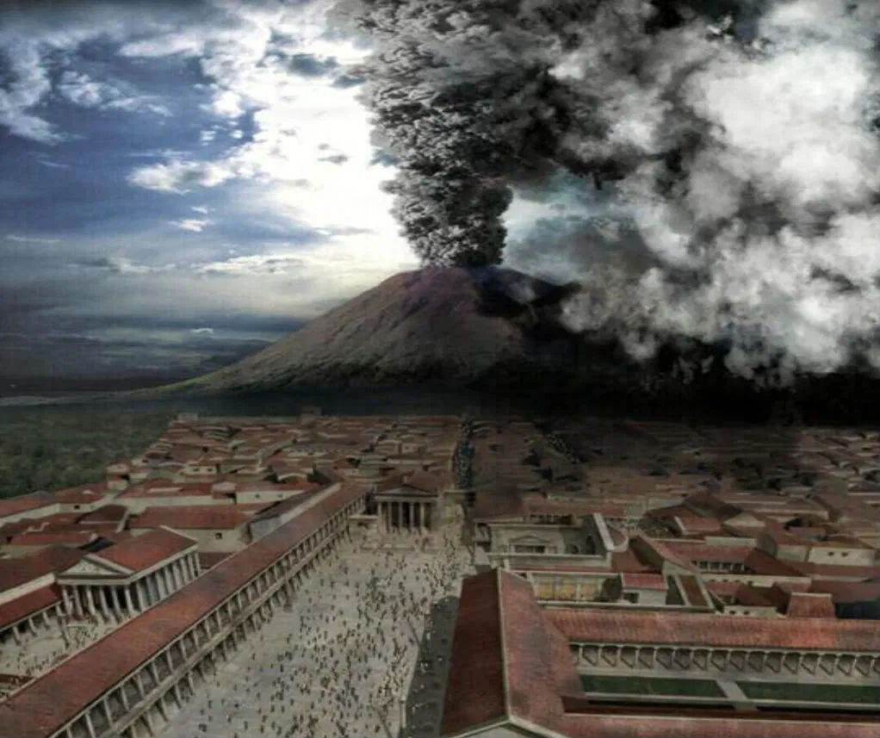
Destruction of Pompeii
In 79 A.D., Mount Vesuvius erupted – either in August, October, or November.
The eruption lasted two days. It began with the raining of pumice stones (Lapili) for 18 hours. This allowed most people to escape. Many people would have breathed in this ash; they would suffocate as the pumice hardened in their lungs.
But, 1,150 people’s bodies have been found – indicating that a few people to stay or return to look for their belongings. Some have been found holding jewellery.
Either on the first night or early on the 2nd day pyroclastic flows began near the volcano – this is a dense, very hot, and very fast ash cloud. It would knock down buildings, incinerate and suffocate the remaining people, and alter the landscape.
Late on the 2nd day, the eruption was over – nothing was visible.
Most people would have died from the superhot ash – at 250 °C.
The superhot ash created casts of the human bodies – which is why today we have so many remains of the people of Pompeii preserved in the death postures.

Slide 4
Timelapse of the fall of Pompeii

Slide 5
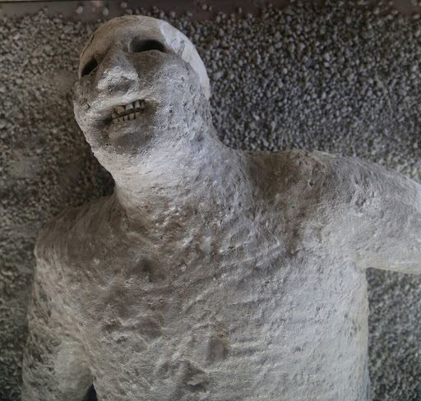
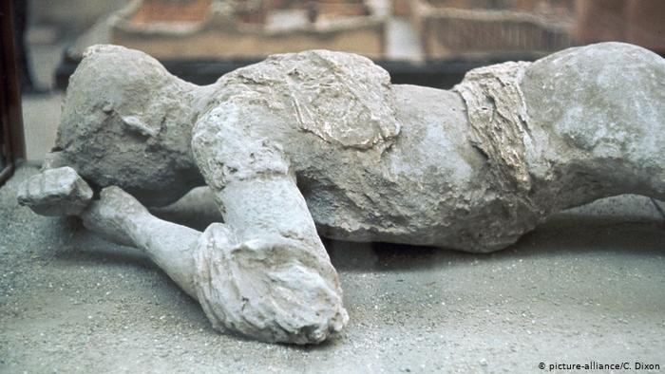
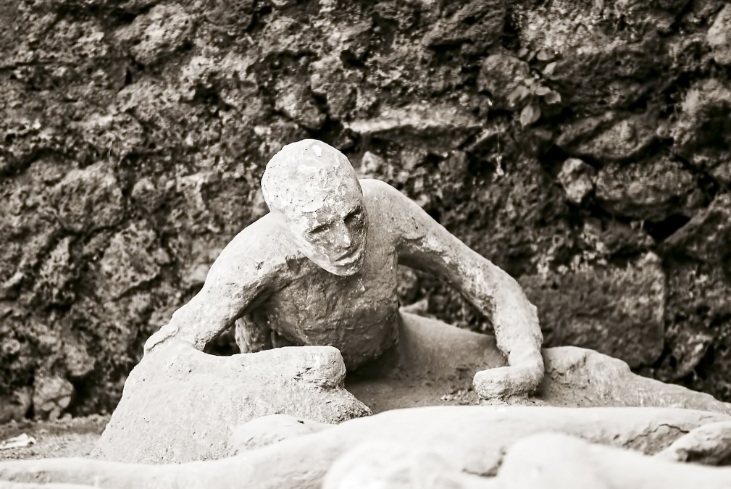
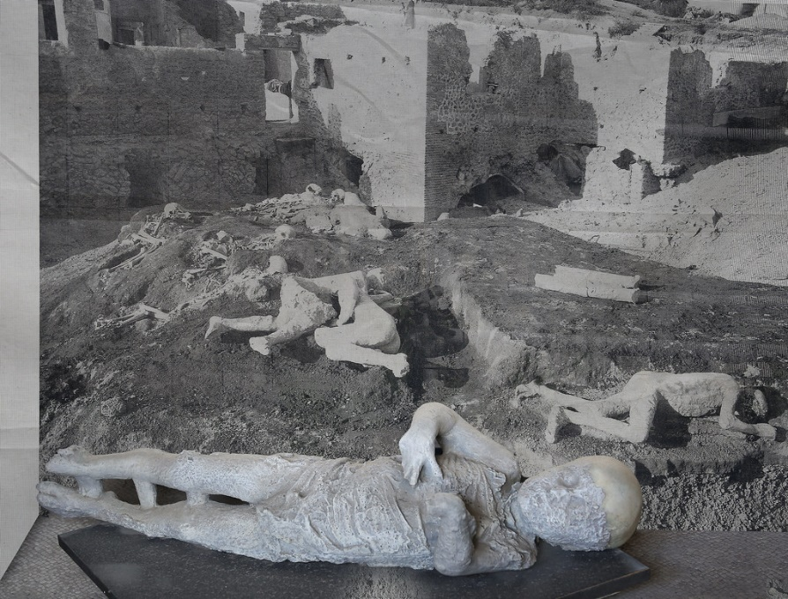
The People: what were these people’s storied before they died?

Slide 6
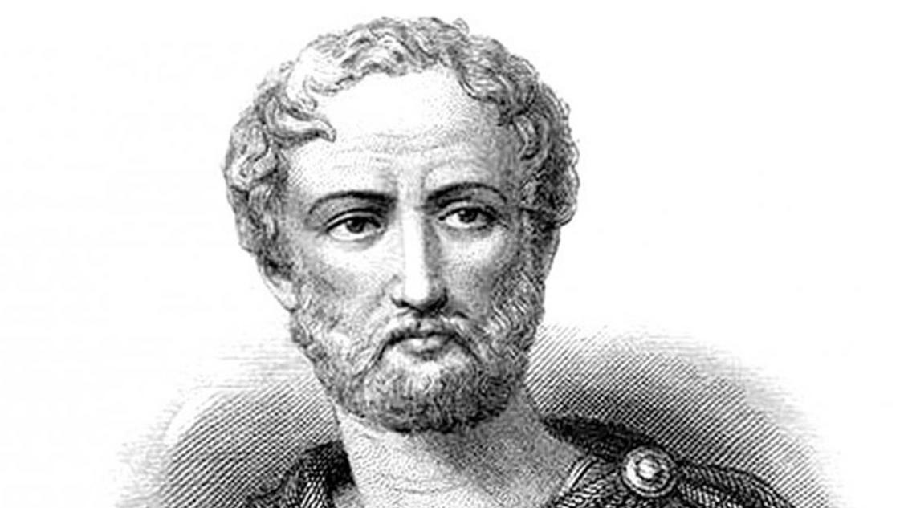
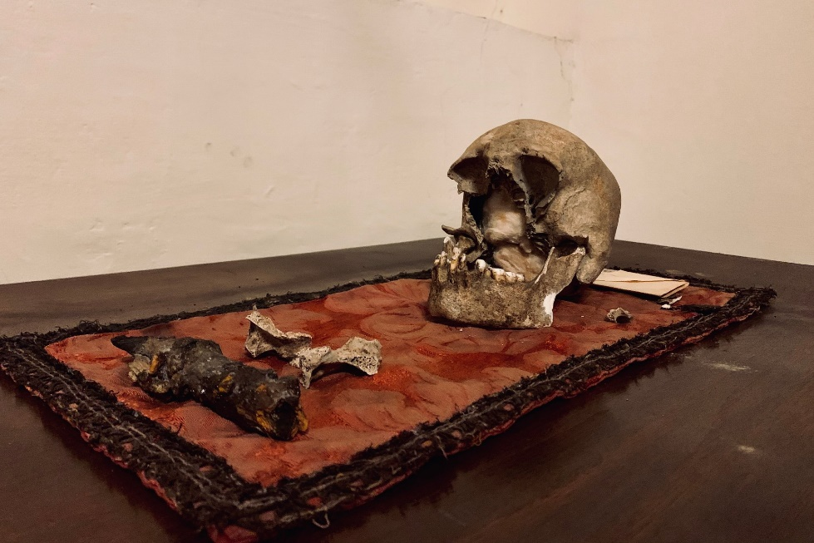
Pliny the Elder
One written source of the eruption does survive – this is very rare in Ancient History. To have the archaeology and the literary evidences.
The story is concerning the Ancient Roman ‘naturalist’ (a person who studies and records nature – geography, animals, etc.) Pliny the Elder.
He was prefect of the navy at Misenum (near Pompeii) in 79 A.D.
He was planning to cross the Bay of Naples to observe the eruption closely, when he received a message from his friend Rectina asking to rescue herself and Pomponius.
He took a fast-sailing ‘cutter’ to rescue his friends. When he arrived he found his friend Pomponius in despair, and Rectina missing. A strong wind prevented them returning straight away and so they were stranded.
Pliny had them feast, bath, and sleep in order to distract them. Eventually they had to evacuate the building for fear it would collapse from the pumice stones on the roof.
As the fled, Pliny could not move. They were forced to leave him behind to die.
It is likely that he died from breathing in the ash which affected him because of asthma or ill-health.
His body was later discovered beneath the rumble, by his friends, and retrieved.

Slide 7
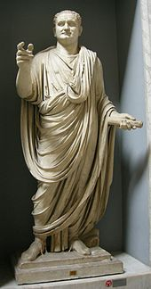
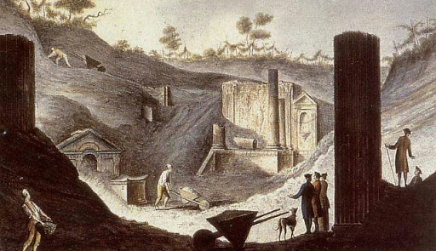
Rediscover of Pompeii
The Emperor Titus appointed 2 ex-consuls (leaders of the senate) to organise the relief effort. He visited the site twice. But no recovery was attempted.
There is evidence that robbers came to site and tampered with the remains.
Soon, however, the name and location was forgotten.
No mention of the city was heard of till 1592 when the architect Domenico Fontana built an underground aqueduct through the city – but he did not mention it.
In 1689, Francesco Picchetti discovered a inscription reading decurio Pompeiis thinking it related to the villa of Pompey the Great. But Francesco Bianchini pointed out the true meaning; and in 1693 Giuseppe Macrini excavated part of the wall
Further excavations of Pompeii and Herculaneum were made by the Spanish and the French.
The greatest progress was made by Giuseppe Fiorelli in 1863, who began scientific documentation and cataloguing of the city.

Slide 8
People of Pompeii: as they died…
1,150 bodies found – in various locations and positions.
Casts of the bodies formed in the 250 C heat of the pyroclastic blast.
Most people would have escaped in the 18 hour ash fall.
And while the deaths of these people is of interest, the preservation of themselves and their town is of more interest to us…

