Slide 1
Olympus
Home of the Gods

Slide 2
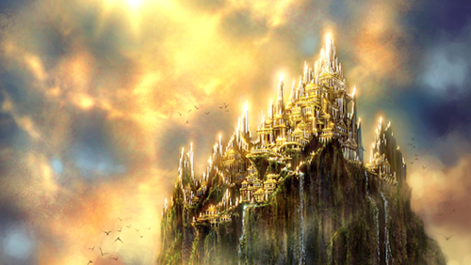
Olympus
The home of the gods was the peak of Mount Olympus.
There is a real mountain in the north of Greece called Mount Olympus. It probably seemed very high and remote to most of the ancient Greeks and therefore a likely place for the Gods to live.

Slide 3
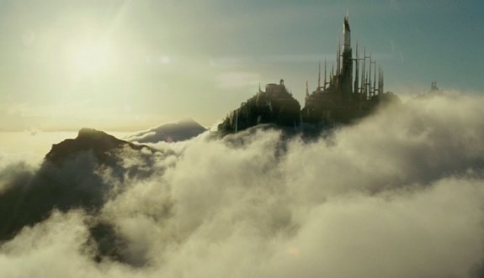
Gradually, Olympus was associated less with the mountain and became an imaginary place high above the earth.
The gods lived here like a family.
Zeus married his sister, Hera, and they ruled as King and Queen.
No-one but the gods could visit Olympus, except by special invitation.

