Slide 1
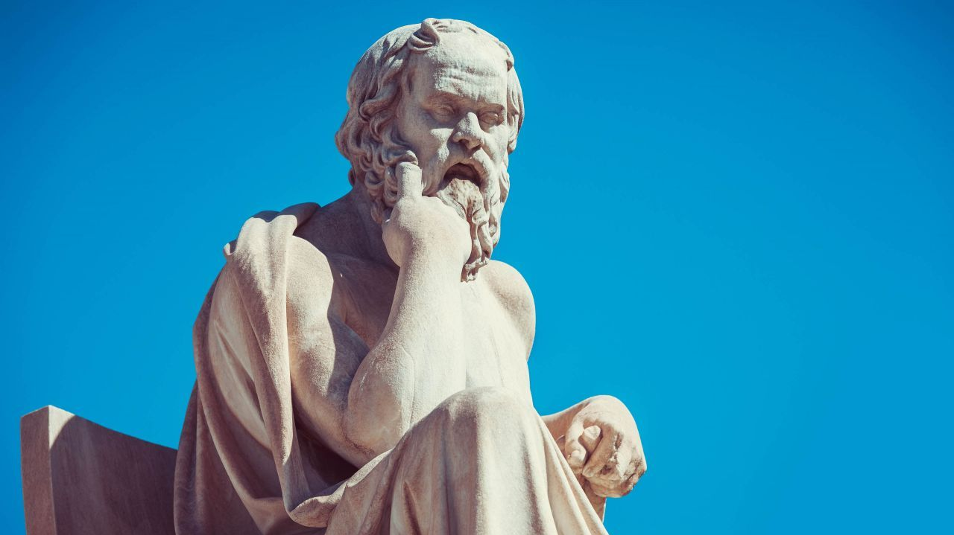
Socrates
Sophistry in Athens

Slide 2
Question:
What are you willing to die for?
Would you die for the freedom of expression?

Slide 3
Ancient Athens
In the 5th Century B.C., the Athenians invented Democracy.
This literally translates as – “People Power”.
Every citizen, male Athenian no matter his statues (as long as he had land) could vote on every law in Athens.
It was very different to today’s democracy: no-one was elected to govern – they governed by allotments (Jury duty); all citizens had a turn of one year in the assembly of 5,000 (there are 160 in the Dáil); every law could be voted by the people; politicians they disliked could be voted into exile for 10 years (ostracised).
The Greeks invented to concept of egalitarian and parrhesia.
This means equality among equals and freedom of expression among equals.
There were also several learned men across Greece in this period called Sophists – wise men who usually charged a fee to teach wealthy youths. These men would conglomerate in Athens.

Slide 4
The Beginning of Science
The Greek Sophists and Philosophers did more than just talk. They laid the foundations for concepts like ethics (what is right and wrong), politics (what is the best way to run a state), aesthetics (what makes something pretty or ugly), moral philosophy (how you should live your life), and what is life after death and the nature of the soul – and the gods.
They also invented to concepts of space and time, atoms, evolutionary theory, matter and energy – even though they could never verify this with empirical enquiry.
The most important philosophy they gave us, however, was epistemology. This is the philosophy which asks how do we know what we know. (The Philosophy of knowledge). Which is fundamental to all of science.

Slide 5
Train track game

Slide 6
Philosophical Questioning
The Ancient Greek Philosophers (and Socrates in particular) practiced what we call dialectic questioning.
This is when you question the assumptions or assertions a person is making on particular topic, and then question them further until you can identify a truth.
It is rhetorical (clever way of using language) in order to make someone agree with you.

Slide 7
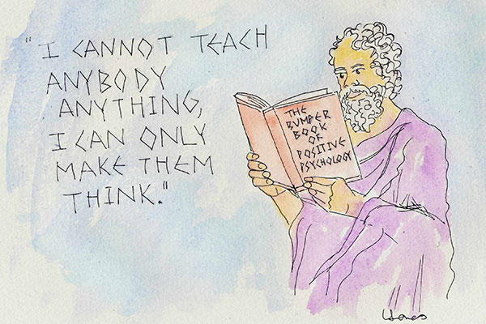
Example of Dialectic Questioning
Are all students bad?
Does this mean all students are good?
Therefore, can we say that there are some bad and some good?
Can bad students have a negative influence on good students?
Can good students have a positive influence on good students?
Should we then keep good students and bad student together – for the good of the bad students?
But, then, why? Are you doing more harm to the….students?
Would it not be better to segregate the good and bad students so that the good students can have a positive influence on each other and become the best students?

Slide 8
Socrates
Who was he?

Slide 9
Learning Intentions -Tasks:
In this class we will be learning an outline of Socrates life.
Take notes on this key learning:
Outline the key events in Socrates life.
Explain the type of society Socrates lived in.
Define the key terms (Sophist, Rhetoric, Democracy, Oligarch, City-State, Philosophy, Dialectic Questioning).

Slide 10
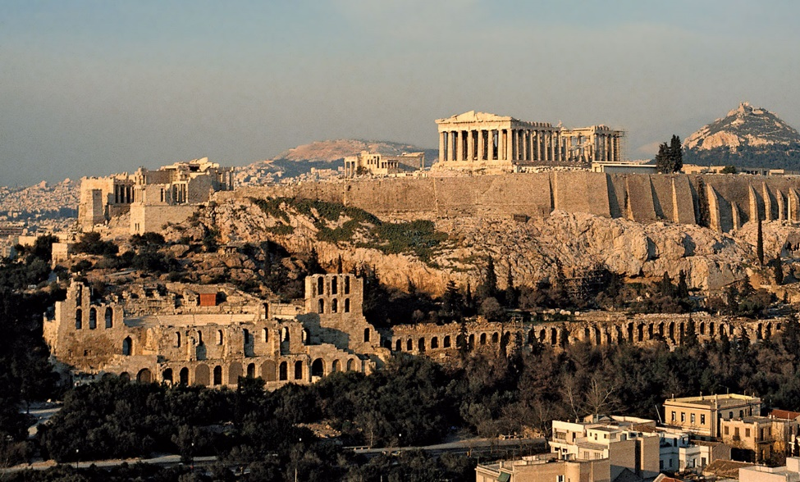
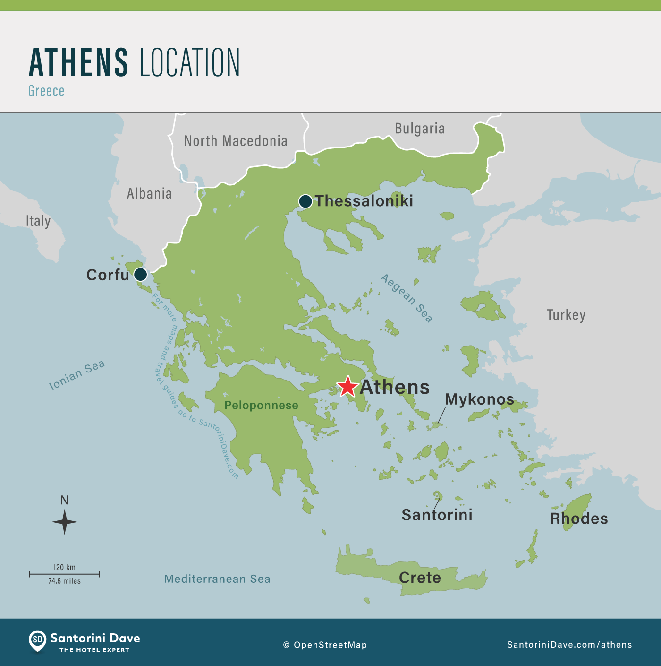
Ancient Athens:
Today, Athens is the capital of Greece. In Ancient Greece, it was only one of many separate Greek City-State.
At the end of the 6th Century, they invented a new system of government, Democracy.
Athens quickly gained power over the next century – fighting back the Persian invasion, building a powerful fleet of ships, and building spectacular buildings – the Parthenon, Akropolis, etc.
They were also fighting a war for the second have of the 5th century B.C. against Sparta and their allies – The Peloponnesian War.

Slide 11
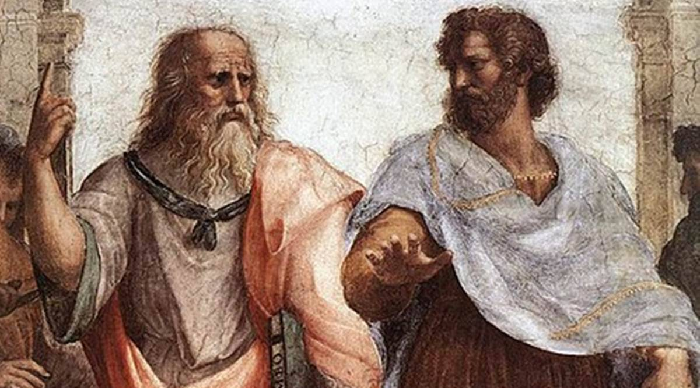
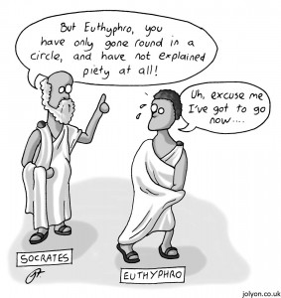
Sophists
During this period, many thinkers travelled across Greece. They would take a fee from wealthy men to teacher their sons in rhetoric and philosophy (particularly morality, ethics, and politics – possibly some metaphysics/science).
Many were in Athens. Socrates had a reputation as a thinker too, but he didn’t take fees – and he had a particular unusual approach.
He was known for challenging (questioning) what others thought, rather than thinking up his own ideas.

Slide 12
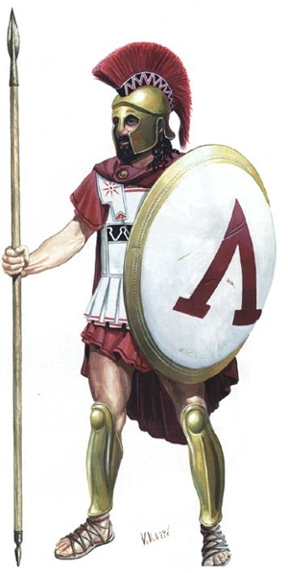
Early Life of Socrates
Socrates was born in 469 B.C. to a stonemason/sculptor and midwife.
He fought in the Peloponnesian War as a hoplite (foot soldier) at the battles of Amphipolis, Delium, and Potidea. He fought with valour.
He married Xanthippe in his 50s and had three sons.
He is likely to have been trained as a stonemason/sculptor.
While youths (young men) were not allowed in the Agora (marketplace) they would frequent the workshops around it. Socrates is likely to have spent time there questioning the craftsmen – and gaining support from the youths of Athens.

Slide 13
Socrates the Sophist
Even though Socrates claimed he was not a Sophist, he was often seen as one.
In 423 B.C., the comic playwright Aristophanes wrote a satirical comedy mocking Socrates and the sophists – it was called Clouds.
Socrates was portrayed as a delusional man who spent his time with his head in the clouds contemplating the nature of the universe, whether the sun was rather a stone than a god, and teaching the young hero of the play “how to make the weak argument stronger.” – how to persuade someone your argument is right, whether it is true or not.
This was a reaction to the sophist in general, who were seen as a negative influence on society, challenging the traditional values of Athens and democracy.
After this play, Socrates would gain a similar reputation.

Slide 14
Downfall of Athens
The war with Sparta was tough on Athens. They had many victories but also many defeats – some disastrous.
Many people – particularly oligarchs (rich people who didn’t like democracy) – were unhappy with the way things were run.
In 411 B.C. these oligarchs overthrew the democratic government – this was called the rule of the Four hundred. However, it did not last long and soon democrat was restored and the 5,000 assembly was restored.
In 406 B.C. Socrates took part in the boule (a smaller council overseeing the assembly). The Athenians tried to trial and execute the generals at the Battle of Arginusae (406 B.C.) where the Athenians narrowly defeated the Spartan fleet, but lost many ships in a storm at sea. Socrates alone tried to block the execution saying he would not break the law. However, the veto/block was deemed illegal and the generals were executed.
In 404 B.C., Athens once again lost it’s democracy to the Thirty Tyrants (Thirty Oligarchs). Socrates along with 5 other men was summoned to Tholos (council chamber) and ordered to journey to Salamis and to arrest Leon the Salamian. Socrates alone refuses to go.

Slide 15
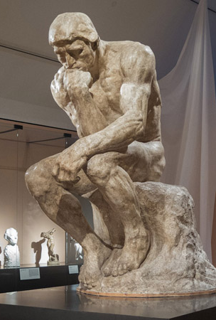
Discursive Question: Can we practice some Dialectic Questioning?
Is Democracy always good?

Slide 16
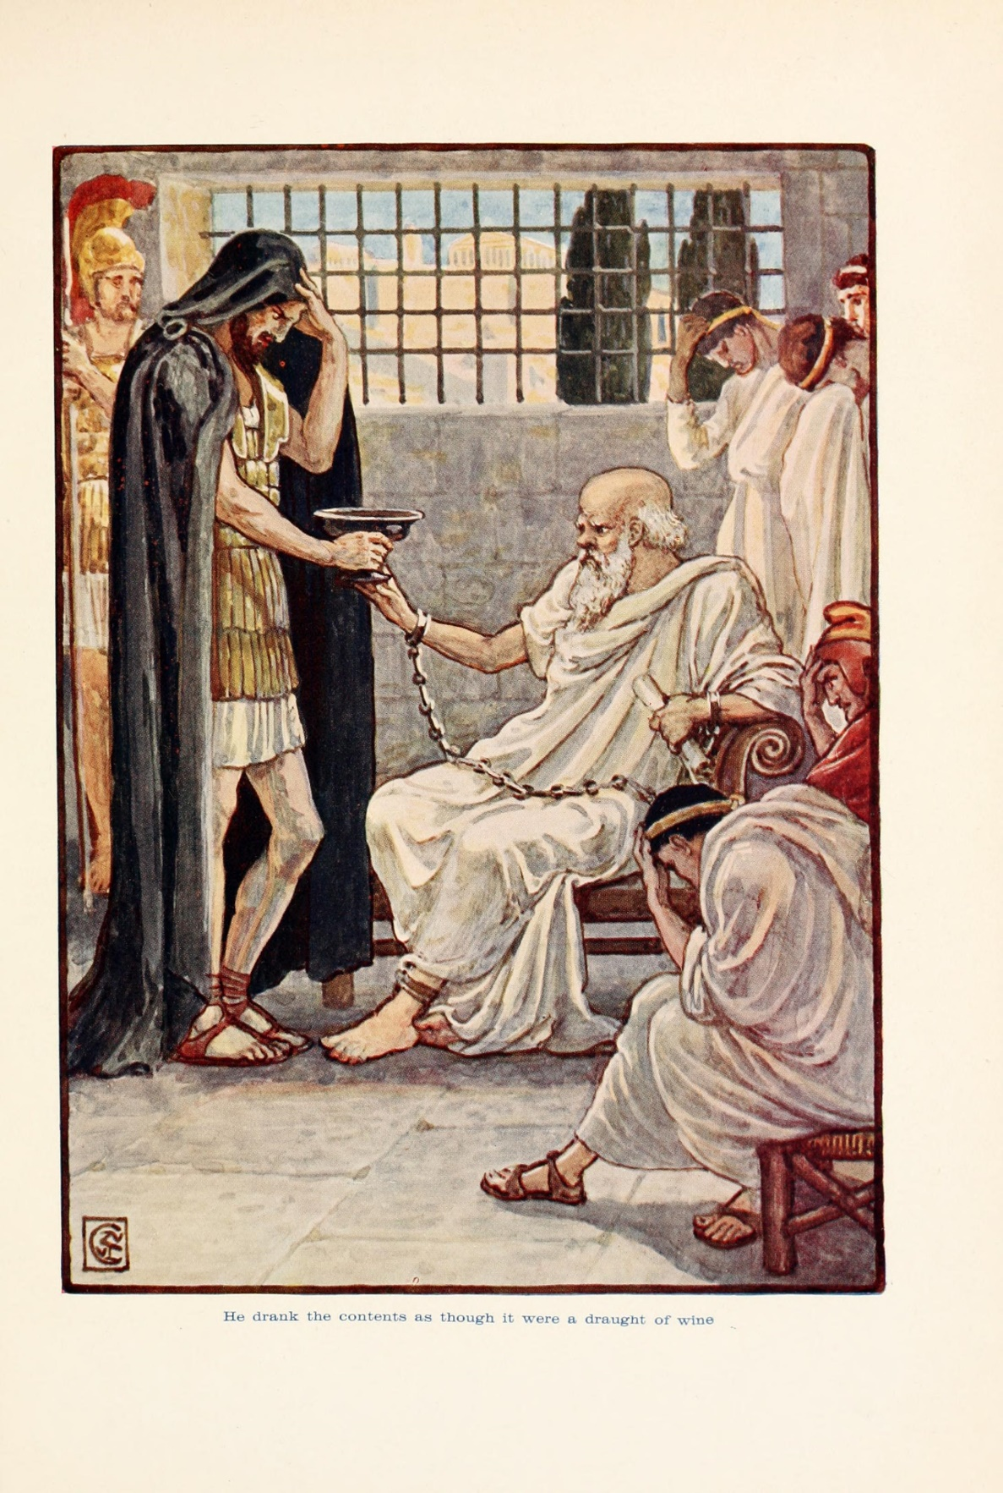
Trial of Socrates
In 399 B.C., Socrates was brought to trial by three men Meletus, Lycon, and Anytus.
Anytus was a rich a socially prominent Athenians who opposed sophists.
Meletus, a poet, was the tool of Anytus and was the only one to take part in the Apology.
Lycon was a professional rhetorician, he joined because he felt Socrates was connected with the pro-Spartan Thirty Oligarchs.
Socrates made his defence, and almost won over the jurors, but was convicted by a count of 280 to 221 (out of 501). He was then sentences for execution by a larger majority of the jury.
Socrates died in 399 B.C. by self-execution, drinking the poison hemlock.

Slide 17
Discursive Question: Can we practice some Dialectic Questioning?
Can capital punishment ever be justified?

Slide 18
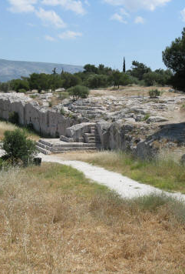
Compare with Ancient Athens
Athenians distrusted the few or the one to make fair and impartial judgements.
There Democracy had 5,000 individual citizens selected by sortition (lottery) to govern.
Every citizen was encourages to attend the Pnyx every day to vote on new laws.
The Boule administered these proceedings.
Only Military Generals were elected.
Video on Athenian Democracy:
Athenian Sortition

Slide 19
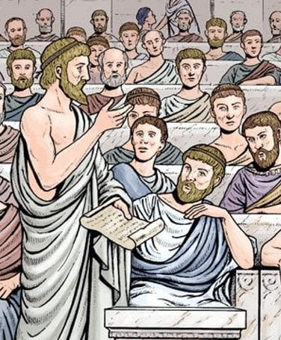
Athenian Juries
Athenians determined who was guilty or innocent by the jury rather than the judge.
They had juries of 501, 1,500, or even 6,000 to decide cases – depending on the case.
Each person accused had to defend themselves. And each person bringing the accusation had to present their accusations. There were no lawyers. But there were professional speech writers (probably Lycon’s role in Socrates trial).
Each juror would vote for you guilty or innocent secretly (stones in a jar).
The danger of these highly democratic trials was the rhetoric or persuasive language used by the defenders/accusers to manipulate the crowd.
Watch the following video on Rhetoric:
Rhetoric

Slide 20
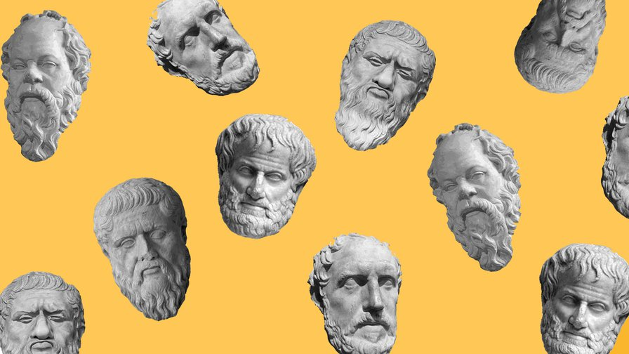
Philosophers
Life of a philosopher
This Photo by Unknown Author is licensed under CC BY

Slide 21
Life of an Ancient Philosopher
Cynics
Hypatia
Plato
Stoics
Outline what you have learned about each of these types of philosophers.
Explain their basic Philosophy.
What importance did these philosophers play in daily life in Ancient Greek society?

