Slide 1
Prometheus
Helper of Mankind

Slide 2
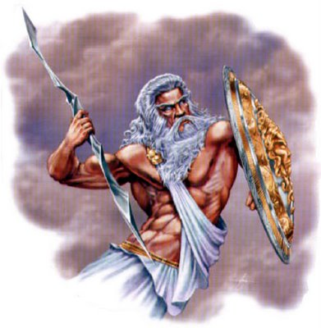

Slide 3
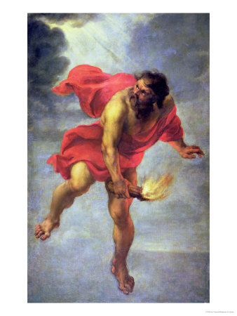

Slide 4
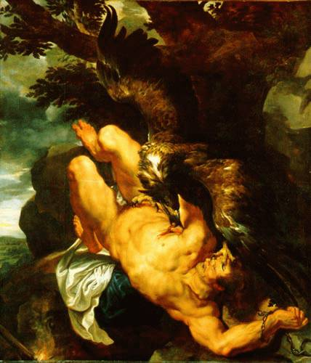

Slide 7
